Slide 1

FINDORA
Find • Explore • Discover
MERN Stack Project Presentation
Team Members: 1.Ch.Poojitha
2.S.Kavya
3.K.Meghana
A smarter way to search, organize, and discover relevant information.
01 / 10

Slide 2
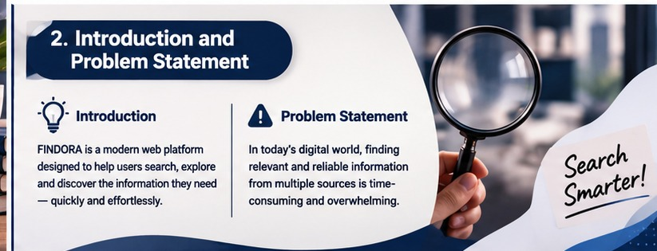
02 | Introduction & Problem Statement
Why a unified discovery experience matters
Introduction
FINDORA is a modern web platform concept that helps users search, explore, and organize useful information through a simple, responsive interface. The project demonstrates a full-stack MERN application.
Problem Statement
Proposed Solution
Information is spread across many sources. Users can lose time switching between pages, sorting irrelevant results, and keeping track of useful items. A focused search experience can reduce this effort.
FINDORA brings search, saved items, user accounts, and organized results into one accessible interface—with a backend API and database to manage data securely.
FINDORA • MERN STACK PROJECT 02 / 10

Slide 3
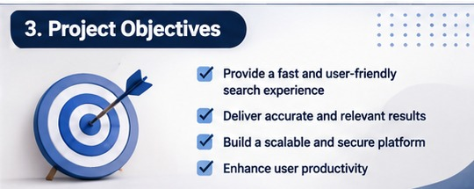
03 | Project Objectives
The goals that guide the design and implementation
Fast and simple search
01
Make the core search journey clear, responsive, and easy to use.
Relevant results
02
Present information in a structured format so users can scan results quickly.
Personal organization
03
Allow users to save useful results and revisit them later.
Secure and scalable foundation
04
Separate frontend, API, and database responsibilities for maintainability.
FINDORA • MERN STACK PROJECT 03 / 10

Slide 4
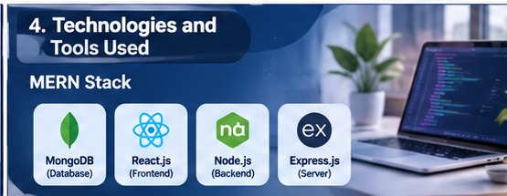
04 | Technologies & Tools Used
MERN stack: one JavaScript-based path from UI to database
MongoDB
Express.js
Database
Stores user profiles, searches, favorites, and other application records.
API layer
Defines REST endpoints and coordinates requests and responses.
React.js
Node.js
Frontend
Builds reusable components and interactive screens.
Runtime
Runs the server-side JavaScript application.
Supporting tools
VS Code • Git & GitHub • Postman
npm • Browser developer tools
Why MERN? Shared JavaScript skills, clear separation of concerns, and a flexible ecosystem.
FINDORA • MERN STACK PROJECT 04 / 10

Slide 5
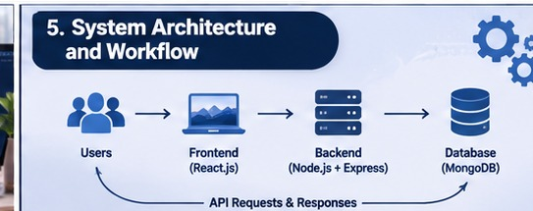
05 | System Architecture & Workflow
A request travels from the browser through the API to persistent storage
User
1
Enters a query or opens a saved item.
React frontend
2
Captures input and displays loading, results, and feedback.
Node + Express API
3
Validates the request, applies business logic, and returns JSON.
Response cycle
The API sends a consistent JSON response. React updates the interface so the user can inspect results, save favorites, or try another query.
MongoDB
4
Reads or writes the required documents and returns data.
FINDORA • MERN STACK PROJECT 05 / 10

Slide 6
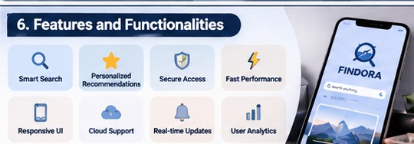
06 | Features & Functionalities
Designed around discovery, convenience, and a consistent user experience
Smart search
Favorites
Search input with clear results and helpful empty states.
Save interesting items and return to them later.
Authentication
Responsive UI
Sign up and log in to support personalized features.
Layouts adapt to desktop, tablet, and mobile screens.
Fast feedback
User dashboard
Loading indicators and clear success/error messages.
A central place to review personal activity and saved items.
Implementation note: real-time updates, recommendations, and analytics can be treated as future enhancements unless implemented in the current build.
FINDORA • MERN STACK PROJECT 06 / 10

Slide 7
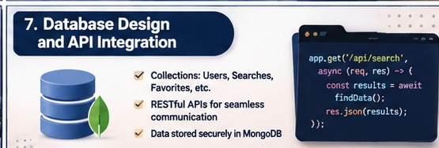
07 | Database Design & API Integration
Organize data clearly and expose it through predictable REST endpoints
Suggested MongoDB collections
Users — account details and securely stored password hashes
Searches — query, timestamp, and result metadata
Favorites — user reference and saved item reference
REST API examples
Data & security practices
POST /api/auth/register — create an account
POST /api/auth/login — authenticate a user
GET /api/search?q=... — retrieve search results
GET /api/favorites — list saved items
POST /api/favorites — save an item
DELETE /api/favorites/:id — remove a saved item
Validate request inputs, use environment variables for secrets, hash passwords, protect private routes, and return useful HTTP status codes. Add indexes where query patterns need them.
FINDORA • MERN STACK PROJECT 07 / 10

Slide 8
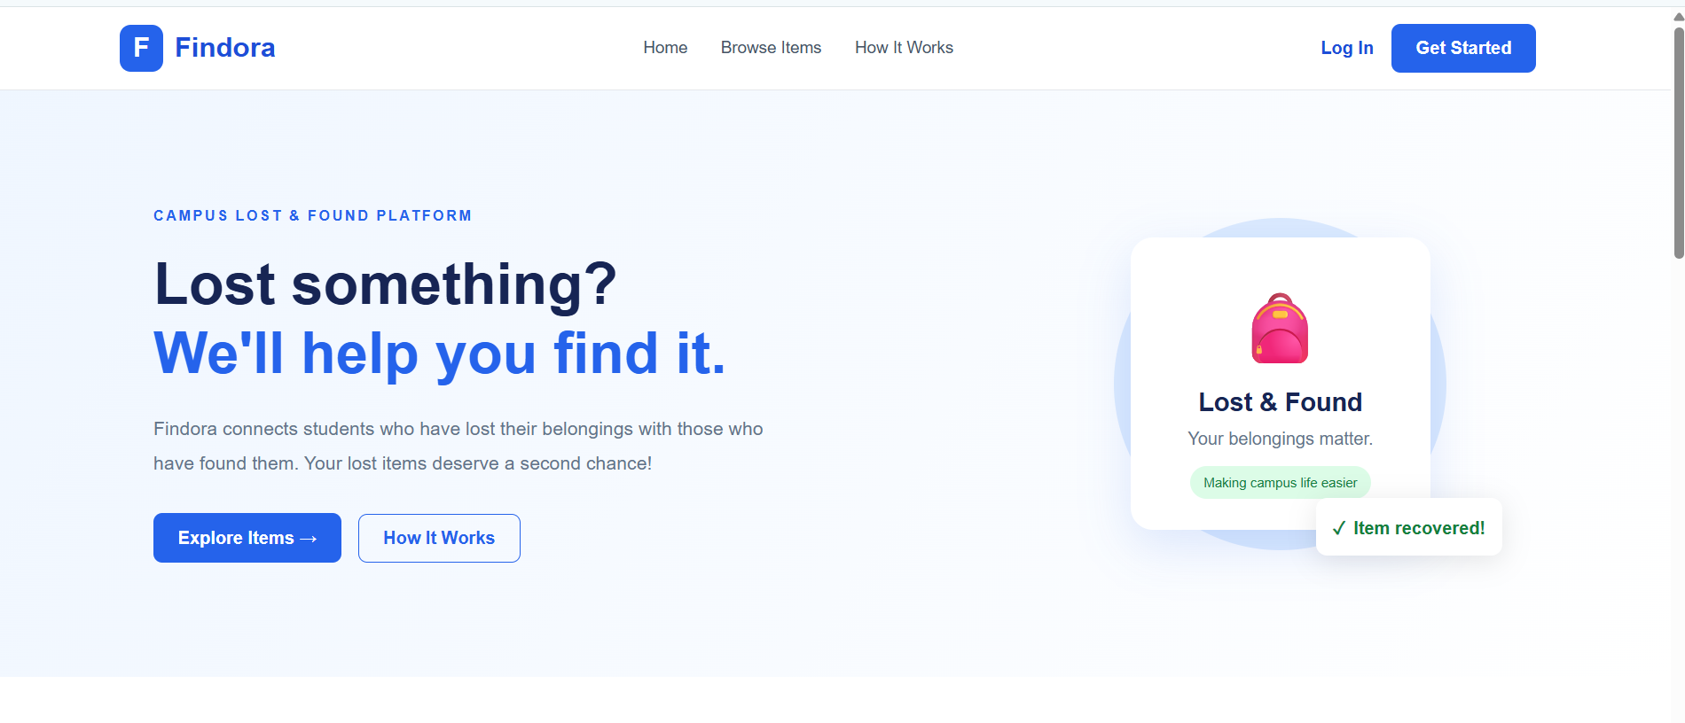
08 | Project Interface & Screens
Suggested screens to demonstrate during the live project walkthrough
Home / Search
Results
Account / Favorites
The first screen introduces FINDORA and lets users begin searching.
A clear result layout helps users scan titles, descriptions, and actions.
Users can sign in and revisit saved items in a personal area.
Replace the reference mockups with actual screenshots from your running application before final submission.
FINDORA • MERN STACK PROJECT 08 / 10

Slide 9

09 | Challenges Faced & Future Scope
Key engineering considerations and opportunities to extend the project
Challenges to address
• Connecting frontend and backend reliably
• Handling empty, invalid, or failed requests
• Designing useful data models and API responses
• Protecting user data and private endpoints
• Keeping the interface usable on small screens
Future enhancements
• AI-assisted semantic search and ranking
• Personalized recommendations
• Mobile-friendly progressive web app
• Analytics for search trends
• Caching and performance monitoring
Build in phases
Core search → Accounts → Favorites → Testing → Deployment → Advanced discovery
FINDORA • MERN STACK PROJECT 09 / 10

Slide 10

FINDORA
Find • Explore • Discover
Conclusion
FINDORA demonstrates how the MERN stack can be used to build a responsive, maintainable web application. By combining a user-friendly interface, REST APIs, and structured data storage, it provides a foundation for a more organized search and discovery experience.
“Search smarter. Discover more.”
10 / 10

