Slide 1

MALLA REDDY COLLEGE OF ENGINEERING AND TECHNOLOGY
(AUTONOMOUS INSTITUTION – UGC,GOVT.O India)
Maisammaguda, dhulapally, kompally, secunderabad, telangana, India.
Aircraft icing and its prevention.
Bachelor of technology
In Aeronautical engineering
By
K. Manaswini
17N31A2123
ANE

Slide 2
ABSTRACT:
Aircraft icing is the formation of ice that can occur on aircraft while on the ground or in flight. Since ice nuclei are often present in a small concentration in the atmosphere (Phillips et al., 2008), for a large temperature range - 38°C < T < 0°C supercooled liquid water (SLW) can exist for a long time.
The surface of an aircraft flying through such a cloud or rain acts as an ice nucleus. Ice accretion in flight may affect the aerodynamic characteristics and engine performance. In this context, ice accretion is the process by which a layer of ice forms on objects exposed to freezing precipitation, supercooled cloud droplets, or fog. There are several types of airframe icing related to supercooled and MPC conditions.
The first has the aspect of a white opaque deposit that forms in clouds of low water content, containing small SLW droplets, at temperatures well below 0°C.
The second consists of a coating of clear ice that forms in clouds of high liquid water content consisting of large SLW droplets in the form of drizzle or rainfall on aircraft, with a temperature near or below 0°C.
The third is a mixed ice or cloudy ice that occurs in clouds with a mix of ice crystals, cloud droplets, and snowflakes. These icing scenarios involve the presence of SLW droplets, a characteristic of MPCs, and have been studied extensively

Slide 3
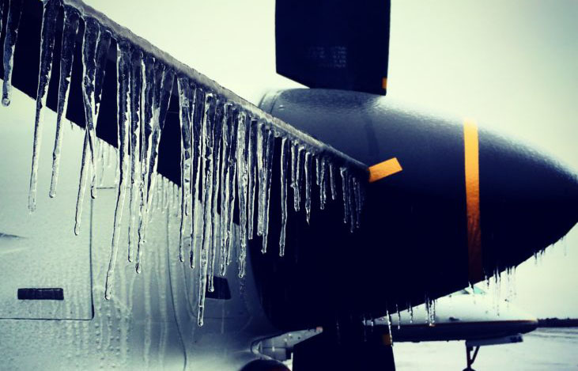
INTRODUCTION
What is aircraft icing?
In aviation, icing conditions are atmospheric conditions that can lead to the formation of water ice on an aircraft. Both airframe and engine icing have resulted in numerous fatal accidents in aviation history.

Slide 4
what are the anti icing and de icing systems of the aircraft?
Anti-icing equipment is designed to prevent the formation of ice, while deicing equipment is designed to remove ice once it has formed. These systems protect the leading edge of wing and tail surfaces, pitot and static port openings, fuel tank vents, stall warning devices, windshields, and propeller blades.
What is the difference between anti icing and de icing? Anti-icing equipment is turned on before entering icing conditions and is designed to prevent ice from forming. Deicing equipment is designed to remove ice after it begins to accumulate on the airframe.

Slide 5
What are the Three Types of Aircraft Icing?
Clear ice: forms when large drops hit the aircraft and freeze slowly.
Rime ice: forms when small drops hit the aircraft and freeze rapidly.
Mixed ice: a mixture of clear and rime ice.

Slide 6
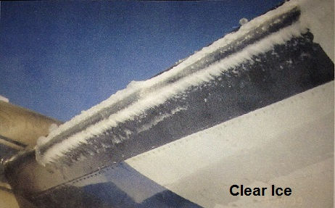
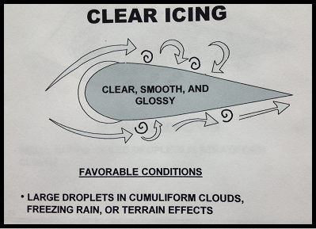

Slide 7
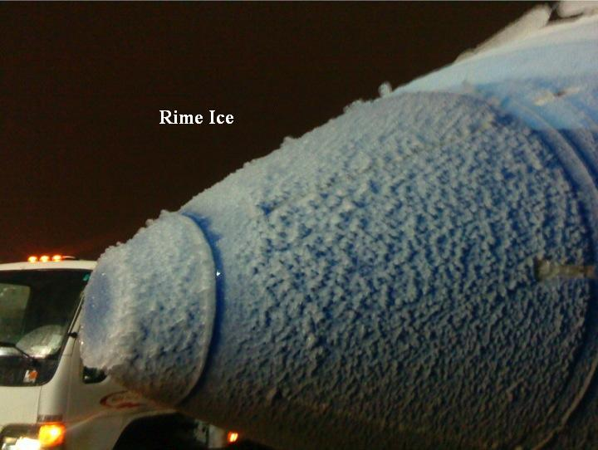
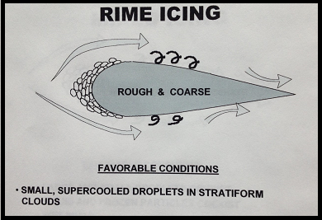

Slide 8
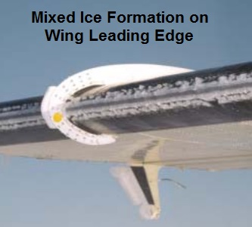
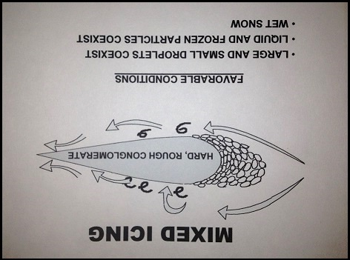

Slide 9
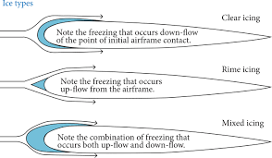

Slide 10
Ice Detection:
Electronic ice detection common, but can give false readings.
GM is developing a mass based ice detection system where ice builds up on external probe.
After mass of probe has increased due to additional ice, anti-icing systems are alerted and turned on.
• This increases fuel efficiency and system life as de-icing systems are only turned on as required by conditions.

Slide 11
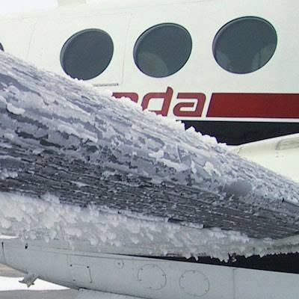

Slide 12
Negative Effects of Ice Buildup
Destroys smooth flow of air over wing, leading to severe decrease in lift and increase in drag forces
Can change pitching moment
As angle of attack is increased to compensate for decreased lift, more accumulation can occur on lower wing surface
Causes damage to external equipment such as antennae and can clog inlets, and cause impact damage to fuselage and engines
Considered a cumulative hard because as ice builds up on the wing, it increasingly changes the flight characteristics

Slide 13
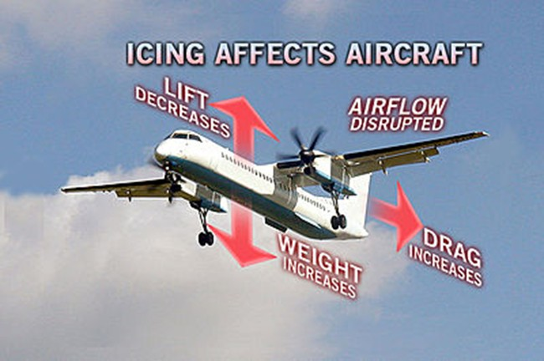

Slide 14
Types of Ice Removal
Anti-Icing
Preemptive, turned on before the flight enters icing condition
Includes: thermal heat, prop heat, pitot heat, fuel vent heat, windshield heat, and fluid surface de-icers
De-Icing
Reactive, used after there has been significant ice build up
Includes surface de-ice equipment such as boots, weeping wing systems, and heated wings

Slide 15
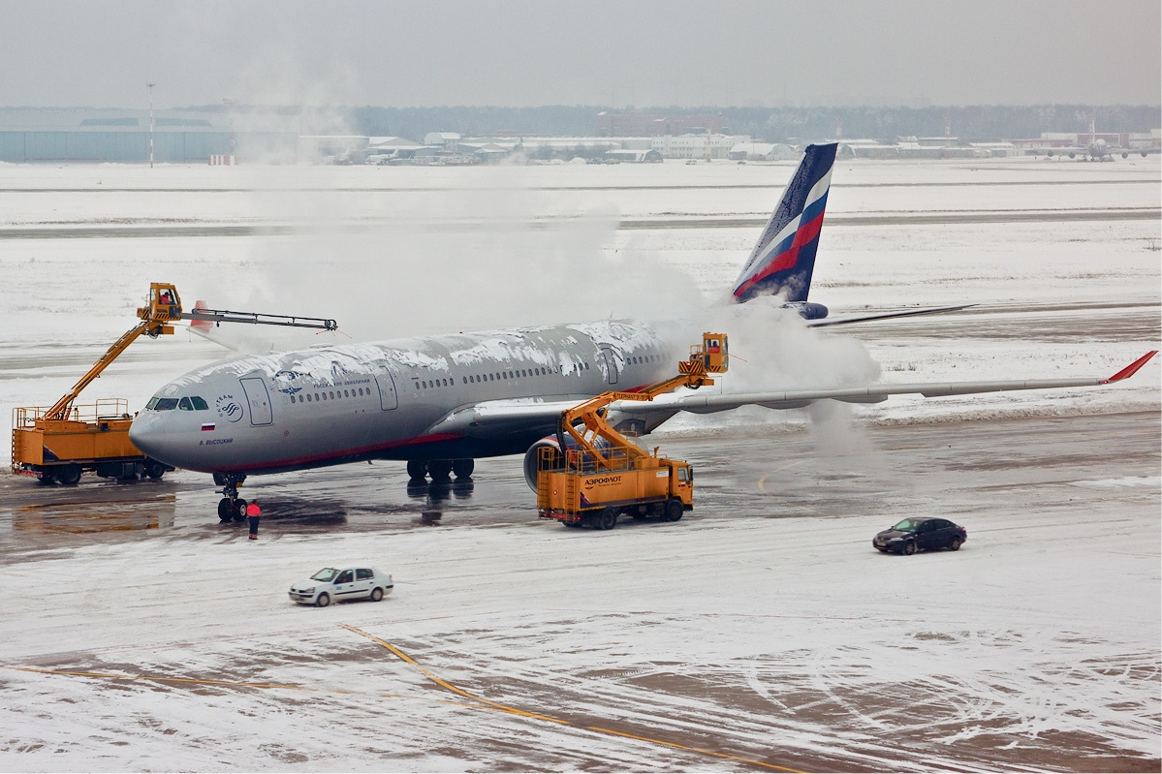
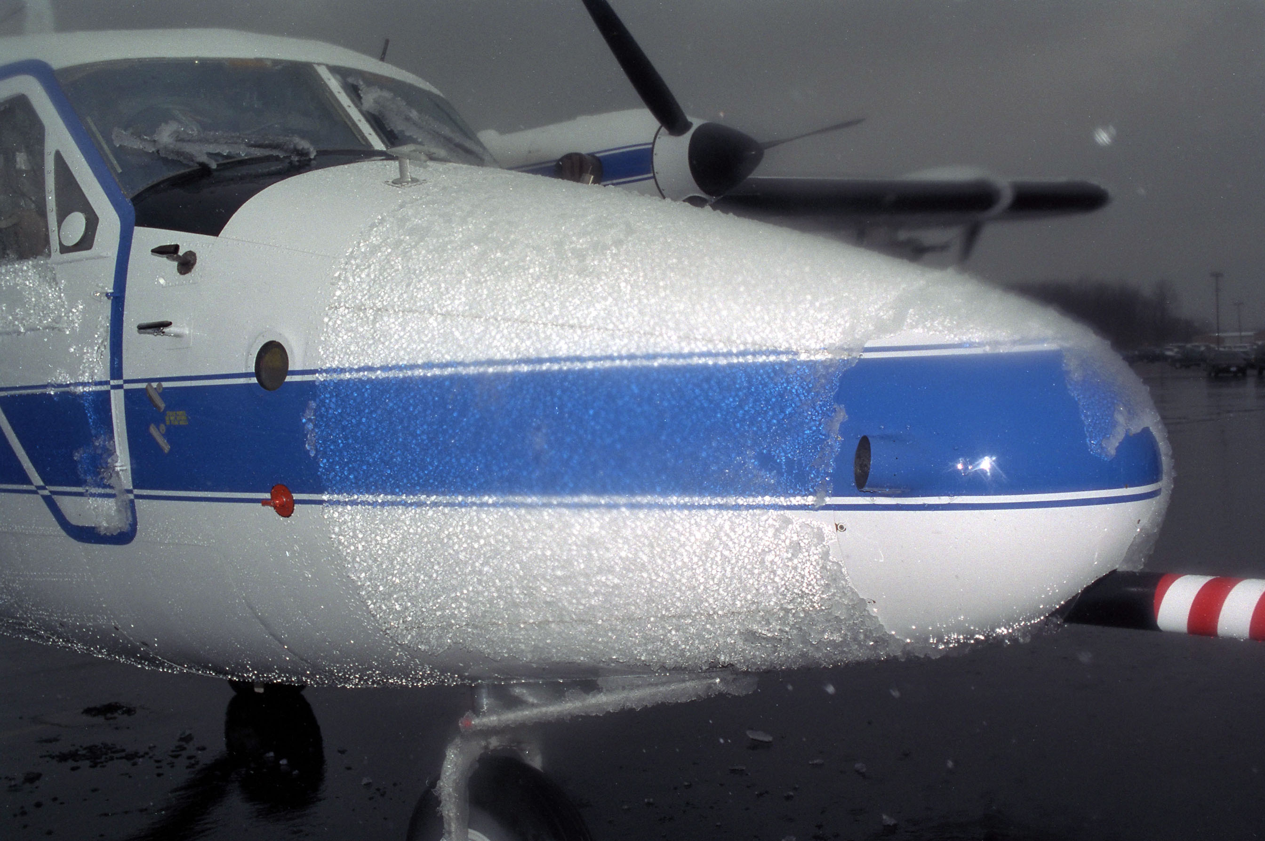

Slide 16
Conclusion:
It’s important to plan ahead and check the weather the night before your flight to determine if snow, freezing rain or frost is in the forecast. When it comes to avoiding ice, pilot reports (PIREPS) as well as SIGMETS and AIRMETS, are among the best tools at your disposal. Always ask your 3rd-party provider for those during a preflight briefing and keep the "big picture" in mind when operating around potential icing conditions.

Slide 17
THANK YOU

