Slide 1
📊 Raw Data
HR ANALYTICS
🧹 Data Cleaning
End-to-End Data Journey
🗃️ SQL Modelling
From Raw Data to Actionable Insights
50,000 Employees | 6 Departments | 10 Job Roles
📈 Visualisation
MySQL
Excel
Power BI
Tableau
💡 Insights
Prepared by Group 3

Slide 2
Objective of This Analysis
Why we analysed this HR dataset — and what we set out to answer.
🔍 01
Identify Attrition Drivers
📊 02
Build a Multi-Dimensional View
Uncover the root causes behind the 50.21% employee attrition rate — whether demographic, financial, or behavioural — using data rather than assumptions.
Go beyond surface KPIs. Analyse attrition across departments, job roles, income bands, age groups, promotion history, and work-life balance simultaneously.
💰 03
Quantify the Business Impact
🛠 04
Validate Data Through Multiple Tools
Translate employee loss into financial terms. Estimate replacement costs, productivity loss, and the true cost of inaction for senior leadership.
Use MySQL for modelling & querying, Excel for pivot-based exploration, Power BI for DAX-driven KPIs, and Tableau for visual storytelling — ensuring cross-tool consistency.
🎯 05
Deliver Actionable Recommendations
Convert findings into 5 prioritised HR interventions with estimated impact, enabling evidence-based decision-making by HR leadership.

Slide 3
DATASET OVERVIEW
What is this HR Dataset About?
This dataset captures detailed workforce records of 50,000 employees across multiple departments, job roles, and seniority levels. It is designed to help HR professionals and data analysts uncover patterns in employee attrition, satisfaction, compensation, and career progression — enabling evidence-based people decisions.
50,000
50.21%
₹26,016
39 Yrs
Total Employees
Attrition Rate
Avg Monthly Income
Avg Age
50.12%
49.88%
10.8 Yrs
2.5 / 4
Male Employees
Female Employees
Avg Tenure
Avg Work-Life Balance
HR Table 1 (HR1) – 18 Columns
HR Table 2 (HR2) – 18 Columns
Employee Demographics (Age, Gender, MaritalStatus, Education level & field)
Job Info (EmpID, Role, Level, Department, Involvement)
Satisfaction Scores (Job, Environment)
Travel & Distance Attributes
Attrition and Wages
Compensation (Monthly Income, Salary Hike >18, Stn.Work hours, )
Career History (Companies Worked, Promotions, Stock option, )
Work Habits (OverTime, Training, Performance, Relationship, Worklife Bal, )
Retention Signals (Tenure, Manager Years, Yrs in Curr role)

Slide 4
DATA CLEANING PROCESS
Transforming Raw HR Data into Analysis-Ready Tables
01
Source Data
02
Null & Duplicate Check
03
Data Type Correction
HR dataset with 36 raw columns — mixed types of data, converted to table and cleaned using power query.
Identified and removed if any duplicate EmployeeNumbers. No Null values
Converted Satisfaction & Level codes (1–4) and Age to INT. Boolean columns standardised to Yes/No text. Replaced extra characters with space in travel col.
04
Removed Columns
05
Table Split (HR1 + HR2)
06
Column Validation
Removed col like Emp Count, Over 18, Stn.hours, that are not useful for analysis.
Dataset split into HR1 (demographics & job) and HR2 (compensation & tenure) for normalisation. And Connected both the tables using Emp Id as primary key.
Final schema validated against SQL CREATE TABLE definitions before LOAD DATA INFILE import.

Slide 5
FEATURE ENGINEERING — BUCKET COLUMNS
Converting numeric/coded fields into human-readable categorical buckets for richer analysis
Column → Bucket
Bucket Labels
Analytical Purpose
Age → AgeB
18-30 | 30-40 | 40-50 | >50
Generational segmentation for attrition & career stage analysis
DistanceFromHome → DFHB
<10kms | 10-30kms | >30kms
Commute stress impact on attrition & WLB
MonthlyIncome → MonIncB
<10k | 10k-20k | 20k-30k | 30k-40k | >40k
Pay band grouping for compensation equity analysis
JobLevel → JobLevelB
Entry | Intermediate | Senior | Lead | Executive
Seniority-based performance & promotion tracking
EnvironmentSatisfaction → EnvSatisfctnB
Highly Dissatisfied | Dissatisfied | Satisfied | Highly Satisfied
Workplace experience scoring
JobSatisfaction → JobSatisfctnB
Highly Dissatisfied | Dissatisfied | Satisfied | Highly Satisfied
Employee engagement measurement
WorkLifeBalance → WLBB
Vulnerable | Fragile | Resilient | Secure ecosys
Holistic wellbeing classification
JobInvolvement → JobInvolvmntB
Detached | Passive | Connected | Hyper Involved
Engagement & burnout risk profiling
YearsAtCompany → Yrs@CompB
Onboarding | Growing | Established | Veteran | Legacy
Retention phase identification
YearsSinceLastPromotion → PromotionB
<5yrs | <10yrs | <15yrs | <20yrs | >20+yrs
Career stagnation risk assessment

Slide 6
DATA MODELLING — RELATIONAL SCHEMA
How HR1 and HR2 are linked via Employee ID to form a unified analytical view
📋 HR1 TABLE
📋 HR2 TABLE
18+ Columns · 50,000 Rows
18+ Columns · 50,000 Rows
INNER JOIN
🔑 EmployeeNumber (PK)
🔗 Employee_ID (FK)
Age / AgeB
EmployeeNumber = Employee_ID
MonthlyIncome / MonIncB
YearsAtCompany / Roles
Attrition
MonthlyRate
YearsSinceLastPromotion
BusinessTravel
NumCompaniesWorked
Department
OverTime
DistanceFromHome / DFHB
PercentSalaryHike
Education / EducationField
PerformanceRating
EnvironmentSatisfaction
RelationshipSatisfaction
Gender / MaritalStatus
StockOptionLevel
HourlyRate
TotalWorkingYears
JobInvolvement / Level / Role
WorkLifeBalance / WLBB
JobSatisfaction
SELECT * FROM hr1 h1 JOIN hr2 h2 ON h1.EmployeeNumber = h2.Employee_ID;

Slide 7
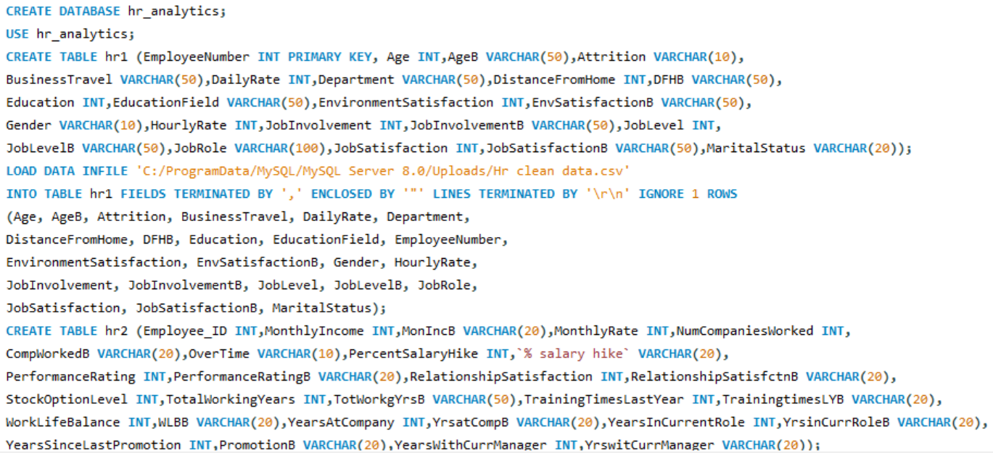
SQL QUERIES

Slide 8
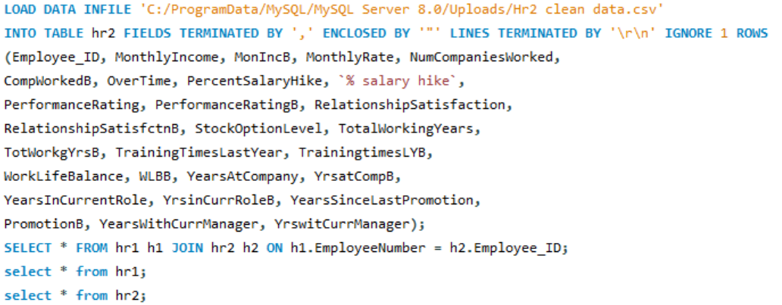
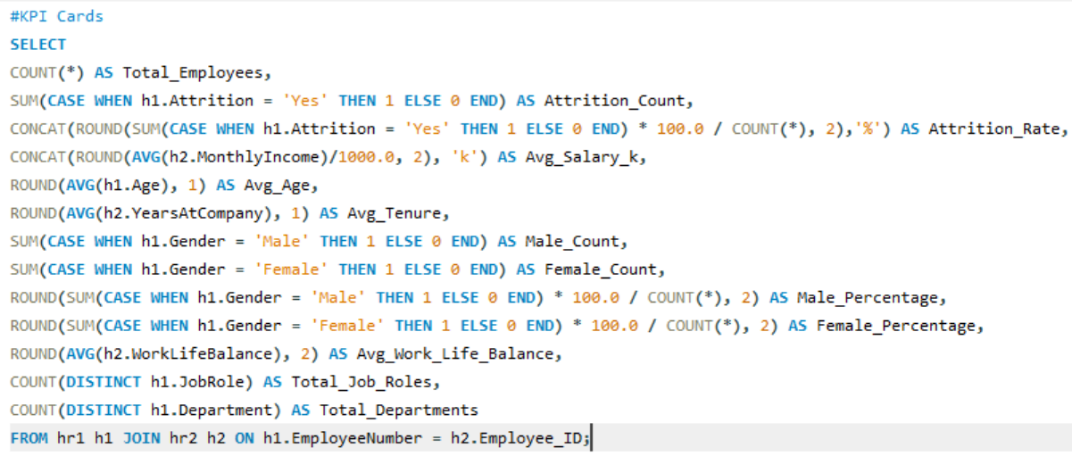
SQL QUERIES

Slide 9
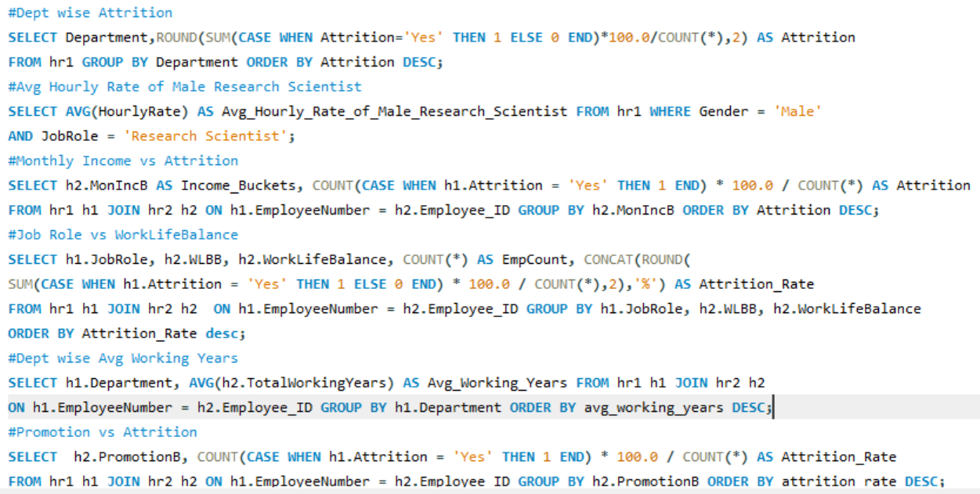
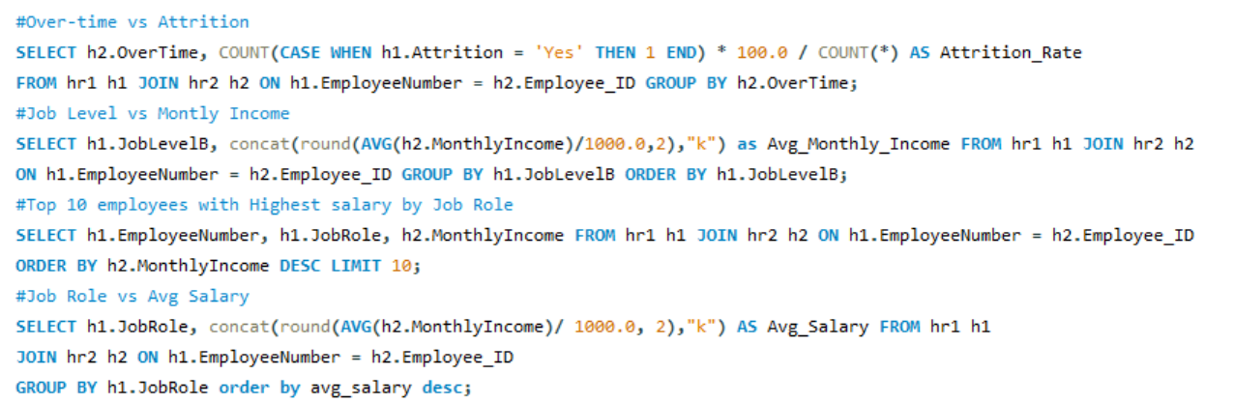
SQL QUERIES

Slide 10
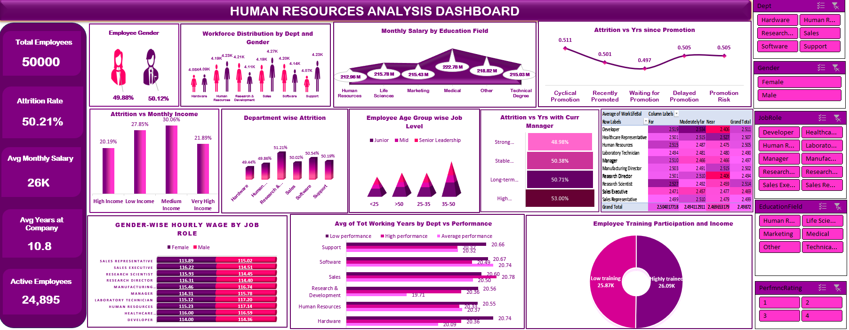
EXCEL DASHBOARD

Slide 11
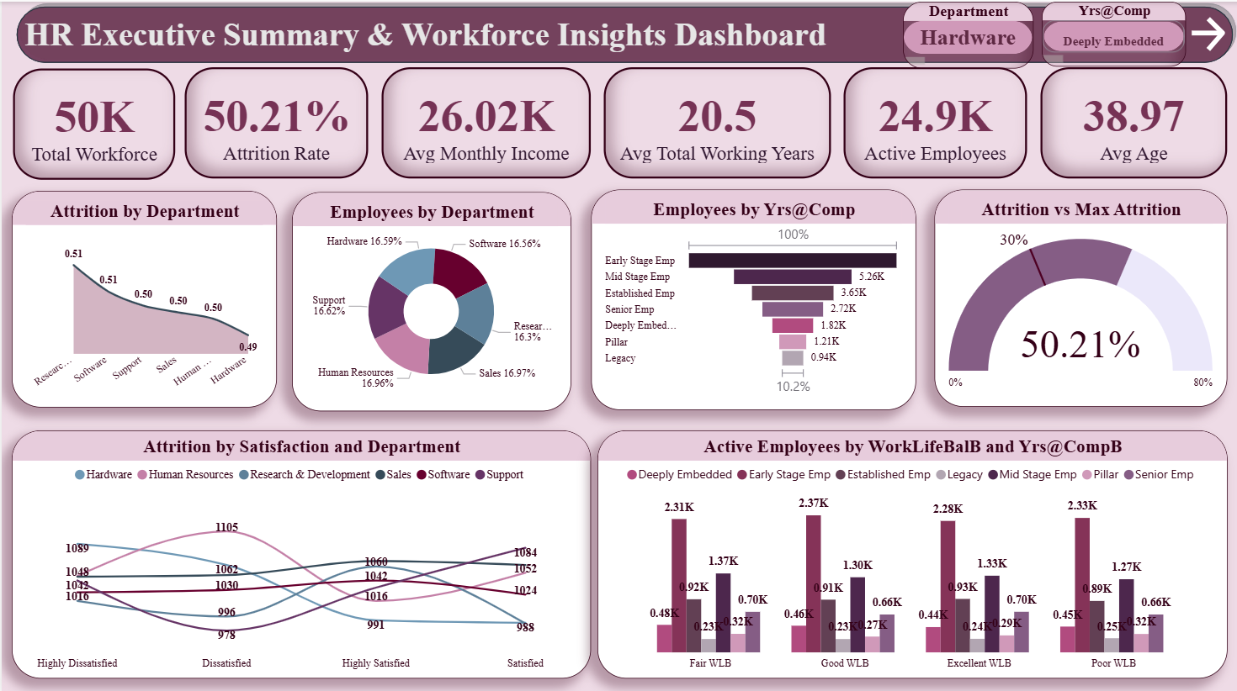
POWER BI DASHBOARD

Slide 12
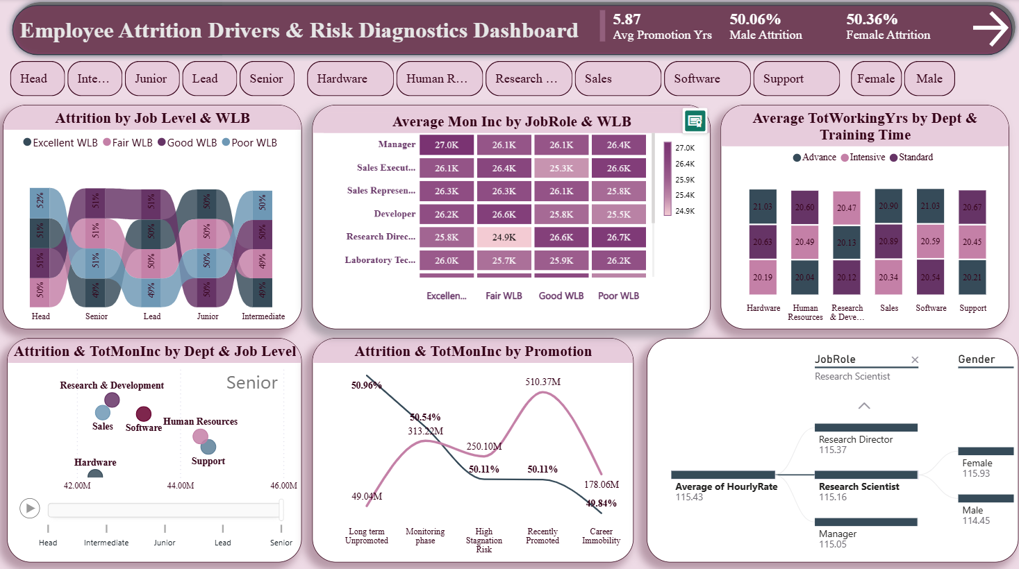
POWER BI DASHBOARD

Slide 13
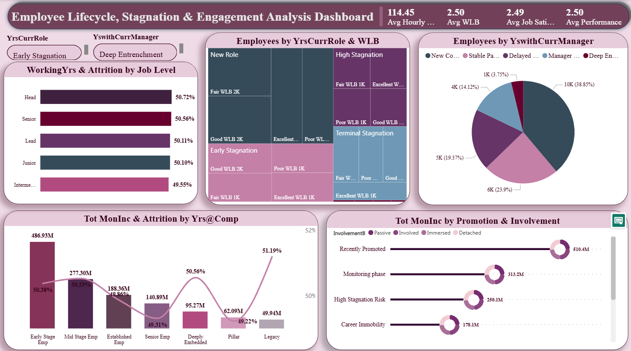
POWER BI DASHBOARD

Slide 14
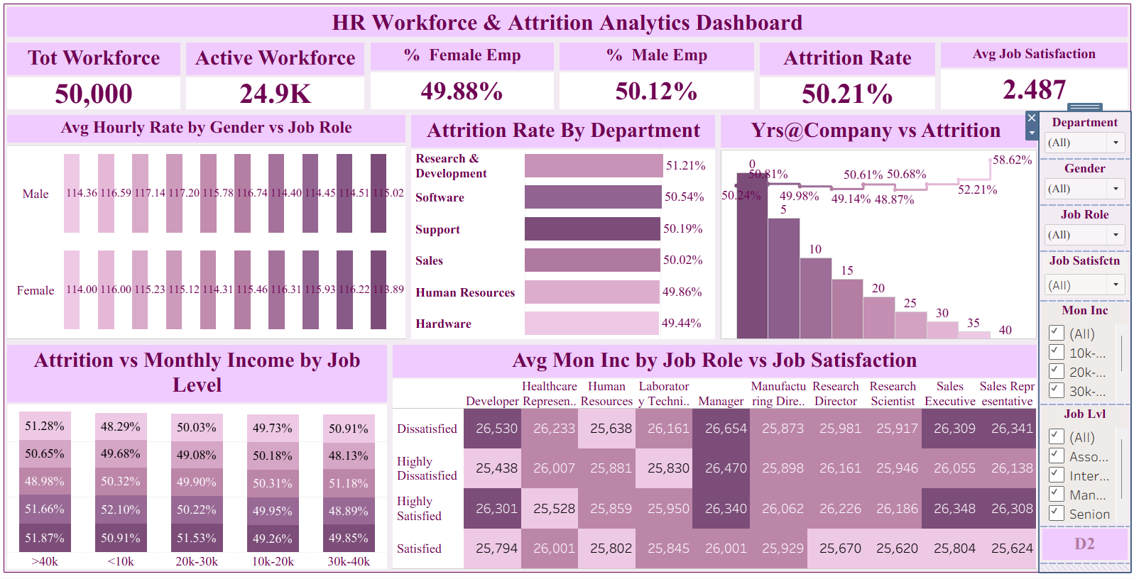
TABLEAU DASHBOARD

Slide 15
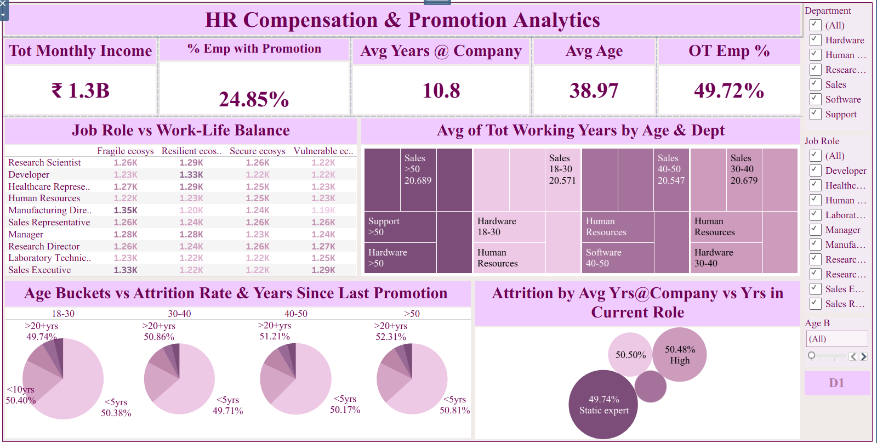
TABLEAU DASHBOARD

Slide 16
Key Focus Area 1
The Retention & Management Crisis
1: "Attrition looks high overall, but since tenure is also high, it means employees stay long and then leave at similar points—not that they leave quickly."
2: "Longer the years since promotion, higher the attrition rate."
3: "An increase in the number of years with a current manager shows a higher attrition of 53%."
4: "High employee count in early stage of years at company, lower employee count as years increase (9k to 943)."
The Deeper Insight
Company doesn't have a "bad onboarding" problem; it has a stagnation and manager burnout problem. Employees are willing to stay long-term, but they eventually hit an invisible ceiling. Staying with the same manager for too long increases attrition to 53%, meaning managers are either micromanaging, blocking growth, or failing to challenge their veteran staff. The drop from 9k to 943 employees shows a severe inability to retain people into senior legacy roles.
What the Company Should Do
Enforce Manager Rotation or Training: Do not leave employees under the same manager indefinitely. Introduce 360-degree manager reviews to see why long-term reports are fleeing.
Clear Career Pathways: Implement a structured internal mobility program so long-tenured employees can transfer to new departments rather than quitting.

Slide 17
Key Focus Area 2
Compensation & Promotion Disconnects
1: “Recently promoted employees earn the most (₹510M total)... as career growth stops, income and involvement drop... a double loss situation."
2: "High attrition seen in associate and senior level employees earning >40k; also senior level show high attrition with monthly income <10k."
The Deeper Insight
The company has a highly reactive, "feast or famine" compensation structure. When people are promoted, they are flooded with cash (₹510M), but once that honeymoon phase ends, they are left to rot. Senior employees are leaving at both ends of the spectrum: high earners (>40k) feel under-challenged or detached, while low earners (<10k) feel severely underpaid and insulted.
What the Company Should Do
Continuous Performance-Based Incentives: Shift away from giant, one-time promotion raises toward smaller, continuous, merit-based quarterly bonuses to keep engagement high.
Fix the Senior Underpayment: Immediately audit and raise the salaries of the senior-level employees earning under 10k to match market standards before they all walk out.

Slide 18
Key Focus Area 3
Work-Life Balance & Burnout Paradoxes
1: "Work-life balance is a major issue... Manufacturing Directors and Sales Executives are in the worst shape, Developers are handling it best."
2: "Junior roles show excellent work-life balance but high attrition."
3: "Research Directors have poor/fair work-life balance despite high incomes (26.7K / 24.9K)."
The Deeper Insight
Money cannot buy wellness. Research Directors make great money but are burning out. Meanwhile, junior employees have great work-life balance but still quit—likely because they feel underutilized, bored, or see no future. Manufacturing and Sales leadership roles are in active crisis.
What the Company Should Do
Re-structure Manufacturing & Sales Executive Roles: Hire assistant managers or co-directors to split the operational workload in these two high-danger zones.
Engage the Juniors: For junior roles, increase engagement through mentorship programs and skill-building, rather than just giving them "easy, low-pressure hours.”

Slide 19
Key Focus Area 4
Department Performance, Satisfaction, & Training
1: "R&D shows highest attrition + highest job dissatisfaction; Software is next. Hardware has the lowest attrition (51.2% vs 49.4%)."
2: "Sales shows high job satisfaction but also high attrition."
3: "Hardware has high tenure (20.74 yrs) but very low performance; Sales has high performance and high tenure (20.8 yrs)."
4: "Highly trained employees earn slightly more (26.1K vs 25.9K) in Hardware, Sales, and Software."
The Deeper Insight
This reveals distinct department cultures. R&D and Software are toxic or deeply frustrating environments (high dissatisfaction). Sales is a high-octane "churn and burn" culture—employees love the job and perform incredibly well, but likely quit due to aggressive targets. Hardware is a "retirement home"—people stay forever (20.74 yrs) because it’s safe, but they are completely unproductive.
What the Company Should Do
R&D/Software Intervention: Conduct an anonymous culture audit in R&D to figure out why they are so deeply unhappy.
Hardware Performance Push: Introduce strict KPIs and performance-improvement plans (PIPs) in the Hardware department to wake up the low performers.
Sales Retention: Introduce retention bonuses or loyalty perks in Sales to keep these high-performing, happy employees from jumping to competitors.

Slide 20
Key Focus Area 5
Demographics, Gender, & Education
1: "Strong gender balance overall, Male slightly high (49.8% vs 50%)."
2: "High male count in HR, Sales, Support (4.24K); High female count in HR, R&D, Sales, Software (4.2K)."
3: "Highest employee count under age 35-50; <25 shows very low count."
4: "Medical education field shows higher monthly income (222.8M) vs HR field (213M)."
5: "Hourly wages: Female Research Directors/Healthcare Reps lean higher (116.2); Male Lab Techs/HR Reps lean higher (117.3)."
The Deeper Insight
While overall gender metrics look balanced, company has an aging workforce risk. Having very few employees under 25 means there is no "pipeline" of young talent being groomed to replace the massive 35-50 age bracket when they retire or quit. Pay gaps are role-specific rather than company-wide.
What the Company Should Do
Launch a University/Graduate Recruitment Drive: Focus heavily on hiring and training the under-25 demographic to future-proof the company.
Standardize Hourly Pay Bands: Formalize the pay scales for Lab Techs, Research Directors, and HR Reps to ensure absolute equity, eliminating the slight gender-based wage skews.

Slide 21
Thank You.
MySQL · Microsoft Excel · Power BI · Tableau

