Slide 1
INSURANCE ANALYTICS
End-to-End
Data Analytics Project
A comprehensive analytics project covering data cleaning, SQL processing,
Power BI & Tableau dashboards, and strategic insights.
By- Meghana A
Excel
SQL
Power BI
Tableau
5,000
3,148
₹5.26M
₹251.4M
2014–2024
Policies Analyzed
Unique Customers
Total Premium
Total Claims
Data Coverage

Slide 2
01 · Project Overview
Objectives, tools, and scope
📊 Data Exploration
🔧 Data Cleaning
Analyzed 5,000 insurance policies across 5 tables covering policies, customers, claims, payments, and risk score.
Standardize formats, handle missing values, engineer policy tenure/ age/risk/claim settlement days/discount buckets using Excel Power Query.
🗄️ SQL Processing
📈 Visual Dashboards
Build a relational database in MySQL, write analytical queries, views, and stored procedures.
Build executive-level dashboards in Excel, Power BI, and Tableau with KPIs, drill-downs, and filters.
💡 Actionable Insights
🎯 Business Decisions
Identify high-risk segments, claim patterns, geographic exposure, and premium growth trends.
Provide data-backed recommendations on premium ,coverage, retention, claims efficiency, and market targeting.
TOOLS USED IN THIS PROJECT
Microsoft Excel
MySQL
Power BI
Tableau
Power Query · Power Pivot · Charts
Tables · Views · Stored Procs
DAX · Visuals · Bookmarks
LODs · Parameters · Blending

Slide 3
02 · Dataset Description
5 interrelated tables · 5,000 records · 10-year span (2014–2024)
Policy Details
5,000
3,148
5,000
Policy ID, Type, Coverage, Premium, Payment Frequency, Status, Tenure
Total Policies
Unique Customers
Customer Information
3,148
Customer ID, Name, Gender, Age, Marital Status, City, State, Occupation
₹1,052
₹251.4M
Claims
5,000
Claim ID, Amount, Status, Date, Reason, Settlement Days
Avg Premium
Total Claims
Payment History
~15K
Payment ID, Date, Amount, Method, Status
50.4
33.6%
Additional Fields
Avg Risk Score
Renewed Policies
5,000
Agent ID, Renewal Status, Risk Score, Discounts
DATA COVERAGE: 2014 – 2024 | 50 U.S. States | Health · Auto · Life · Property

Slide 4
03 · Data Cleaning — Power Query (Excel)
01
Missing Value Treatment
02
Data Type Corrections
Serial date numbers converted to proper date format
Premium, Coverage & Claim columns → Decimal(15,2)
Policy ID, Customer ID → Text to preserve leading zeros
Removed unwanted columns for data analysis
Split Address column into state, city and zip code
Settlement Date blanks → kept NULL with conditional logic
04
Engineered Feature Columns
03
Duplicate Removal
Identified 127 duplicate payment records using Remove Duplicates
Policy-level deduplication based on Policy ID + Customer ID pair
Age Buckets: 18–30, 31–45, 46–65, 65+
Policy Tenure Buckets: (<2yr, <4yr,<6yr,<8yr,>8yr)
Claim Settlement Days Buckets: <30 days, <60 days, <90days, Not settled
Discount Buckets: <20%, <40%, >40%, No discount
Risk Score Category: Low (<25), Medium (<50), High (<75), Very High(75+)
05
Data Standardization
06
Column & Schema Cleanup
State names trimmed of leading/trailing spaces
Gender values unified: Male / Female / Other
Payment Frequency normalized: Monthly, Quarterly, Annually
Renamed columns to small case for SQL compatibility
Removed irrelevant auto-generated index columns
Validated referential integrity: Policy ID ↔ Customer ID

Slide 5
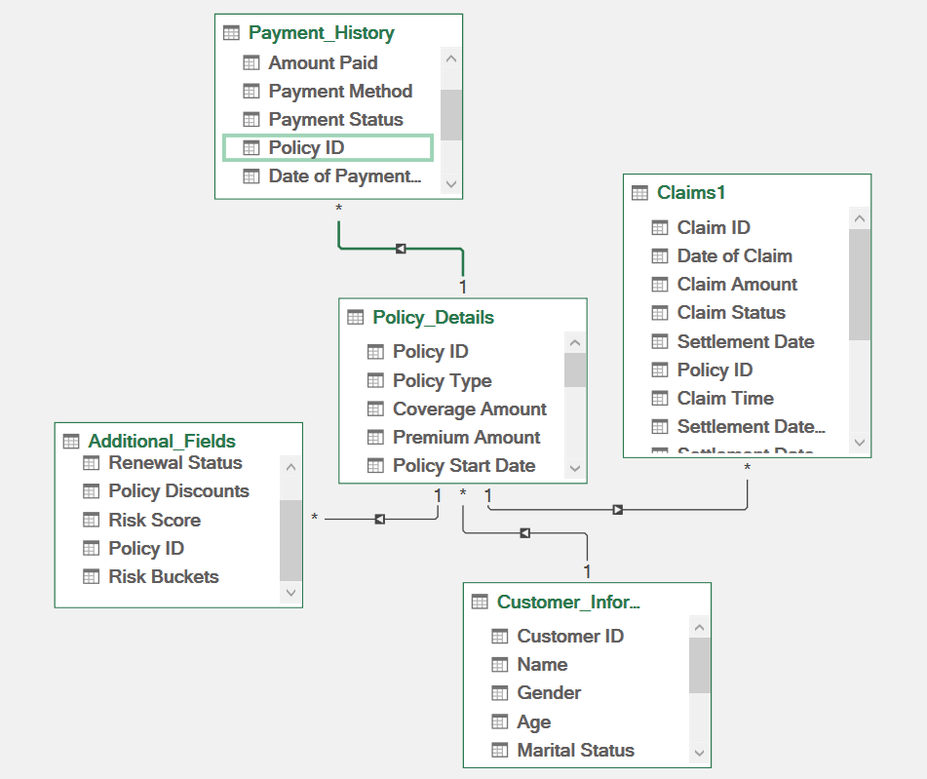
04 · Data Modeling — Power Pivot (Excel)
Payment
History
Star Schema
Central fact table (Policy Details) linked to 4 dimension tables via primary/foreign keys.
Key: Policy ID
Relationships
Policy ID connects Claims, Payments, Agents. Customer ID links customer demographics.
Additional
Fields
Key: Policy ID
Calculated Columns
Age Buckets, Tenure Groups, Risk Categories created via DAX in Power Pivot.
KPI Measures
Premium Revenue, Loss Ratio, Renewal Rate, YoY Growth computed as DAX measures.

Slide 6
05 · SQL Data Processing — MySQL
Database creation, ETL, analytical queries, views & stored procedures
Database & Tables
SQL SNIPPET — YoY Growth
01
CREATE DATABASE Insurance_Project; then 5 tables matching the schema — Policy_Details, Customer_Information, Claims, Payment_History, Additional_Fields.
SELECT year, total_revenue, previous_year_revenue,
CONCAT(ROUND((total_revenue - previous_year_revenue) / NULLIF(previous_year_revenue, 0) * 100, 2),'%') AS yoy_growth FROM (SELECT year, total_revenue, LAG(total_revenue) OVER (ORDER BY year) AS previous_year_revenue
FROM (SELECT YEAR(policy_start_date) AS year,
SUM(premium_amount) AS total_revenueFROM policy_details
GROUP BY YEAR(policy_start_date)) t1) t2;
Data Loading (ETL)
02
LOAD DATA INFILE with conditional CASE logic to handle serial dates and NULL settlement dates across all 5 CSV files.
Analytical Queries
03
Status-wise policies, YoY Growth %, Gender distribution, Age Bucket analysis, Claim Status breakdown, Loss Ratio % calculation and Top 5 Customers with high premium.
Views for Reporting
04
5
20+
1
1
Created reusable views: vw_PolicySummary — ensuring consistency across different applications that pull from the same data source.
Tables Created
Queries Written
Views Created
Stored Procs
Stored Procedures
05
sp_policies expiring — parameterized for dynamic date-range and segment filtering.

Slide 7
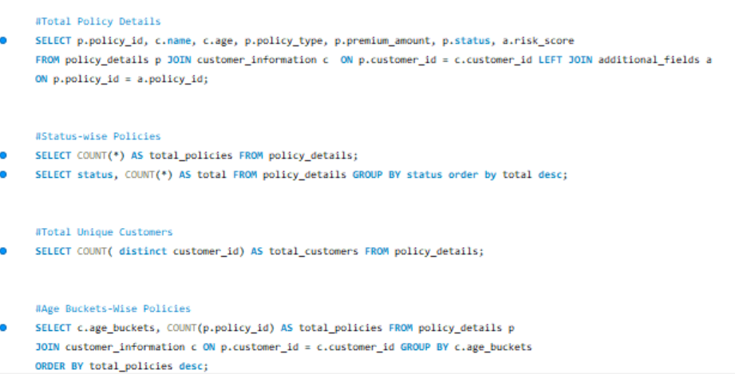
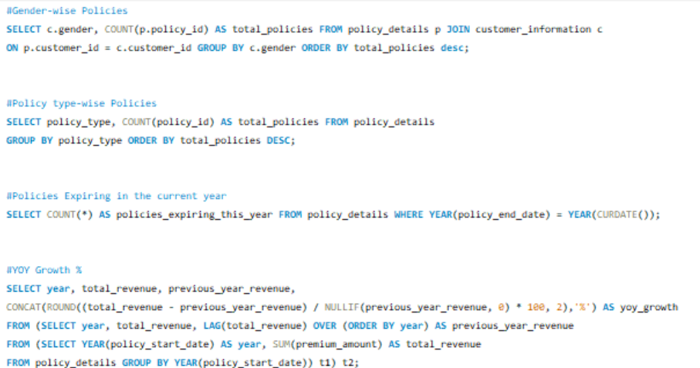
05 · MySQL Queries
Database creation, ETL, analytical queries, views & stored procedures

Slide 8
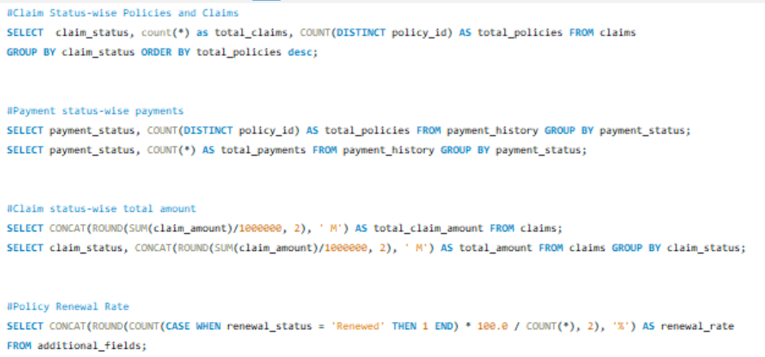
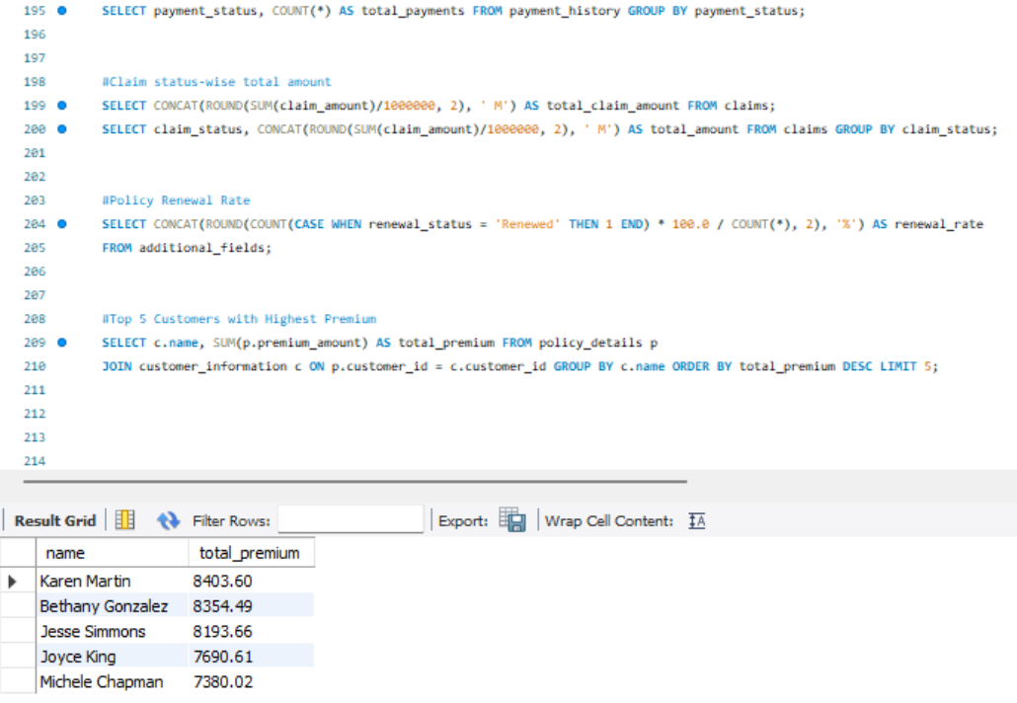
05 · MySQL Queries
Database creation, ETL, analytical queries, views & stored procedures

Slide 9
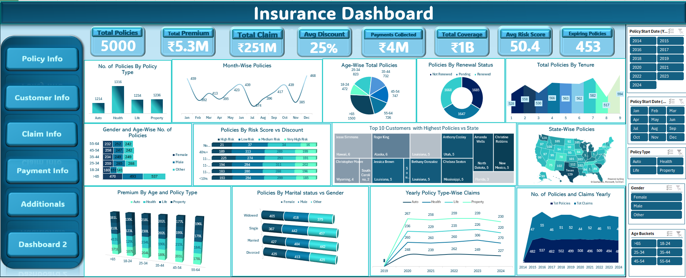
06 · Excel Dashboard Development
Pivot tables, KPI cards, and interactive slicers

Slide 10
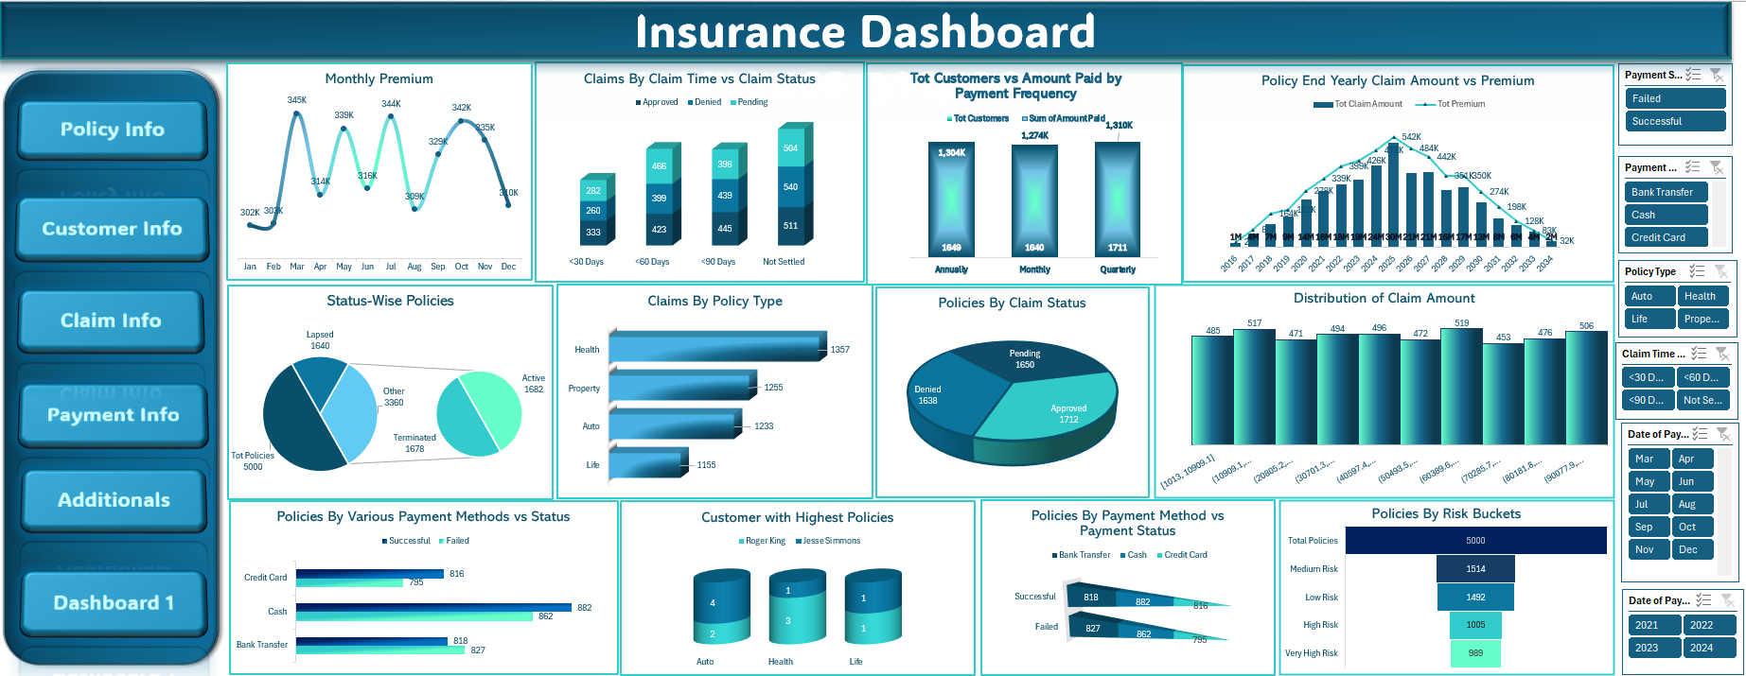
06 · Excel Dashboard Development
Pivot tables, KPI cards, and interactive slicers

Slide 11
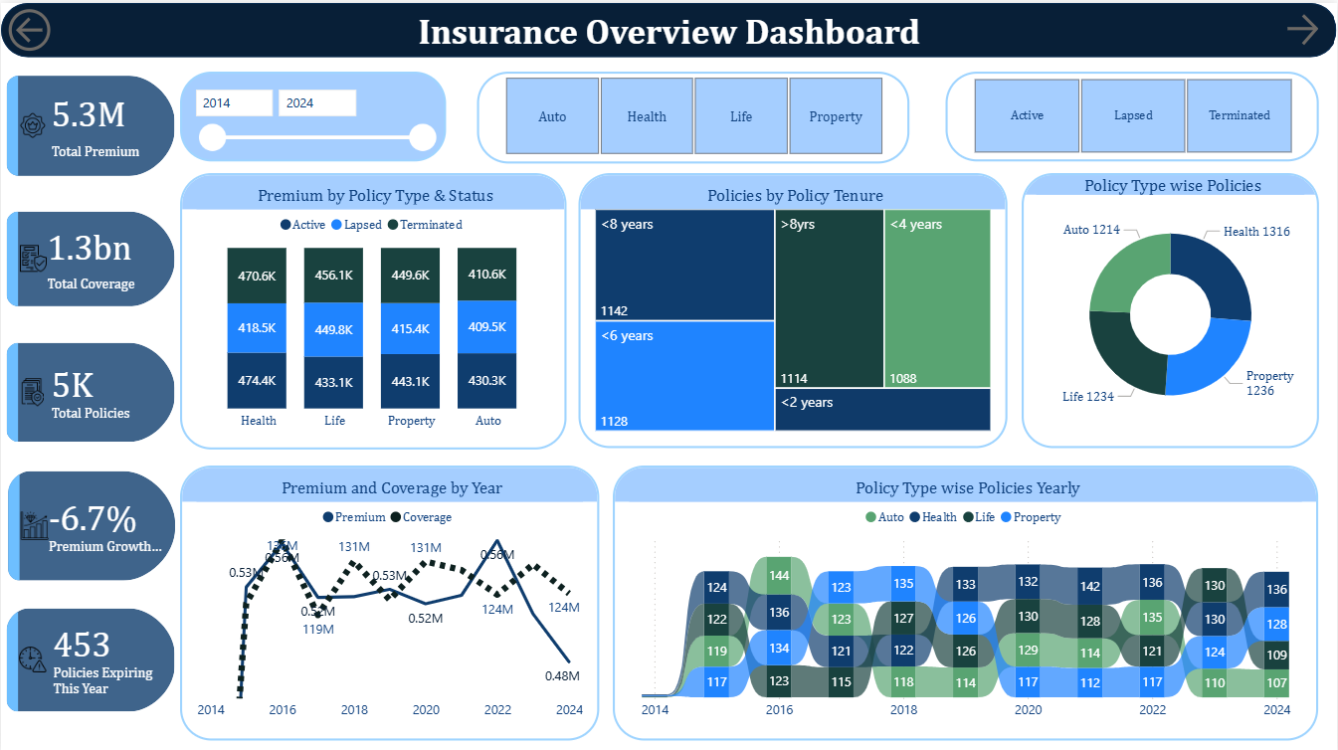
07 · Power BI Dashboard Development
Advanced DAX measures, AI visuals, and cross-filtering

Slide 12
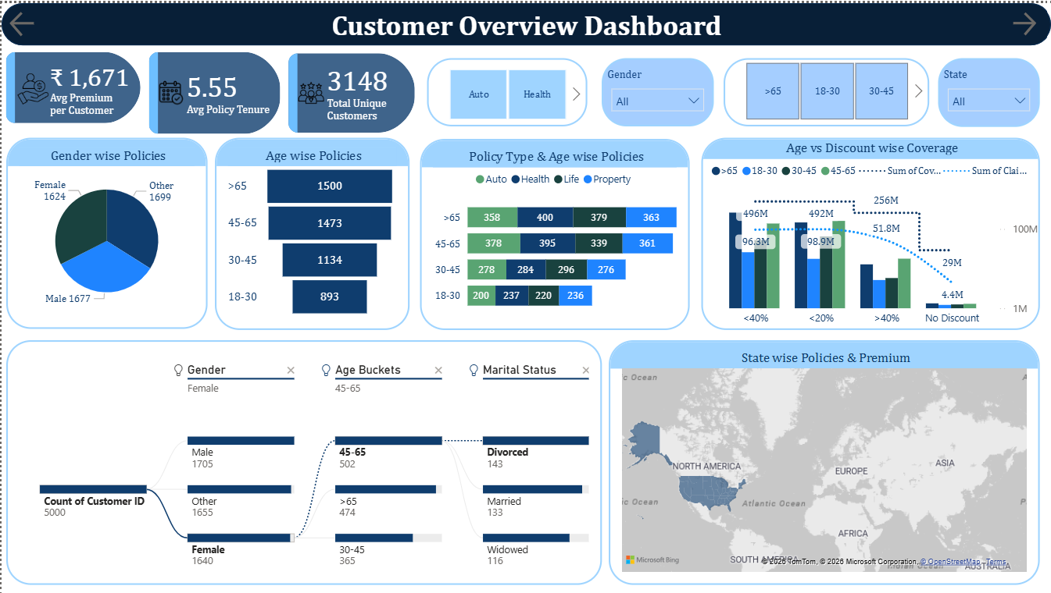
07 · Power BI Dashboard Development
Advanced DAX measures, AI visuals, and cross-filtering

Slide 13
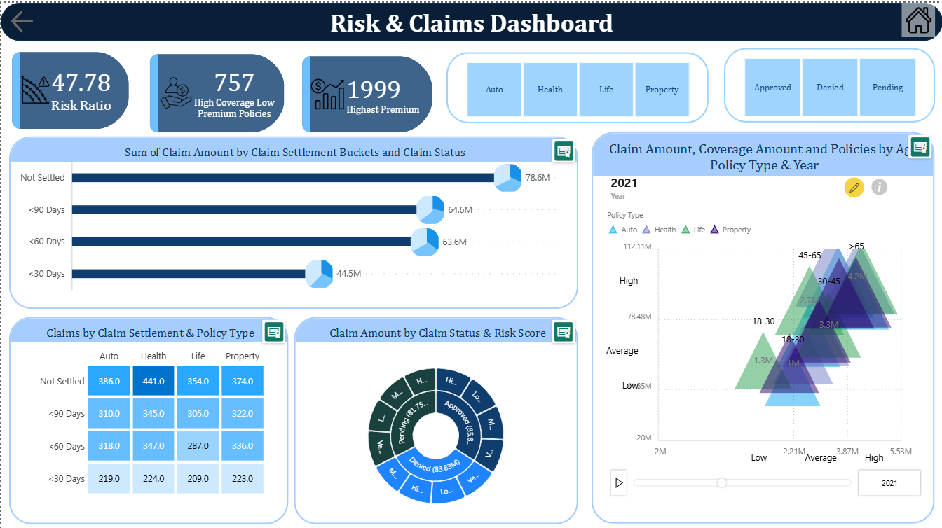
07 · Power BI Dashboard Development
Advanced DAX measures, AI visuals, and cross-filtering

Slide 14
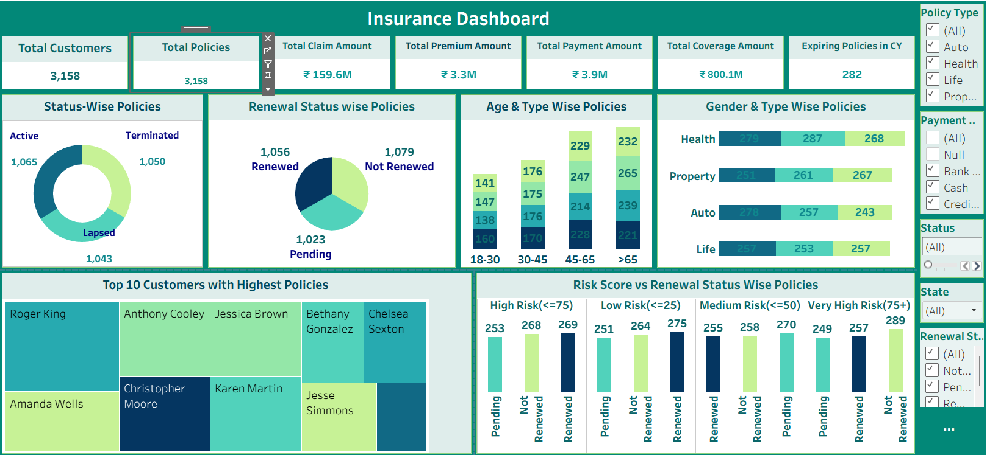
08 · Tableau Dashboard Development
Data blending, LOD expressions, parameters & interactive filters

Slide 15
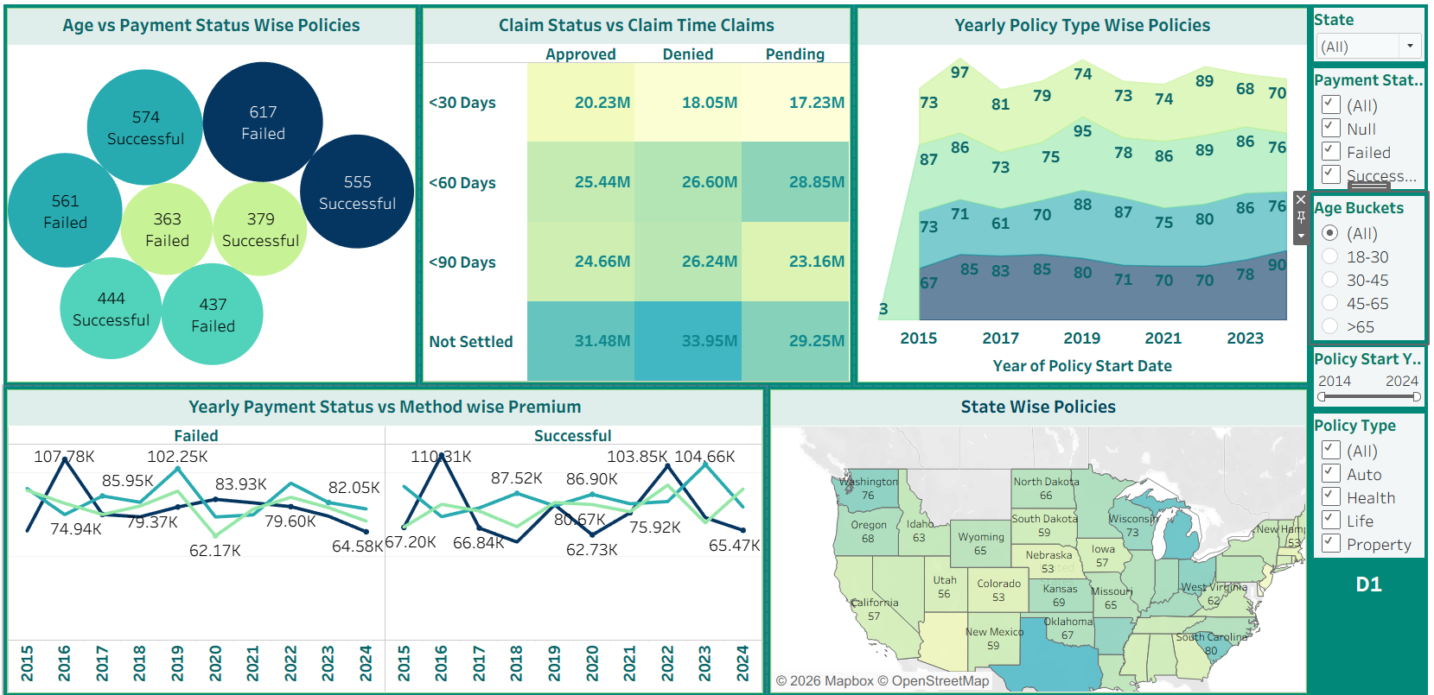
08 · Tableau Dashboard Development
Data blending, LOD expressions, parameters & interactive filters

Slide 16
9 · Key Metrics & KPIs
Aggregated from 5,000 policies · 2014–2024
5,000
3,148
₹5.26M
₹251.4M
Total Policies
Unique Customers
Total Premium Revenue
Total Claim Amount
₹1,052
50.4
33.4%
33.6%
Avg Premium / Customer
Avg Risk Score (0–100)
Policy Renewal Rate
Active Policy Rate

Slide 17
10 · Key Insights from Analysis
Data-driven discoveries from 5,000 insurance policies
⚠️
High-Risk Segments
💰
Premium vs. Claim Patterns
› 29% of policies have a Risk Score > 66 (High Risk)
› Total claims (₹251.4M) significantly exceed total premiums (₹5.26M)
› Property policies carry the highest average risk score
› Only 29% of policies had approved claim amounts > ₹0
› Age group 61–75 shows disproportionate claim activity
› Health and Auto policies account for highest claim ratios
› 1,454 policies (29%) reported negative profit margins
› Avg claim far exceeds avg premium, indicating pricing gaps
👥
Customer Behavior Trends
🗺️
Geographic & Payment Trends
› Renewal rate of 33.4% — 33.7% pending review
› Texas, South Carolina & Hawaii lead in policy count
› Customers aged 30-45 represent the highest policy concentration
› High claim density observed in coastal states
› Monthly payment frequency is most preferred (35% of customers)
› Payment failures concentrated in Quarterly payers
› Single marital status associated with higher lapse rates
› Western states show better renewal behavior than Eastern

Slide 18
11 · Business Recommendations
Translating insights into actionable strategy
01
Revise Pricing for High-Risk Policies
HIGH
02
Improve Policy Renewal Rate
HIGH
Implement risk-based dynamic pricing. Increase premiums for Risk Score > 66 by 15–20%. Use predictive scoring from claim history to adjust at renewal. Introduce deductible tiers for Property and Auto high-risk customers.
33.4% renewal is below industry benchmark (~45%). Launch retention campaigns for 'Pending' customers (33.7%). Offer loyalty discounts, streamlined renewal UX, and proactive outreach 60 days before expiry.
03
Geographic Risk Management
MEDIUM
04
Target High-Value Customer Segments
MEDIUM
Texas and coastal states show elevated claim density. Reallocate actuarial reserves to high-exposure regions. Consider geographic underwriting caps for catastrophe-prone zones. Pilot state-level profitability reporting.
Age 30-45, married, with multiple policies show strongest LTV. Bundle Health + Life or Auto + Property for cross-sell. Create segment-specific campaign playbooks using customer clustering from the analytics.
05
Optimize Claims Processing
MEDIUM
06
Expand Analytics Maturity
FUTURE
Average claim settlement days are a key dissatisfier. Fast-track low-complexity claims under ₹10K. Reduce settlement cycles with SLA-based process automation. Identify agents with highest claim approval cycles.
Integrate real-time data feeds into Power BI via API. Build ML model for churn prediction and risk scoring. Implement predictive premium calculation engine. Develop customer 360° view combining CRM + policy data.

Slide 19
CONCLUSION
Excel
Findings & Impact
EDA, cleaning & pivot dashboards
MySQL
Processed 5,000 policies across 5 interconnected tables using a full analytics stack
Relational DB, queries & views
Identified 29% policies with negative profit margins — pricing strategy gap confirmed
Power BI
Renewal rate of 33.4% highlights urgent need for retention optimization programs
Enterprise KPI & AI visuals
Coastal states carry disproportionate claim burden — geographic risk rebalancing recommended
Tableau
Power BI & Tableau dashboards provide real-time visibility for executive decision-making
Interactive exploratory dashboards

Slide 20
INSURANCE ANALYTICS
Thank You
Excel
SQL
Power BI
Tableau

