Slide 1
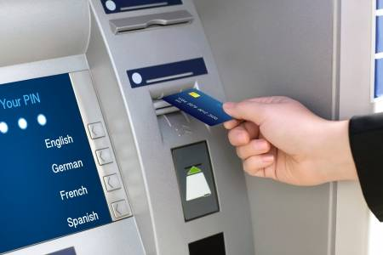

Slide 2

Have You Ever Tried To Know The Internal Functioning Of An Atm Machine?????

Slide 3
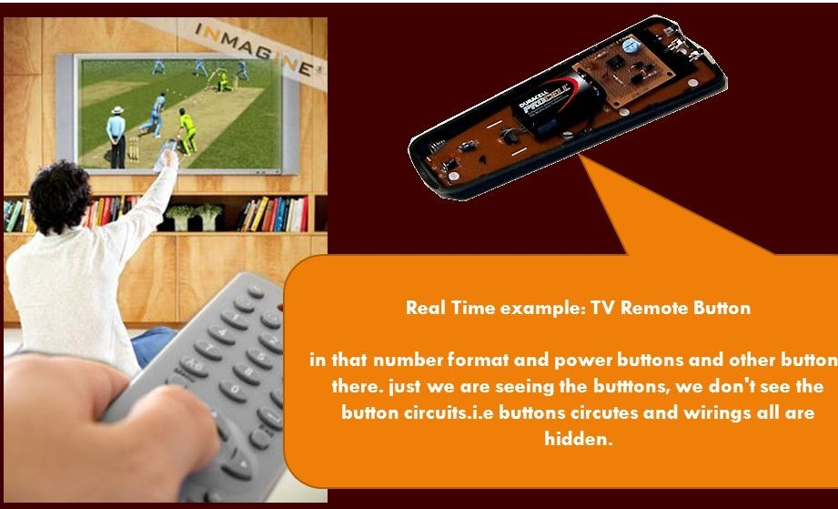
What is Abstraction????

Slide 4


Slide 5


Slide 6
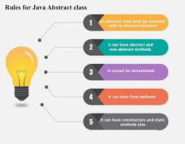

Slide 7
