Slide 1
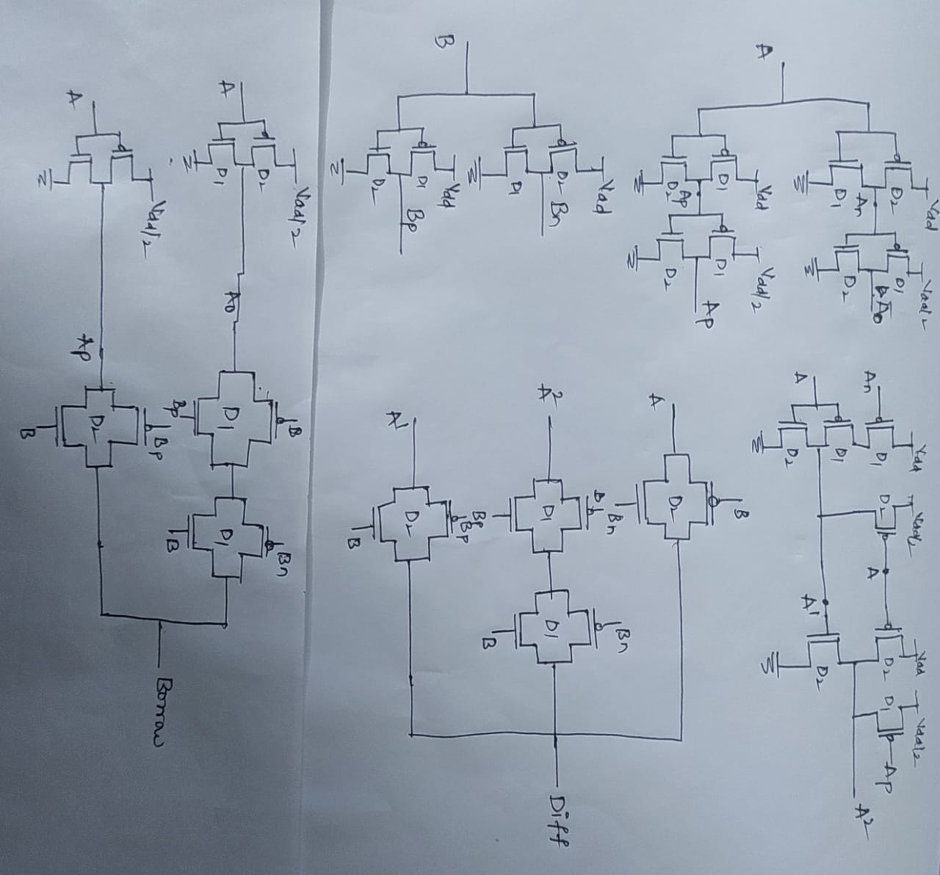
Implementation of Half subtractor using unary Operators:

Slide 2
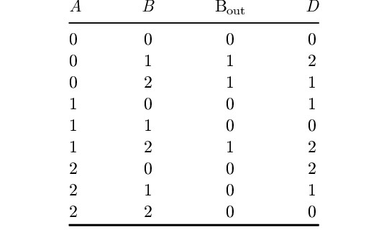
Truth Table of Ternary Half Subtractor:

Slide 3
Boolean Expressions for Ternary Half Subtractor:
Using unary operators:
Difference = A.B₀+ A^{2.} B₁ +A¹ .B₂
Borrow = A₀.B₁+ A_{p}. B₂

Slide 4
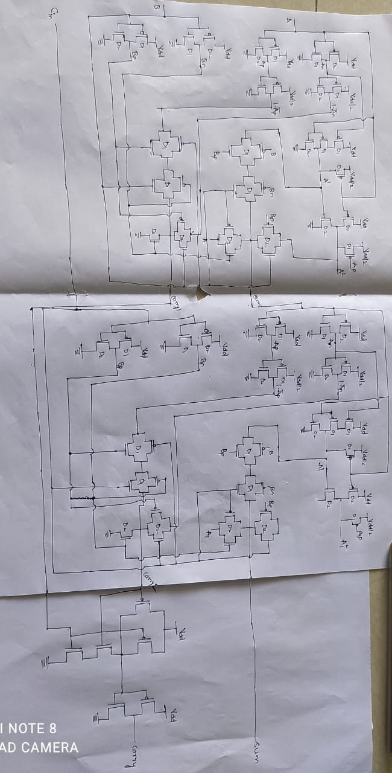
Implementation of Ternary Full adder using Ternary half adder:

Slide 5
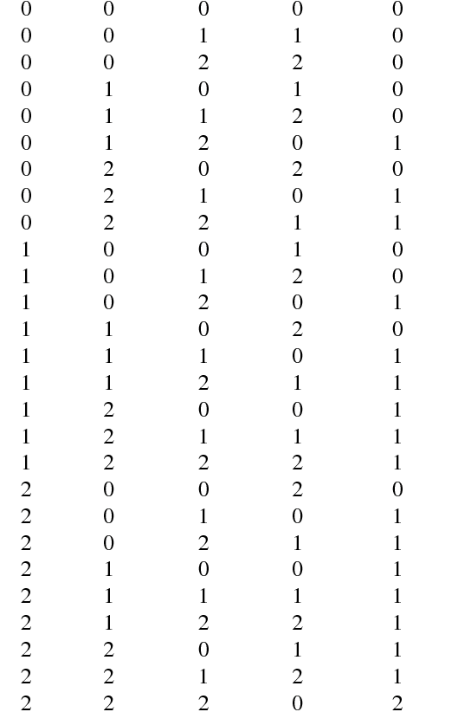
Truth Table of Ternary Full adder:
A
B
C
SUM
CARRY

Slide 6
Boolean Expressions for Ternary Full adder:
Sum = c₀ [b₀ · A + b₁ · A¹ + b₂ · A²]
+ c₁ [b₀ · A¹ + b₁ · A² + b₂ · A]
+ c₂ [b₀ · A² + b₁ · A+ b₂ · A¹]
Carry = c₀ [b₀. 0 +b₁. (1 . A_{p}) + b₂. (1.A_{n})]
+ c₁ [b₀. (1 . A_{p}) +b₁. (1 . A_{n}) + b₂ .1]
+ c₂ [b₀ . (1 . A_{n}) +b₁ .1 + b₂ . (1 +. A_{p})]

Slide 7
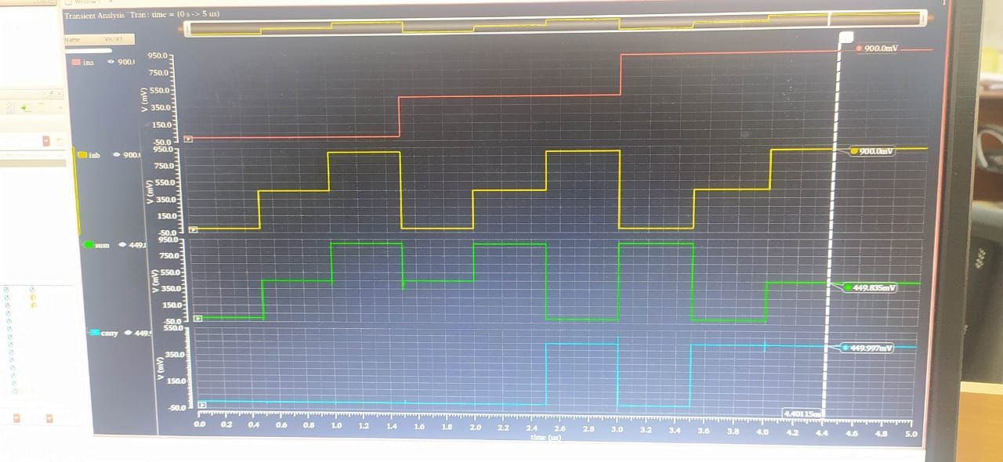
Simulation Result of Ternary Half Adder:

Slide 8
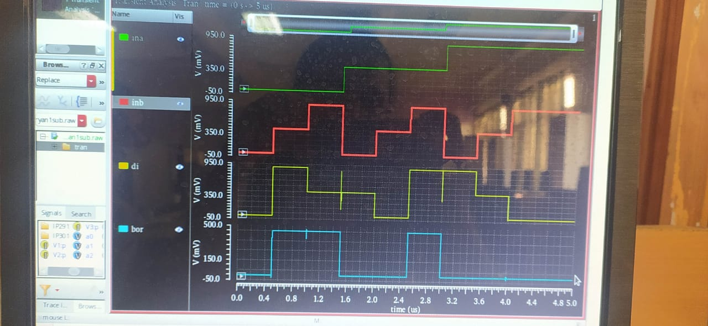
Simulation Result of Ternary Half Subtractor:

Slide 9
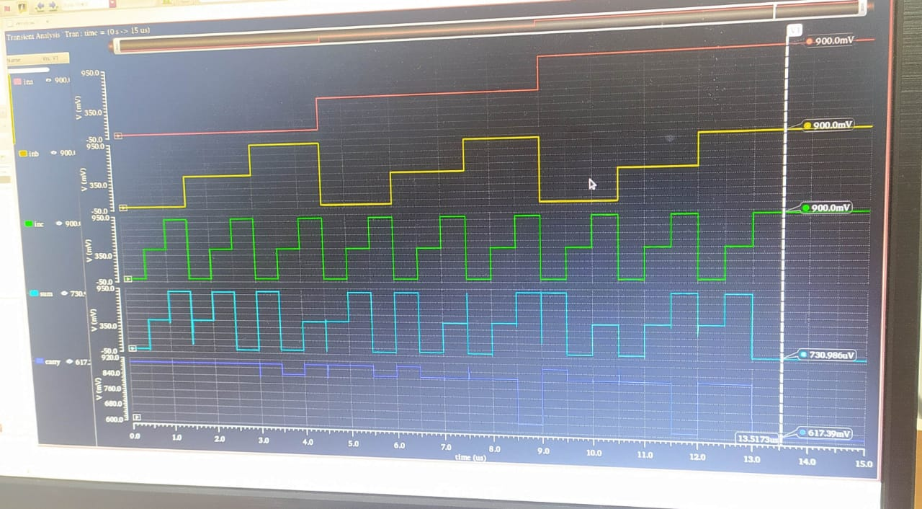
Simulation Result of Ternary Full Adder:

Slide 10
Simulation Result
For Half Adder, We have designed the whole circuit and the simulation is done.
For Half Subtractor, we have designed the circuit and the simulation is done.
For Full Adder, we have designed the circuit and the simulation is done only for sum combinations ,we didn’t got some of the waveforms for carry combinations.

