Slide 1
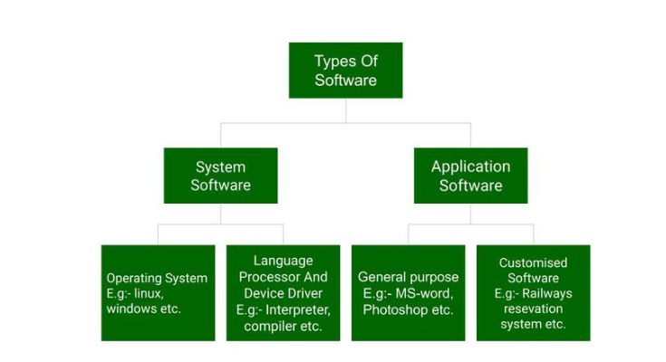
Types of software
Difference between Web, windows and Mobile applications

Slide 2
Software Requirement
The software requirements are description of features and functionalities of the target system.
Requirements convey the expectations of users from the software product
Benefits Of Software Requirement
Clarifying the product vision and goals.
Defining the target market and user requirements.
Facilitating alignment among stakeholders.
Improving the chances of success for the product.
Reducing the risk of scope creep.
Sources Of Software Requirement
Stakeholders
Case studies
Domain Experts
Beneficiaries
Requirement
Developer
Operators
Testers
Automated Tools

Slide 3
Characteristics Of Good And Bad Requirements
Good Requirements | Bad Requirements
Complete | Incomplete
Consistent | Inconsistent
Unambiguous | Ambiguous
Traceable | Lack of traceability
Verifiable | Not verifiable
Prioritized and aligned with business goals | Not prioritized with respect to business goals
Testable | Confusion between validation of needs and verification of the product
High-level And Low-level | Vague needs. Not mastered scenarios
Relevant for testing | Requirements not good enough for tests
Human Readable | Not understandable. Use of synonyms or words with multiple meanings

Slide 4
Types Of Requirements
Implicit Requirements:
Implicit requirements are features and characteristics of the product experience that customers will expect
They are the unspoken desires, needs, and expectations that can significantly shape the final product.
They influence the behavior, features, and usability of the software in ways that may not be immediately apparent
Explicit Requirements:
Explicit requirements are the details the product team captures and shares with stakeholders. These requirements might show up in several formats, including:
Product backlog
Sprint backlog
Product roadmap
Acceptance criteria
Wireframe
Mockup
Product requirements document

Slide 5
Types Of Requirements
Functional And Non Functional Requirements:
Functional Requirements | Non-functional requirements
Functional requirements help to understand the functions of the system. | They help to understand the system's performance.
Functional requirements are mandatory. | While non-functional requirements are not mandatory.
They are easy to define. | They are hard to define.
They describe what the product does. | They describe the working of product.
It concentrates on the user's requirement. | It concentrates on the expectation and experience of the user.
It helps us to verify the software's functionality. | It helps us to verify the software's performance.
These requirements are specified by the user. | These requirements are specified by the software developers, architects, and technical persons.
There is functional testing such as API testing, system, integration, etc. | There is non-functional testing such as usability, performance, stress, security, etc.
Examples of the functional requirements are - Authentication of a user on trying to log in to the system. | Examples of the non-functional requirements are - Time taken to login.
These requirements are important to system operation. | These are not always the important requirements, they may be desirable.
Completion of Functional requirements allows the system to perform, irrespective of meeting the non-functional requirements. | While system will not work only with non-functional requirements.

