Slide 1
GIT

Slide 2
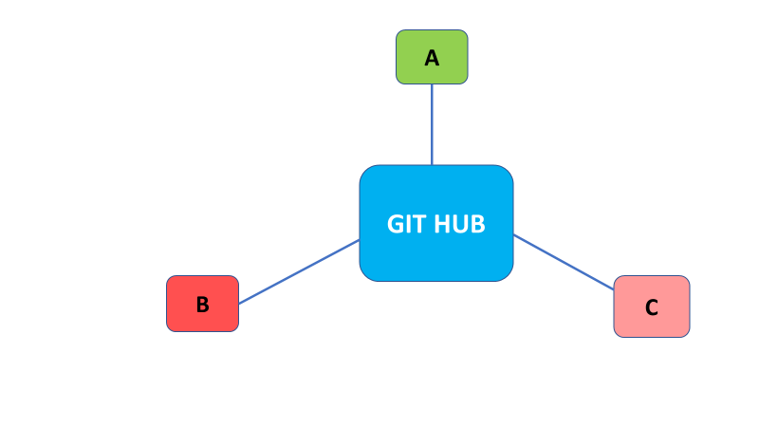
About GIT
Git Hub is a central Repository.

Slide 3
Why GIT
Free
Open Source
Super fast
Easy Branching and merging

Slide 4
Using GIT
Using the command line
Code editors/IDE
GUI

Slide 5
Installing GIT
Download GIT from git-scm.com/downloads
Run the installer
Keep pressing Next until the installation is done
Open Powershell and type git and press enter
This way we can check if GIT is installed

Slide 6
GIT Vs GITHUB
GIT | GITHUB
Installed locally | Hosted in the cloud
First released in 2005 | Company launched in 2008
Focused on version control and code sharing | Focused on centralized source code hosting
Primarily a command line tool | Administered through the web
Provides a desktop interface named Git GUI | Desktop interface named GitHub Desktop
No User Management features | Built-in user management
Open source licensed | Includes a free tier and pay-for-use tiers

Slide 7
Basic GIT commands
mkdir git_demo
cd git_demo
Initialise git – git init
ls and ls –a to list directories and hidden files
git status – to check commits
touch demo2.txt
git add demo2.txt
git commit –m “First commit”

Slide 8
Working with GITHUb
Create a repository in GITHub
Copy the URI
Make git hub repo as the central repository by using the below commands
git remote add origin <URL>
git remote set-url origin <URL>
Push from local repo to central repo
git push –u origin master

Slide 9
Other Commands
----------------Cloning a repository--------------
Create a directory
Go to the directory and use the below command to clone the repo
git clone <URI>
git log → gives all the commits

Slide 10
Editing the file in Bash
Edit the file using below commands
vim <file Name>
Press i
Insert a new line
Press ESC and type :wq and hit enter
To stage the changes
git add <FileName>
If you want to undo the stage then use the below command
git restore –staged <FileName>
git restore <filename>

Slide 11
Commit and PUSH
git commit –m “My first edit”
git push origin master

Slide 12
Pull command
Make changes to file in GIT Hub and save the changes
View the file content in bash using vim <File Name>
Now to pull the changes, use the below command
git pull <uri>
View the content of the file again

Slide 13
GIT Branching
What is Branching and why it is required?
To create a new branch use,
git branch <name of the branch>
git checkout <branch name>
Create a new file in a new branch using
vi <filename>
Commit and push the changes
For push use :- git push origin develop

Slide 14
Merging the branches
To merge your branch with the main branch, we need to first checkout the main branch by using,
git checkout master
Merge your branch with main branch using,
git merge develop
Push the changes of master to github
git push origin master

Slide 15
Resolving Merge conflicts
A merge conflict arises when Git cannot automatically resolve code differences between two commits.
Say a developer is ready to submit his/her changes (via the “git push” operation), that person may discover other conflicting changes to the same set of code have already been committed/pushed to the same branch in the meantime.

Slide 16
Merge Conflicts contd..
Ex:
Create a new branch and checkout the branch
Make changes to the file in new branch, commit and push the changes to that branch
Say, developer 2 made changes to the same file in Master
Developer1 will checkout master and pull the changes
Merge new branch changes to master by using – git merge newbranch
Now it will show the marge conflicts
Use command cat <filename> to view the conflicts
Use vi command to edit the file and save the changes and then commit and push the changes

