Slide 1

Enhancing Medical Diagnosis Through Multimodal Medical Image Fusion
GUIDE NAME:
DR K SAI PRASAD
(Head of the Department-AIML)
Team Members:
K MEGHANA- 20R21A6625
L BHARGAVI- 20R21A6628
C SAI SREEYA- 20R21A6611
V. TIRUNESWAR- 20R21A6653

Slide 2
PROBLEM STATEMENT
The project aims to develop a user-friendly FLASK-based application dedicated to enhancing brain tumor diagnosis. By employing advanced wavelet transform techniques, it seamlessly integrates MRI and CT scan images, facilitating a thorough analysis of tumors. Through the incorporation of a Convolutional Neural Network (CNN) model, the application streamlines tumor detection and classification, ensuring faster and more accurate results. Ultimately, this innovative approach aims to significantly improve patient outcomes and elevate the standard of neuro-oncological care.

Slide 3
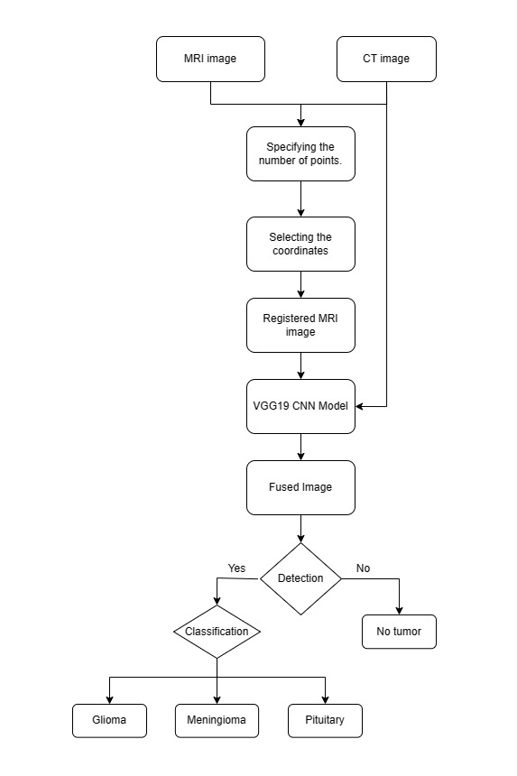
ARCHITECTURE

Slide 4
IMPLEMENTATION
Image Registration
Image Fusion
Image Classification

Slide 5
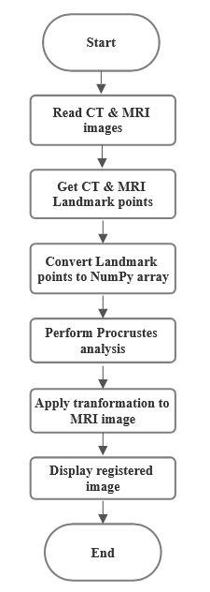
IMPLEMENTATION: IMAGE REGISTRATION
Precise spatial alignment of MRI and CT image data.
Utilization of Procrustes analysis algorithms for accurate registration.
Accounts for variations in patient positioning and imaging acquisition parameters.
Enables seamless integration and fusion of complementary imaging modalities.

Slide 6
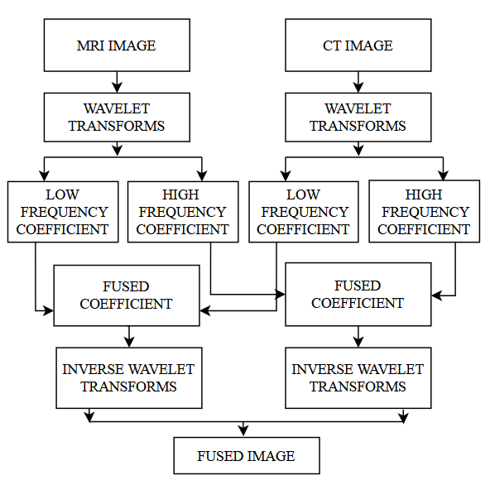
IMPLEMENTATION: IMAGE FUSION
Combines registered MRI and CT image data using wavelet transform techniques.
Generates a comprehensive visualization of brain anatomy and tumor characteristics.
Leverages the strengths of different imaging modalities for a complete understanding.
Fused images provide rich, multimodal information for tumor detection and analysis.

Slide 7
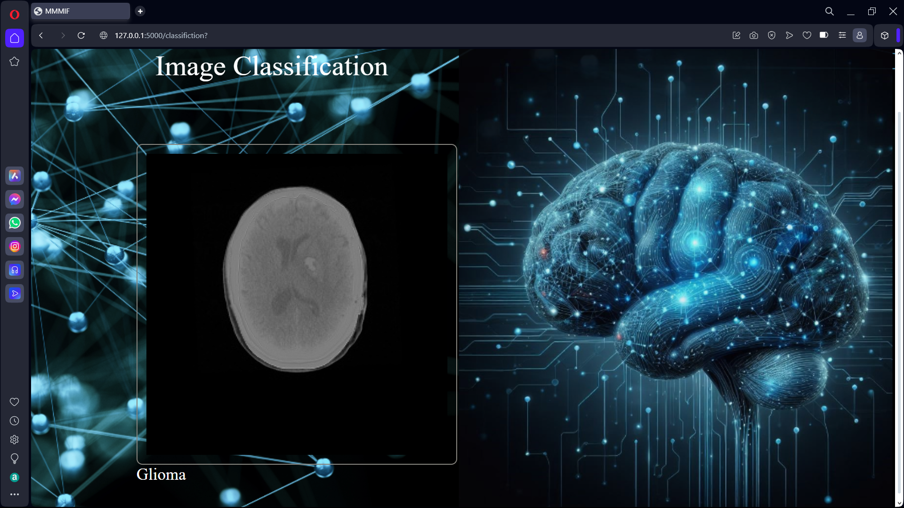
IMPLEMENTATION: IMAGE CLASSIFICATION
Convolutional Neural Network (CNN) model processes fused multimodal images
Accurately detects and localizes brain tumors within the fused image data
Classifies detected tumors into three main types: glioma, meningioma, and pituitary adenoma
Deep learning model leverages the rich information from fused images for precise tumor characterization
Tumor classification supports personalized treatment planning and clinical decision-making

Slide 8
THANK YOU

