Slide 1
_ KAGITHA MEGHANA
PERSONAL PORTFOLIO

Slide 2

PROJECT TOPIC
PERSONAL PORTFOLIO
Using HTML,CSS,JavaScript

Slide 3
AGENDA
Showcase my professional achievements, skills, and expertise.
Highlight my work experience and educational background.
Demonstrate my passion and commitment to my field.
Provide a platform to display projects and accomplishments.
Establish credibility and build a strong online presence.
Use it as a tool for networking and career advancement.

Slide 4

Project Overview
The overview of creating a personal portfolio is to establish an online presence that showcases my professional skills, accomplishments, and expertise. The portfolio will serve as a comprehensive platform to demonstrate my work experience, educational background, and passion for my field.
The success of the project will be measured by increased networking opportunities, career advancement prospects, and positive feedback from visitors, ultimately establishing a strong personal brand in the professional world.

Slide 5
WHO ARE THE END USERS?
Potential Employers: Hiring managers, recruiters, and human resources professionals who are considering me for job opportunities. They will use the portfolio to assess my qualifications, skills, and work experience.
Potential Clients: Individuals or businesses seeking services or collaboration within my area of expertise. The portfolio will demonstrate my capabilities and showcase past projects, helping to build trust and credibility.
Colleagues and Peers: Professionals in my field who may visit the portfolio to learn more about my work, stay updated on my achievements, or potentially collaborate on projects.
Recruiters and Headhunters: Recruitment agencies and headhunters who may come across the portfolio while searching for suitable candidates for specific job roles.

Slide 6
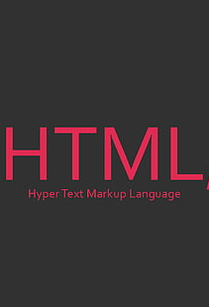
01
HTML
HTML
HTML, which stands for Hypertext Markup Language, is the standard language used to create and structure web pages. It forms the backbone of the World Wide Web, enabling content to be displayed and linked across browsers and devices. HTML uses tags to define the elements within a web page, such as headings, paragraphs, images, links, and more. It works in conjunction with CSS (Cascading Style Sheets) and JavaScript to enhance the presentation and interactivity of websites.

Slide 7
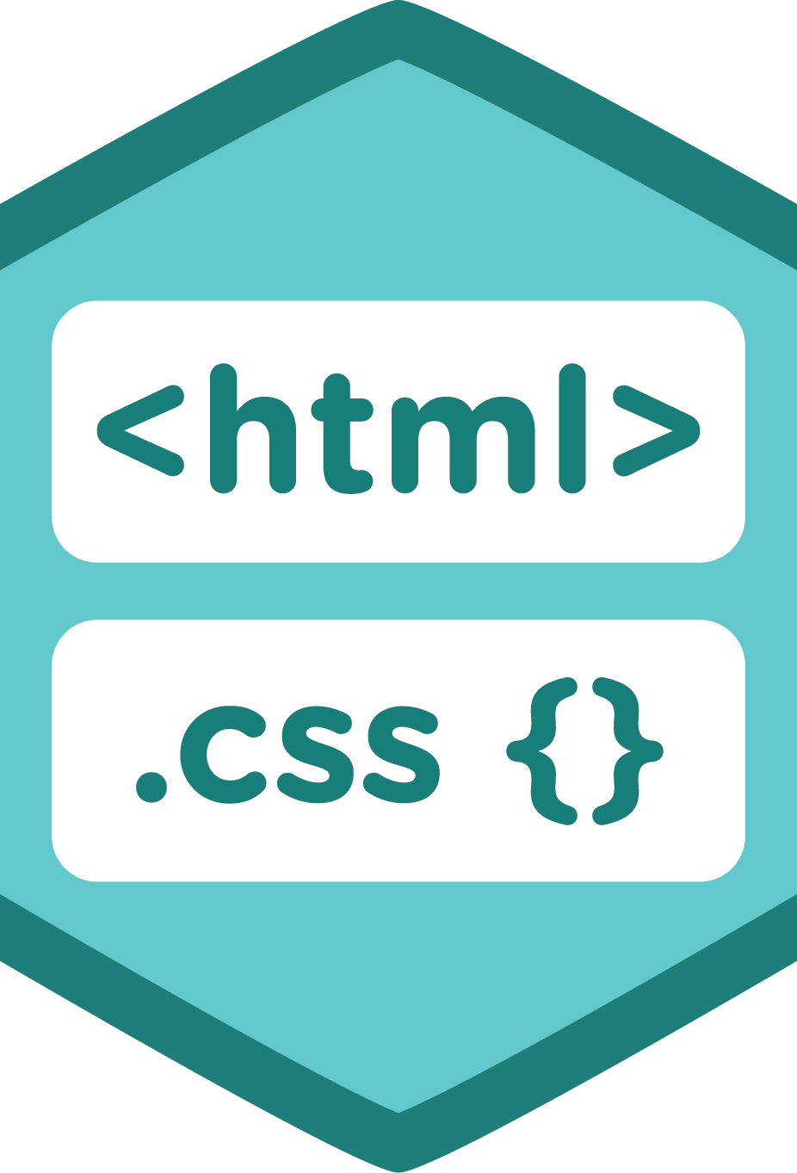
02
cascading style sheets
CSS
CSS, which stands for Cascading Style Sheets, is a fundamental technology used in web development to control the presentation and layout of HTML documents. It complements HTML by allowing developers and designers to apply styles, such as colors, fonts, spacing, and positioning, to HTML elements, making web pages visually appealing and engaging.

Slide 8

03
JavaScript
JavaScript
JavaScript is a high-level, versatile, and widely used programming language that adds interactivity and dynamic functionality to web pages. Initially developed as a client-side language for web browsers, it has since evolved to be used on both the client-side and server-side through platforms like Node.js.
As web technologies continue to evolve, JavaScript remains an essential skill for developers seeking to build modern and interactive web applications.

Slide 9
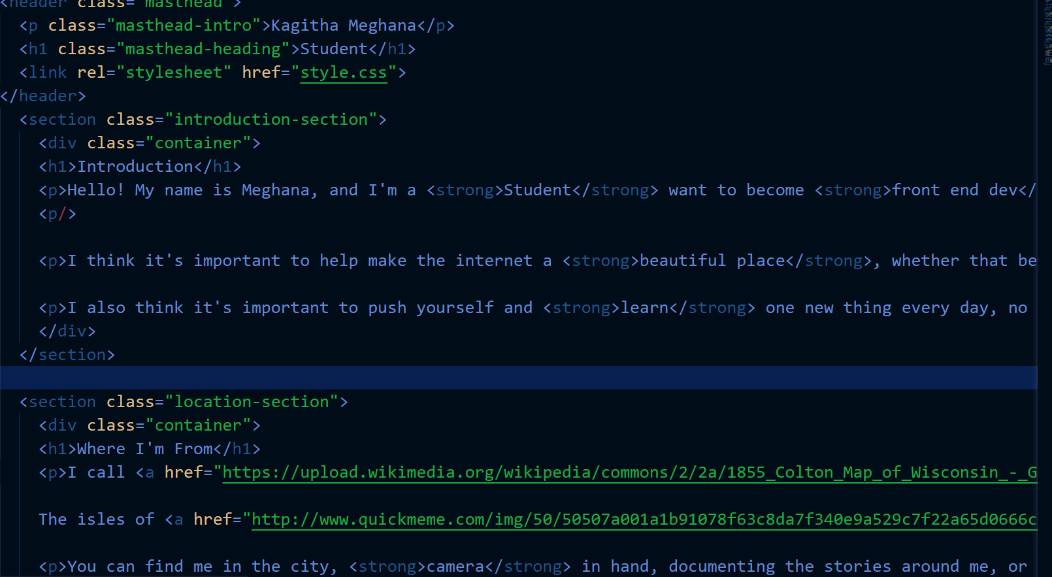
Modeliing:- Html

Slide 10
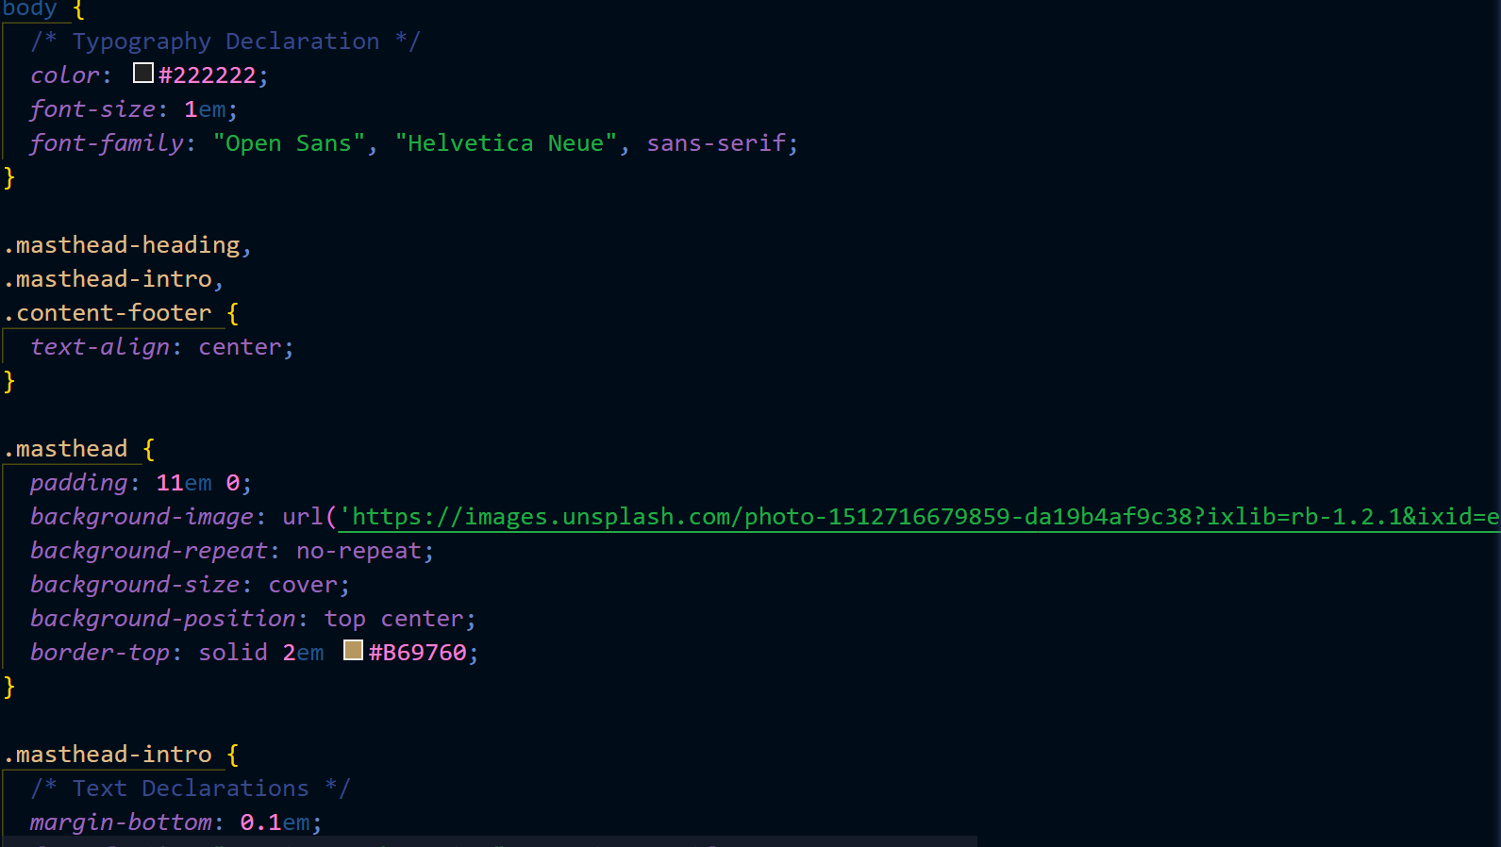
Modeliing:- CSS

Slide 11
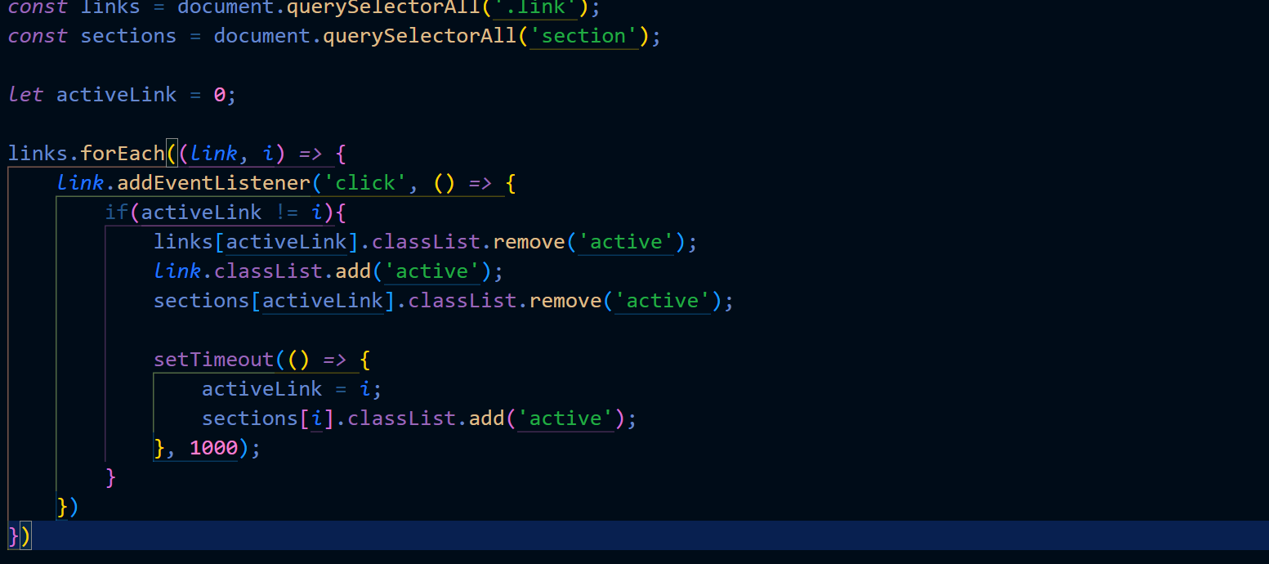
Modeliing :- JavaScript

Slide 12
LINKs:- https://github.com/MeghanaKagitha/Project
https://drive.google.com/file/d/1yGSH3wxtsxLJPwOrnHMxIuDrPO1u65Iz/view?usp=sharing

Slide 13
THANK YOU
KAGITHA MEGHANA

