Slide 1

Modeling Obesity Risk: The Role of Eating Habits and Physical Health -A machine learning approach using the UCI dataset

Slide 2
Contents
Team Introduction
Dataset Overview
Review of Previous Solutions to the Problem
Opportunities Through Business Analytics
Approach to Problem Solving: a. Data Used/Found/Derived b. Models Applied and Tested
Results Description & Process Details
Conclusion with Recommendations Based on Analysis
Business Problem & Motivation Overview

Slide 3
Team Introduction
Meghana Santhoshi Kandagatla – U41694366
Geetha Sathyasri Reddi - U28303668
Venkata Sai Kolla - U58085203
Revanth Malisetty - U28694758

Slide 4
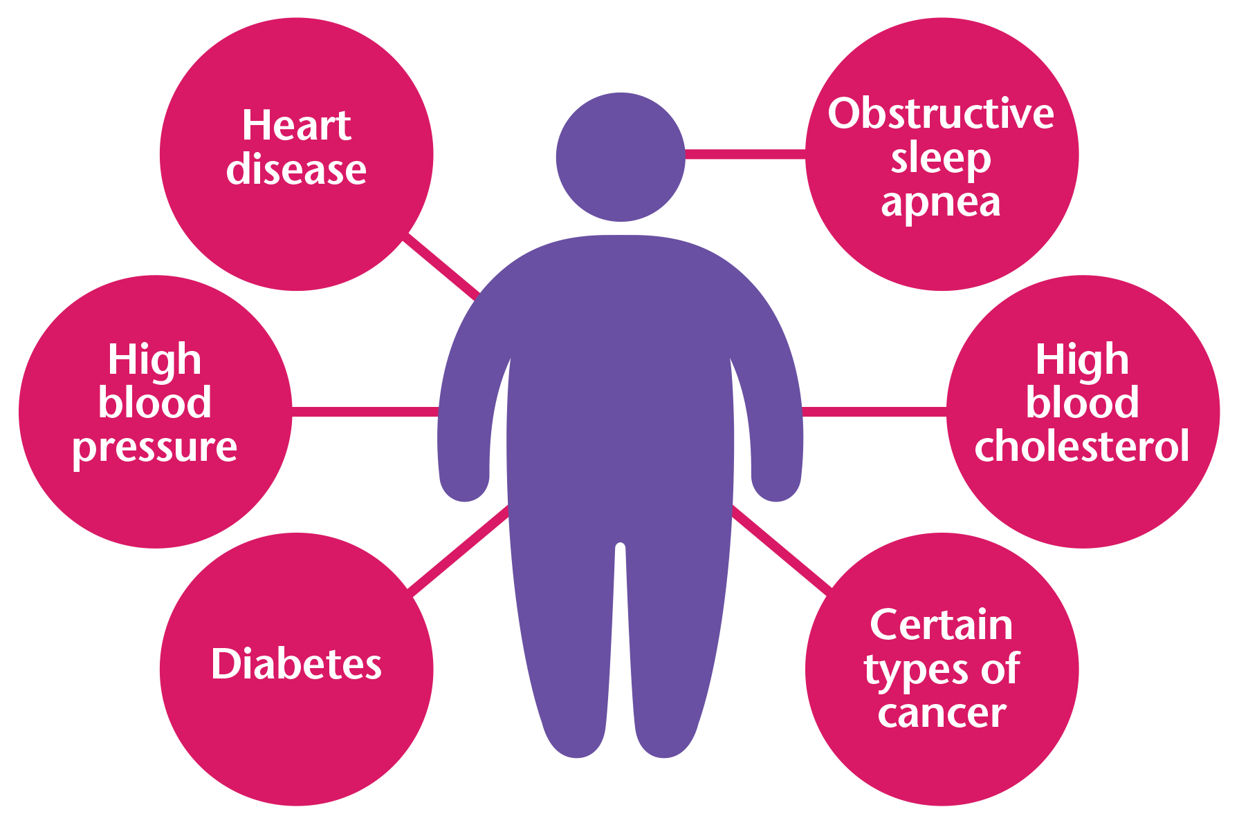
Business Problem & Motivation
Obesity is a serious health concern that can lead to various physical problems and affect a person’s overall quality of life. As awareness grows, people are becoming more interested in understanding the factors that contribute to obesity and finding ways to predict its development.
The issue is especially troubling because obesity is closely linked to cardiovascular diseases, and many developing countries are starting to see a rise in these health challenges.
Problem statement:
The main aim of this project is to create a machine learning model that can predict obesity levels by analyzing factors like eating habits, physical condition, and other lifestyle elements. This could help identify at-risk individuals and promote healthier lifestyles.

Slide 5
Why We Need Obesity Predictive Tools?
Identify at-risk individuals early for timely interventions.
Assist public health planning by analyzing obesity trends.
Reduce healthcare costs through preventive care.
Empower individuals to monitor and improve their habits.
Support research on the causes and prevention of obesity.
Address the rising global obesity epidemic with proactive strategies.
Business Context
This project leverages machine learning to predict obesity based on eating habits and physical health indicators, enabling organizations to:
Provide personalized health recommendations.
Develop targeted wellness programs.
Support preventative healthcare initiatives.

Slide 6

Dataset Overview
Dataset Overview:
It includes 17 attributes, 8 are numerical, while 9 are categorical.
Key Attributes Include:
A range of habits and characteristics, including how often people eat high-calorie foods, consume vegetables, number of main meals, and physical activity frequency.
Other factors include daily water intake, alcohol consumption, and whether they track their calorie intake.
Along with lifestyle factors like technology usage, transportation choices.
Personal demographics like gender, age, weight, height, family history of obesity, and smoking habits.

Slide 7
Review of Previous Solutions to the Problem
Obesity Risk Prediction in Indonesia:
Utilized Logistic Regression for predicting obesity in the Indonesian population.
Limitation: Lacked depth in variables, excluding crucial factors like genetics and socioeconomic influences. This limited the ability to capture the multifactorial nature of obesity.
Obesity Level Estimation Software based on Decision Trees:
Classified obesity levels based on parameters like weight and lifestyle using Decision Trees.
Limitation: Faced overfitting risks with small or imbalanced datasets. Also, Decision trees may miss complex nonlinear relationships.
Machine Learning in Dietary and Physical Activity Patterns:
Applied various models to predict obesity based on diet and physical activity.
Limitation: Faced challenges with feature selection, potentially leading to suboptimal model performance, making them less actionable for policymakers.

Slide 8
Opportunities Through Business Analytics
Proactive Interventions: By predicting obesity risks, businesses and healthcare providers can intervene early, reducing long-term health complications.
Efficient Resource Allocation: Insights from data analysis can help organizations and policymakers focus resources where they are most needed, such as high-risk demographics.
Personalized Strategies: Data-driven insights can tailor wellness programs and dietary recommendations, increasing their effectiveness.
Trend Analysis: Organizations can monitor obesity trends across various regions, demographics, and age groups, enabling better decision-making for product or service delivery.

Slide 9
Methodology
Conduct exploratory data analysis and Data preprocessing to handle outliers, missing and duplicate data.
1
Feature selection to uncover the most influential factors driving obesity levels.
2
Apply machine learning algorithms to classify obesity levels.
3
Use evaluation metrics like accuracy, precision, and recall to compare model performances.
4

Slide 10
Approach
Data
Exploratory Data Analysis
Data Preprocessing
Outlier Detection
Handling, Missing Duplicates
Renaming Columns
Feature Scaling
Encoding categorical Factors
Feature Selection Using Decision Trees
Model Implementations
Logistic Regression
K-Nearest Neighbors
Support Vector Machines
Random Forest
XGBOOST
Metrics & Comparison

Slide 11
Approach to Problem Solving
Data used/found/derived:
Source: UCI Machine Learning Repository
This dataset include data for the estimation of obesity levels in individuals from the countries of Mexico, Peru and Colombia, based on their eating habits and physical condition.
The data was gathered from a study of 2,111 participants aged between 14 and 61 years, using a survey method. It covers various factors, including diet, physical activity, and lifestyle.
The records are labelled with the class variable NObesity (Obesity Level), that allows classification of the data using the values of Insufficient Weight, Normal Weight, Overweight Level I, Overweight Level II, Obesity Type I, Obesity Type II and Obesity Type III
Among the 17 attributes, 8 are numerical (like age and weight), and 9 are categorical (such as gender and smoking status).
Implemented Feature selection using Decision Trees to identify features that are most influential in predicting the target variable which significantly increases the model’s performance.

Slide 12
B. Models chosen to apply and test
Logistic Regression: Implemented with default settings, this model uses a linear approach for classification tasks. It's efficient for binary and multiclass problems.
K-Nearest Neighbour (KNN): Configured with k = 10, this model classifies data based on the majority class of the nearest neighbors. It’s simple and effective for smaller datasets.
Support Vector Machine (SVM): Applied with the RBF kernel, it maps data into higher dimensions to handle non-linear relationships effectively.
Random Forest: Configured with 100 trees, ensuring robust performance and reduced variance through ensemble learning.
XGBoost: Configured with a learning rate of 0.3, a maximum depth of 6, and 100 estimators, balancing efficiency and accuracy with these parameters.

Slide 13
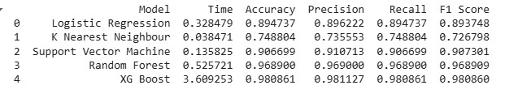
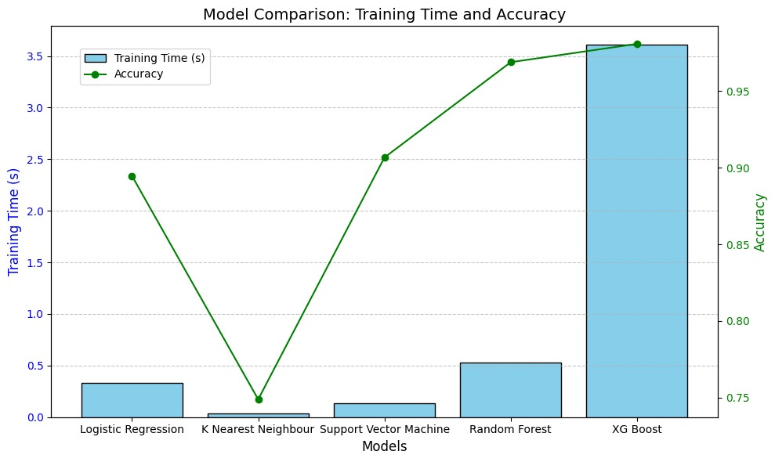
Results

Slide 14
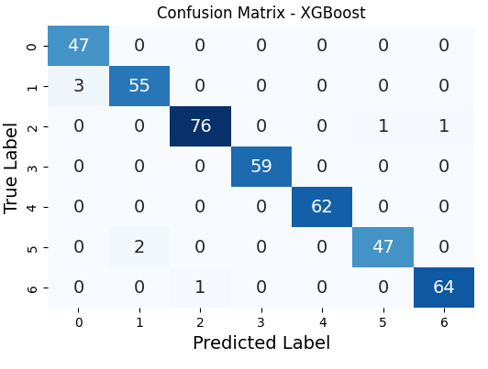
Confusion Matrix - XGBoost
Key Observations:
The confusion matrix evaluates the XGBoost model's performance across 7 obesity categories (Classes 0–6).
Class-wise Performance:
Class 0: All 47 samples correctly classified (perfect accuracy).
Class 1: 55 correct; 3 misclassified as Class 0.
Class 2: 76 correct; 2 misclassified (1 each as Class 5 and Class 6).
Class 3: 59 correct; no misclassifications.
Class 4: 62 correct; no misclassifications.
Class 5: 47 correct; 2 misclassified as Class 2.
Class 6: 64 correct; 1 misclassified as Class 2.
Insights:
High predictive accuracy for most classes, particularly Classes 0, 3, 4, and 6.
Minimal misclassification observed, primarily between neighboring classes like Class 1 and Class 0 or Class 2 and others.
Overall, the model demonstrates strong performance in distinguishing obesity levels.

Slide 15
Recommendations
1.For Maximum Accuracy:
Choose XGBoost: The clear winner in accuracy, ideal for critical tasks where prediction precision is paramount
limitation: longer training time and resource consumption.
2.For Balance Between Accuracy and Speed:
Choose Random Forest: Provides near-XGBoost accuracy with significantly less computational cost, making it suitable for a wide range of scenarios.
3.For Interpretability & Moderate Accuracy:
Choose Logistic Regression or SVM: Both models strike a balance between performance and simplicity, ideal for applications requiring interpretable models or quicker deployment.
4.For Speed with Limited Accuracy:
Choose KNN: Useful in scenarios where computational speed is critical, but its low accuracy limits its applicability.

Slide 16
Conclusion
XGBoost stands out as the most accurate model but requires more computational resources.
Random Forest is an excellent second choice, with strong performance and reasonable computation time.
Logistic Regression and SVM provide interpretable solutions with moderate accuracy and speed.
KNN, while fast, may only be considered for non-critical tasks where efficiency outweighs accuracy.
The choice of the model should align with the specific priorities of the application, such as the importance of accuracy, computational constraints, or the need for interpretability.
Through this the stakeholders across industries can adopt a proactive and personalized approach to tackle obesity, improve health outcomes, and reduce associated costs.

Slide 17

Thank you

