Slide 1
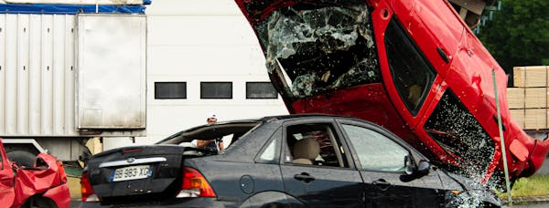
Examining Patterns and Preventive Strategies for Vehicle Crashes
Team – 11: Meghana Kota, Harshad Gupta Pasumarthy Course: ADTA 5940 – Analytics Capstone Experience Instructor: Dr. Jamie Humphries

Slide 2

Introduction
About 36,164 motor vehicle crashes occurred every day across the U.S. in 2021, according to the National Safety Council’s report of 13,200,000 crashes that year.
Motor vehicle crashes are a leading cause of serious injuries and fatalities across the globe.
Our project explores factors contributing to traffic crashes in Chicago using open-source crash data from the Chicago Police Department.
The aim is to identify key variables influencing crash severity and recommend interventions for policy makers and urban planners.
The scope includes time, location, weather conditions, vehicle actions, and road characteristics.

Slide 3





Research Questions
What factors contribute most to severe crashes in Chicago?
How do weather conditions impact the severity of crashes?
How does crash frequency vary by time of day?
Have traffic safety measures like speed limits helped reduce crash severity?
What is the effect of road lighting (daylight, dusk, darkness) on crash risk?

Slide 4





Data Description
The dataset used in this study originates from the Chicago Police Department and is published through the data.gov website, adhering to the SR1050 crash report format.
It includes detailed records of vehicle crashes reported between 2020 and 2025. The initial dataset has 540,032 rows and 48 columns
Each entry captures structured information such as location, crash time, date, weather, lighting conditions, and road characteristics.
This rich dataset enables both descriptive analysis and machine learning-based predictive modeling to uncover patterns in crash severity and inform safety interventions.
The analysis focuses on the target variable ‘MOST_SEVERE_INJURY’, a categorical field classifying crash outcomes into levels like No Injury, Non-Incapacitating Injury, Incapacitating Injury, Fatal Injury, and Reported but Not Evident Injury.

Slide 5
Literature Review
Numerous prior studies have informed the direction of our crash severity analysis in urban areas. Research has consistently shown that both human behavior and environmental conditions—such as driver experience, weather, lighting, and time of day plays significant roles in crash outcomes.
Abdel-Aty & Radwan (2000) and Chen et al. (2012) emphasized the influence of driver behavior and nighttime visibility on crash severity, which justified our inclusion of lighting and crash hour as predictive variables.
Chang & Wang (2006) demonstrated the effectiveness of using tree-based models like CART and ensemble methods, aligning with our use of Multinomial logistic regression and XGBoost classifier for pattern recognition.
Research also highlighted the limitations of police-reported data and the benefits of integrating multiple sources, which we considered when evaluating the quality of our dataset.
These insights collectively guided our feature selection and reinforced the value of using advanced machine learning techniques to uncover meaningful risk factors in crash analysis.

Slide 6
Methodology and Data Preparation
Data Cleaning & Preprocessing:
Exclusion of 2025 data due to incompleteness and high percentage of missing values.
Handling missing data:
Dropped columns with more than 5% null values.
Missing categorical values → replaced with ‘Unknown’.
Missing numeric values → imputed with mean of the respective column.
Converted categorical columns (e.g., weather, lighting) to numerical values for modeling
Checked and corrected data types (e.g., timestamps).
Applied machine learning models to predict severity outcomes (e.g., Logistic Regression and XGBoost Classifier)

Slide 7
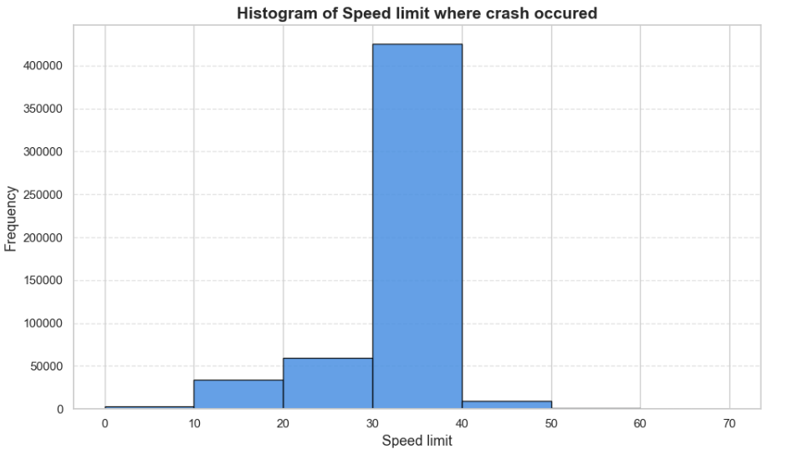
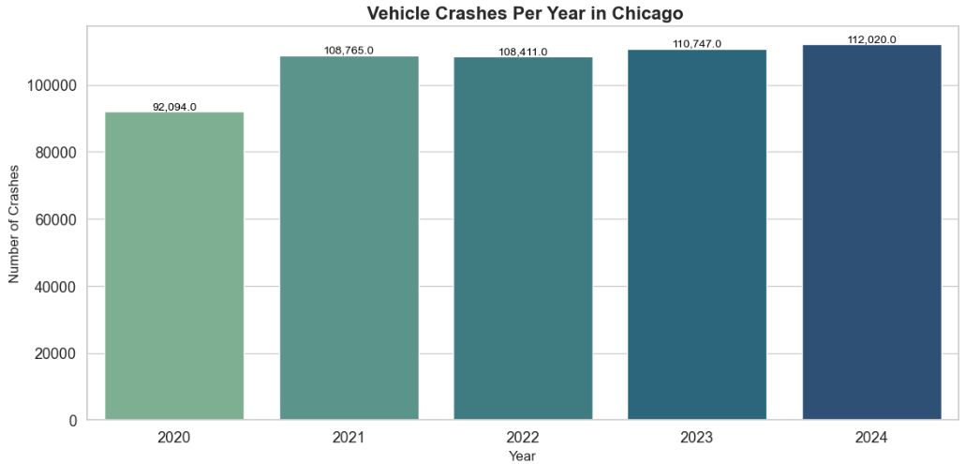
Exploratory Data Analysis
Number of Crashes Per Year (2020–2024):
Year-wise analysis shows a consistent number of crashes from 2020 to 2024
2020 recorded slightly fewer crashes, likely due to COVID-19 lockdowns
Crash volume increased steadily from 2021 onwards
Speed Limits Where Crashes Occurred:
Most crashes occurred in areas with 30–40 mph speed limits
Fewer crashes were observed at extreme speed zones (0–10 and 60–70 mph.

Slide 8
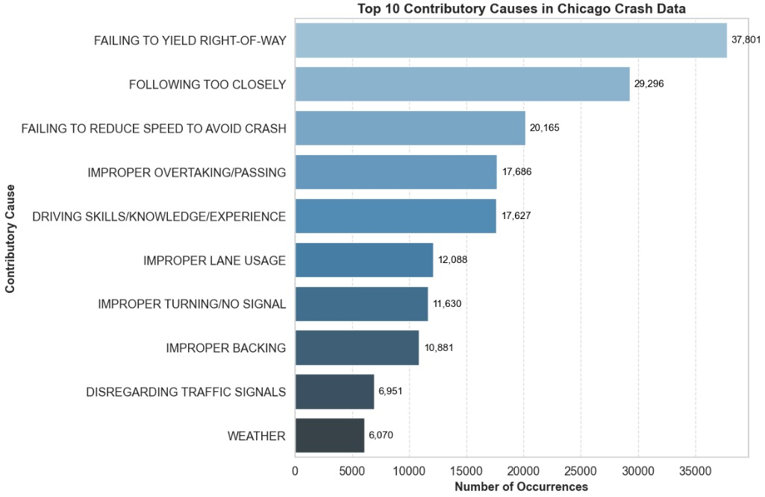
Causes of Crashes
Top causes include:
Failure to yield
Following too closely
Speeding
Improper overtaking
Distracted driving
Environmental factors like weather is less frequent

Slide 9
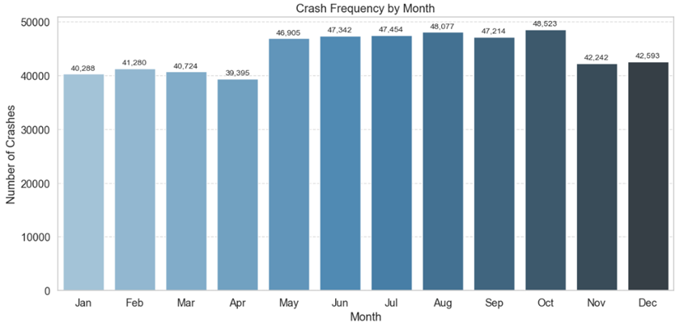
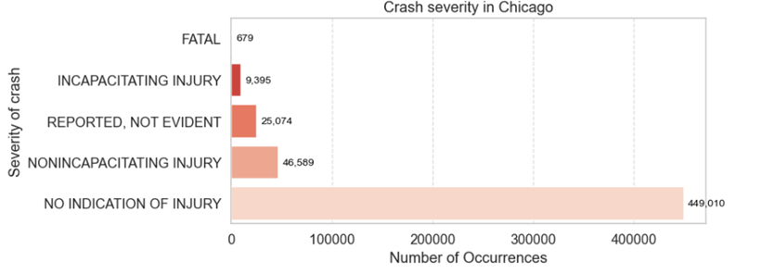
Number of Crashes by Month
Crash frequency peaks during August and October
Fewer crashes occur in February–April
Warmer months generally show higher crash volumes
Crash Severity and Number of Occurrences
Majority of crashes result in no injury
Non-incapacitating and reported (but not evident) injuries follow
Fatal and incapacitating injuries are rare but critical

Slide 10
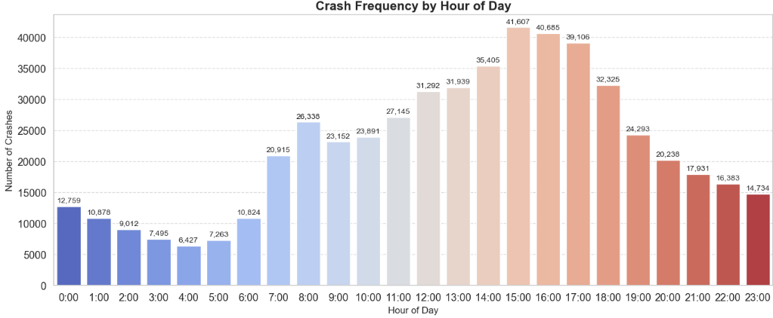
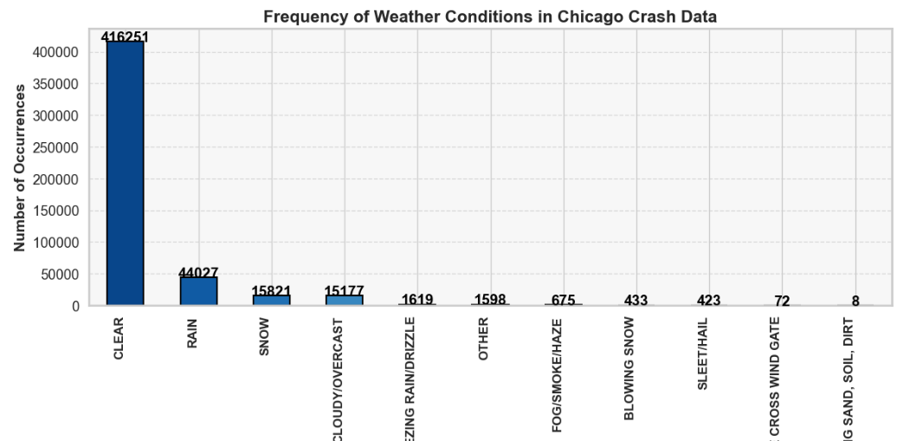
Crashes by Hour of Day
Crash rates peak between 4 PM and 6 PM.
Early mornings (12 AM–6 AM) have fewer crashes.
Correlates strongly with traffic volume during commute hours.
Weather Conditions During Crashes:
Most crashes occurred in clear weather.
Rain, snow, and drizzle account for smaller but significant crashes.
Weather alone isn't the primary factor in crash severity.

Slide 11
Modeling
Two classification models were applied to predict crash severity outcomes: 1. Multinomial Logistic Regression – A baseline interpretable model suited for multiclass classification problems. 2. XGBoost Classifier – A powerful ensemble method known for its accuracy, handling of non-linearity, and robustness against class imbalance.
To address class imbalance, SMOTE (Synthetic Minority Over-sampling Technique) was employed. Model performance was evaluated using Accuracy, Precision, Recall and F1-score.

Slide 12
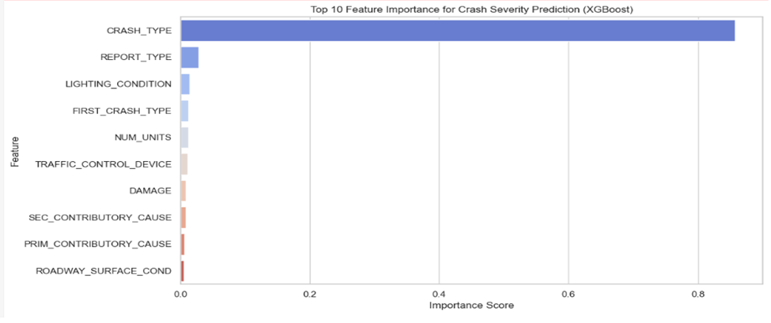
XGBoost Classifier
The XGBoost Classifier achieved strong performance with an accuracy of 72%, indicating reliable predictions across crash severity levels. Key influencing features included CRASH_TYPE, NUM_UNITS, and LIGHTING_CONDITIONS, highlighting their importance in predicting injury outcomes.
Feature Importance
Performance Metrics | Values
Accuracy | 0.72
Precision | 0.71
Recall | 0.72
F-1 score | 0.71

Slide 13
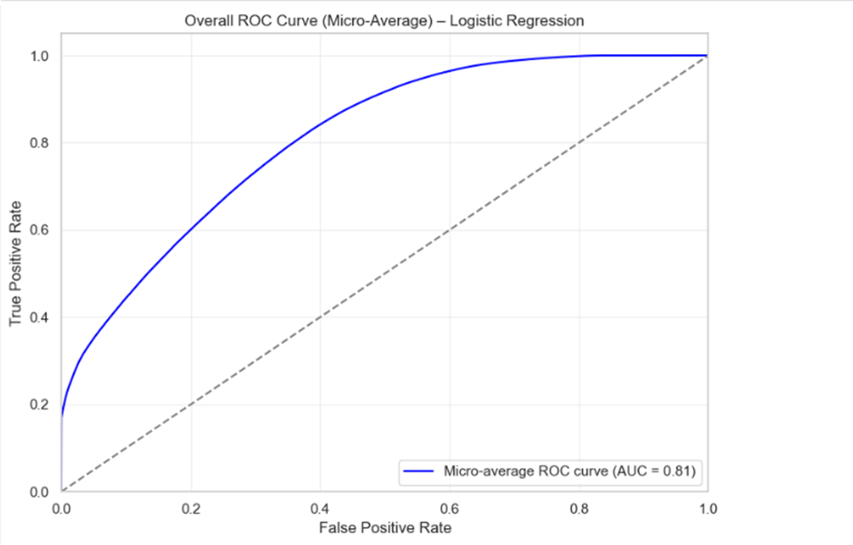
Multinomial Logistic Regression
The Multinomial Logistic Regression model achieved an accuracy of 49%, indicating moderately accurate predictions across crash severity levels. The ROC curve shows a strong micro-average AUC of 0.81, reflecting the model’s solid capability to distinguish between multiple injury classes.
Performance Metrics | Values
Accuracy | 0.49
Precision | 0.50
Recall | 0.49
F-1 score | 0.49

Slide 14
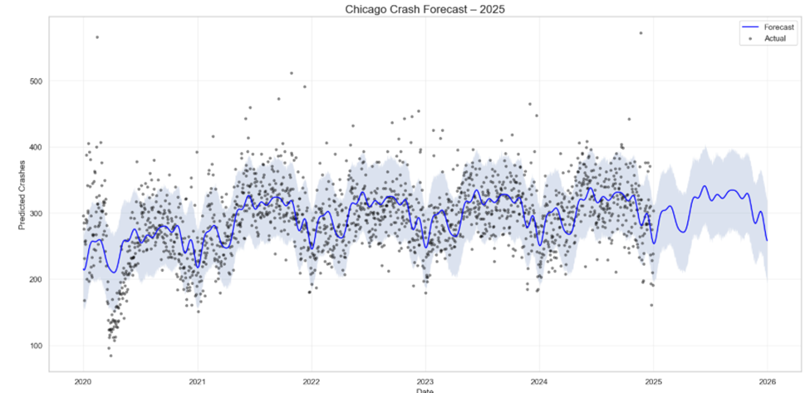
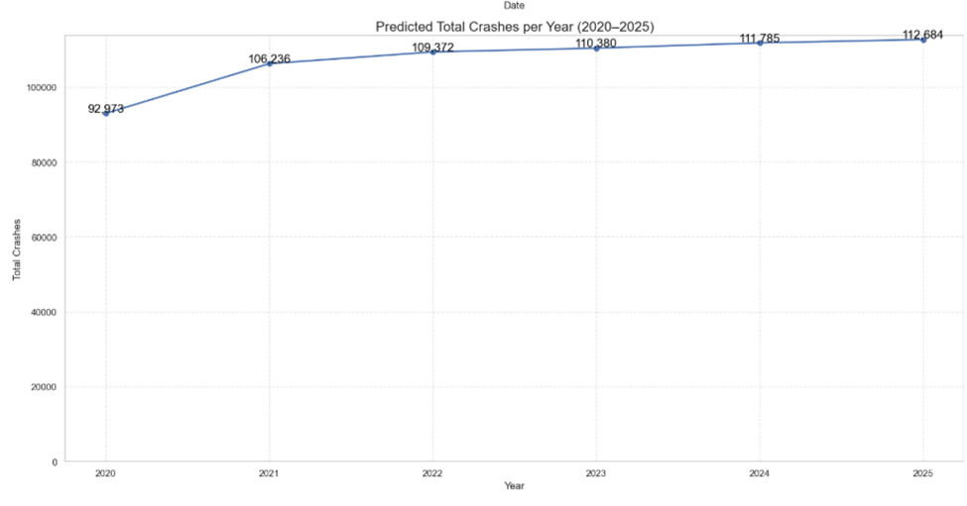
Time Series Forecasting
Forecast vs. Actual Trend
The first chart shows the forecast of traffic crashes in Chicago from 2020 to 2025.
The blue line represents the forecasted number of crashes, while the black dots indicate actual reported crashes.
The shaded area around the blue line illustrates the confidence interval, capturing forecast uncertainty.
Seasonal patterns are clearly visible, with periodic spikes and dips
Yearly Crash Totals Forecast
Crashes are projected to steadily increase from 92,973 in 2020 to 112,684 in 2025.
This 21% increase over six years highlights the growing concern for traffic safety and the importance of proactive planning and interventions.

Slide 15
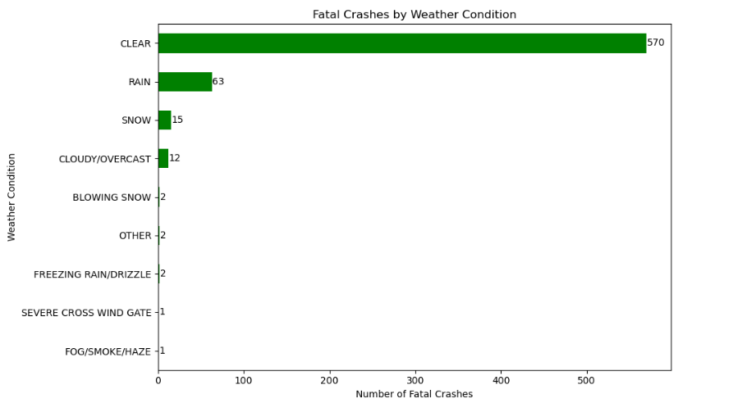
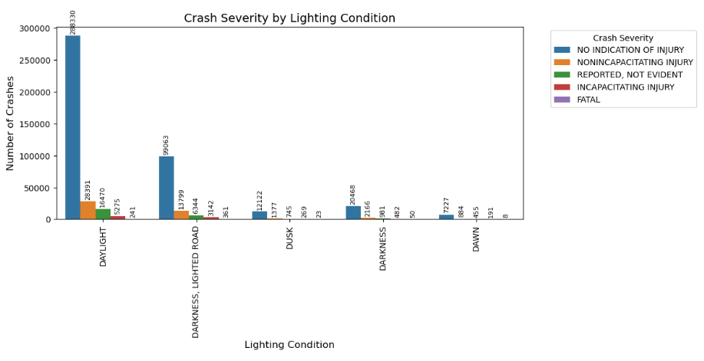
How do weather conditions and lighting conditions affect severity of crash?
Clear weather had the highest number of fatal crashes (570), suggesting high traffic volume, not just poor weather, contributes to fatalities.
Fatal crashes increase in poor lighting, especially on dark but lighted roads and during dusk/dawn.
Daylight sees the most crashes overall, but low-light conditions lead to more severe outcomes.

Slide 16
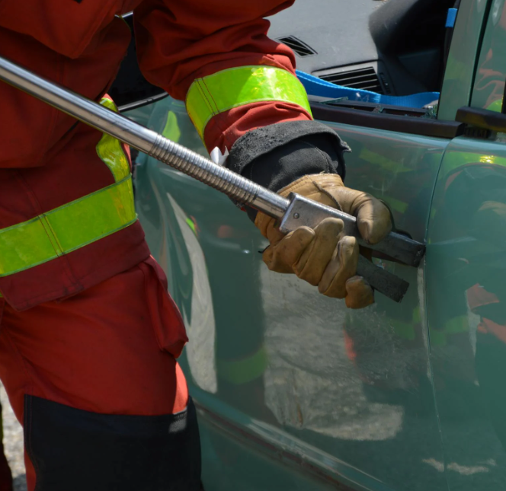
Conclusion
Our analysis revealed key factors influencing crash severity in Chicago, such as crash type, number of vehicles involved, and lighting conditions.
Among the models tested, XGBoost Classifier delivered the best overall performance with an accuracy of 72% , effectively handling class imbalance and feature interactions.
The use of SMOTE improved classification results by balancing injury class distributions.
These insights can help inform targeted traffic safety interventions and enhance data-driven decision-making for urban planning and accident prevention.

Slide 17
Limitations
Limited behavioral data: The dataset lacked variables like driver distraction, fatigue, or alcohol consumption, which are critical for understanding crash dynamics.
Imbalanced real-world class distribution: Although SMOTE was used, oversampling may not fully reflect real-world injury distributions.
Categorical encoding limitations: One-hot encoding expanded feature space significantly, potentially reducing model interpretability and increasing computational cost.
Potential reporting bias: Crash reports has inconsistencies in less severe incidents, impacting model accuracy.

Slide 18

Policy Recommendations & Future Scope
Target high-risk hours (late afternoons/evenings) with increased patrols, awareness campaigns, and smart traffic controls in hotspot zones.
Enhance road lighting, especially at intersections and poorly lit areas, to help reduce crash severity.
Adopt proper sampling methods and expand datasets to include behavioral data (e.g., from hospitals or insurance records).
Invest in real-time data technologies like traffic sensors and connected vehicles to enable dynamic, data-driven safety interventions.
Leverage predictive analytics to support proactive planning and policy decisions.

Slide 19
References
Publisher data.cityofchicago.org. (2025, March 1). City of Chicago - traffic crashes - crashes. Catalog. https://catalog.data.gov/dataset/traffic-crashes-crashes
Chang, L.-Y., & Wang, H.-W. (2006). Analysis of traffic injury severity: An application of non-
parametric classification tree techniques. Accident Analysis & Prevention, 38(5), 1019–1027.
https://doi.org/10.1016/j.aap.2006.04.009
Chen, H., Cao, L., & Logan, D. B. (2012). Analysis of Risk Factors Affecting the Severity of
Intersection Crashes by Logistic Regression. Traffic Injury Prevention, 13(3), 300–307.
https://doi.org/10.1080/15389588.2011.653841
https://www.progressive.com/lifelanes/when-do-car-accidents-happen/
Abdel-Aty, M. A., & Radwan, A. E. (2000). Modeling traffic accident occurrence and involvement. Accident Analysis & Prevention, 32(5), 633–642. https://doi.org/10.1016/S0001-4575(99)00094-9

Slide 20

Thankyou​!

