Slide 1
InternshipWeek1
Python Programming

Slide 2
Functions
Python Functions is a block of statements that return the specific task. The idea is to put some commonly or repeatedly done tasks together and make a function so that instead of writing the same code again and again for different inputs, we can do the function calls to reuse code contained in it over and over again.
Some Benefits of Using Functions
Increase Code Readability
Increase Code Reusability

Slide 3

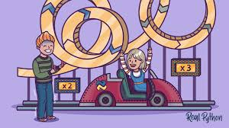

Slide 4
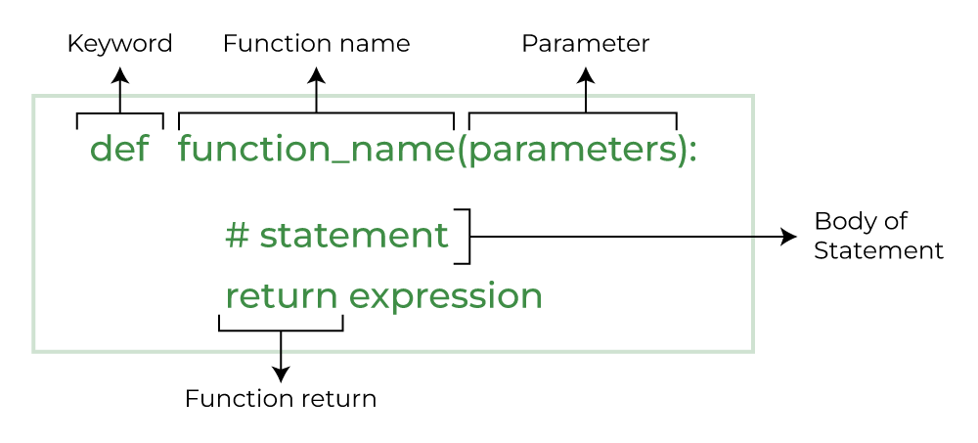
Python function declaration

Slide 5
Types of function
Built-in library function: These are Standard functions in Python that are available to use.
User-defined function: We can create our own functions based on our requirements.

Slide 6
Defining a function
You can define custom functions to provide the required functionality. Here are simple rules to define a function in Python.
Function blocks begin with the keyword def followed by the function name and parentheses ( ( ) ).
Any input parameters or arguments should be placed within these parentheses. You can also define parameters inside these parentheses.
The first statement of a function can be an optional statement; the documentation string of the function or docstring.
The code block within every function starts with a colon (:) and is indented.
The statement return [expression] exits a function, optionally passing back an expression to the caller. A return statement with no arguments is the same as return None.

Slide 7
Calling a Function
Defining a function only gives it a name, specifies the parameters that are to be included in the function and structures the blocks of code.
Once the basic structure of a function is finalized, you can execute it by calling it from another function or directly from the Python prompt.

Slide 8
Function Arguments
The process of a function often depends on certain data provided to it while calling it. While defining a function, you must give a list of variables in which the data passed to it is collected. The variables in the parentheses are called formal arguments.
When the function is called, value to each of the formal arguments must be provided. Those are called actual arguments.

Slide 9
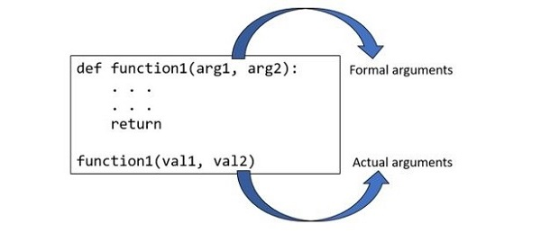

Slide 10
Types of function
Based on how the arguments are declared while defining a Python function, there are classified into the following categories −
Positional or required arguments
Keyword arguments
Default arguments
Positional-only arguments
Keyword-only arguments
Arbitrary or variable-length arguments

Slide 11
Modules
A function is a block of organized, reusable code that is used to perform a single, related action. Functions provide better modularity for your application and a high degree of code reusing.
The concept of module in Python further enhances the modularity. You can define more than one related functions together and load required functions. A module is a file containing definition of functions, classes, variables, constants or any other Python object. Contents of this file can be made available to any other program. Python has the import keyword for this purpose.

Slide 12
Built in Modules
Python's standard library comes bundled with a large number of modules. They are called built-in modules. Most of these built-in modules are written in C (as the reference implementation of Python is in C), and pre-compiled into the library. These modules pack useful functionality like system-specific OS management, disk IO, networking, etc.

Slide 13
User Defined Modules
Any text file with .py extension and containing Python code is basically a module. It can contain definitions of one or more functions, variables, constants as well as classes. Any Python object from a module can be made available to interpreter session or another Python script by import statement. A module can also include runnable code.

Slide 14
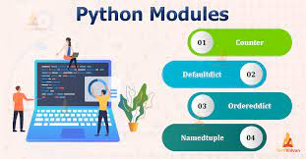

Slide 15
Data Manipulation in Python
Data manipulation with python is defined as a process in the python programming language that enables users in data organization in order to make reading or interpreting the insights from the data more structured and comprises of having better design

Slide 16
Data Manipulation using Pandas
Installing Pandas.
Creating DataFrame.
Adding data in DataFrame using Append Function.
Getting Shape and information of the data.
Getting Statistical Analysis of Data.
Dropping Columns from Data.
Dropping Rows from Data.

Slide 17
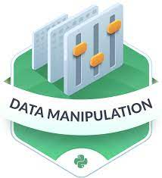

Slide 18
Thank You

