Slide 1
BOOMER(Ask me anything)
DEPARTMENT OF INFORMATION SCIENCE AND ENGINEERING
COURSE NAME:MINI PROJECT
COURSE CODE:21ISE38A
PRESENTATION BY
1.MEGHANA M(1NH21IS092)
2.S VARSHINI(1NH21IS129)
Under the guidance of
Guide name:Dr.Sivaramakrishnan
Designation:Professor

Slide 2
Agenda
Introduction
Problem definition
Objective
Design Model
Algorithm
Flow Chart
Conclusion

Slide 3
Hello!
I am Boomer
How can I help you

Slide 4
Introduction

Slide 5
objective
Virtual assistant is a remote employee who offers administrative support for you and your business . The existing systems are developed using C and C++ languages.
For example google is built with using java script and typescript in the frontend and C++ and Java and PHP in the backend.
Siri is developed using a programming language called swift but python provides an API called speech recognition to allow us to convert audio into text for the processing.

Slide 6
Problem Definition
The existing system are developed using codes like C and C++ in which we have to use many keywords and modules.
The coding for this language are not time efficient
They have to be invested with long term cost
You may need the new hardware to develop the software.
There is no flexibility and agility
There may be issues like compatibility , hidden costs and security risks.

Slide 7
Design modules
Our work started with analyzing the audio commands given by the user through the microphone . It can be anything like getting any information. The text used in this project are made by programming according to books and online resources.
It is developed using python language with minimum number of lines and simple control statements.
We have imported many python packages for voice recognition , accessing date and to communicate with users.
It is both time and cost efficient.

Slide 8
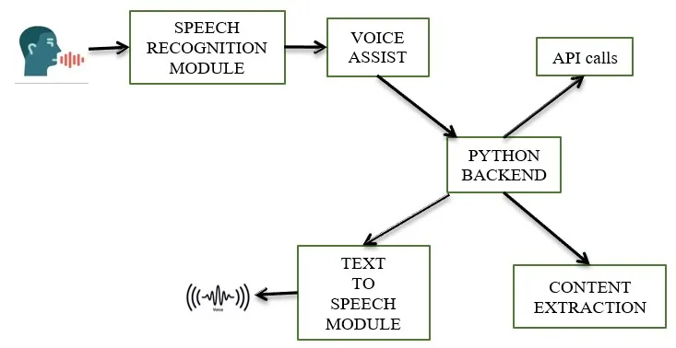
Use case diagram/flow chart

Slide 9

lOGO

Slide 10
Conclusion
In this project we discussed the design and implementation of the virtual assistant . This project is built by using open source software module with atoms backing which can accommodate any updates shortly. The modular nature of this project makes it more easy and flexible to add additional features without disturbing current system functionality.

Slide 11
Thank you

