Slide 1
SUPER BOWL LIV GAME DAY ANALYTICS

Slide 2
This year, 51 brands paid $7M per 30 second spot.
Total tweets – 1048234
Total likes count: 3466611
Total retweet count: 2700510566

Slide 3
Top 3 ads
Warner bros
Disney
Marvel

Slide 4
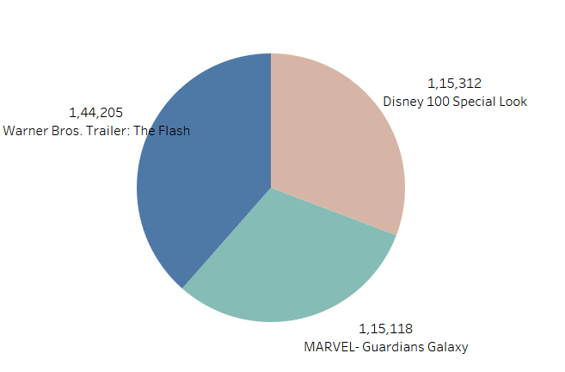
Top 3 ads

Slide 5
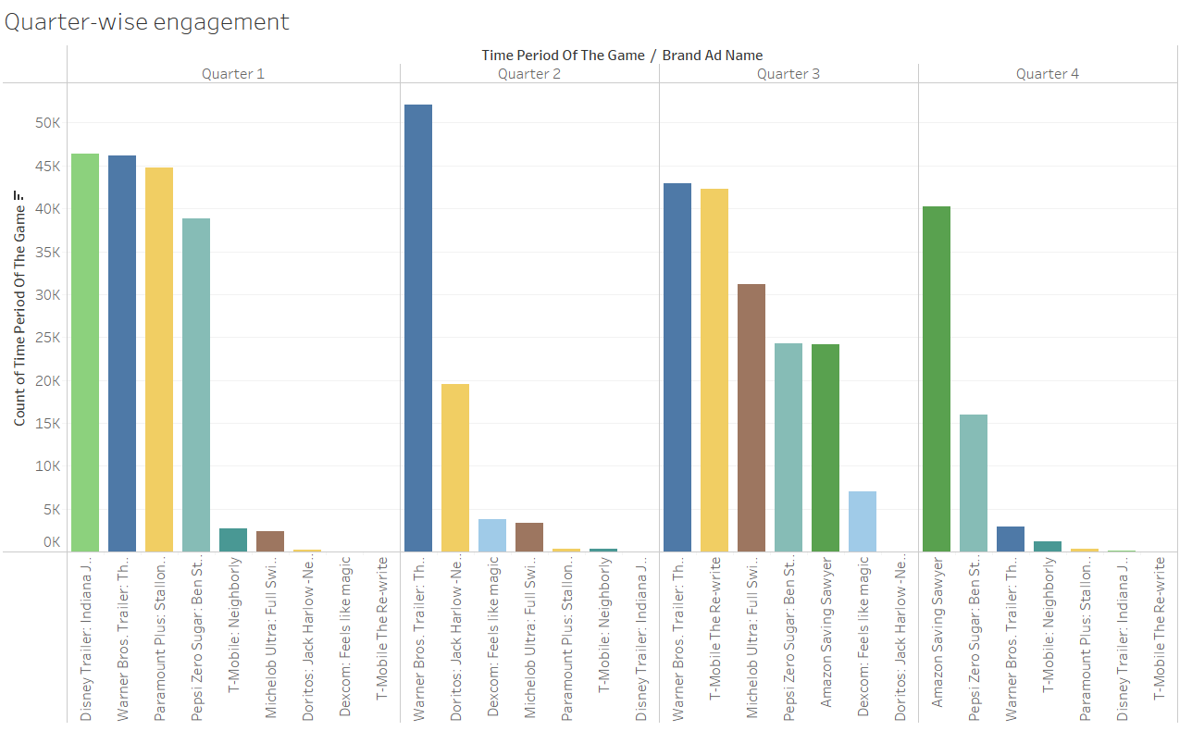
Quarter wise engagement

Slide 6
Warner bros has the highest engagement in 2 quarters

Slide 7
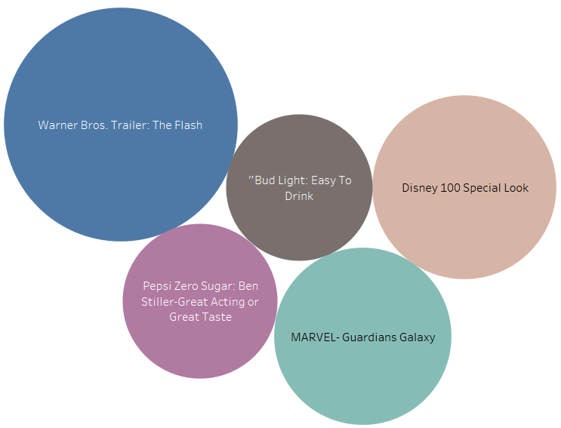
Most Quoted Brands

Slide 8
Most talked Celeb
Most talked celebs: Ben Afflleck, Aaron paul, Bryan Cranston, Alicia Silverstone, Serana Williams

Slide 9
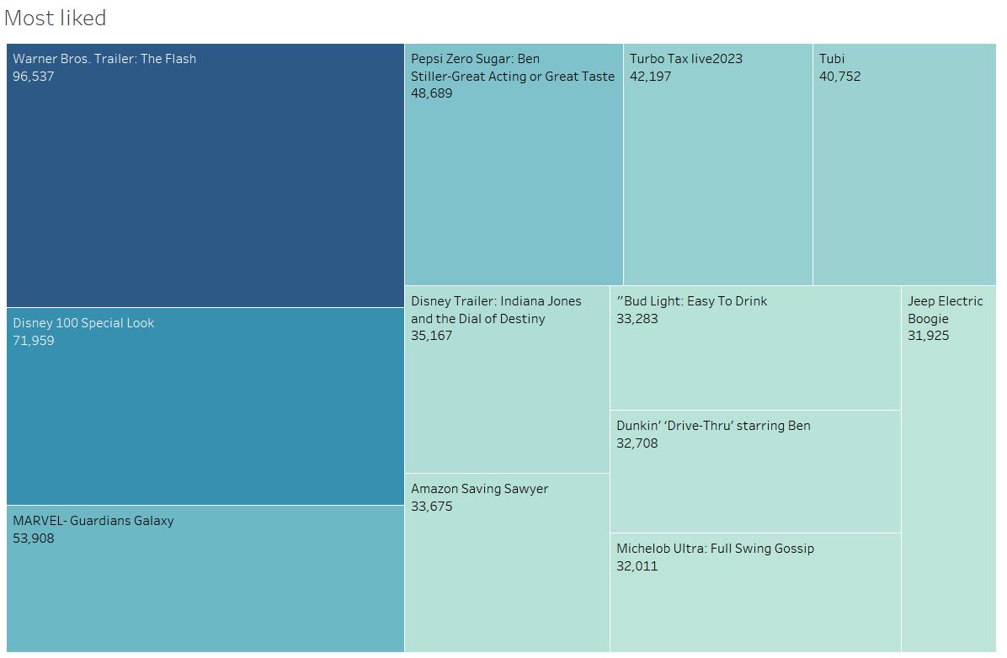
Brands with most likes

Slide 10
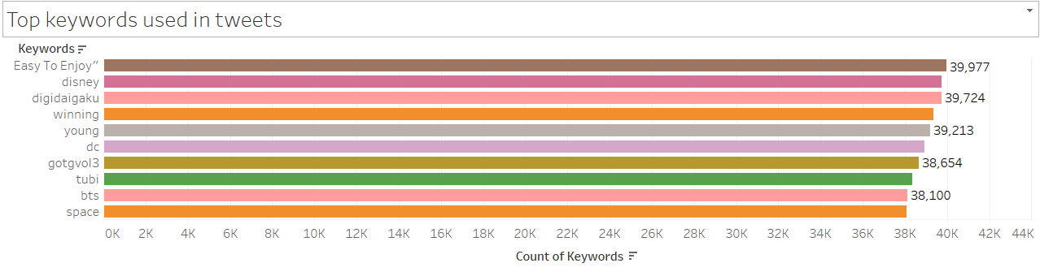
Most used keywords

