Slide 1
Data Visualization Laboratory BCS358D
Experiment No. 8
1BY22IS087- MEGHANA PURUMU
1BY22IS088- MIT D PATWA
1BY22IS089 - AAMIR

Slide 2
QUESTION
Write a python program to explain working with bokeh line graph using Annotations and Legends.
a) Write a python program for plotting different types of plots using bokeh.

Slide 3
Bokeh Library
Bokeh : Bokeh is a data visualization library in Python that provides high-performance interactive charts and plots.
Annotations: Annotations are used to highlight or label specific features on a plot. Some common types of annotations in Bokeh include :
Text Annotations
Arrow Annotations
Line Annotations
Legends
Legends are essential when you have multiple data series on a single plot. They help users identify and differentiate between different elements in the plot. Bokeh allows you to easily add legends to your plots.

Slide 4
CODE
a) from bokeh.plotting import figure, show
from bokeh.models import Label
# Importing NumPy for generating random data
import numpy as np
# Generate some random data
x_values = np.linspace(0, 10, 100)
y_values1 = np.sin(x_values)
y_values2 = np.cos(x_values)
# Create a Bokeh figure
p = figure(title='Line Graph with Annotations and Legends', x_axis_label='X-axis', y_axis_label='Y-axis’)
# Plot the first line
line1 = p.line(x_values, y_values1, line_width=2, line_color='blue', legend_label='Sin(x)')

Slide 5
CODE
a) # Plot the second line
line2 = p.line(x_values, y_values2, line_width=2, line_color='red', legend_label='Cos(x)’)
# Add annotations
annotation1 = Label(x=3, y=0.8, text='Annotation 1', text_color='green', text_font_size='10pt’)
annotation2 = Label(x=7, y=-0.8, text='Annotation 2', text_color='orange', text_font_size='10pt’)
p.add_layout(annotation1)
p.add_layout(annotation2)
# Add a legend
p.legend.location = 'top_left’
p.legend.title = 'Legend’
p.legend.label_text_font_size = '10pt’
# Show the plot show(p)

Slide 6
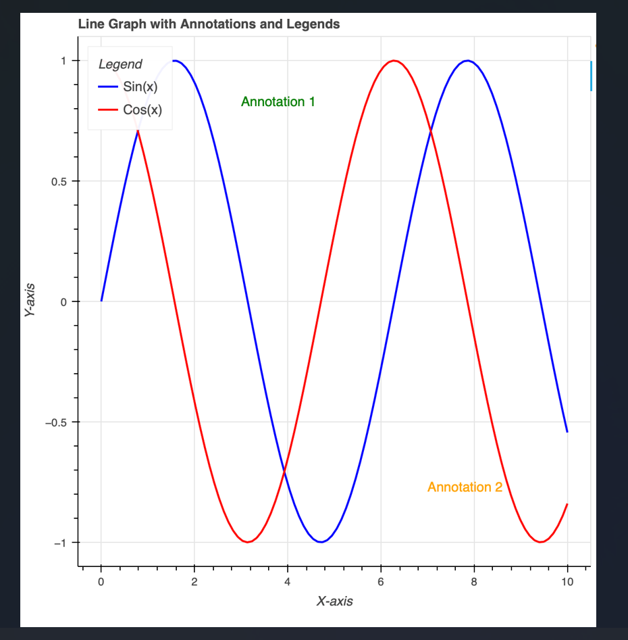
//Output

Slide 7
CODE
from bokeh.plotting import figure, show
from bokeh.io import output_file
from bokeh.models import Label
from bokeh.layouts import gridplot
import numpy as np
# Create a Bokeh output fileoutput_file("bokeh_plots.html")
# Generate some sample data
x_values = np.linspace(0, 10, 100)
y_values = np.sin(x_values)
# Create a Bokeh figure for Scatter Plot
scatter_plot = figure(title='Scatter Plot', x_axis_label='X-axis', y_axis_label='Y-axis’)
scatter_plot.circle(x_values, y_values, size=8, color='green', alpha=0.6)

Slide 8
CODE
# Create a Bokeh figure for Bar Plot
categories = ['Category A', 'Category B', 'Category C’]
bar_plot = figure(x_range=categories, title='Bar Plot', x_axis_label='Categories',y_axis_label='Values’)
bar_plot.vbar(x=categories, top=[3, 5, 2], width=0.8, color='orange’)
# Create a Bokeh figure for Histogram
histogram_plot = figure(title='Histogram', x_axis_label='Values', y_axis_label='Frequency’)
histogram_plot.quad(top=np.histogram(y_values, bins=20)[0], bottom=0, left=np.histogram(y_values, bins=20)[1][:-1], right=np.histogram(y_values, bins=20)[1][1:], fill_color="purple", line_color="black")

Slide 9
CODE
# Add annotations
annotation = Label(x=7, y=0.8, text='Annotation', text_color = 'red', text_font_size = '10pt')line_plot.add_layout(annotation)
# Combine plots into a grid layout
plots = [[scatter_plot], [bar_plot, histogram_plot]]
grid = gridplot(plots, sizing_mode='stretch_both’)
# Show the grid layout
show(grid)

Slide 10
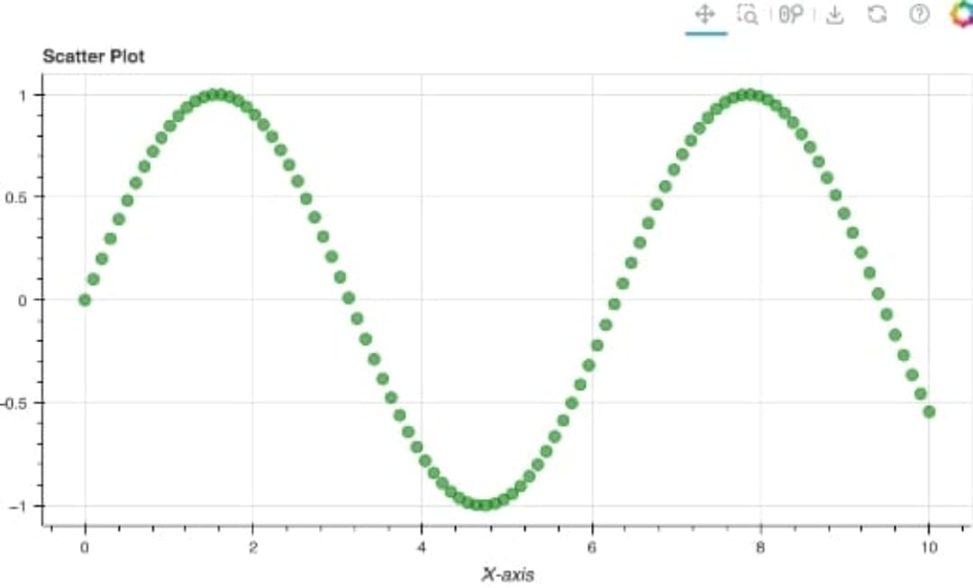
//output

Slide 11
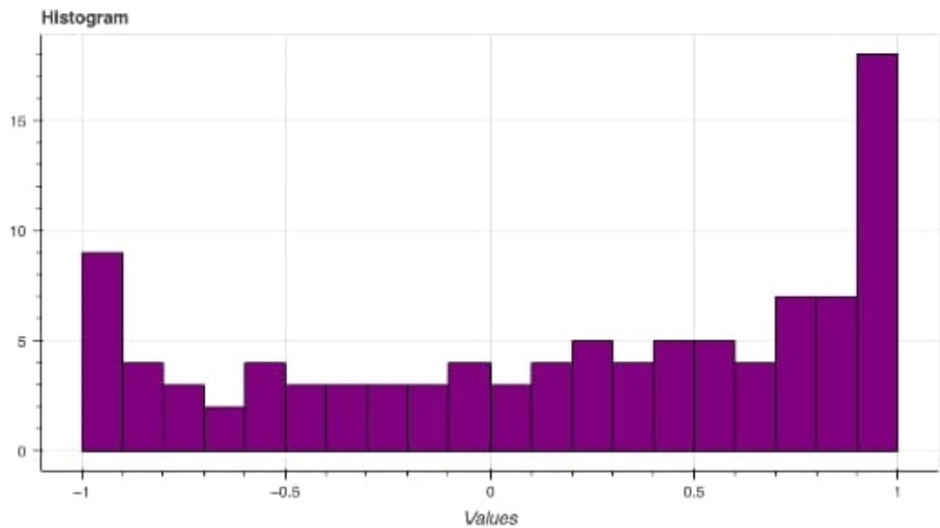
//output

Slide 12
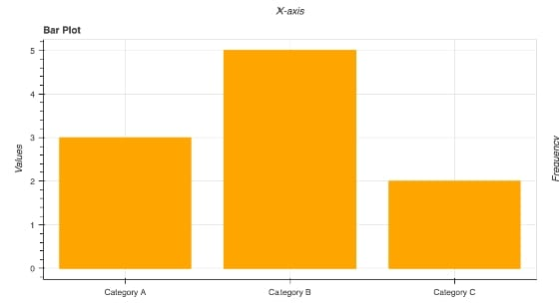
//output

Slide 13
APPLICATIONS
Data Visualization:
Custom Web Applications
Network Graphs
Machine Learning Model Visualization

Slide 14
THANK YOU

