Slide 1
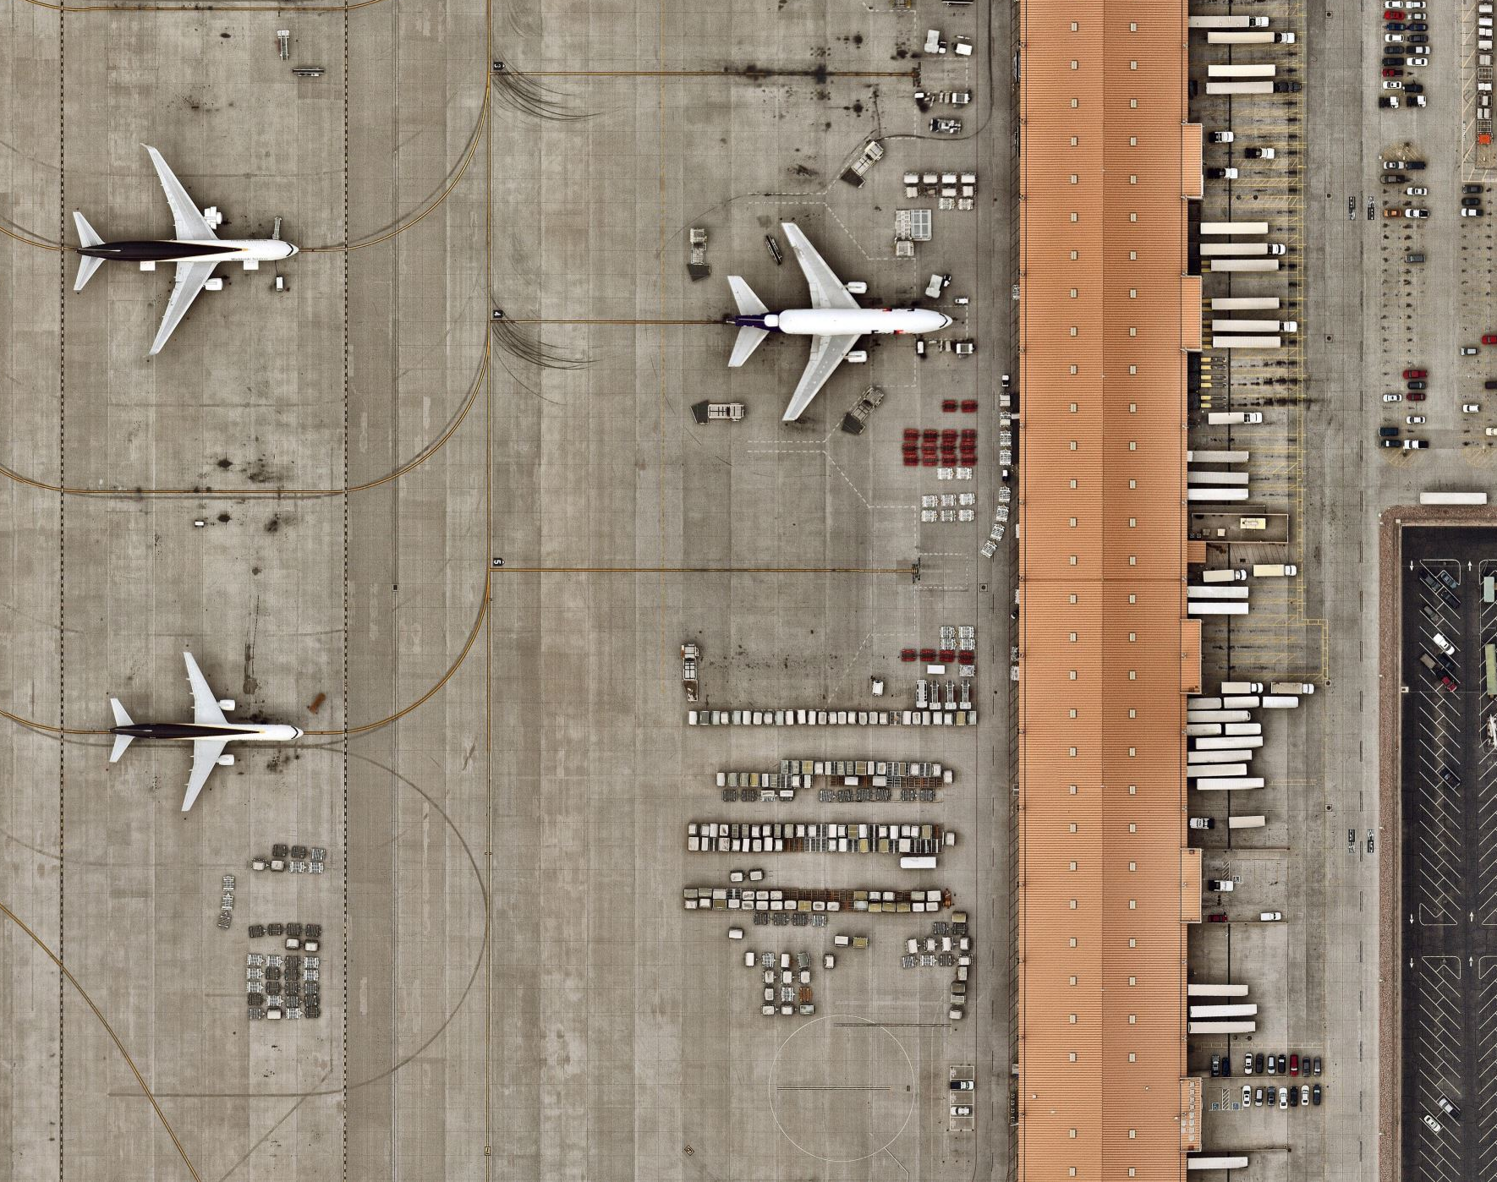
AIRPORT MANAGEMENT SYSTEM

Slide 2
Contents
Introduction
ER Diagram
Technologies Used
Flow of Airport Management System
Conclusion
Future Work

Slide 3
Introduction
Airport Management System maintains the information related to airplanes and employees working in the airport
Shows the list of employees, untested airplanes, and technicians who have worked less than five hours
Allows the admin to add new airplanes and remove any employees

Slide 4
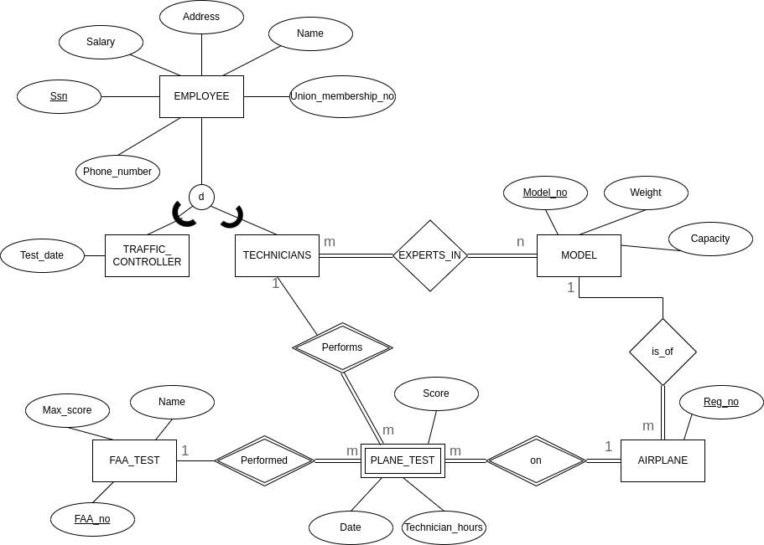
ER-Diagram

Slide 5
Technologies
Programming Language: JavaScript
Front end: HTML, CSS, Bootstrap
Database: MySql
DB Connector: “mysql2” node module
Framework: Node.js, ExpressJS

Slide 6
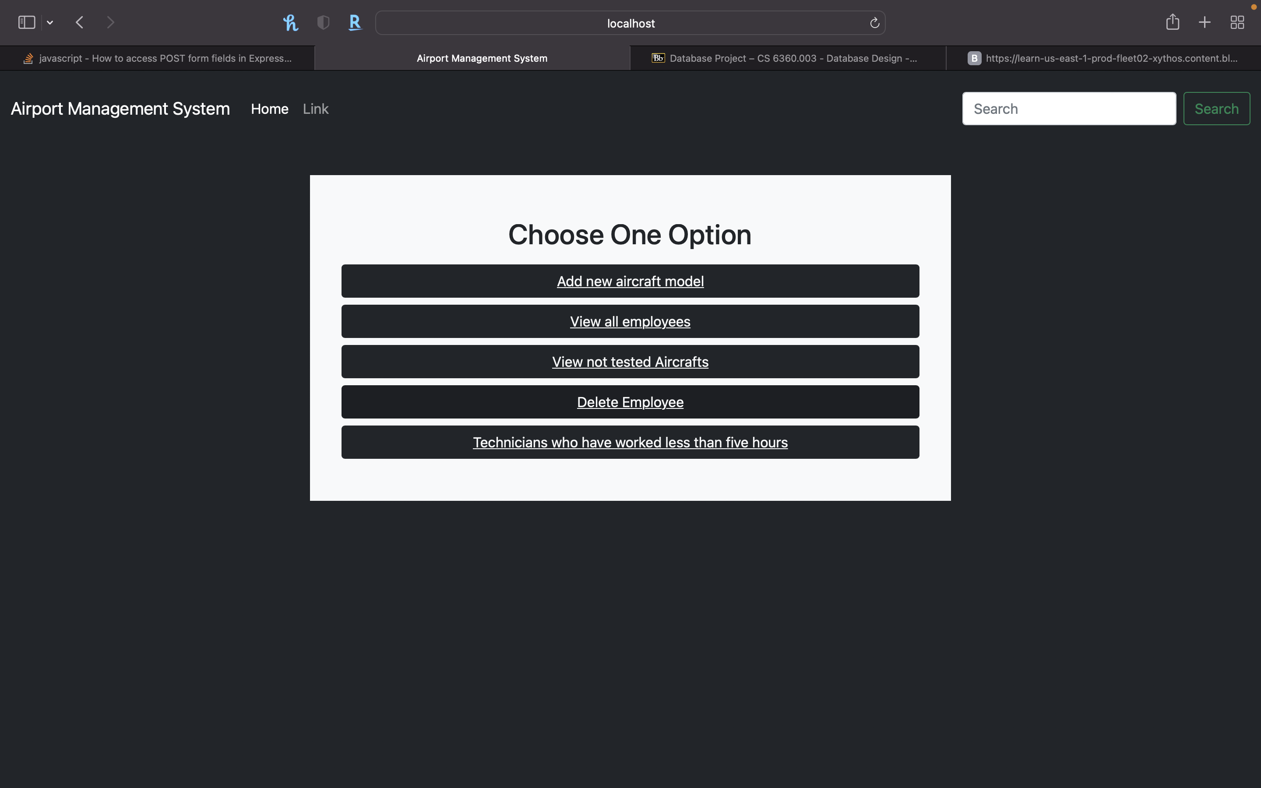
Flow Of Airport Management System
Home Page

Slide 7
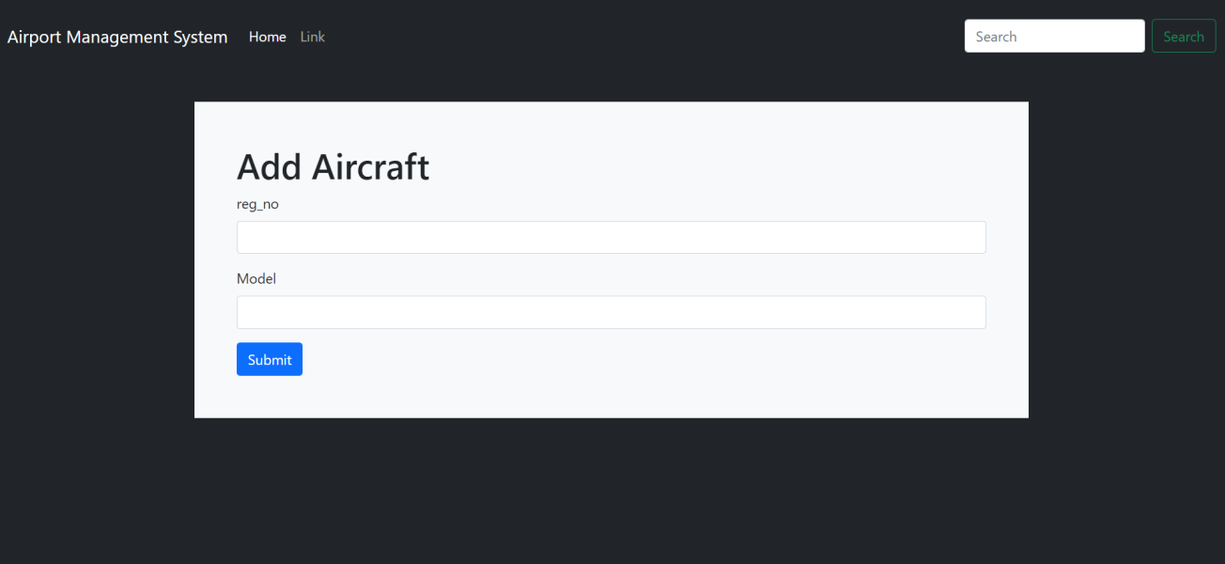
Flow Of Airport Management System
Add New Airplane

Slide 8
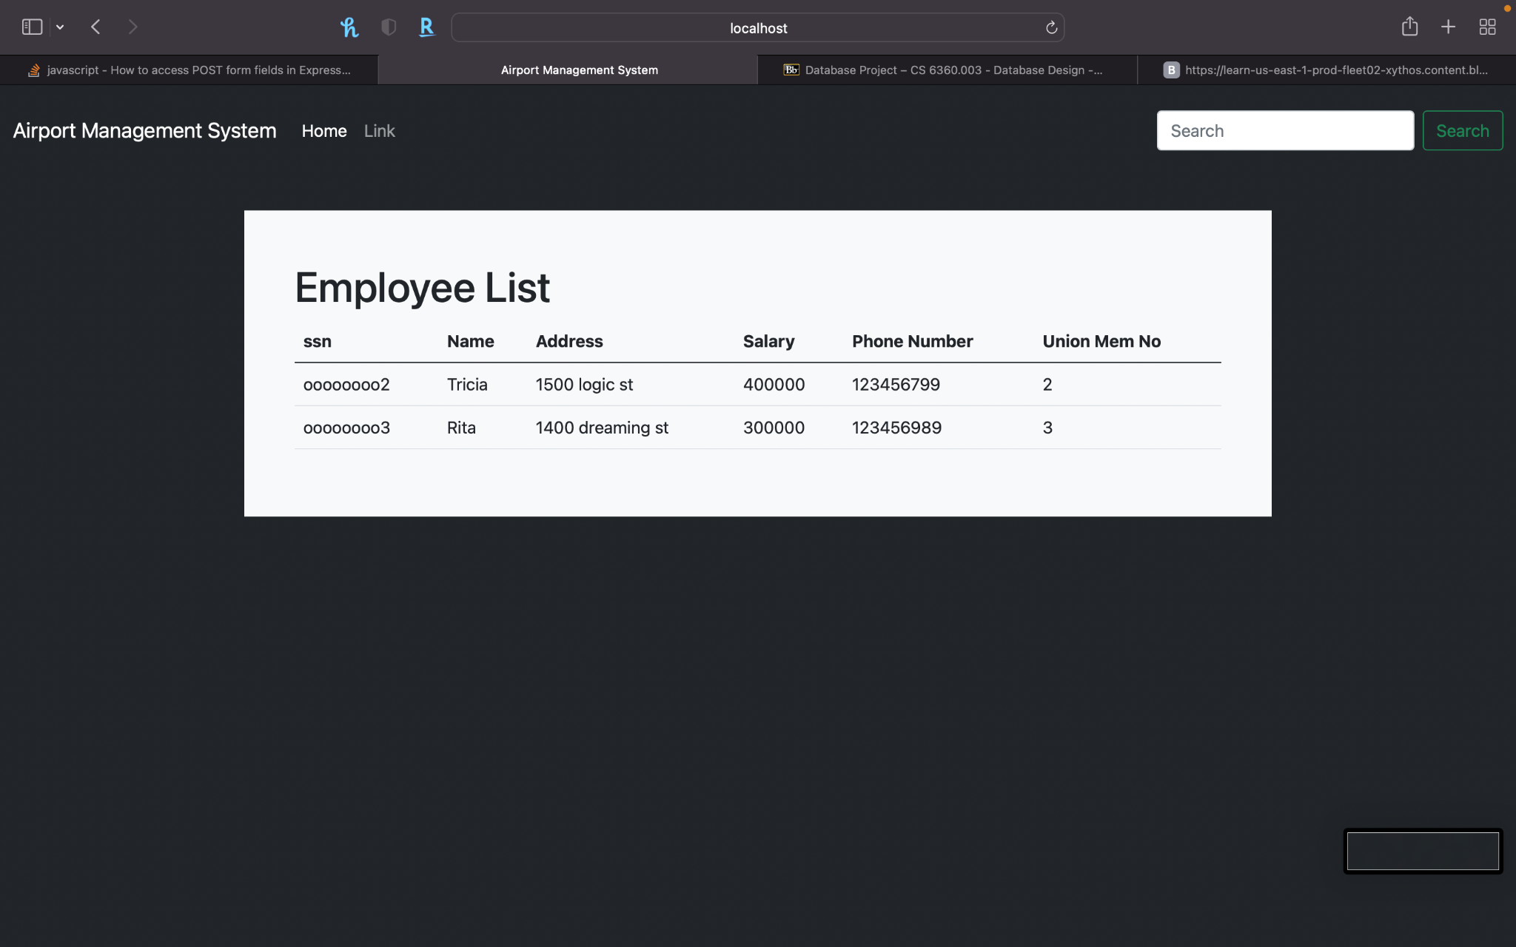
Flow Of Airport Management System
Employee Page

Slide 9
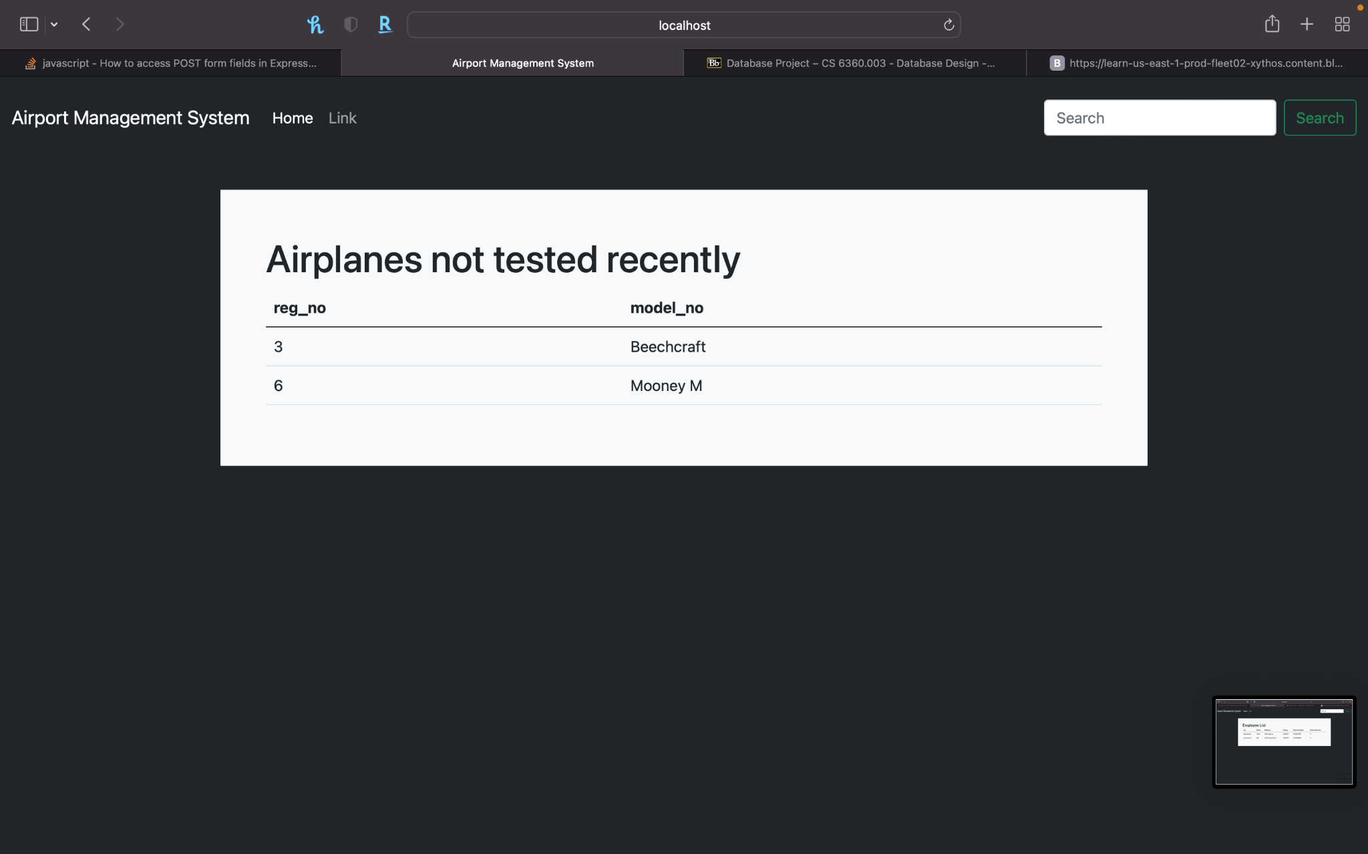
Flow Of Airport Management System
Airplanes not tested recently

Slide 10
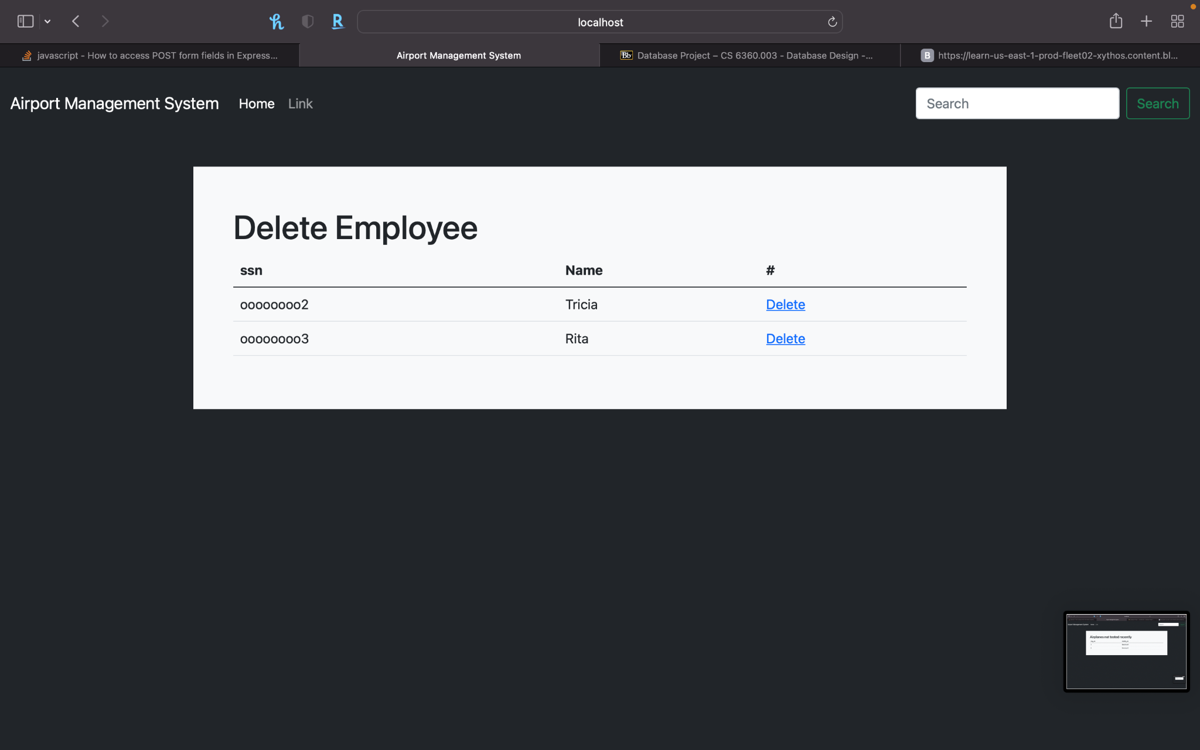
Flow Of Airport Management System
Remove Employees

Slide 11
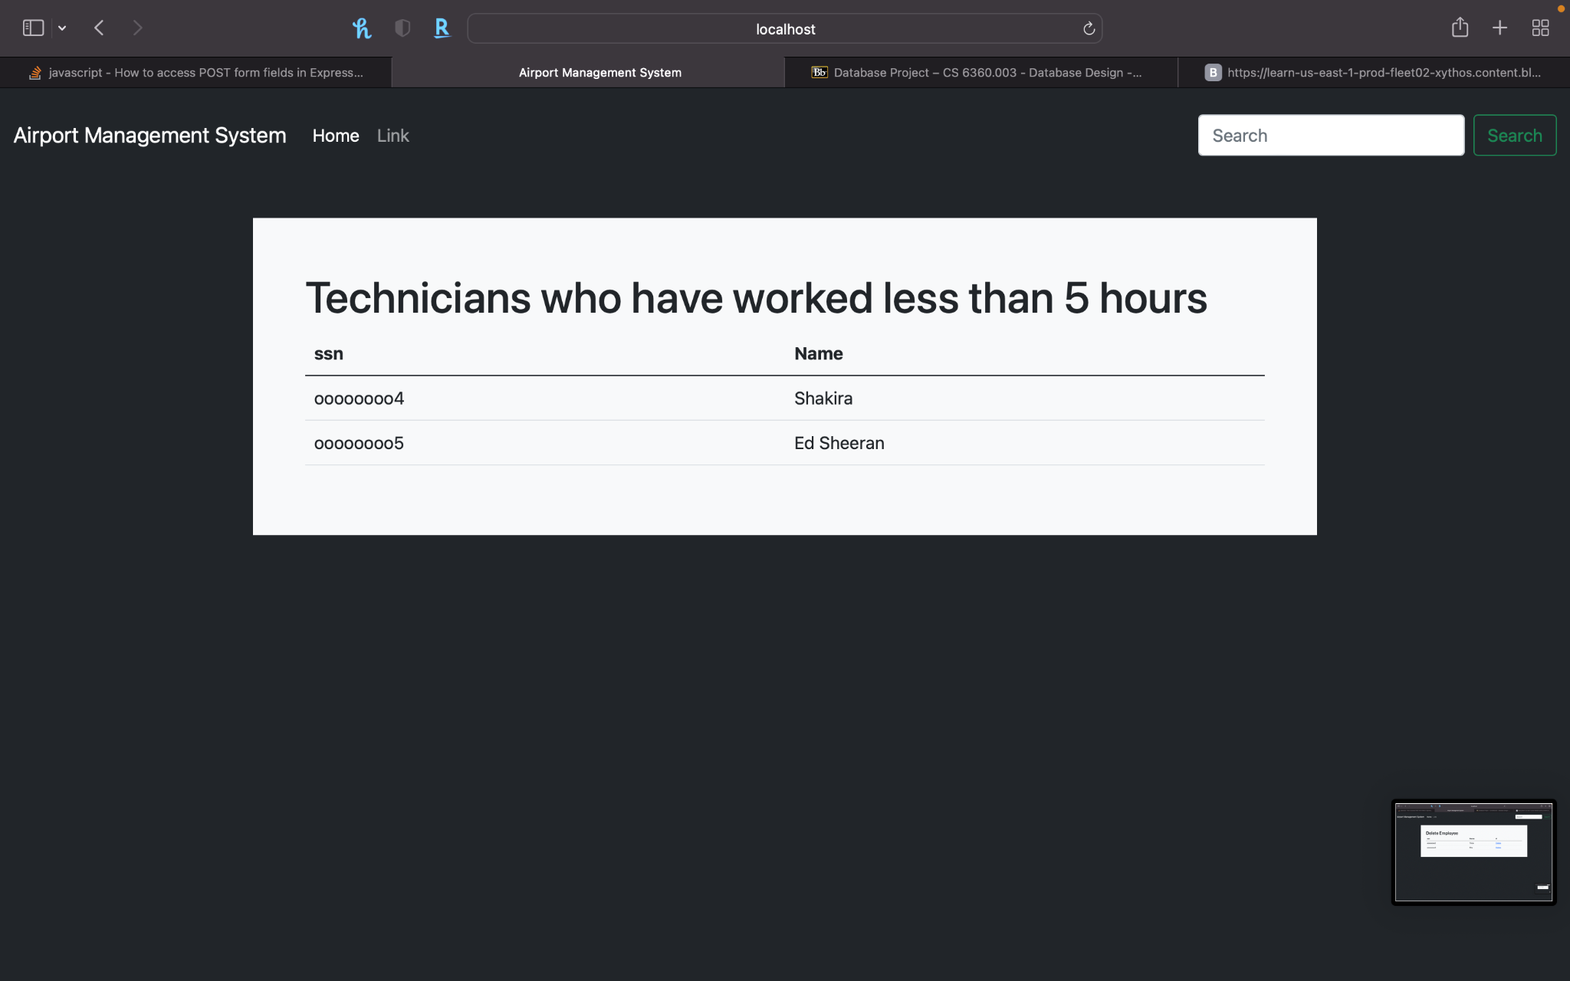
Flow Of Airport Management System
Technicians worked less than 5 hours

Slide 12
Conclusion
Efficient mechanism to store and organize data than spreadsheets
Allows for a centralized facility that can easily be modified and quickly shared among multiple users
Having a web based front end removes the requirement of users having to understand a database and allows users to connect from anywhere with an internet connection and a basic web browser
Reduces human intervention in storing the records of items and provides a secure way of data storage by reducing the errors

Slide 13
Future work
For future work, the system can be further implemented to enable more functions, the database can be extended to support commercial aspects of the airport, login, airlines
On the user side it can be extended for login and other controls, more functionality can be added to enable user role specific functions, access to the functionality, security

Slide 14

Thank you

