Slide 1
Go Application Overview
Group-A

Slide 2
Overview of Go-Based Web Service
The Go application serves a web page displaying student information .
It randomly selects a student from a predefined list and generates unique contact details.
The information is displayed in a styled HTML format, and the server listens on port.

Slide 3
How Our Go Application Works?
Application Overview:
Serves a web page with student information.
Displays student’s ID, name, email, and phone number.
Key Features and Functionality:
Randomly selects a student from a predefined list.
Generates unique contact details for the selected student.
Uses http.ListenAndServe to start the server on port.

Slide 4
Local Execution of the Go Application
Open main.go in VSCode.
Run go run main.go in the Terminal.
Navigate to http://localhost:8080 in your browser.

Slide 5
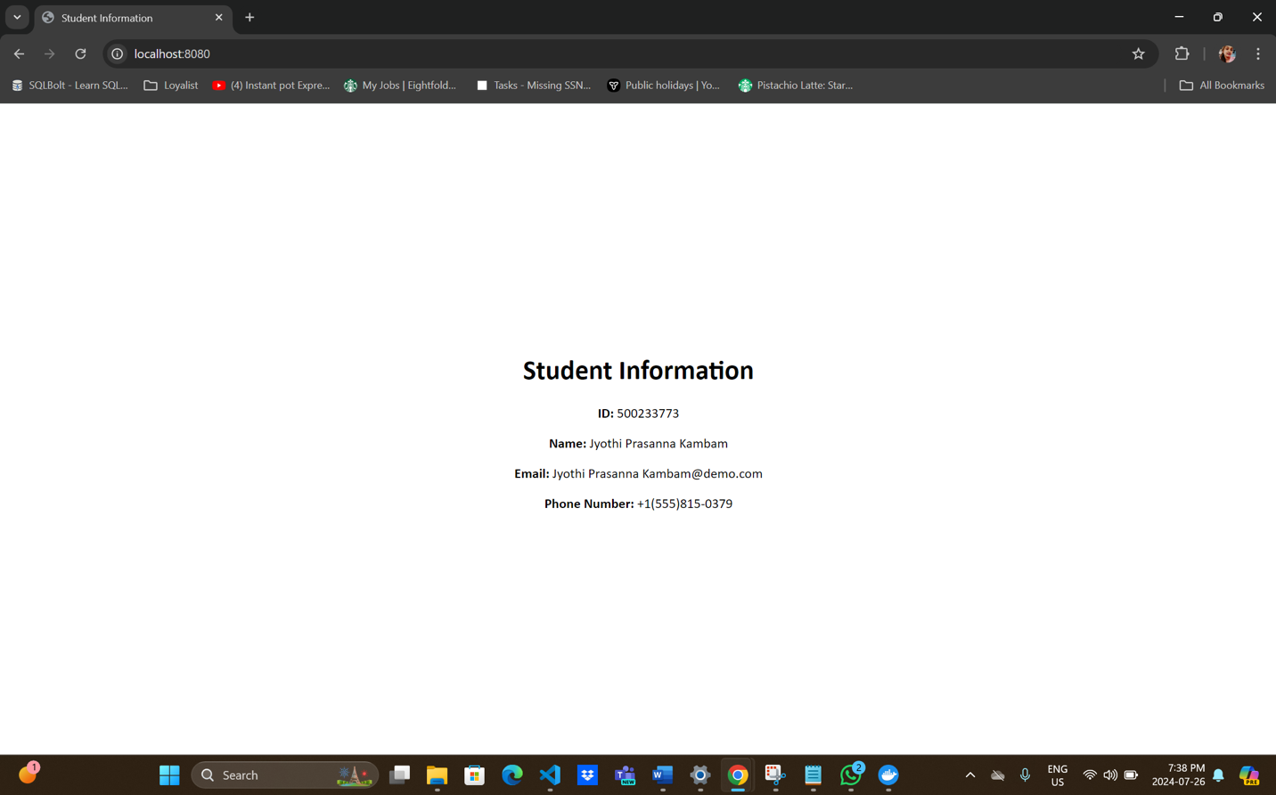
Snapshot of the Local Application

Slide 6
Docker Image Build Steps
Commands to Build and Push the Docker Image
Build the Image: docker build -t saimeghana1/go-hostname-app:latest
Run the Container: docker run -d -p 8081:8080 saimeghana1/go-hostname-app:latest
Push to Docker Hub: docker push saimeghana1/go-hostname-app:latest
Verify Upload: Check the Docker Hub repository.

Slide 7
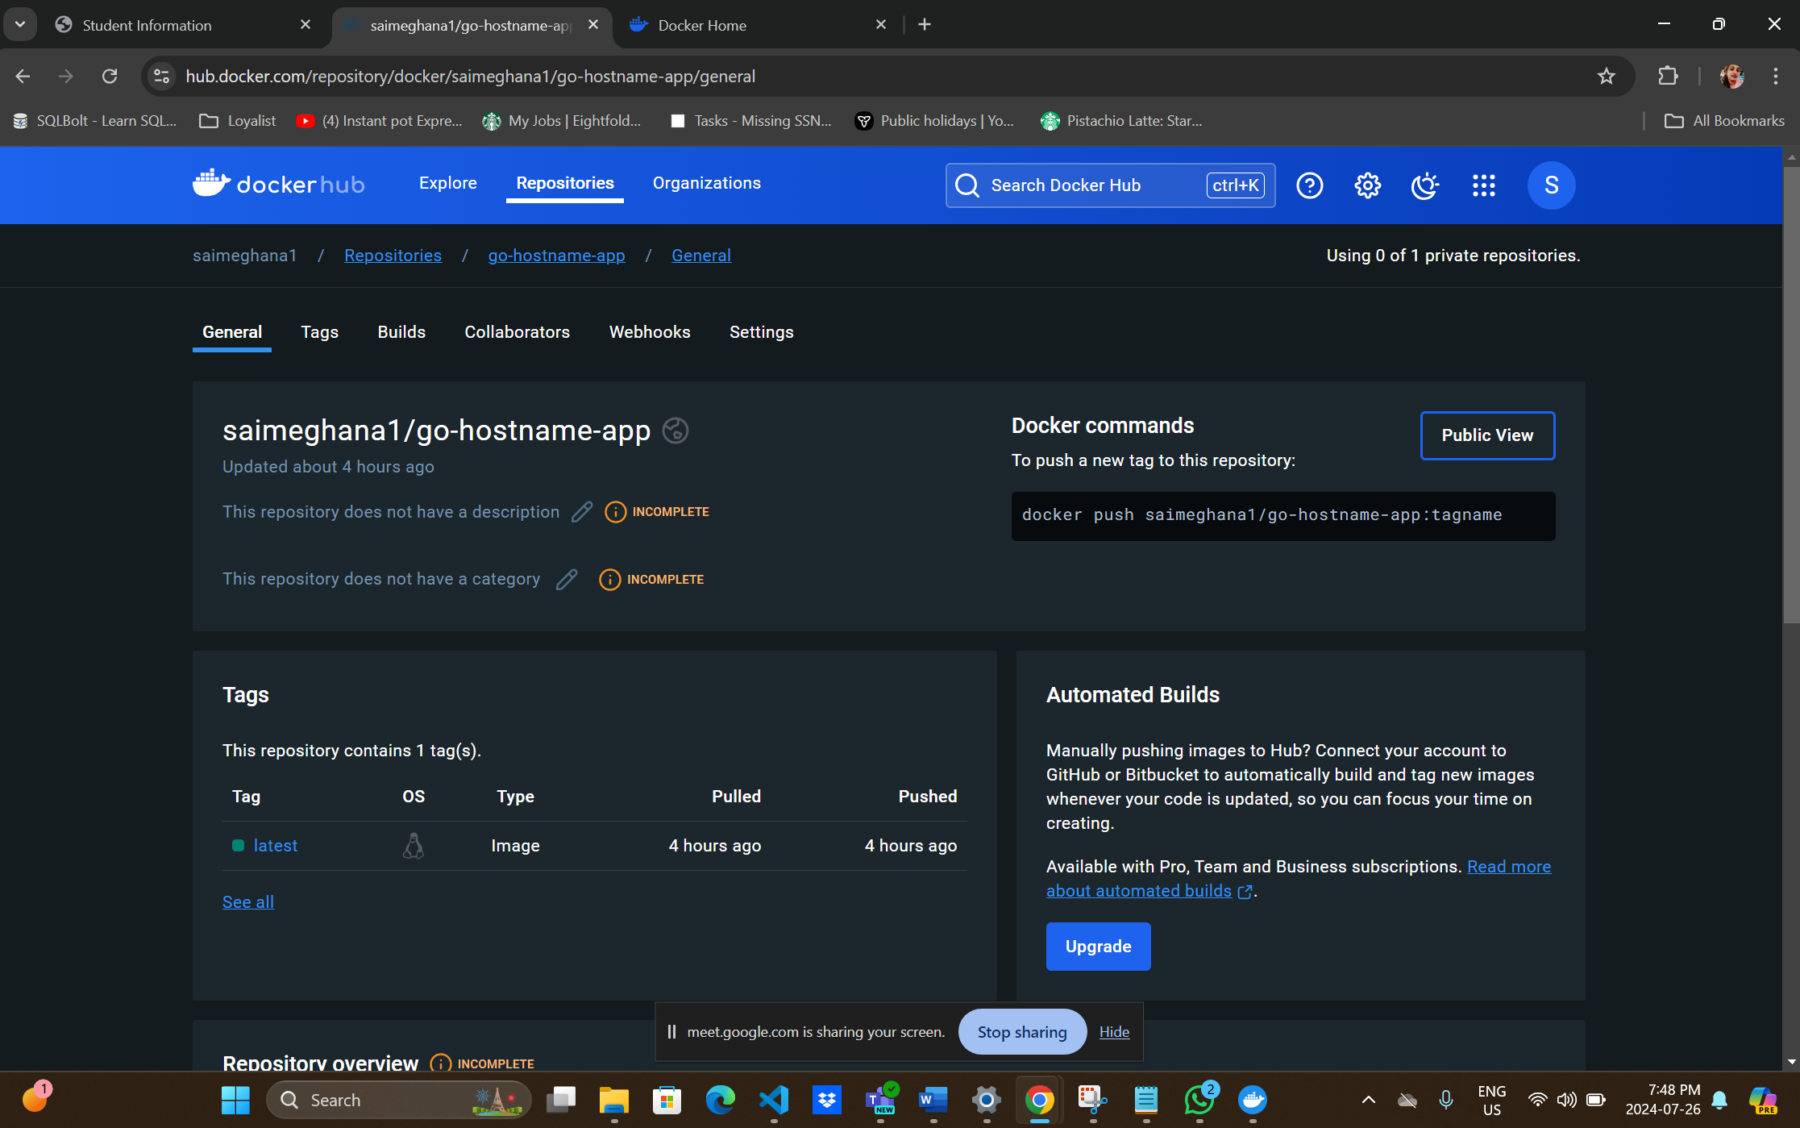
Repository Status on Docker Hub

Slide 8
Azure VM Creation and Configuration
Create a Debian-Based VM
1. Log in to Azure Portal.
2. Go to “Virtual machines” and click “Add”.
3. Enter VM details:
• Choose subscription, resource group, and region.
• Select “Debian” image and VM size.
• Set authentication to “Password” and enter credentials.
4. Configure disks, networking, and ports
Allow: Port 22 (SSH),Port 80 (HTTP),Port 443 (HTTPS)
5. Review and create the VM.

Slide 9
Swarm Deployment Steps
Initialize Swarm Mode : sudo docker swarm init
Create and Deploy Service :
sudo docker service create --name myservice --publish 8081:8080 --replicas 4 saimeghana1/go-hostname-app:latest
Monitor Deployment:
Visit http://4.248.12.230:8081/

Slide 10
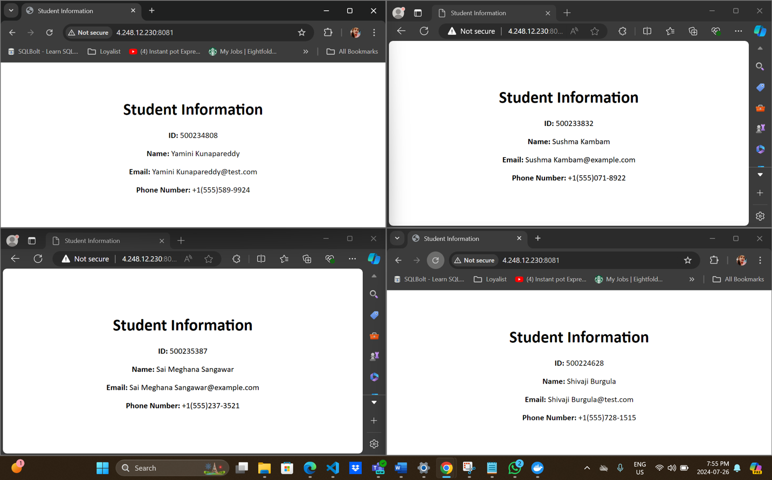
Container Access via One IP in Different Browsers

Slide 11
Conclusion
• Developed a Go Application: Displays student information.
• Containerized with Docker: Ensured consistent deployment.
• Deployed on Azure VM: Managed with Docker Swarm for scalability.

Slide 12
Learnings
Go Application Development: Gained experience in building Go applications.
Docker Containerization: Learned to package apps with Docker.
Cloud Deployment: Acquired skills in deploying apps on Azure VMs.
Docker Swarm Management: Managed containerized apps for scalability.
Team Collaboration: Enhanced teamwork and communication skills.

Slide 13
Thank you

