Slide 1
ANZ Task 1: Exploratory Data Analysis
By Meghana Sesetti

Slide 2
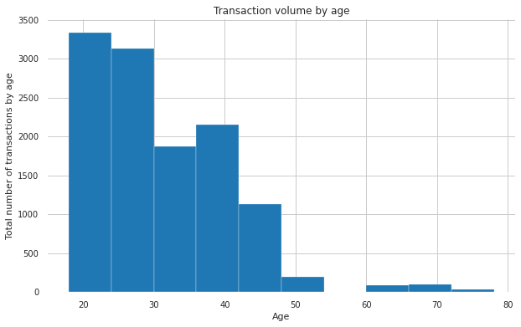
Transaction volume by Age

Slide 3
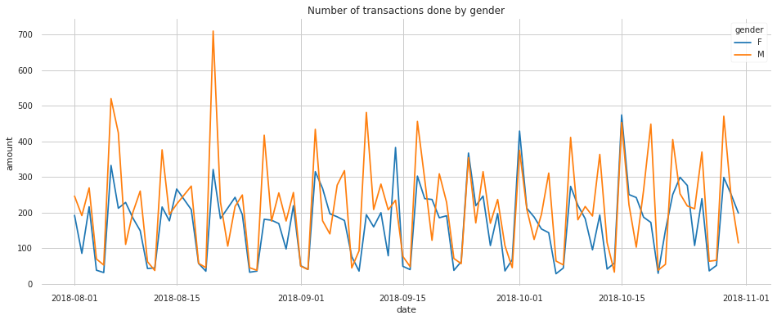
Transaction volume by gender

Slide 4
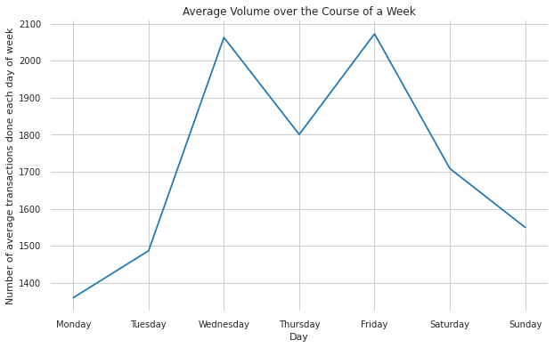
Average transaction per each day of the week

Slide 5
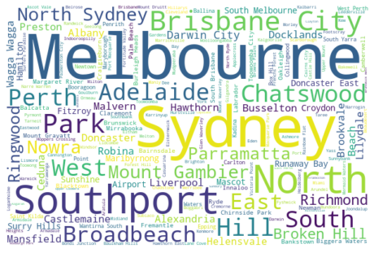
Transactions made in each merchant suburb

Slide 6
Thank you

