Slide 1
ANALYSIS OF MOVIE DATA IMDB (2006-2016)
BY SNAKES RALLY

Slide 2
Introduction:
The aim of the project is to perform exploratory data analysis on a movie dataset
It contains information on 1000 movies from the year 2006 to 2016 from a movie database, IMDB.
We look at a variety of variables within the dataset to see which areas affected the revenue and ratings.
We look at several variables like Votes, Meta score, Ratings, Genre, etc. to determine how the revenue was affected.

Slide 3
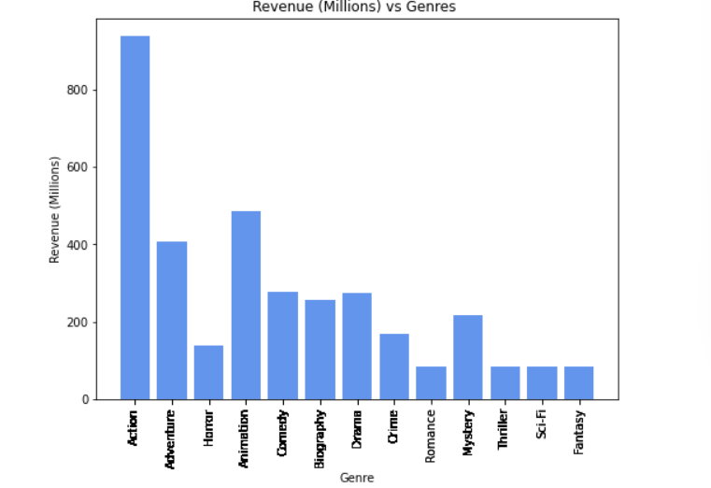
Bar Graph (Genre vs Revenue in millions)
Action makes the highest revenue in comparison to the rest of the Genre which is greater than 900 million $.
It is approximately 7 times more than the Genre with the lowest Revenue(Romance, Thriller, Fantasy and Sci-Fi) over 2006 to 2016.
The Second highest Revenue is for Genre which is around 500 million $.

Slide 4
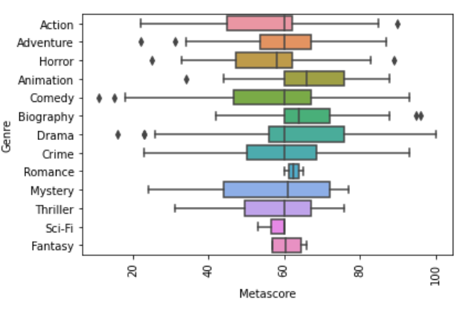
Box Plot (Meta score vs Genre)
Comedy has the highest spread of values ranging between 20 and 95
Almost every genre has 75% of the Meta score values ranging from 60 to 80.
There are outliers present for the Genre Adventure, Horror, Drama, Animation.

Slide 5
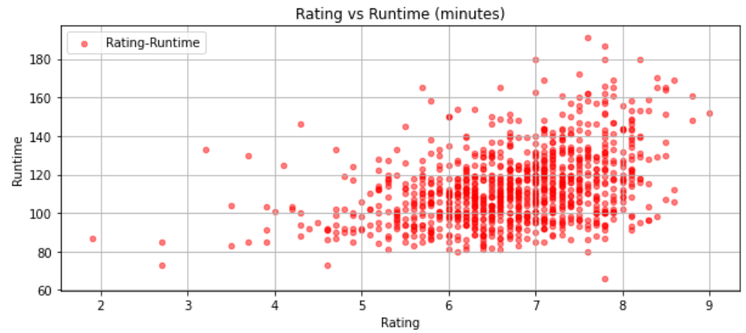
Scatter Plot (Rating vs Runtime in minutes)
The movies with runtime between 80 and 140 minutes are most likely to get majority of rating from 5 to 8.
However, the movies with runtime between 160 and above 180 minutes have least number of ratings, but they have highest rating ranging between 7 and 9.
The directors can look up this data and make a decision on runtime based on rating.

Slide 6
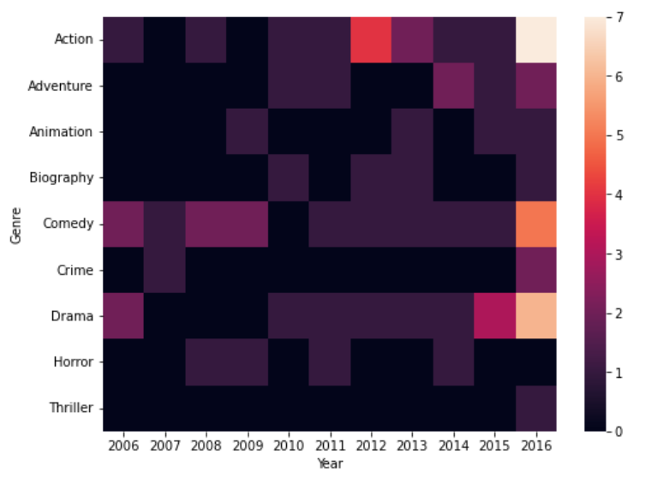
Heat Map (Genre vs Year)
Action Genre has an increase of movies made over the period between 2006 and 2016.
Thriller shows no increase in movies made from 2006 to 2016 causing us to infer why the revenue is low.(ref Bar graph)
Comedy and Drama both saw the decrease in number of movies from 2006 to 2014 and increased significantly in the year 2016.

Slide 7
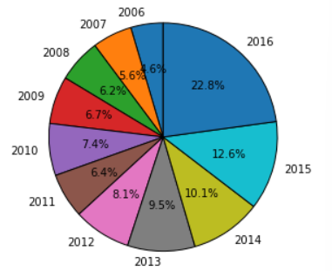
Pie Chart (Percentage of Revenue from movies for specific year)
With the rise of Streaming service there is a steady increase of revenue .Due to the fact you don’t have to go to theaters and can stream them from anywhere.
The Quality of movies has improved drastically from 2006 to 2016 which is around 5 times the revenue in 2006.

Slide 8
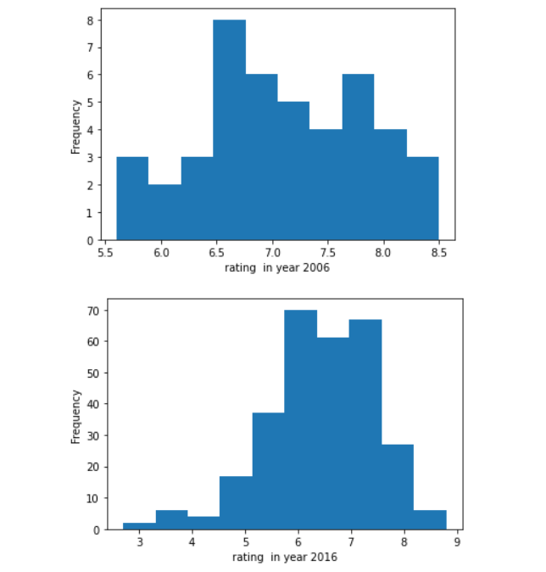
Histogram (Rating vs Number of movies 2006,2016)
In 2006 it is less frequent to achieve rating between 5 to 8 than in 2016.
In both 2006 and in 2016,we can see that it is difficult and uncommon to get a rating between 8.5 and 9.
Over the decade, the quality of movies and audience satisfaction has improved.

Slide 9
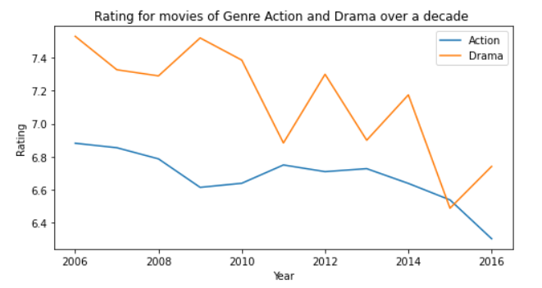
Line Graph (Year vs Rating of Genre Action and Drama)
Both the Genre Action and Drama took dip in terms of rating.
Though Drama has several fluctuations over the period of 2006 to 2016.
Action has steady downfall from 2006 to 2008 and then it took a climb from 2009 to 2011 and eventually decreased.

Slide 10
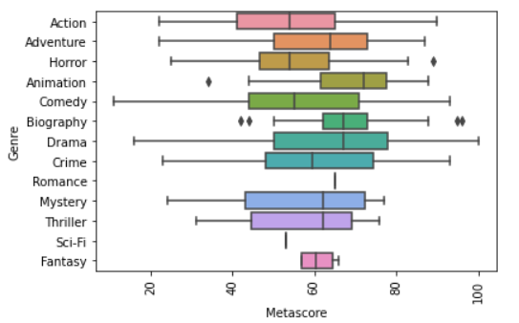
IMPUTATIONS (Box Plot)
Imputations are performed on “Meta score” using mode.
Before imputation we can notice that values are spread over the graph.
However, after imputations almost all Genre values are scattered around median which explains data accuracy and data quality.
WITH IMPUTATION WITHOUT IMPUTATION

Slide 11
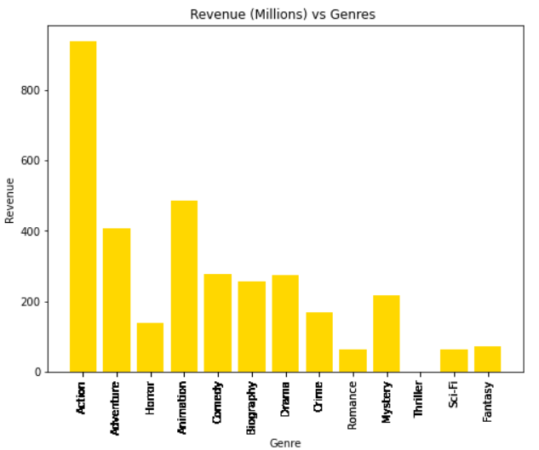
IMPUTATIONS (Bar Graph)
Imputations performed on Revenue variable using Mean.
We can see that Thriller Genre has very low revenue which is not appeared on the non imputed bar graph.
However, Using statistical approach for filling values we can see Thriller has the lowest Revenue along with Sci-Fi, Fantasy and Romance.
WITH IMPUTATION WITHOUT IMPUTATION

Slide 12
Conclusion
Studying the data, we can infer that Action Genre has the highest revenue and audience popularity over the decade.
Thriller has not improved with audience satisfaction over the decade and thus they have produced lowest revenue.
Movie Quality has improved over the period and thus has raised the frequency of higher ratings.
Lastly, we notice that the revenue has steadily increased from 2006 to 2016 due to many factors like higher movie quality, Streaming services.

Slide 13

Recommendations
Theatre Industry :What Kind of Genre are the best investment and would fetch the profits.
Actors, Directors: What kind of genre bring more exposure and income.
Movie Production Company: Which movies the audience enjoy the most based on Rating and Meta Score.
Government Taxes: Which years brought in the most Revenue to the Government.
Audience: What movies the audience enjoy the most based on Rating, Votes and Genre.
OTT platforms: What movies they bid on based on the audience popularity.

