Slide 1
Design And Construction Of A Dust Extractor Machine
19951A0333(Meghana)

Slide 2
Abstract
The essence of this study is to develop a low cost dust extractor device that will be of immeasurable value to our local industries. This device, the dust extractor machine will eliminate dust and other similar solid pollutants of related sizes form enclosures. The effect would be the purification of the surrounding air. . The design of the dust extractor machine is based on engineering laws, principles and theory.

Slide 3
The machine was fabricated in accordance with the specification and although this is a research model, the specification was strictly adhered to. The materials used in construction were locally sourced Aesthetics, ergonomics and safety of usage were equally taken into account in the design and construction of this device. The machine has been designed for safe operation and easy maintainability.

Slide 4
INTRODUCTION
The ability to better future a better way to solving the problems of the society has always been a trait of the engineer. Engineers employ their creative ingenuity in proffering solutions to the problems of mankind. One of such problems is pollution brought about by the effluence from certain industrial machineries and processes.

Slide 5
And specifically is the issue of dust pollution. Industrial processes such as those involving cement productions, for instance, releases dust effluents to the atmosphere, which if left uncontrolled could lead to serious health problems for those working in such plants or people living in the environment.
There is therefore the need to design a device, machine or process that would extract the dust from the air before the air is released to the atmosphere, and such a device must be inexpensive but very effective to enable small scale business owners have access to it. Hence the design and construction of the "Dust Extractor Machine“ is to be done.

Slide 6
BACKGROUND OF STUDY
Pollution is a serous problem in modem civilization. It is the contamination of a system or the environment by harmful substances. The environment we live-in has continued to experience pollution from different types of contaminants as a result of human activities. Environmental pollution can be categorized into three major groups depending on the part of the environment being contaminated. These are: Air pollution, soil (land) pollution and water pollution. The solid pollution is sometimes referred to as dust pollution.

Slide 7
Dust pollution in our environment is mainly brought about by human activities such as earth movement (involving road construction), solid mineral processing, wood processing, grains and cereals processing, flour milling, just to mention a few. In the past, serious attention was not paid to environmental dust pollution. However since the harmful effects of pollution to our health and environment have become a matter of concern, environmental laws and regulations have been promulgated to curtail the act of indiscriminate pollution of our environment.

Slide 8
AIMS AND OBJECTIVES
The purpose of this research are to
i. design and construct a simple machine that would capture and purify the air within a production room.
ii. To test and evaluate the designed machine

Slide 9
SIGNIFICANCE OF THE STUDY
This device is targeted at solving the problem of dust pollution occurring from small scale business ventures where dust is generated such as solid mineral processing factories, wood processing factories, grain milling and threshing and other such similar ventures or activities where dust is readily and openly released to the atmosphere or the environment.

Slide 10
LITERATURE REVIEW
Historical Development
Environmental Management and Pollution control pose a major concern to all. Over the years, different techniques have been developed to either suppress the dust at the source before it is generated or control the dust after being generated. So that it doesn't get access to the atmosphere . The former is a recent development spanning for about a decade now and is based on advanced technology techniques. Kaveri developed these dust suppression systems in 1981.

Slide 11
The application of existing and new technology has resulted in the development of many air pollution control devices to this effect . In the last two dozen intervening years, much of these equipments has reached the end of their useful life .
The major controlling performance parameters are:
Particle size, weight, shape., Particle velocity, Gas temperature / density, Solubility and Ph, System pressure drop and mass transfer conditions, Particle size distribution, Gas viscosity, Humidity level, Chemical Stoichiometry and Residence Time.

Slide 12
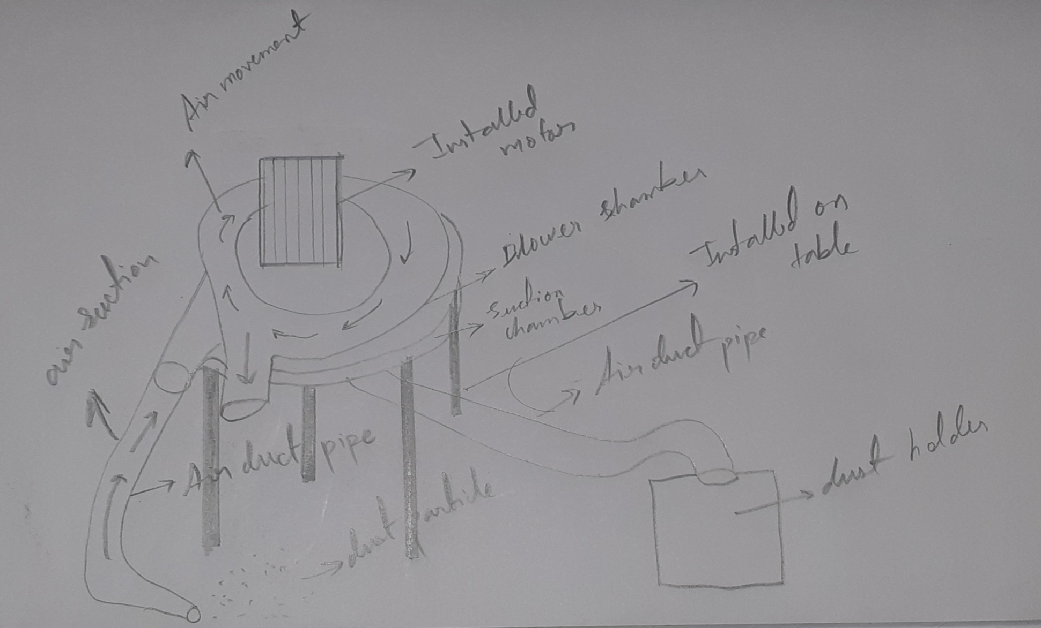
DESIGN METHODOLOGY
Design Concept and Operating Principles

Slide 13
The Concept consists of the following
1. Dust capture-hood
2. centrifugal blower
3. Suction chamber
4. Air duct
5. Bin to store the dust

Slide 14
Principle of Operation
The major or main components of the machine are the suction chamber and bower.The process starts from when the motor is switched on. by the movement of motor this cause the impeller inside to rotate. The impeller then produces air , as the air is being sucked and pushed out throw outlet value . There is no use of the blown out air. Now as the air suction part is being opened to air , we instal the suction chamber . The suction chamber sucks the air thru the suction value . The suction values of the blower chamber and the suction chamber’s suction values are mounted . As this mounted is done the air is sucked and this sucked air which needs to capture the dust is then attached to a air duct of some length and cross sectional area . This helps in suction and the sucked air is then sent to a cylindrical bin which stores the collected dust in it.

Slide 15
Machine Components
1. Capture-hood
2. Centrifugal blower
3. Suction chamber
4. Air duct
5. Bin to store the dust

Slide 16
DESIGN SPECIFICATIONS OF COMPONENT PARTS
(((impeller specifications)))
Width of impeller at outlet - 35*35mm
Speed of blower - 1000rpm
Blade diameter - 45mm
Blade angle - 90°
Prime mover type - Single phase induction motor
(((suction chamber specifications)))
chamber diameter - 90mm
Chmber internal suction value radius - 35mm
suction duct lengh - 35*35mm
Air-duct length - Pipe of some lengh
Air duct cross-sectional area - 35*35mm

Slide 17
DESIGN PARAMETERS
(i) Torque developed by the blower in moving the air,
(ii) Theoretical power required.
(iii ) Volume flow rate of air through the conduit
(iv) Power required to move air

Slide 18
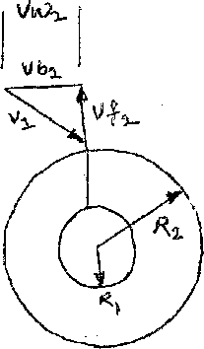
Design Calculations
Referring to figure beside, the velocity diagram of the air flow consists of the following:
Vb2 = Outlet blade velocity
Vw2=Exit velocity (whirl velocity) of dust-laden air.
Vw2 = Vb2, This is because it is the blade that impacts the angular motion to the dust laden air.
Considering figure 2, the dimensions of the impeller blade is given by the following parameters: m, R1 R2 and w
Where
m = mass of air flowing through the impeller in Kg/s
R1 = Internal radius of the impeller - 25mm
R2 - External radius of the impeller - 70rnm
w = Angular velocity of the impeller. The angular velocity w of the impeller is given by:
W = ((2*pi*N /(60))

Slide 19
From the design specification, N = 1000rpm
W = ((2X3.142X1000)/(60) )
= 104.73
Thus W=104.73 rad/s (_Angular velocity)
The angular momentum of dust laden air entering the impeller per second is given by:
Angular momentum (entry) = mVw1R1
Where ,
R1 = internal radius of impeller
m = mass flow rate of dust laden air (in Kg/s)
Vw1 = entry velocity of dust laden air.
Similarly the angular momentum of dust laden air leaving the impeller per second is given by:
Angular momentum (exit) — mVw2R2
Where m = mass flow rate of dust laden air (in Kg/s)
Vw2 = exit velocity of dust laden air
R2 = external radius of the impeller

Slide 20
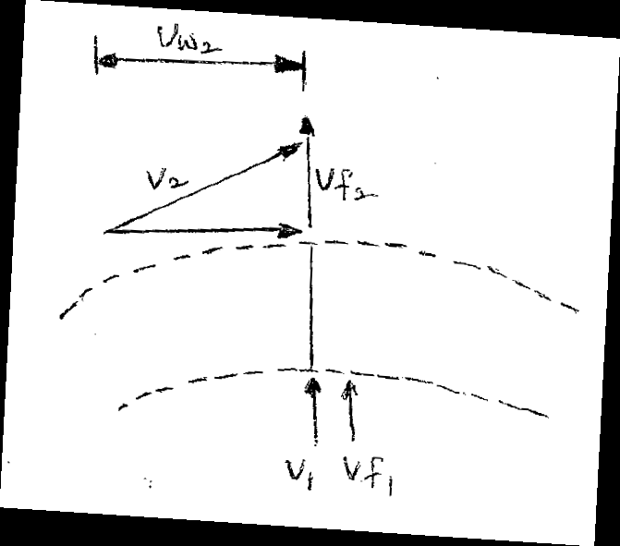
According the principle of conservation of angular momentum, the angular momentum about an axis of a given rotating body or system of bodies is constant, if no external toque acts about that axis.
Thus:
mVw2R2 = mVw1R1
i.e. mVw2R2 – mVw1R1 - 0
Or m(Vw2R2 – Vw1R1)-0
But for radial blades, Vw1 = 0
Now for straight or radial blades (i.e. blade angle = 90°) at inlet the absolute velocity Vi is in-line with Vfi ,
That is, V1 – Vf1
And V1 - Vf1 = 0
Thus Vw1 = V1 – Vf1 = 0
From figure 3.2, we recall that Vw2 = Vb2
Hence Vw2-Vb2 = (pi* D2*N/60)
= ((3.142X0.14X1000)/(60))
= 7.331m/s

Slide 21
Similarly we have that;
Q- piD2b2Vf2
Where Q = flow rate (m/s)
D2= External diameter of impeller = 2R2 = 140mm
b2 = Width of impeller at outlet = 45mm
Vf2 = radial velocity of flow at outlet = 4.5m/s
Q = 3.142 X 0.14X 0.045X 4.5
= 0.0890757metercube/s (volume flow)
Also,
m = Pa x Q
Pa = density of air (1.2Kg/m3)
m=1.2X0.089
= 0.1068Kg/s
Hence torque = 0.1068 (7.331 X 0.035)
= 0.0274 Nm (Torque)

Slide 22
Power required to move air
The power required to move air is given by:
P = Tw
Where ,
T = Toque developed (Nm)
w = angular speed of the blade (rad/s)
.'. Power = 0.0274 x 104.74
= 2.8698W = 0.00288698KW (Power)
lHp= 0.746KW
xHp = 0.00288698KW, xp = 0.0038699
Thus p = 0.0038699 HP

Slide 23
MATERIAL SELECTION
The selection of working materials is based on:
(i) Functionality of component parts:
By knowing purpose of the component
(ii) Cost of the materials: Rs200 squarefoot
Size: 1300 x 2800 mm
Thickness: 1.3mm - 5.0mm
(iii) Availability of the materials:
available in plywood shops

Slide 24
TEST / RESULT
The result and test will be observed and noted when the prototype is made

Slide 25


