Slide 1



SQL PROJECT
ON
GO_PIZZAS.COM
PIZZA SALES
ANALYSIS
FROM :MEGHANA
BATCH:batch MIP-DA-12

Slide 2




DATABASE OVERVIEW
The pizza sales database manages and analyzes pizza orders with the following key tables
𝗧𝗮𝗯𝗹𝗲 𝟭- 𝗼𝗿𝗱𝗲𝗿_𝗱𝗲𝘁𝗮𝗶𝗹𝘀
order_details_id: Unique ID for order detail.
order_id: ID of the order.
pizza_id: ID of the pizza.
quantity: Number of pizzas ordered.
𝗧𝗮𝗯𝗹𝗲 𝟯 - 𝗽𝗶𝘇𝘇𝗮_𝘁𝘆𝗽𝗲𝘀
pizza_type_id: Unique ID for the pizza type.
name: Name of the pizza.
category: Pizza category
ingredients: Ingredients of the pizza.
𝗧𝗮𝗯𝗹𝗲 𝟰 - 𝗽𝗶𝘇𝘇𝗮𝘀
pizza_id: Unique ID for the pizza.
pizza_type_id: ID linking to the pizza type.
size: Size of the pizza.
price: Price of the pizza.
𝗧𝗮𝗯𝗹𝗲 𝟮- 𝗼𝗿𝗱𝗲𝗿𝘀
order_id: Unique ID for the order.
date: Order date.
time: Order time.

Slide 3

QUESTIONS
1
The total number of order place
2
The total revenue generated from pizza sales
3
The highest priced pizza.
4
The most common pizza size ordered
The top 5 most ordered pizza types along their quantities
5
The quantity of each pizza categories ordered.
6
The distribution of orders by hours of the day.
7
8
The category-wise distribution of pizzas.
The average number of pizzas ordered per day.
9
Top 3 most ordered pizza type base on revenue.
10
11
The percentage contribution of each pizza type to revenue.
12
The cumulative revenue generated over time
The top 3 most ordered pizza type based on revenue for each pizza category
13

Slide 4




The total number of order place

Slide 5

2. The total revenue generated from pizza sales

Slide 6


3. The highest priced pizza.

Slide 7


4. The most common pizza size ordered

Slide 8
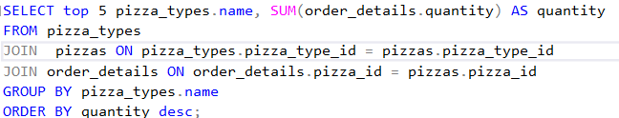
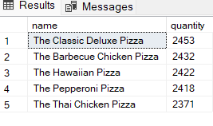
5. The top 5 most ordered pizza types along their quantities

Slide 9
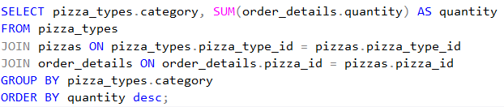
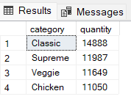
6. The quantity of each pizza categories ordered.

Slide 10
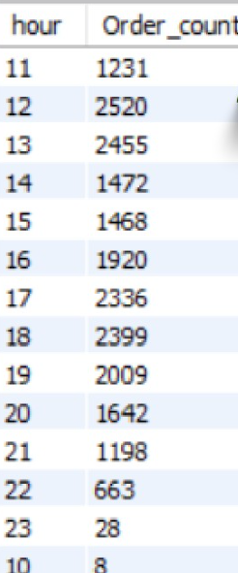

7. The distribution of orders by hours of the day.

Slide 11

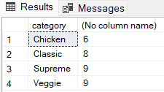
8. The category-wise distribution of pizzas.

Slide 12
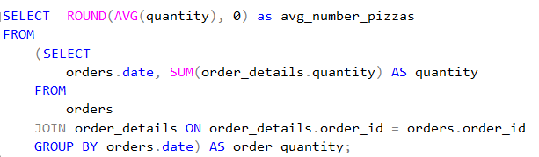

9. The average number of pizzas ordered per day.

Slide 13
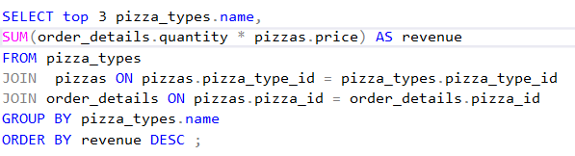

10. Top 3 most ordered pizza type base on revenue.

Slide 14
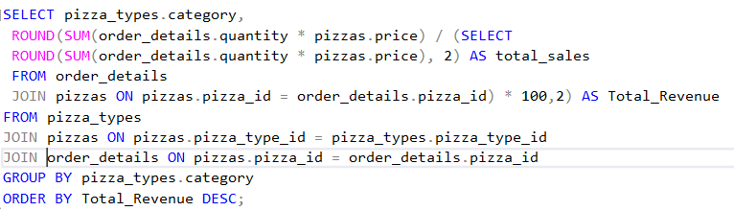

11. The percentage contribution of each pizza type to revenue.

Slide 15
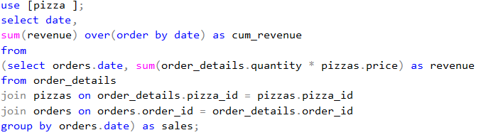
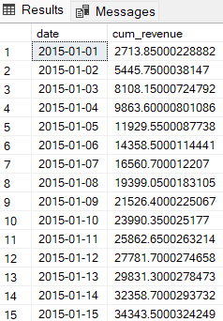
12. The cumulative revenue generated over time

Slide 16
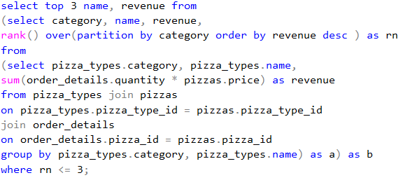

13. The top 3 most ordered pizza type based on revenue for each pizza category

Slide 17



bye.......

