Slide 1

Containerization Technology

Slide 2
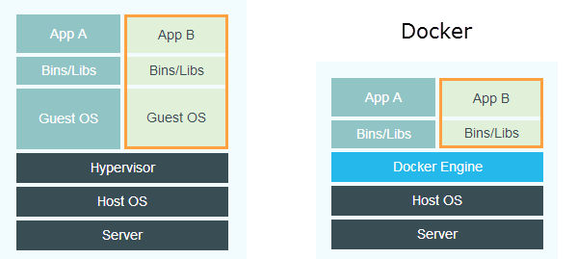
Virtualization and Containerization
The image describes the difference between a VM and Docker. Instead of a hypervisor with Guest OSes on top, Docker uses a Docker engine and containers on top. Does this really tell us anything? What is the difference between a "hypervisor" and the "Docker engine"? A nice way of illustrating this difference is through listing the running processes on the Host.

Slide 3
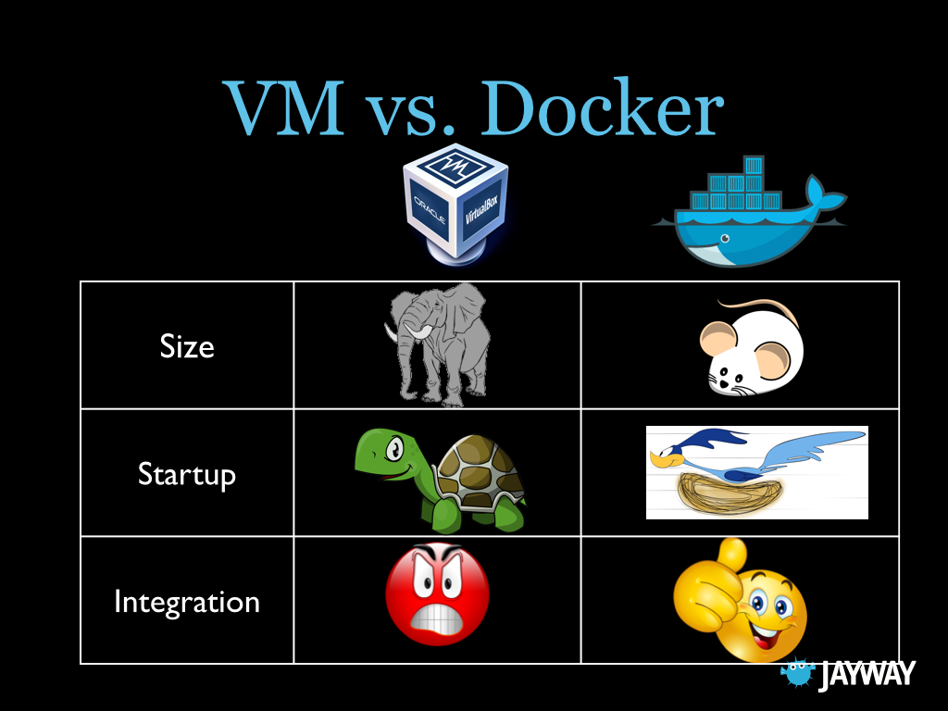
Differences In a Nutshell
Notes:
Difference
Virtualization Containerization
> Mixed OS’s > efficient
More Flexible > Less OS Maintenance
Very Mature > Fast Deployment

Slide 4
How Dockers Works?
Docker file
Nginx
Php
Java
…
…
Dcoker Image
Container
Container
Container
Docker File → Docker Image → Container

Slide 5
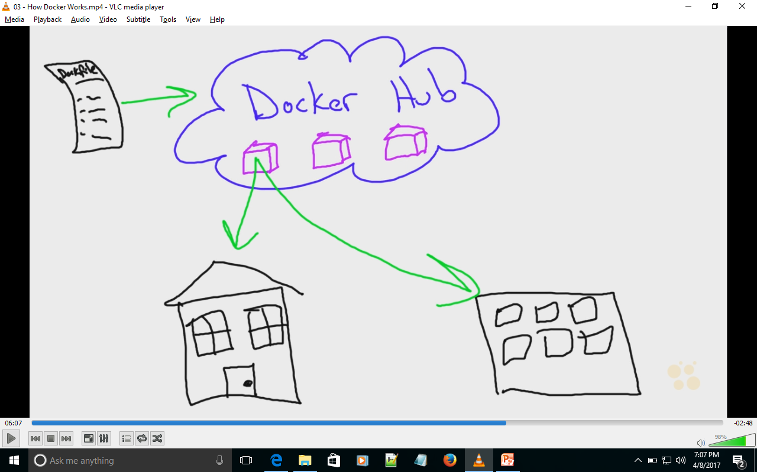
Docker Community
Home Environment
Office Environment

Slide 6
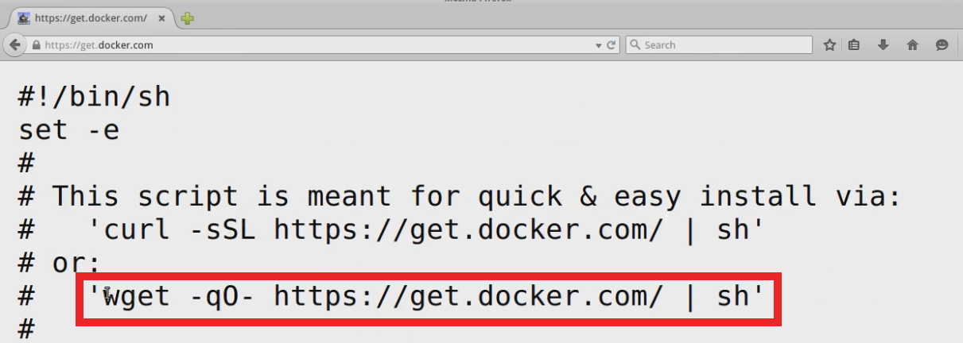
Docker Installation
What not to do?
apt-cache search docker or yum list and do not prefer
docker.io
Or Do not
Yum install docker or
Apt-get install docker
To Install the correct way got use the Docker Installer platform :
STEP 1: got to
www.get.docker.com
Copy the
'wget -qO- https://get.docker.com/ | sh‘
To your terminal and hit enter use | sh if not root user else not.
Step 2: Check Docker version.
$ docker version
Step 3: Check for Docker service is running
$ service docker status/start/restart

Slide 7
Simple Dockerized App.
What is Docker HUB?
How to download a Docker Image
Run the IMAGE and hence call it a container.
Check the log.
A Docker HUB is a DOCKER IMAGE repository. You can visit www.hub.docker.com
Try the below code in the docker image.
/bin/bash -c 'while true; do X=$[$X+1]; echo $X; sleep 1; done'
$ sudo docker run -d centos /bin….
$ sudo docker ps (docker process running)
$ sudo docker logs <Cont. Name/Cont.ID>
$ sudo docker stop <Cont. Name/Cont.ID>
Check for
$ sudo docker -ps (docker process running)

Slide 8
Start, Stop and remove
Learn how to Start, Stop and remove containers and Images.

Slide 9
NETWORKING IN DOCKER
HOST
Eth0: 192.168.0.X
Docker0:172.16.0.1
VetnXXX: BridgeNet.
NETWORK
CONTAINER
Eth0:172.16.0.12

Slide 10
