Slide 1
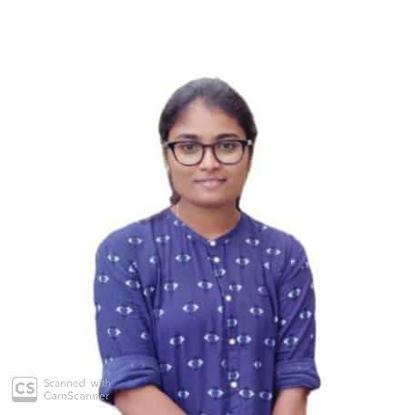



MEGHANA L
Analyst/Software Engineer
Bachelor of Engineering and Technology, Electronics and Instrumentation : 2017 - 2021
Bangalore
Skills
Meghana.l@capgemini.com
TECHNICAL | OutSystems, PowerApps,C, C++, Core Java Spring Boot, Advance Java.
DATABASE | SQL database – Oracle, MySQL No SQL database – MongoDB
UI Tech | HTML 5 & CSS 3,JavaScript and Bootstrap
Tools | Git
Add On skills | Peer learning, Github,Maven, Postman.
Additional Skills: | Project Management, Team Building, Project Management, Team Leader, Business Analysis and Development, Excellent Communication and Interpretation skills
+91 7676739448
A4
Trained On OUTSYSTEMS and POWERAPPS
Hands on Experience in creating Traditional and Reactive application on outsystems.
Proficient in creating OutSystems Applications.
Hands on Experience in creating Traditional and Reactive application on PowerApps.
Proficient in creating PowerApps Applications.
Hands on experience in developing web pages using HTML5, CSS3, Object Oriented Java script. Good understanding of Document Object Model (DOM) and DOM Functions.
Hands on experience in creating microservices with Spring boot, Post Man, Swagger API
Online Chatting Application
Created chat application using OutSystems where users can create their account and chat with registered users privately in one-to-one chatting or they can chat with all the available users in the public chat section.
Covid Vaccination Registration
The Application is used to register for Vaccine where user can register themselves and also can choose the vaccine which is available and also the place where vaccines are available
Check out my work on GitHub & Video Profile

