Slide 1
H UMAN ACTIVITY RECOGNITION
Guided by : Dr. Amit Thakkar
Prepared by : 17IT087

Slide 2
OUTLINE
Here, the human activity recognition model is to be prepared using The Kinetics Human Action Video Dataset which includes 400 activities, and hereby the model which is actually pre-trained accordingly with the above dataset is to be tested by providing externally, the path of video and also further adding a functionality, i.e. the web camera is also used to recognize the live activity.

Slide 3
OBJECTIVE
The goal of human activity recognition is to examine activities from video sequences or still images. Motivated by this fact, human activity recognition systems aim to correctly classify input data into its underlying activity category.
Further it aims at an automated analysis or interpretation of ongoing events and their context from video data.

Slide 4
PROJECT DESCRIPTION
Implementation of human activity recognition is done using two versions the OpenCV library and the Python programming language.
Here the Kinetics dataset is used to train our human activity recognition model.
we can extend ResNet, which typically uses 2D kernels, to instead leverage 3D kernels, enabling us to include a spatiotemporal component used for activity recognition.
Here, we also extract the frames from a video given in the path to train the model.

Slide 5
TOOLS AND TECHNOLOGY
Software:
Python Programming
Libraries:
OpenCV : Most used computer vision library. Highly efficient. Facilitates real-time image processing.
Imutils : Collection of helper functions and utilities to make working with OpenCV easier.
With OpenCV, we can utilize pre-trained networks with popular deep learning frameworks. The fact that they are pre-trained implies that we don’t need to spend many hours training the network — rather we can complete a forward pass (pass the input to model and multiply weights and add bias at every layer) and utilize the output to make a decision within our application.

Slide 6
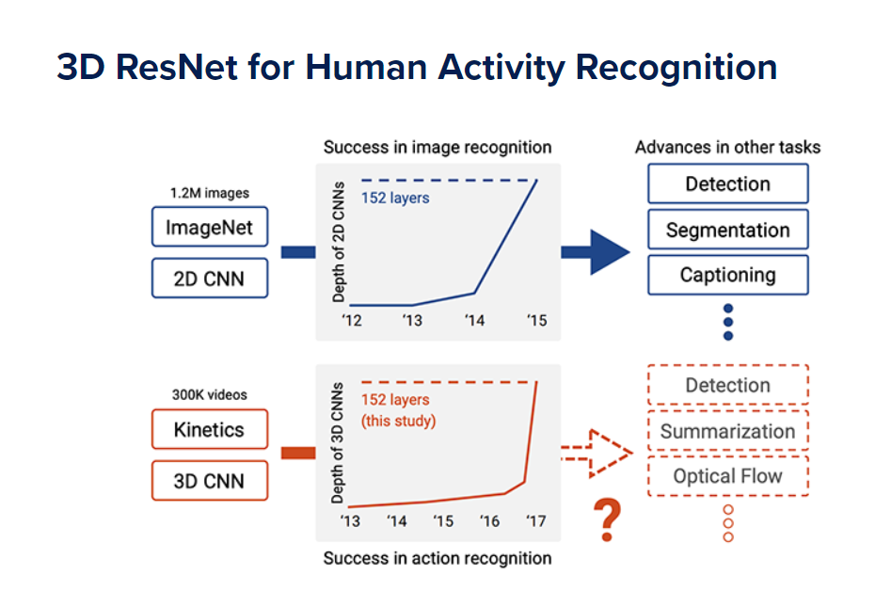

Slide 7
Dataset
Here we use kinetics400 dataset which includes activities such as:
archery, laughing, counting money , playing guitar, yoga, stretching leg etc.
This dataset consists of:
400 human activity recognition classes
At least 400 video clips per class (downloaded via YouTube)
A total of 300,000 videos
The Kinetics dataset has sufficient data for training of deep 3D CNNs, and enables training of up to 152 ResNets layers, interestingly similar to 2D ResNets on ImageNet.

Slide 8
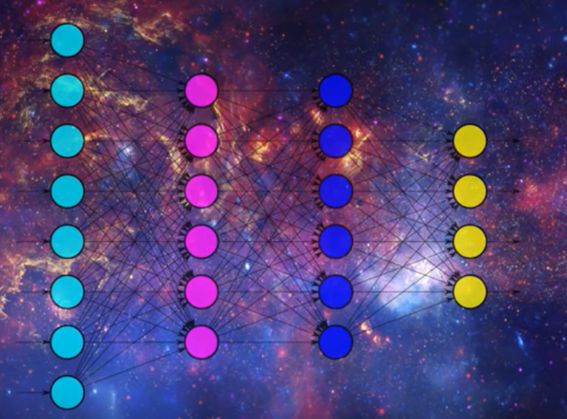
CNN
Specialization to detect pattern and make sense of them. This Pattern detection makes CNN useful for image detection.
With each layer – we need to specify the no. of filters(detect pattern) the layer should have. The deeper the network the more sophisticated the filters are.
After taking the dot matrix of the input matrix and the filter matrix , the result is stored in the output matrix.

Slide 9
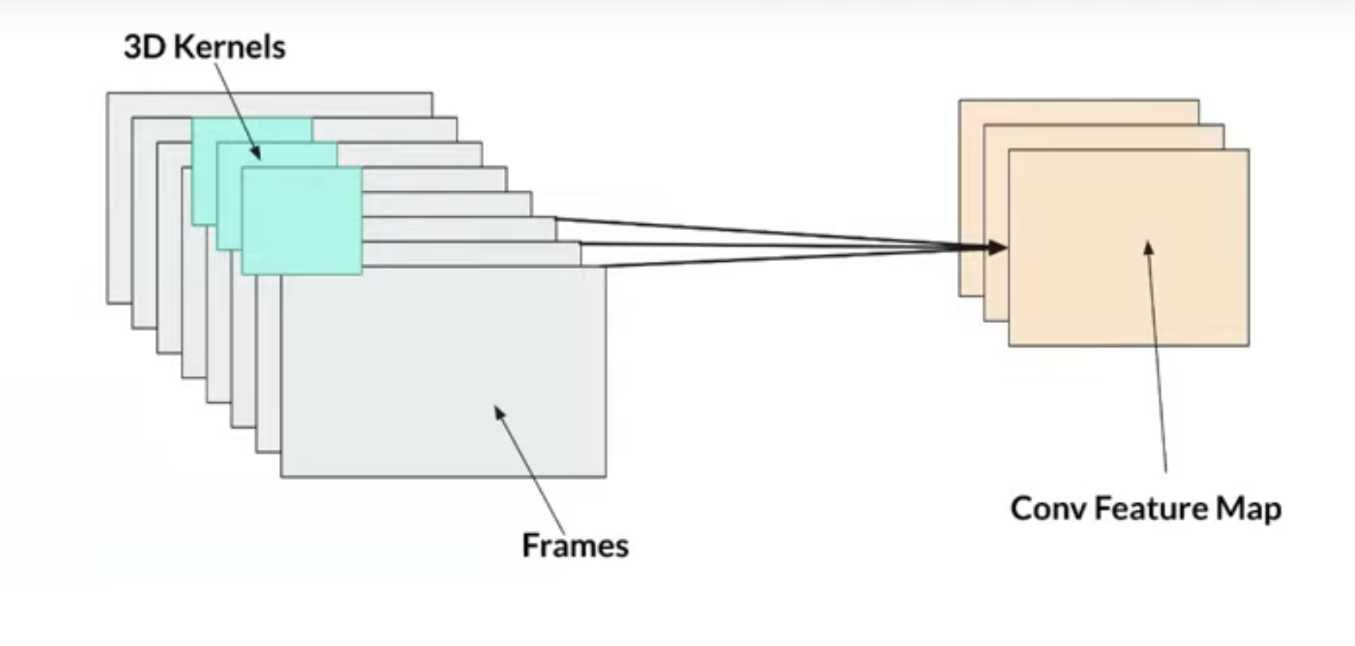
3D CONVOLUTIONAL NEURAL NETWORK
It is experimentally proved, that the 3D ResNets trained on the Kinetics did not suffer from overfitting despite the large number of parameters of the model, and achieved better performance.
RESNET => Deep CNN and popular neural network.
Much of the success of Deep Neural Networks has been accredited to these additional layers. The intuition behind their function is that these layers progressively learn more complex features. The first layer learns edges, the second layer learns shapes, the third layer learns objects, the fourth layer learns eyes, and so on.

Slide 10
WorkFlow
Download libraries as in OpenCV, imutils etc.
Parse arguments – provide path of model, class labels etc.
Define sample duration (i.e. no. of frames for classification).
Pre-Trained model
Begin looping over frames and performing human activity recognition.
loop over our frames where first we initialize the no. of frames that will be passed through the neural net .
Construct a blob(dimensions) from our input frames list.
To perform human activity recognition inference followed by annotating the frame with the predicted label and showing the prediction to our screen

Slide 11
PROJECT GOAL
These architectures should be able to perform video classification by
(1) changing the input volume shape to include spatiotemporal information and
(2) utilizing 3D kernels inside of the architecture.
Demonstrating that these model architectures can be utilized for video classification simply by including spatiotemporal information and swapping 2D kernels for 3D ones.

Slide 12
LIMITATION
When you train a model through a given dataset, the testing may not always result into 100% accuracy, at a time there always is some overfitting problem lies during training cause you can never get any accurate dataset for training a model.
We can expect maximum of 70% to 80% accuracy in accordance to the given kinetics dataset based as per research after training the model with kinetics400 dataset.

Slide 13
Applications
Automatically classifying/categorizing a dataset of videos on disk.
Training and monitoring a new employee to correctly perform a task.
Drowsiness Detection while driving car.
Verifying that a food service worker has washed their hands after visiting the restroom or handling food that could cause cross-contamination.

Slide 14
Reference
Based on research paper:
Can Spatiotemporal 3D CNNs Retrace the History of 2D CNNs and ImageNet?
https://www.frontiersin.org/articles/10.3389/frobt.2015.00028/full

Slide 15
THANK YOU

