Slide 1
ML Documentation - Garbage Collector Invocation
Team Name:yoKnockers
Institute:Indian Institute of Technology Guwahati

Slide 2
Approximations
Following approximations were made:
gcInitialMemory = initialUsedMemory
GcFinalMemory = finalUsedMemory
GcTotalMemory = finalUsedMemory+finalFreeMemory = initialUsedMemory + initialFreeMemory

Slide 3
Feature Extraction
We made a feature called ‘queryno’ which was the token number
We deleted the ‘query token’ and used ‘queryno’ instead
We made a feature called ‘resources’ = finalUsedMemory-initialUsedMemory

Slide 4
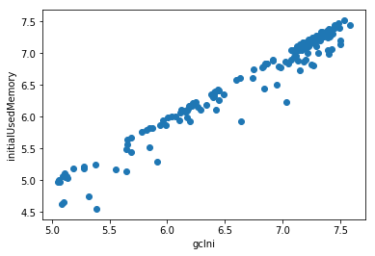
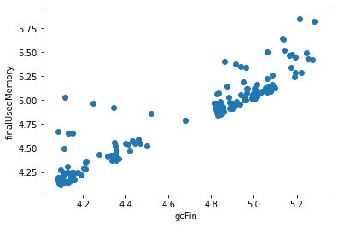
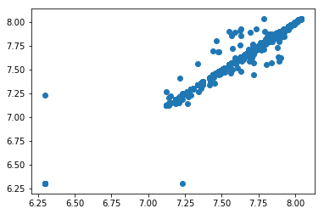
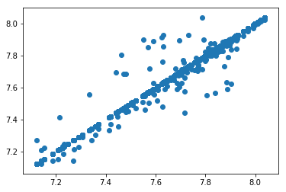
Plottings Made
The gcInitialMemory was plotted in
x axis with initialUsedMemory.
The plot shows us that there is a good
linear relationship between the 2 variabes.
The gcFinalMemory was plotted in
x axis with finalUsedMemory.
The plot shows us that there is a good
linear relationship between the 2 variabes.
The finalUsedMemory+finalFreeMemory was plotted
in x axis with initialUsedMemory+initialFreeMemory.
The plot shows us that there is a good
linear relationship between the 2 variabes.
We can see 3 outliers
The finalUsedMemory+finalFreeMemory was plotted
in x axis with initialUsedMemory+initialFreeMemory.
The plot shows us that there is a good
linear relationship between the 2 variabes
after we remve those see 3 outliers

Slide 5
Strategy to decide final list
Linear Regression
Following the plots and approximations we predicted:
gcInitialMemory using linear regression with initialUsedMemory
finalUsedMemory using linear regression with resources+initialUsedMemory
gcTotalMemory using linear regression with initialUsedMemory+initialFreeMemory
FinalFreeMemory using linear regression with initialFreeMemory+initialUsedMemory-finalUsedMemory
Xgboost- for classifying gcRun xgboost was to predict.

