Slide 1

MACHINE LEARNING ADVENTURES WITH MLFLOW

Slide 2

CONTENTS
What is MFlow
Why it is used
Concepts with MLFlow
4.Training with MLFlow
5.Production with MLFlow

Slide 3
MLFlow
Exploration
MLFlow is an open-source end-to-end platform for managing a machine learning lifecycle provided by Databricks.
There is also a Managed MLFlow version for enterprise usage.
Run experiments with any ML library, framework or language.
Automatically keep track of parameters, metrics, code and models from each experiment

Slide 4
MLFlow
Why MLFlow
Most data scientists and ML engineers may use Anaconda, Jupyter or some other IDE to code their ML models. The following problems arise when they have to improve their model performance over time and when multiple members of a team are working on the same model
MLFlow Keep track of all the parameters tuned and tweaked in the model.
Keep track of the outputs, accuracy and error scores.
Maintain the record of models and their related data objects (scalers, imputers, encoders etc.)
Version their models.
Share the model with team members — what are the prerequisites/setup needed in place for other members to run the model on their system.
Wrap their models with API and deploying it, will require extra coding and tech stack knowledge.

Slide 5
MLFlow vs META Flow
MLFlow | Meta Flow
It can work with any machine learning library, language or any existing code. It runs in the same manner in any cloud. | Metaflow was open-sourced by Netflix and AWS , it can integrate with SageMaker, Python, and deep learning base libraries
It includes an API | Metaflow provides a unified API to stack, which is required to execute from prototype to production-based
MLflow models help you deploy different types of machine learning models. Each model is saved as a dir containing arbitrary files. | After deployment in production you track all your experiments, versions and data.
ML FLow can be used with any operating system | Works only with Linux EC2 instance
Viewable outcome with UI, for tracking the version | We cannot view with UI

Slide 6
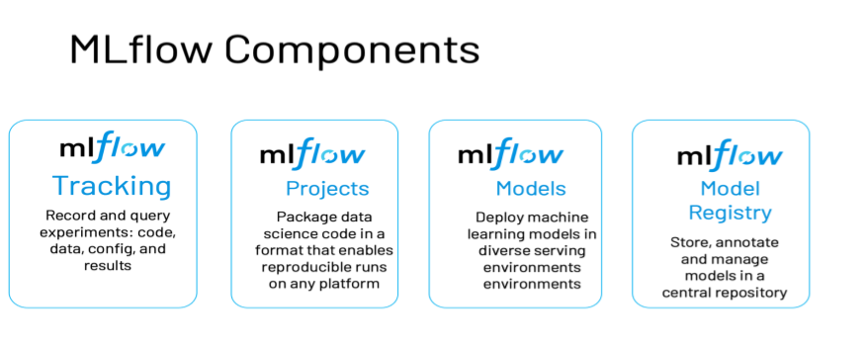
MLFlow

Slide 7

MLFlow
Model Tracking
As a data scientist or ML engineer, you will spend a lot of time improving the models that you have created.
It becomes tedious to keep track of what parameters you have tweaked, which particular combination gives you better performance and which error metric you need to compare.
Model Tracking is an important concept to understand. It’s easier to track model performance and compare the models when you have all the metrics and measures tabulated and readily available.

Slide 8
MLFlow
Model Project
All software developed generally follow a design or architecture pattern, this is not the case when it comes to machine learning.
It becomes difficult to share the code and setup model across systems in a team or organization.
MLFlow creates a standardized pattern and structure which covers most ML use cases and makes the code easily portable.

Slide 9
MLFlow
ML Model
Once your model is ready, you want your model to be deployed to a cloud or an edge device.
You need to package your model to deploy it. Packaging a model involves specifying what environment your model requires, what is the signature of your model i.e what is the input your model needs and in what format should the input be provided?
Once you have packaged the model, you can store it in a pickle format and can be deployed.

Slide 10
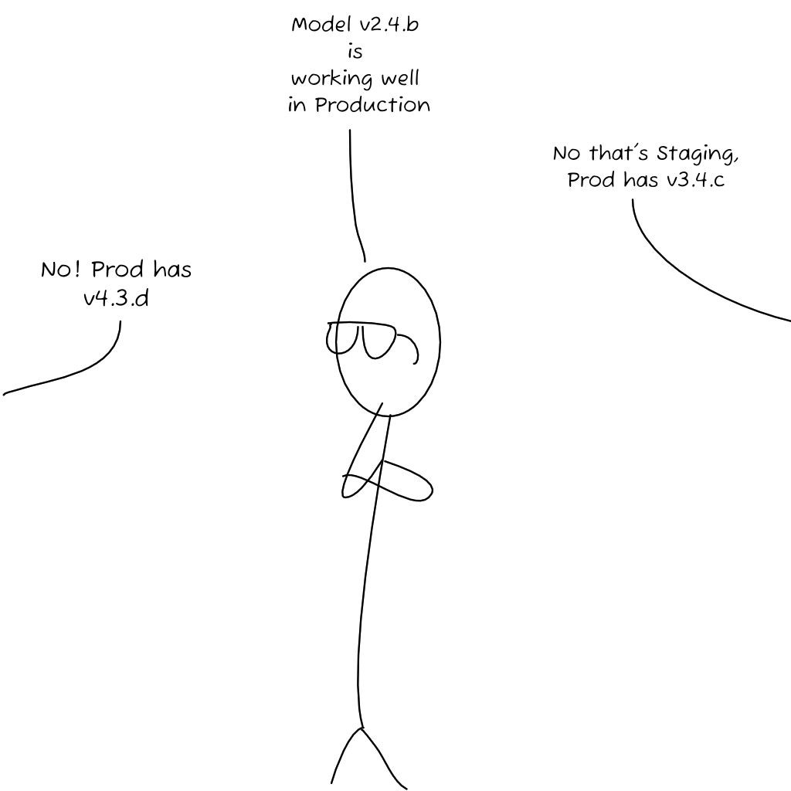
MLFlow
ML Registry
As you keep improving the models with new data, you will have different versions of models with different accuracy, error level and other metrics.
You might have a different model in production than you do in the development stage.
MLflow Model Registry helps you keep track of which model is present in which stage. You can even archive some of the older models when not in need.

Slide 11
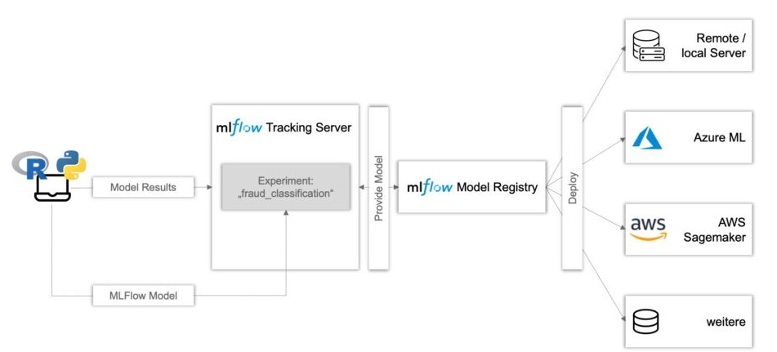
MLFlow
Model Diagram

Slide 12
MLFlow
MLFlow server locally
Before we race off to build the greatest classifier ever seen, we need to start the MLFlow server on our local system.
Download the mlflow library using python
$ pip3 install mlflow

Slide 13
MLFlow
Training and Tracking
import mlflow
with mlflow.start_run():
# Adding your model
# Paramters to add and store log
mlflow.log_param("max_depth",max_depth)
mlflow.log_metric("acc",acc)
Creates a local mlruns folder to store all models and their associated data.
Starts the MLFlow server on http://127.0.0.1:5000/ on your system

Slide 14
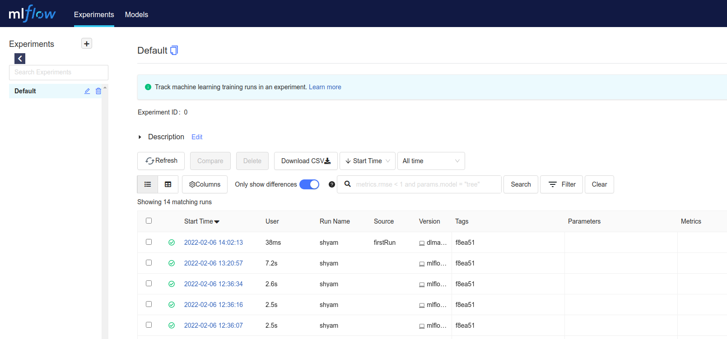
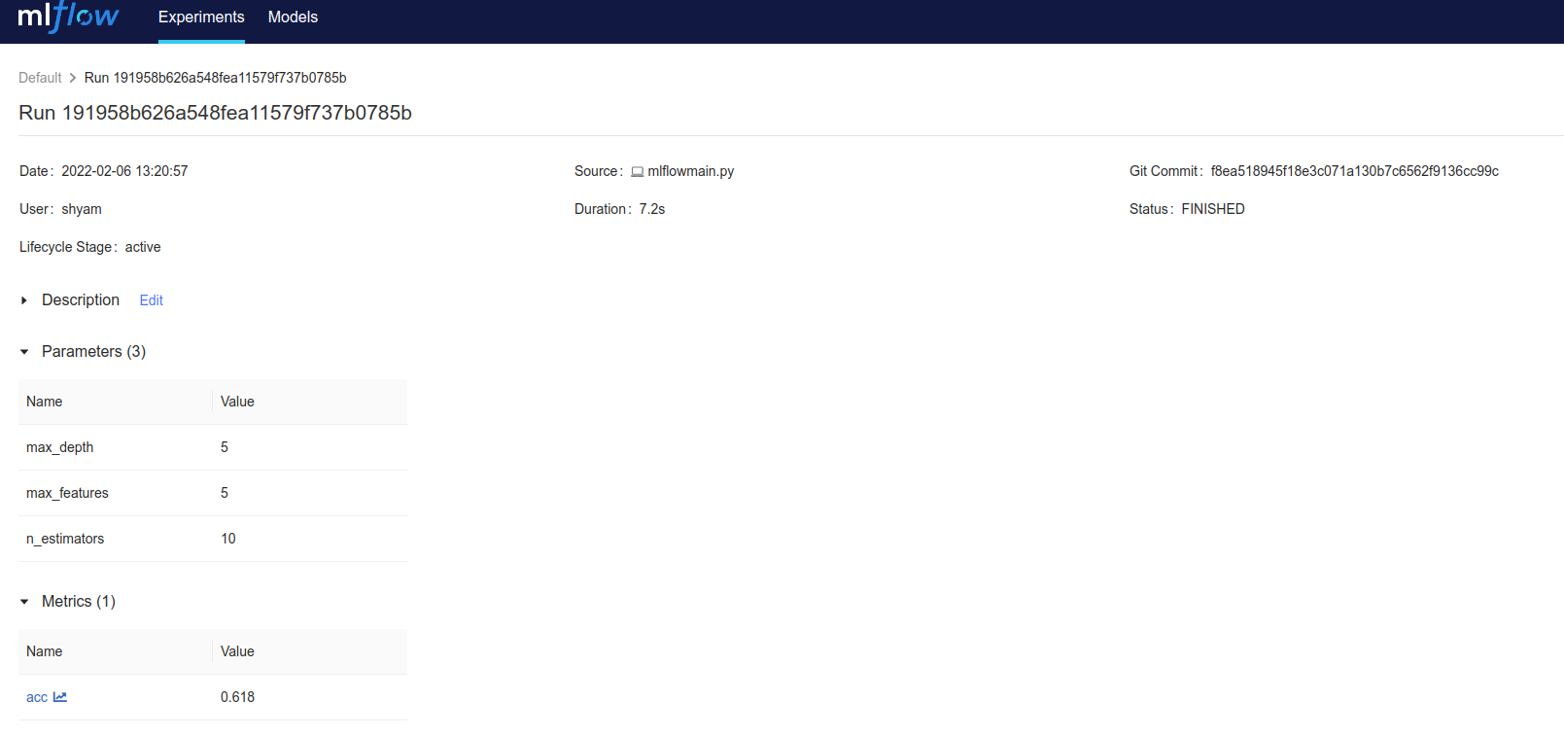
MLFlow
MLFlow UI

Slide 15
MLFlow
MLFlow AWS Cloud
Launch a tracking server on AWS
If you're a team of developers or data scientists, you can spin up a tracking server where everyone logs his/her runs
1. Prepare an EC2 machine and an S3 bucket
create an IAM user on AWS. Get its credentials, namely Access key ID and Secret access key with this same user, create an s3 bucket to store future artifacts: give this bucket a name. Mine is mlflow-artifact-store-dem but you cannot pick it
Launch an EC2 instance: it doesn't have to be big. a t2.micro eligible to free tier does perfectly the job
Configure the security group of this instance to accept inbound http traffic on port 5000

Slide 16
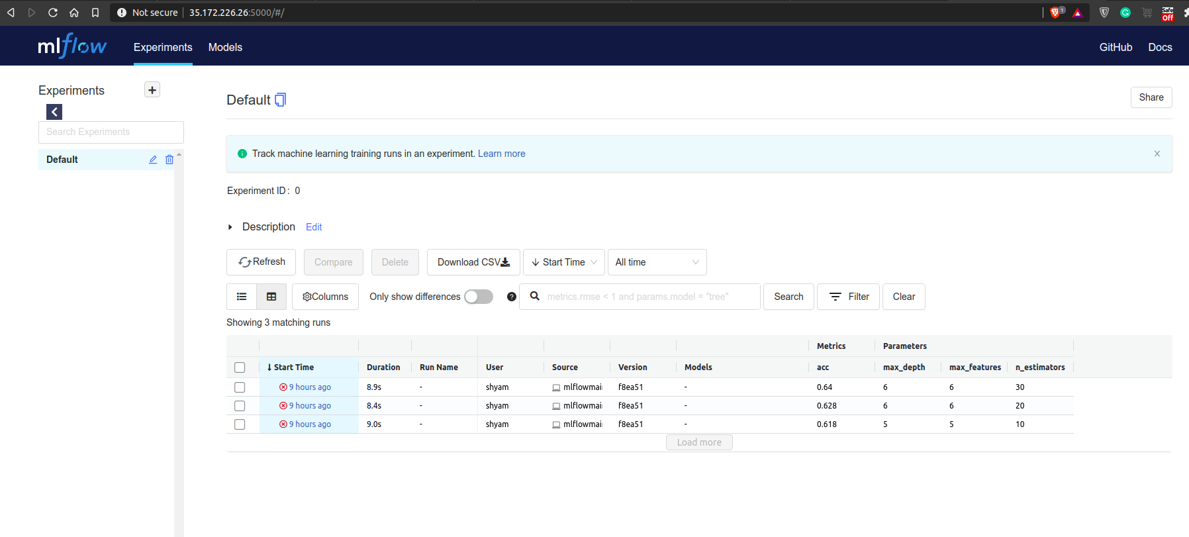
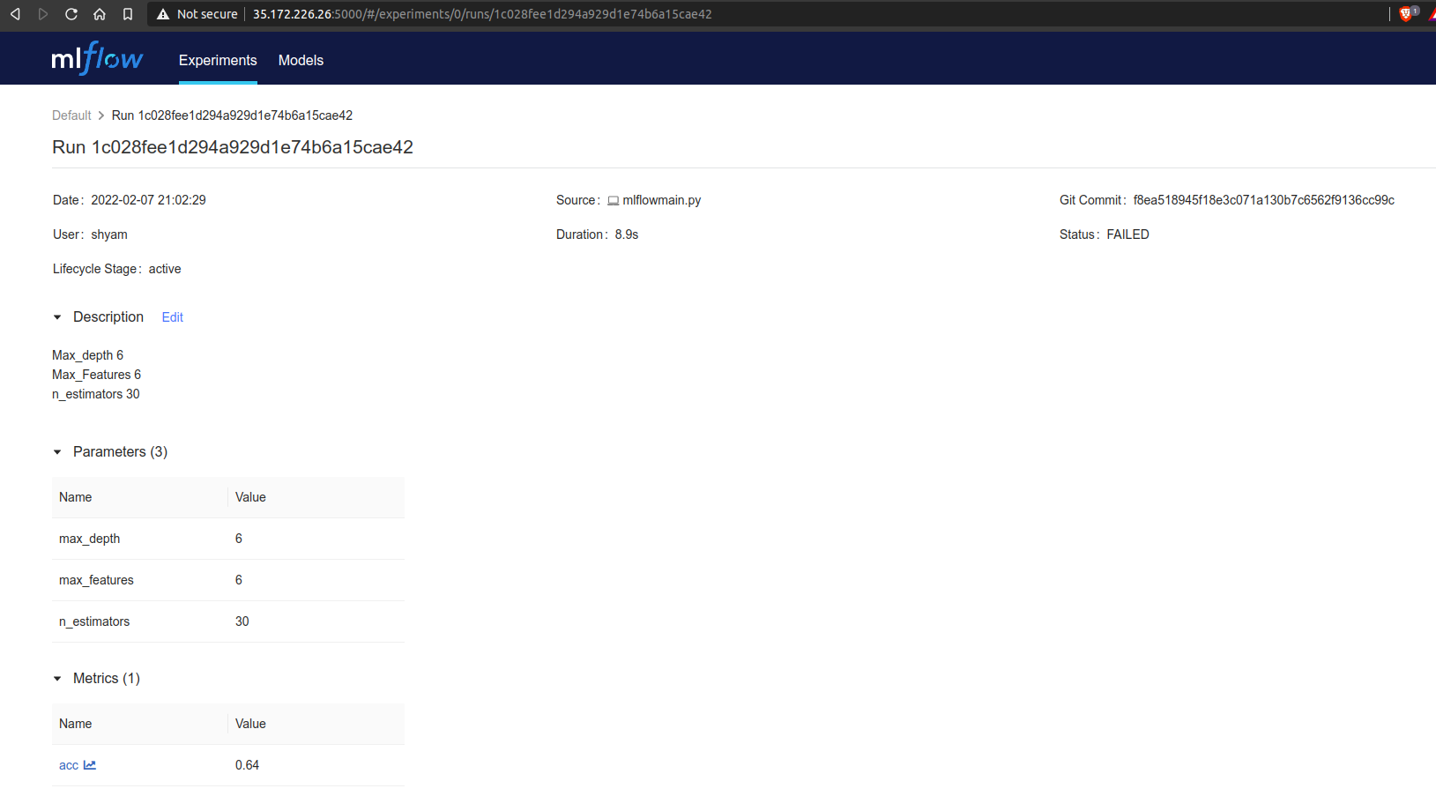
MLFlow
Tracking MLFlow in AWS
https://github.com/Meghashyamt/MLFlow
AWS Cloud http://35.172.226.26:5000
Azure http://52.186.80.208:5000/

Slide 17
MLFlow
Conclusion
Tracking, managing and optimizing models is a slow process.
Keep experimenting with MLFlow, over the course of time, you will get better at model management.
Reference
https://docs.aws.amazon.com/cli/latest/userguide/cli-configure-quickstart.html

