Slide 1

SMART ATTENDENCE SYSTEM USING QR+WIFI IP CHECK
MEGHNA P
MES24MCA-2028
Department of Computer Applications
MES College of Engineering, Kuttippuram
20/08/2025

Slide 2
PRODUCT OWNER Ms.PRIYA JD ASSISTANT PROFESSOR DEPARTMENT OF COMPUTER APPLICATIONS MES COLLEGE OF ENGINEERING, KUTTIPPURAM

Slide 3
TABLE OF CONTENTS
Introduction
Objective
Existing System
Proposed System
Motivation
Functionalities
Module Description
Developing Environment
Sprint Backlog
Product Backlog
User Story
Project Plans
Data Flow Diagrams
ER Diagram
Department of Computer Applications
3

Slide 4
SMART ATTENDENCE SYSTEM USING QR +WIFI IP CHECK
A Smart Attendance System that integrates QR code authentication with WiFi IP verification to ensure accurate and reliable student attendance.
This Uses a dual authentication method that include session-based dynamic QR code + campus WiFi IP verification.
Ensures physical presence before marking attendance, preventing proxy entries.
Provides role-based access for Admin, Faculty, and Students.
Department of Computer Applications
4

Slide 5
Stores attendance securely in a centralized database with real-time logging.
Generates automatic reports for easy review and auditing.
Scalable architecture adaptable to different institutions and networks.
Enhances security and transparency with modern authentication methods.

Slide 6
OBJECTIVES
Develop a secure, dual-authentication attendance system using QR code + WiFi IP check.
Eliminate proxy attendance and ensure physical presence verification.
Maintain attendance records in a centralized, easily accessible database.
Provide real-time monitoring, reporting, and scalability for various institutions
Department of Computer Applications
4

Slide 7
EXISTING SYSTEM
Manual roll call or paper-based registers used for attendance.
Single-factor authentication methods such as ID card swiping or QR scanning only.
Time-consuming for faculty to mark and verify attendance.
Limited or no real-time monitoring of attendance records.
Records often stored in dispersed or unsecured formats, making audits difficult
Department of Computer Applications
4

Slide 8
PROPOSED SYSTEM
Implement dual authentication with dynamic QR code scanning and campus WiFi IP verification.
Ensure physical presence verification to eliminate proxy and remote attendance.
Maintain attendance in a centralized, secure, real-time database.
Provide role-based access, automated reporting, and scalability for various institutions.
Department of Computer Applications
4

Slide 9
MOTIVATIONS
Prevent Proxy Attendance by ensuring only physically present individuals can mark attendance.
Improve Accuracy & Security over traditional manual or single-factor methods.
Save Time for Faculty/Administrators through automated verification and logging.
Promote Digital Transformation in attendance management for institutions.
Department of Computer Applications
4

Slide 10
FUNCTIONALITIES
Role-Based Access Control: Separate interfaces and permissions for administrators, faculty, and students.
Dynamic QR Code Generation: Creates unique, time-sensitive QR codes for each session to prevent reuse.
WiFi IP Verification: Confirms user’s device is connected to the institution’s registered network before attendance is marked.
Real-Time Attendance Logging: Instantly records attendance in a centralized database.
Department of Computer Applications
4

Slide 11
Session Creation & Management: Faculty can set up sessions, manage participants, and close attendance windows.
Automated Report Generation: Generates attendance summaries and detailed reports for analysis.
Secure Data Storage: Protects attendance records with authentication and encryption techniques.
Scalability & Integration: Supports future integration with biometric or RFID systems.

Slide 12
MODULE DESCRIPTION
1)ADMIN MODULE
Account Creation:Securely create and manage user accounts for teachers and students
No Self-Registration:Maintains control and security by preventing unauthorized user sign-ups
Monitoring&Reporting:provides real-time oversight and generates detailed attendence reports.
2)TEACHER MODULE
QR Generation:Create unique QR codes for each class session instantly
Secure QR Sharing:share QR codes safely within the classroom
Live Monitoring:Track students attendence as it happens,in real-time
Department of Computer Applications
4

Slide 13
MODULE DESCRIPTION
PDF Export:Export attendence records to PDF for easy record keeping and sharing
3)STUDENT MODULE
Secure Login:Access the system with personalized,encrypted credentials
QR Scan:Effortlessly scan the sessions QR code to mark attendence
Wifi Validation:Automatic verification against campus wifi subnet for added security
Attendence History:View personal attendence records and track progress over time.
Department of Computer Applications
4

Slide 14
MODULE DESCRIPTION
4)QR CODE MANAGEMENT
Unique Encrypted Codes:Each QR code is uniquely generated and encrypted to prevent duplication
Session Specific Details:codes embeded essential information like class,time,and date for precise tracking
One-Time Use:Codes are valid for a single scan per student per session,preventing reuse
5)WIFI SUBNET VERIFICATION
Campus wifi Validation:Ensures students are physically on campus when marking attendence
Subnet Matching:Verifies that the devices wifi subnet matches registered campus networks.
Anti-Proxy Measures:Significantly reduces attempts at fraudulent proxy attendence
Department of Computer Applications
4

Slide 15
DEVELOPING ENVIRONMENT
Operating System:Windows
Front End:HTML,CSS,Java Script
Back End:Python(django)
Database:SQLite
QR Library:Qrcode in python
Ip Validation:python’s socket module
IDE:VS code
Department of Computer Applications
4

Slide 16
SPRINT PLAN
Backlog tem | Completion Date | 0Original Estimation in Hours | Day 1 hrs | Day 2 hrs | Day 3 hrs | Day 4 hrs | Day 5 hrs | Day 6 hrs | Day 7 hrs | Day 8 hrs | Day 9 hrs | Day 10 hrs
SPRINT1
Requirement Analysis | 09/08/2025 | 3 | 1 | 1 | 1 | 0 | 0 | 0 | 0 | 0 | 0 | 0
Database Design | 12/08/2025 | 4 | 1 | 1 | 1 | 1 | 0 | 0 | 0 | 0 | 0 | 0
UI design(Login+QR) | 19/08/2025 | 5 | 1 | 1 | 1 | 1 | 1 | 0 | 0 | 0 | 0 | 0
SPRINT 2
QR code Generation | 26/08/2025 | 6 | 1 | 1 | 1 | 1 | 1 | 1 | 0 | 0 | 0 | 0
Attendence Marking Logic | 02/09/2025 | 6 | 1 | 1 | 1 | 1 | 1 | 1 | 0 | 0 | 0 | 0
Department of Computer Applications
4

Slide 17
SPRINT PLAN
Backlog tem | Status And Completion Date | Original Estimation in Hours | Day 1 hrs | Day 2 hrs | Day 3 hrs | Day 4 hrs | Day 5 hrs | Day 6 hrs | Day 7 hrs | Day 8 hrs | Day 9 hrs | Day 10 hrs
SPRINT3
Admin Dashboard | 12/09/2025 | 6 | 1 | 1 | 1 | 1 | 1 | 1 | 0 | 0 | 0 | 0
Report Generation | 16/09/2025 | 6 | 1 | 1 | 1 | 1 | 1 | 1 | 0 | 0 | 0 | 0
SPRINT 4
Integration Testing | 24/09/2025 | 6 | 1 | 1 | 1 | 1 | 1 | 1 | 0 | 0 | 0 | 0
Deployment& Docs | 30/07/2025 | 6 | 1 | 1 | 1 | 1 | 1 | 1 | 0 | 0 | 0 | 0
TOTAL |  | 48 | 9 | 9 | 9 | 8 | 7 | 6
Department of Computer Applications
4

Slide 18
PRODUCT BACKLOG
ID | NAME | PRIORITY <high/medium/low> | ESTIMATE (Hours) | STATUS <Planned/In progress/Completed>
1 | Requirement Analysis | High | 3 | In progress
2 | Database Design | High | 4 | In progress
3 | UI design(Login+QR) | High | 5 | planned
Department of Computer Applications
4

Slide 19
PRODUCT BACKLOG
ID | NAME | PRIORITY <high/medium/low> | ESTIMATE (Hours) | STATUS <Planned/In progress/Completed>
4 | QR code Generation | High | 6 | planned
5 | Attendence Marking Logic | High | 6 | planned
6 | Admin Dashboard | Low | 4 | planned
Department of Computer Applications
4

Slide 20
ID | NAME | PRIORITY <high/medium/low> | ESTIMATE (Hours) | STATUS <Planned/In progress/Completed>
7 | Report Generation | High | 6 | Planned
8 | Integration Testing | High | 6 | Planned
9 | Deployment& Docs | Low | 4 | Planned

Slide 21
USER STORY
User Story ID | As a type of User | I want to <Perform some task> | So that i can <Achieve Some Goal>
1 | ADMIN | Login | Access the system securely
2 | ADMIN | Verify with WiFi IP | Ensure only in-campus students mark attendance
3 | FACULTY | Generate QRcode | Students can scan to mark attendance
4 | FACULTY | View Attendance Reports | Track student performance
5 | STUDENT | Register & Login | Use the system securely
6 | STUDENT | Scan QR Code | Mark my attendance
7 | STUDENT | View My Attendance | Check my attendance status
Department of Computer Applications
4

Slide 22
PROJECT PLAN
User StoryID | Task Name | Start Date | End Date | Days | Status
1 | SPRINT 1 | 06/08/2025 | 09/08/2025 | 14 | In progress
2 |  | 10/08/2025 | 12/08/2025 |  | In progress
3 |  | 13/08/2025 | 19/08/2025 |  | In progress
4 | SPRINT 2 | 20/08/2025 | 26/08/2025 | 14 | planned
5 |  | 27/08/2025 | 02/09/2025 |  | planned
Department of Computer Applications
4

Slide 23
PROJECT PLAN
User StoryID | Task Name | Start Date | End Date | Days | Status
6 | SPRINT 3 | 03/09/2025 | 12/09/2025 | 14 | planned
7 |  | 13/10/2025 | 16/09/2025 |  | planned
8 | SPRINT 4 | 29/09/2025 | 05/10/2025 | 14 | planned
9 |  | 06/10/2025 | 07/10/2025 |  | planned
Department of Computer Applications
4

Slide 24
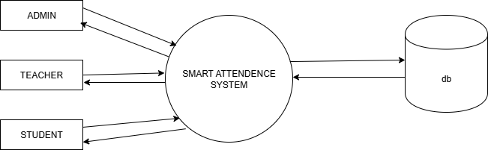
DATA FLOW DIAGRAM
LEVEL 0
Department of Computer Applications
4

Slide 25
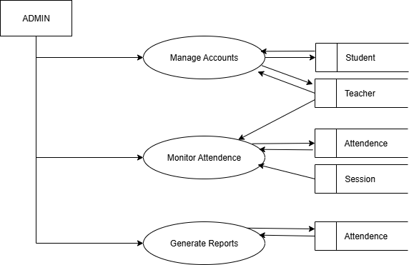
DATA FLOW DIAGRAM
Level 1
Department of Computer Applications
4

Slide 26
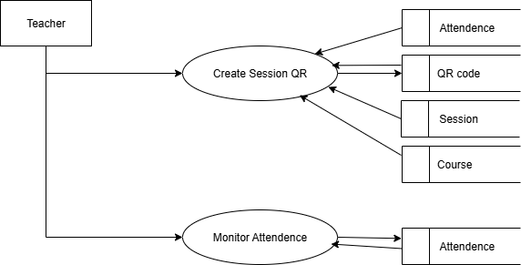
DATA FLOW DIAGRAM
Level 2
Department of Computer Applications
4

Slide 27
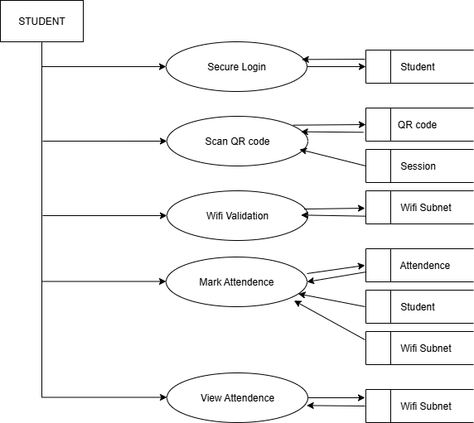
DATA FLOW DIAGRAM
Level 3
Department of Computer Applications
4

Slide 28
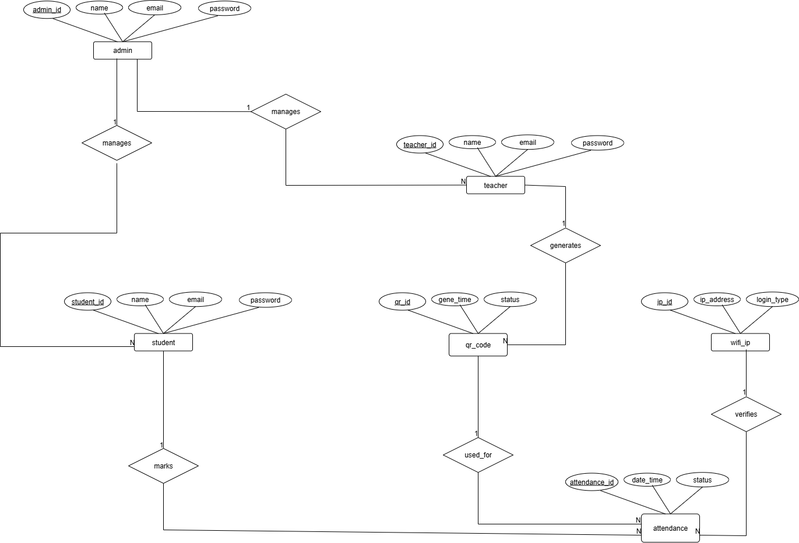
ER DIAGRAM
Department of Computer Applications
4

Slide 29
Implementaion of key functionalities
Demonstrtion of two main features:
1.Admin Dashboard
2.Teacher Session Management
.
Department of Computer Applications
4

Slide 30
Functionality1-Admin Dashboard
.
Admins can:
View overall system statistics (total courses, students, teachers)
Monitor recent attendance sessions
Access system overview for management
Implemented using:
admin_dashboard
Department of Computer Applications
4

Slide 31
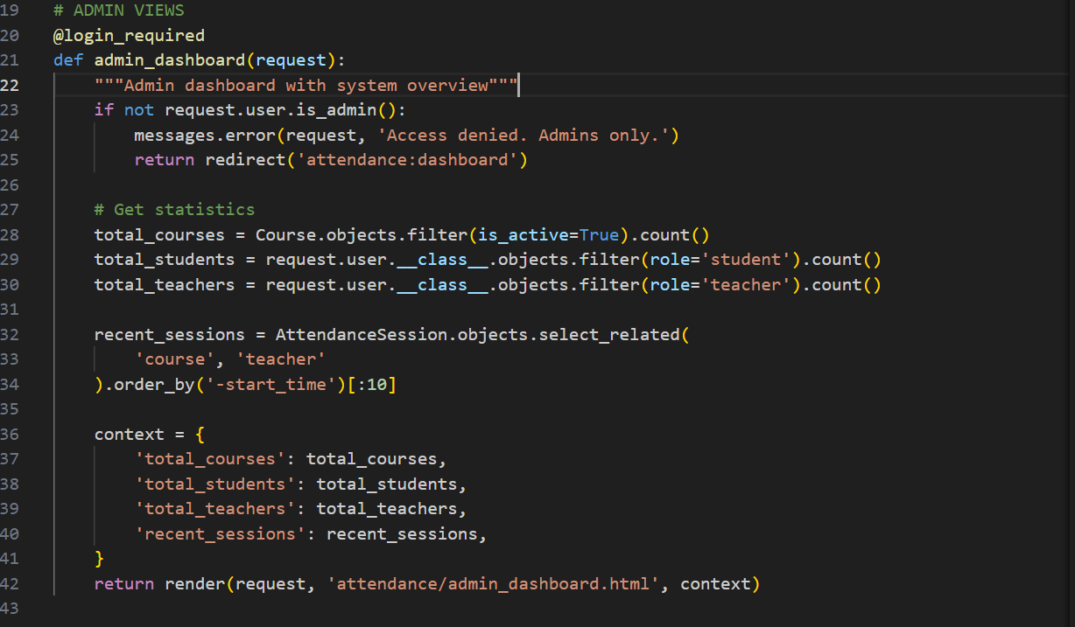
Functionality1-code snippet
Functionality1-code snippet
.
Department of Computer Applications
4

Slide 32
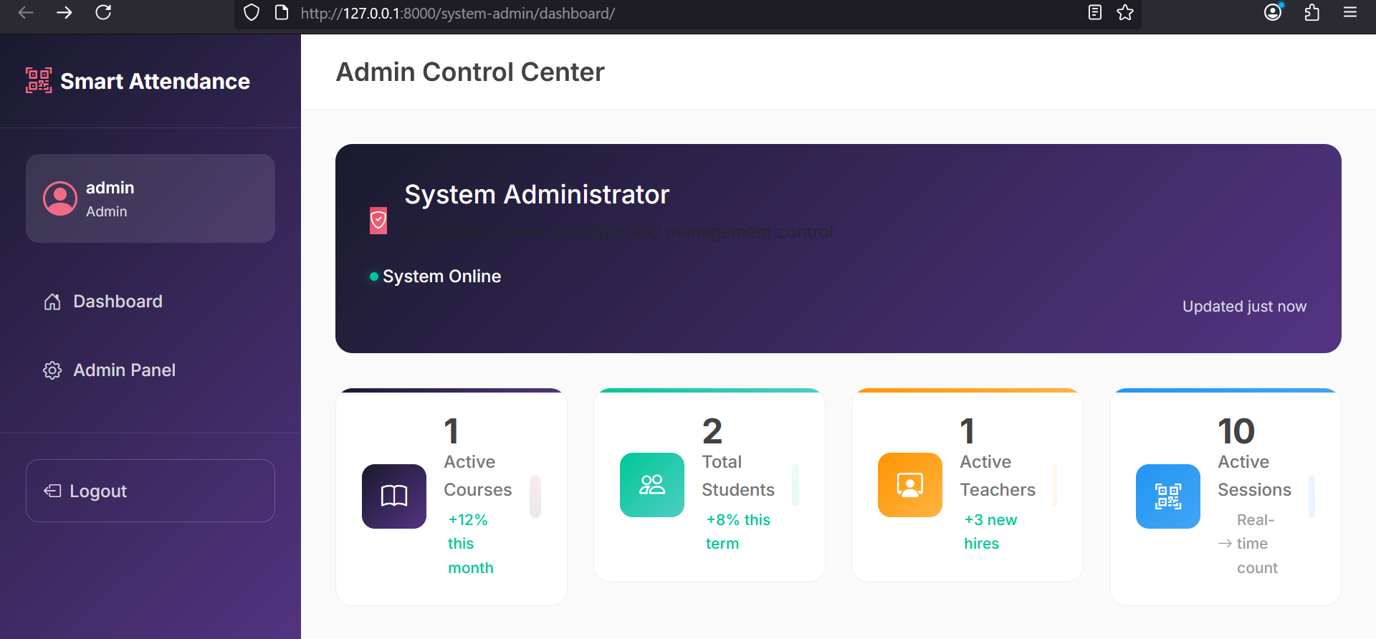
Functionality1- screenshot

Slide 33
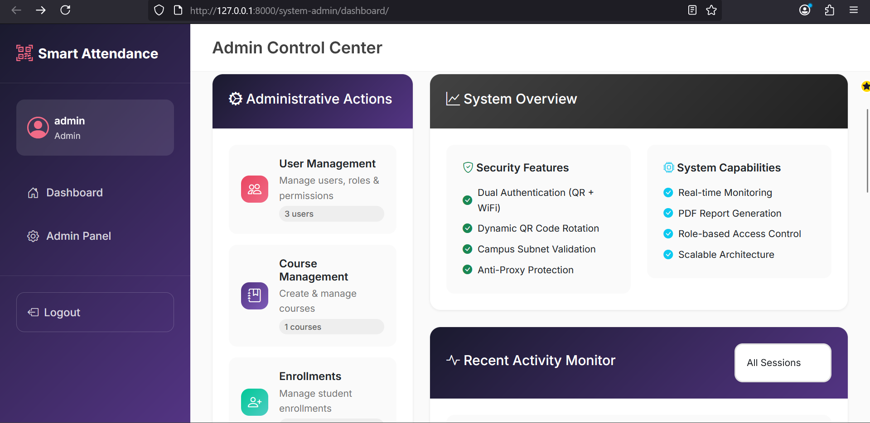
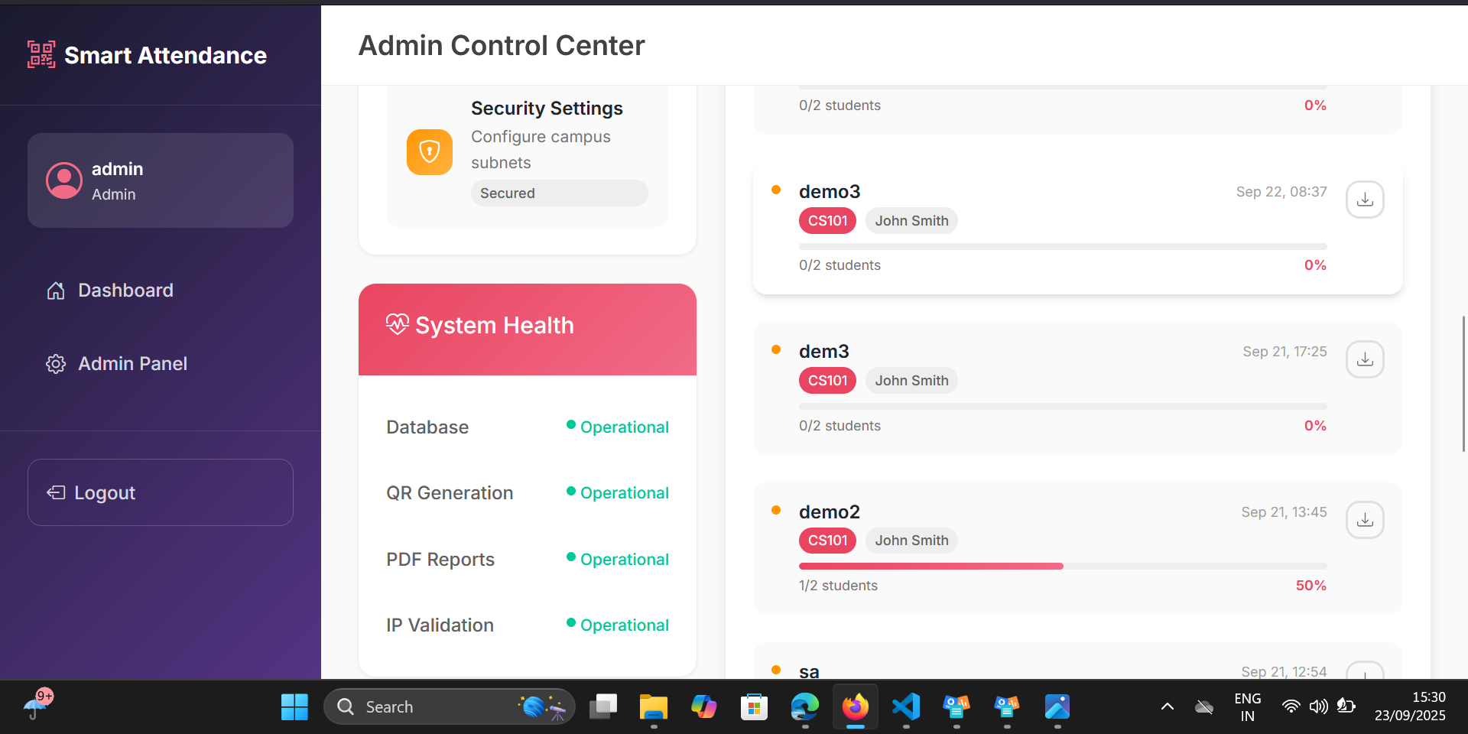
Functionality1-screenshot

Slide 34
Functionality2-Teacher Session Management
Teachers can:
Create new attendance sessions for their courses
Generate QR codes for attendance
View session details & student attendance records
Implemented using:
create_session, session_detail, refresh_qr, live_attendance_updates
create_session.html, session_detail.html

Slide 35
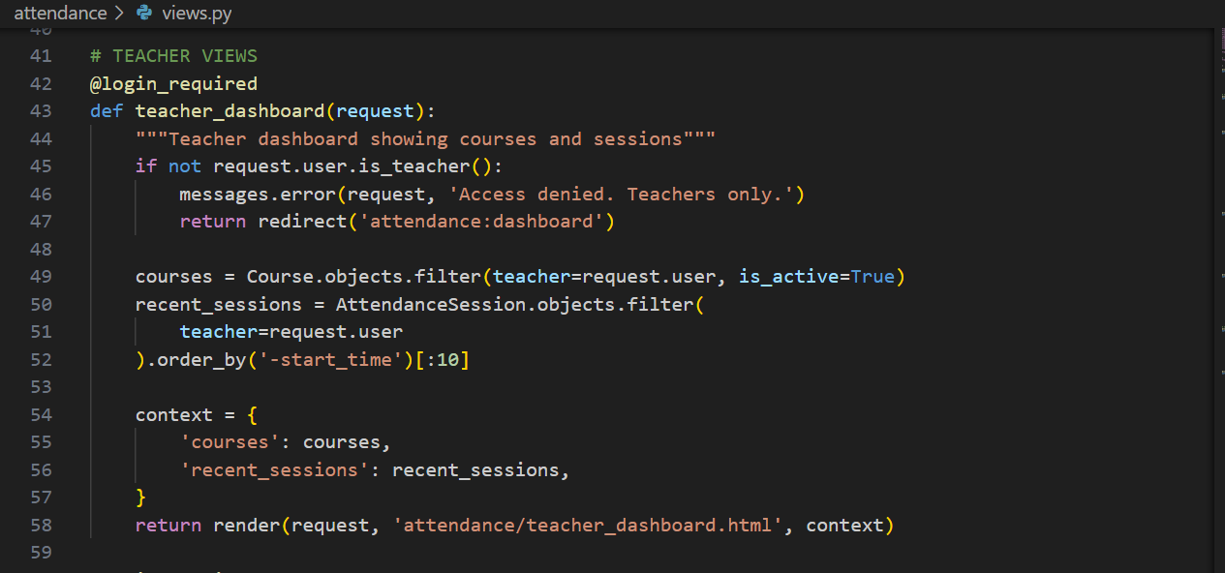
Functionality2-code snippet

Slide 36
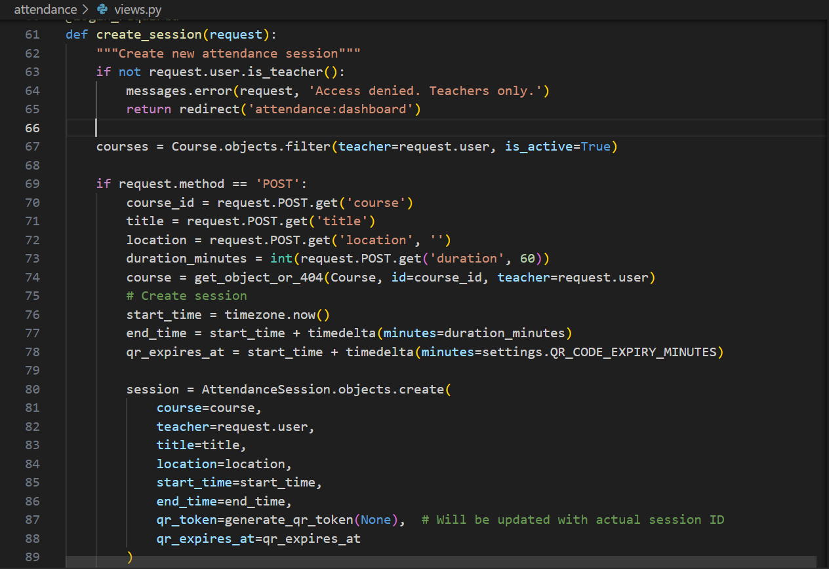
Functionality2-code snippet

Slide 37
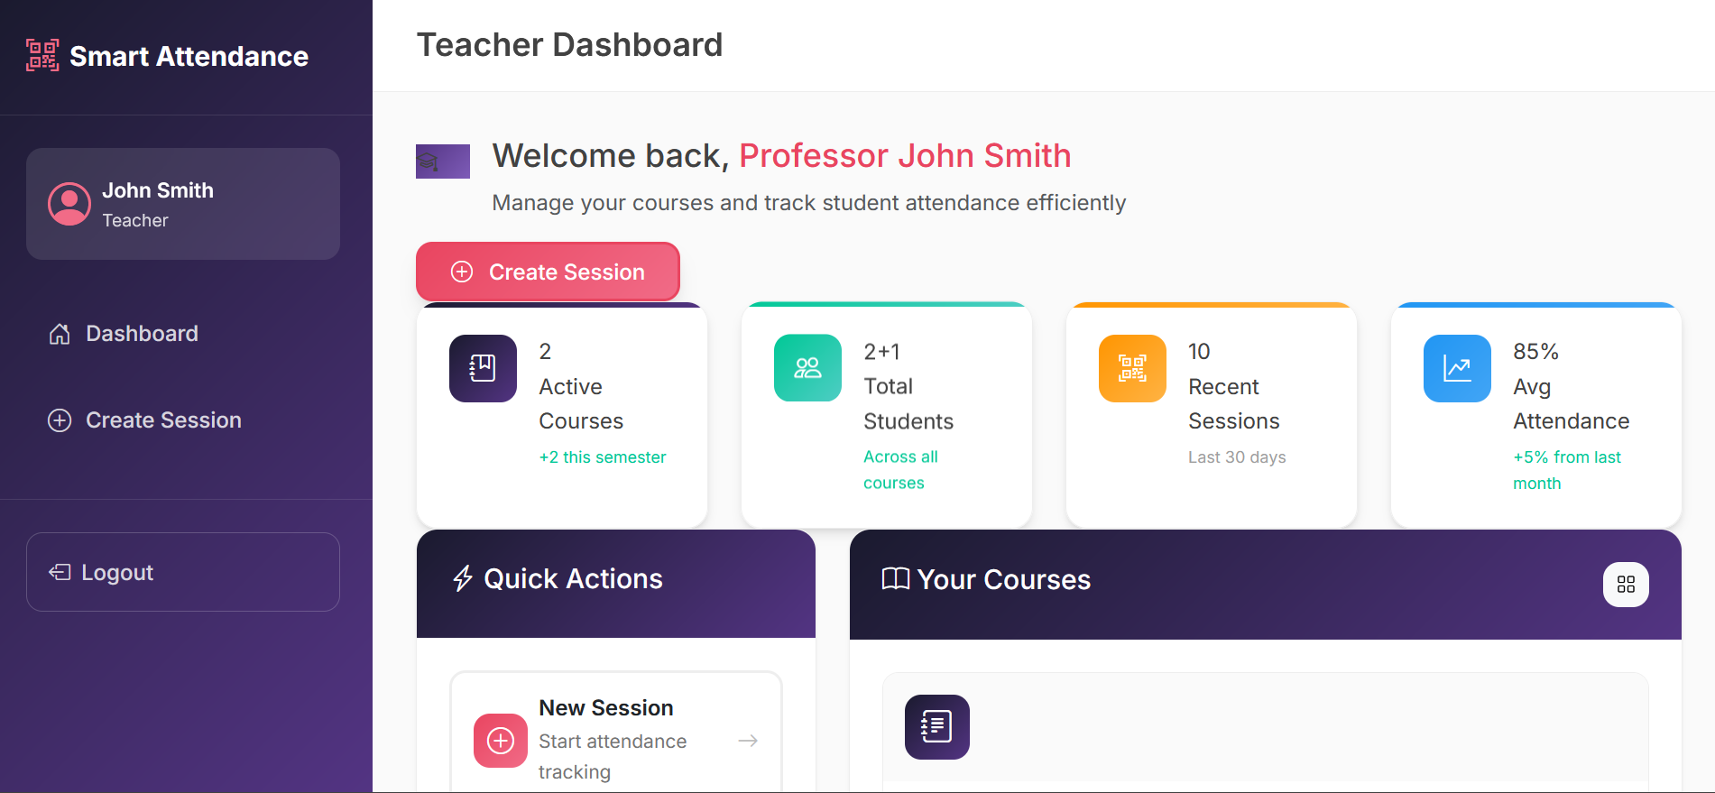
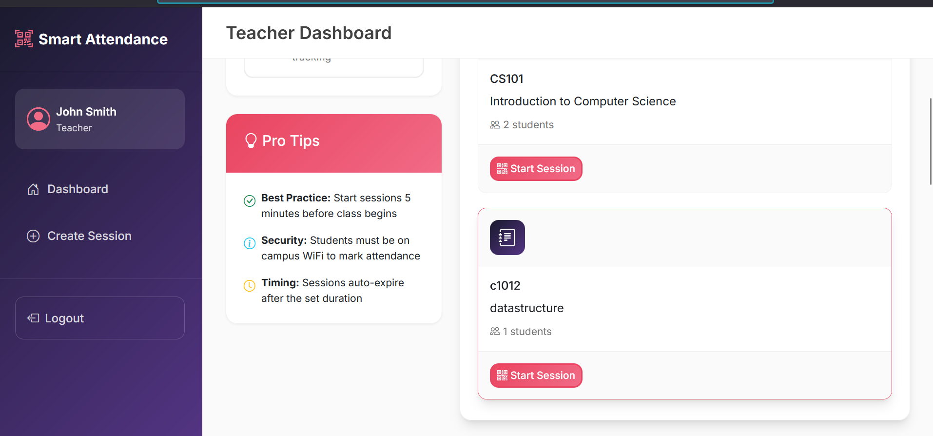
Functionality2-code snippet

Slide 38
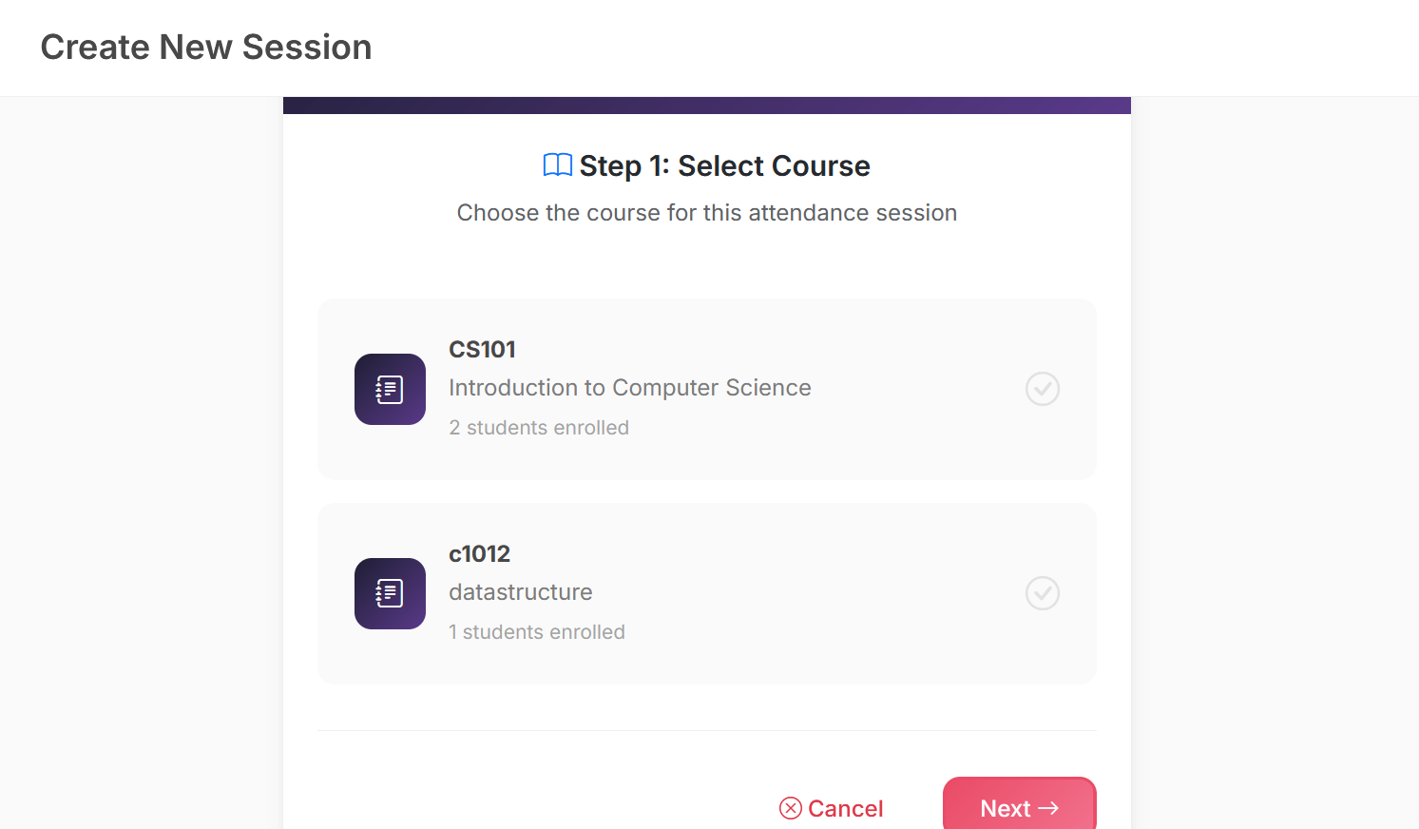
Functionality2-code snippet

Slide 39
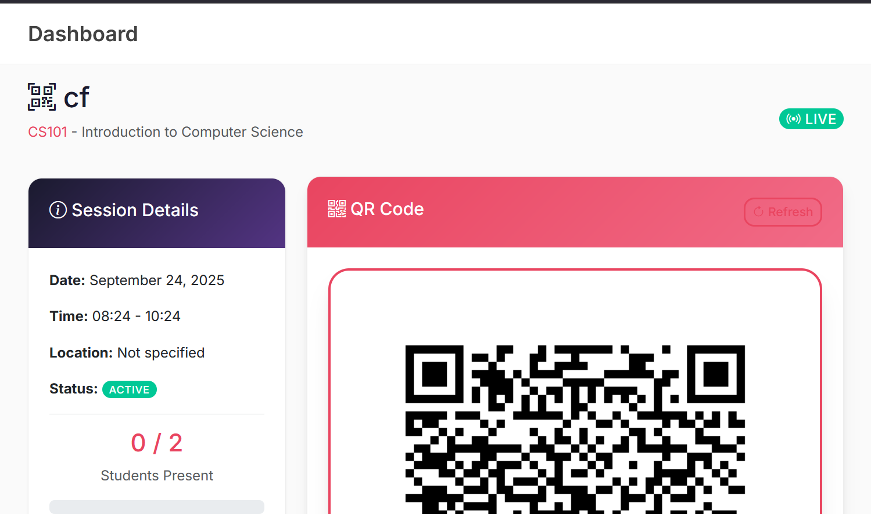
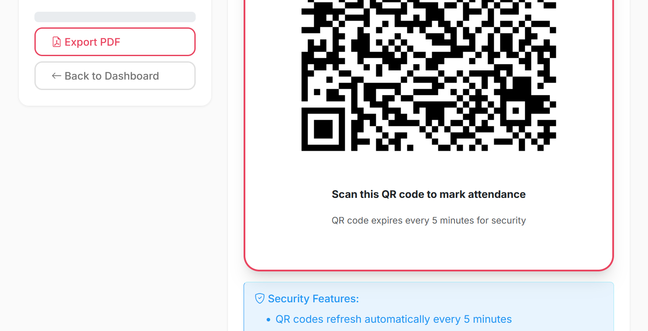
Functionality2-code snippet

Slide 40
THANK YOU

