Slide 1

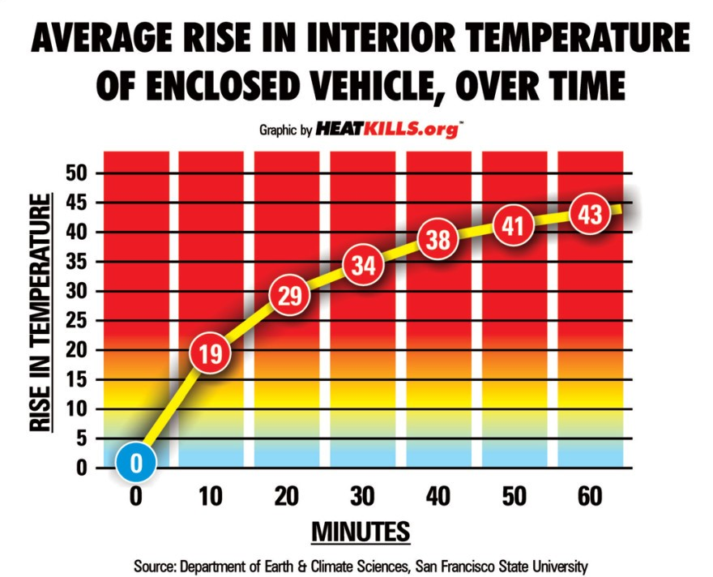
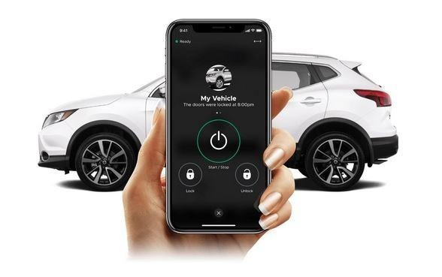
SmartHeat Guardian
Protect Lives with Engineering
ProProblem & Solution
As per NHTSA - 1000s of children have died due to high temperature in cars as the body temperature of kids raise up 3 to 5 times faster than adults.
As per PETA - Animals can sustain brain damage or die from heatstroke in just 15 minutes.
My idea is to build an intelligent solution that is easy to install, practical and affordable and prevents deaths due to heat-stroke in children and pets
Key design considerations:
It must detect both heat and motion accurately.
It should send automatic alerts and escalate if needed.
It should take measures to reduce casualties by lowering the temperature.
It should operate from the vehicle’s battery with backup power.
It should be affordable and easily installable in old and new vehicles.
Working Principle
Detect
Monitor temperature and movement inside car.
Escalate
Alert Owner
Alert & Contact Emergency services in the next 2 minutes.
Contact owner to take action within 2 minutes

Slide 2
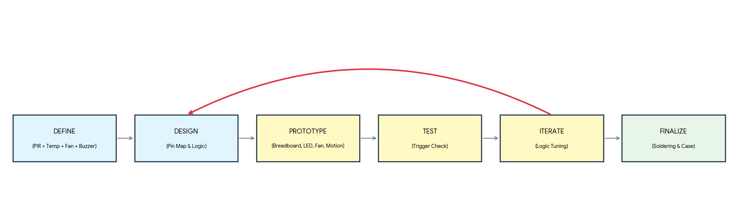
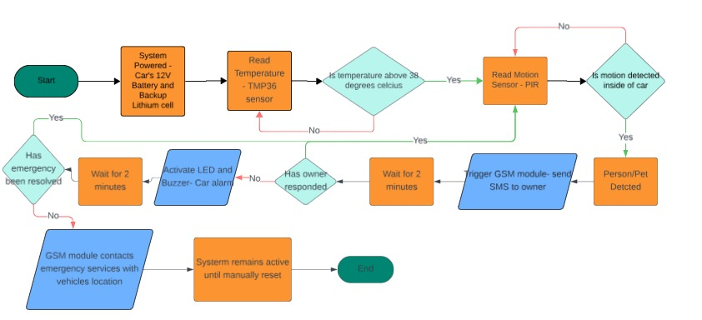
SmartHeat Guardian
Protect Lives with Engineering
Engineering Design Process
Features
⛭
Sensors Capture Data
✔
Conditions Are Checked
📱
Owner Notification
🚪
Owner Response
🚨
Alarm Activation (After 2 Minutes)
☎
Escalation to Emergency Services
🛡
False Alarm Prevention

Slide 3
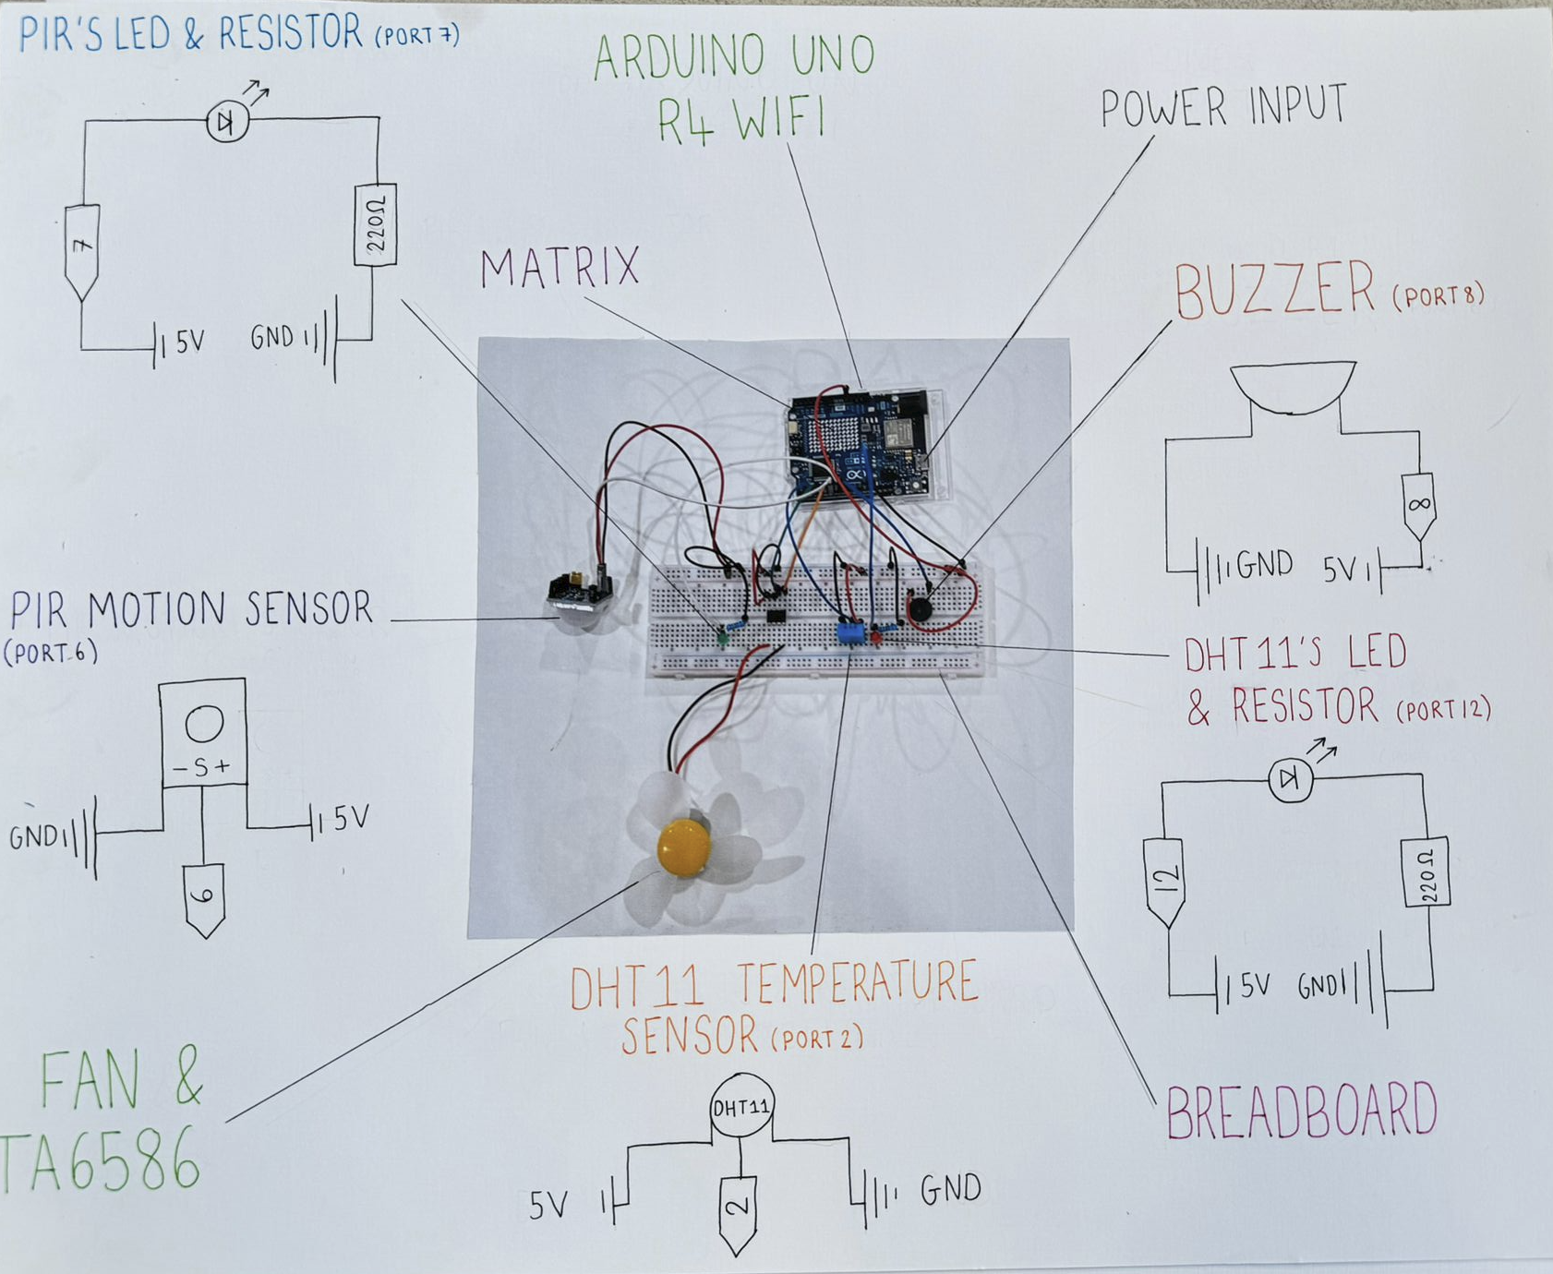
SmartHeat Guardian
Protect Lives with Engineering
Prototype
Components Used
Arduino Uno R4 WIFI Board
DHT11 Temperature Sensor
Fan
LED
PIR motion sensor
Buzzer
Implemented and Tested
Motion Detection
LED activation
Buzzer
Fan
WIFI Connection
Temperature sensor
Currently working on
SMS Notification to owner
To be implemented
Weight tracking
Escalation to emergency

Slide 4
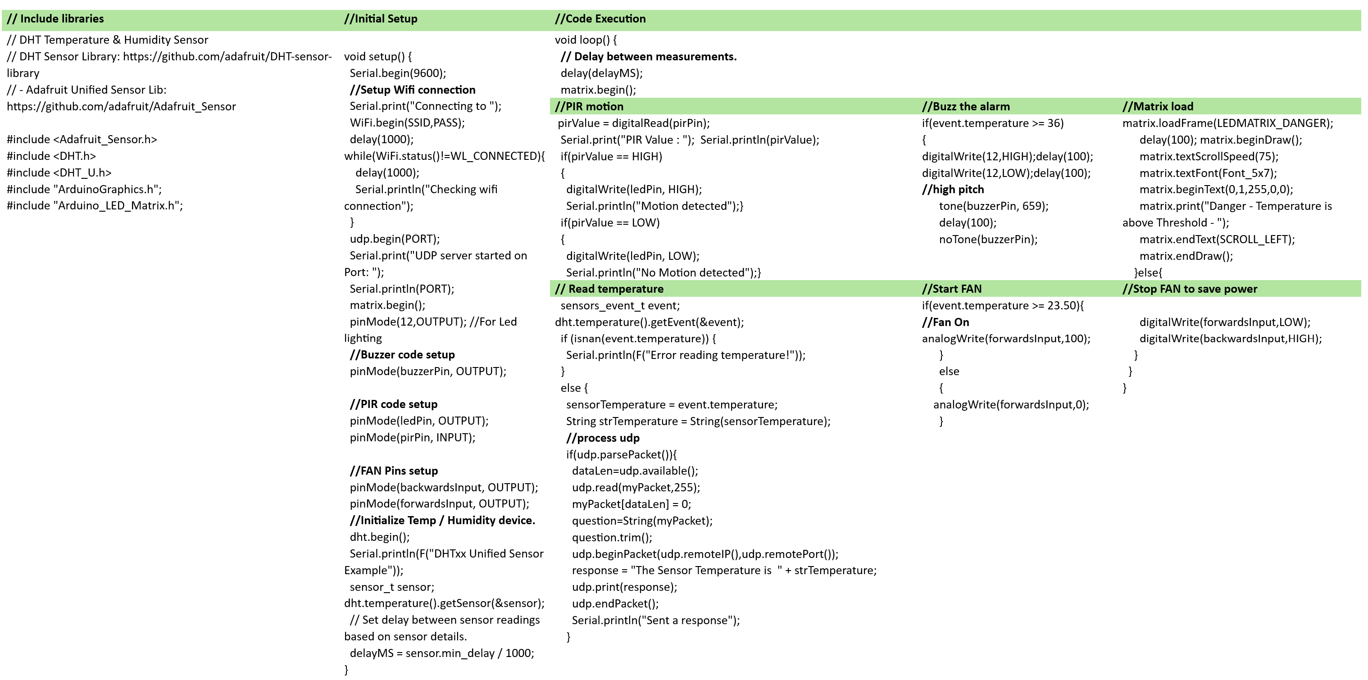
SmartHeat Guardian
Protect Lives with Engineering
Code

Slide 5
SmartHeat Guardian
Protect Lives with Engineering
Installation
Cost
PIR And TMP36 sensor on the roof
Microcontroller/GSM module behind the dashboard
Connected to the car’s 12 V battery system, which will recharge while the car runs with a backup lithium battery
Arduino Uno R4 Wifi board costs £30
The installation cost will be nominal as it can be inbuilt or a plug-in with minimal configuration.
Key Challenges
Future Improvements
1. False Triggers
2. Delayed Alerts due to the lack of signal
3. Power Management
4. Reducing temperature in cabin
5. Integration with other systems
1. Intelligent AI-powered systems
2. Predictive Risk Analysis
3. Automated Emergency Response
Key Differentiators
Pet mode is only available in new and expensive electric vehicles
It takes measures to lower the cabin temperature using AC
My solution contacts the owner and escalates to emergency services.
SmartHeat Guardian - Smarter Safety for What Matters Most

