Slide 1
Web Scraping
Web scraping is the extraction and copying of data from websites using software.
It can be done with a bot or web crawler that simulates human web surfing or with HTML requests that inform the website code of what data to copy.
Web scraping is used for various purposes, such as collecting information for analysis, comparison, or indexing
Extracted the data from the [Welcome to Python. Org]

Slide 2
Output:-

Slide 3
Parsing HTML with BeautifulSoup
What does BeautifulSoup do?
We used requests to get the page from the AllSides server, but now we need the BeautifulSoup library (pip install beautifulsoup4) to parse HTML and XML. When we pass our HTML to the BeautifulSoup constructor we get an object in return that we can then navigate like the original tree structure of the DOM.
This way we can find elements using names of tags, classes, IDs, and through relationships to other elements, like getting the children and siblings of elements.

Slide 4
Libraries installed:
Beautiful Soup
Requests

Slide 5
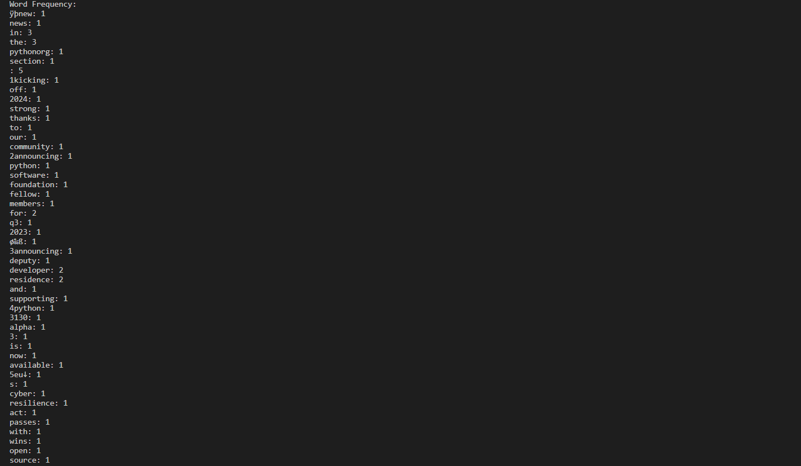
Output of word frequency : -

