Slide 1

Project Title - Typing Behavior Tracker for Learning & Self-Improvement
Subramani Meghna

Slide 2

PROBLEM STATEMENT
Many students and computer users type daily, but they do not know how they actually type — which keys they use often, which keys they press wrongly by mistake, or how consistent their typing is.
Due to this, they cannot improve their typing skills or fix bad typing habits.

Slide 3
Project Description
This project is a typing behavior tracking system that records the keys pressed by the user during typing practice.
The system stores the keystrokes in text and JSON format so that the user can later review their typing pattern.
The application runs only when the user clicks the start button and is intended for personal learning, typing practice, and keyboard usage analysis.

Slide 4

WHO ARE THE END USERS?
This project is a typing behavior tracking system that
Students
Beginners
Programmers
People preparing for typing test

Slide 5

Technology Used
Python
Tkinter (GUI)
pynput (keyboard events)
JSON (structured logs)
Text file (simple logs)

Slide 6
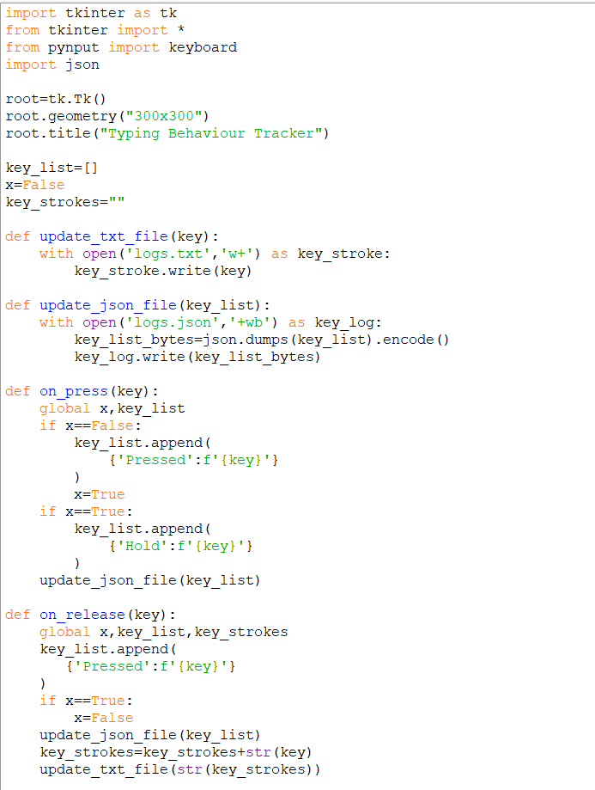
RESULTS

Slide 7
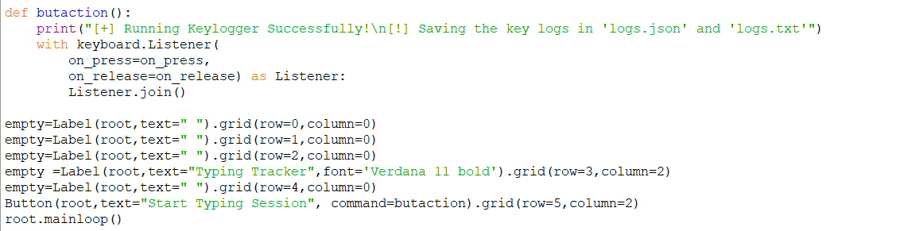
Continuation of code

Slide 8
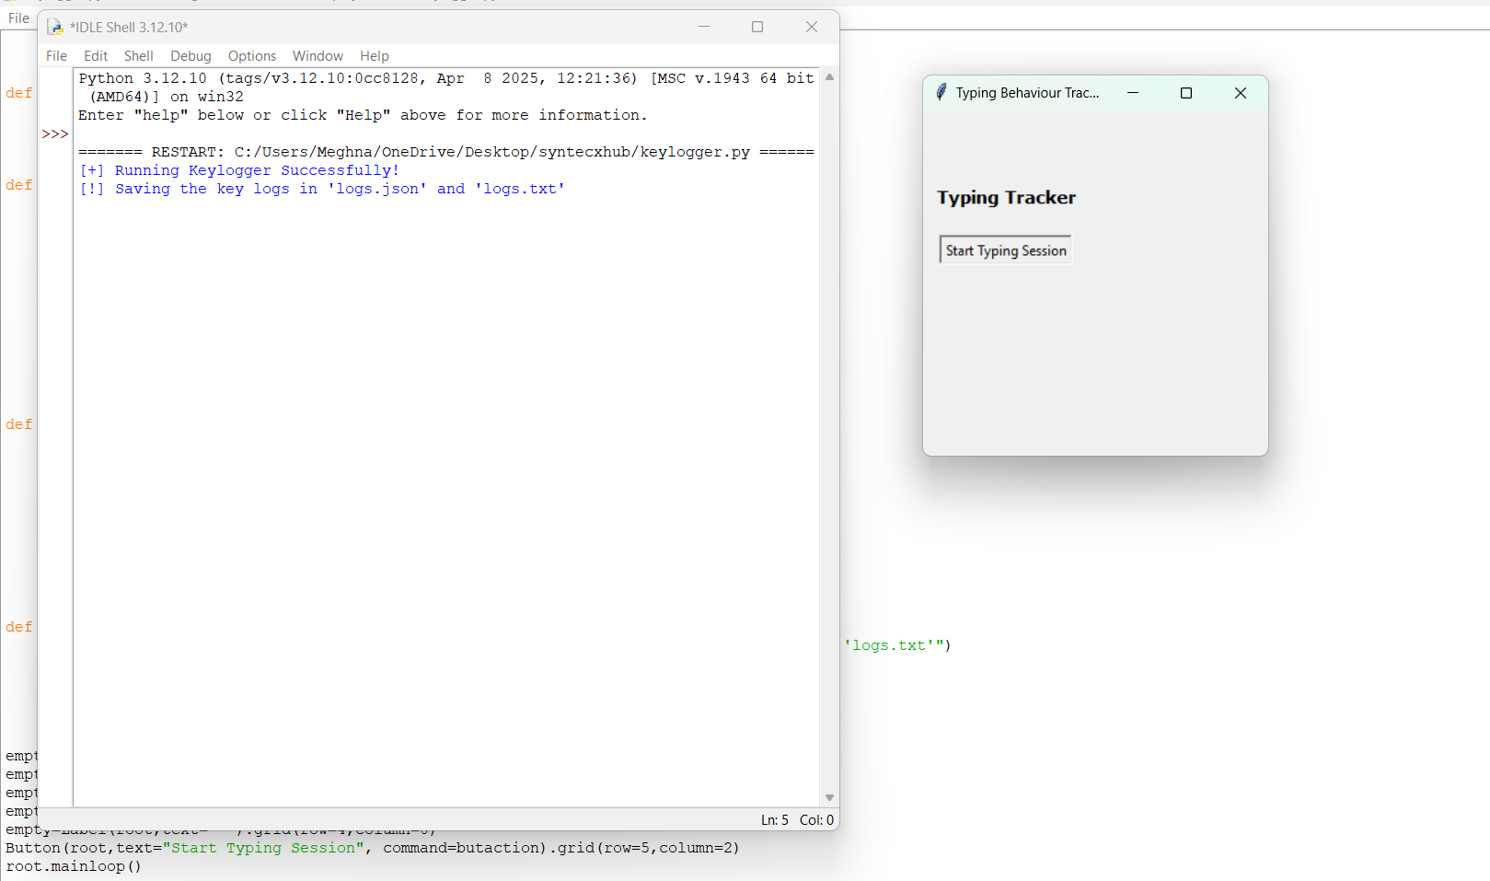

Slide 9
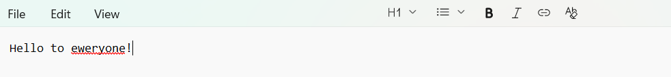
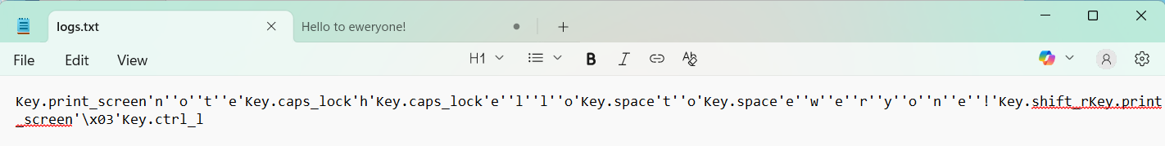
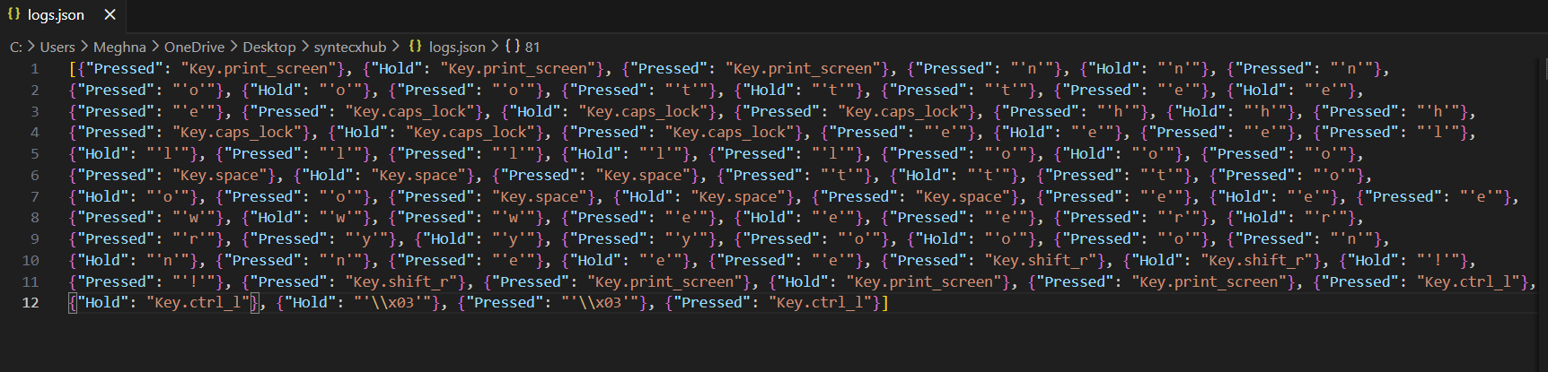

Slide 10
Thank you
.
.

