Slide 1
Yelp Business Analysis Tool
Introduction to Machine Learning
CSD316
Group 2

Slide 2
Objective
We wished to build a platform that enables businesses to analyse their performance in comparison with similar businesses in the region (state).
The platform primarily makes use of sentiment analysis to extract useful insights from the Yelp dataset.

Slide 3
Data Used
Business data
Other than basic information like business ID, name and state, we made use of the ‘categories’ field (to determine similar, competitor businesses).
Review data
The reviews corresponding to given business ID’s were extracted from review.json.

Slide 4
How It Works
Our Algorithm

Slide 5
Break review into sentences.
Get nouns using POS tagging
Use word embedding similarity to keywords to categorize
Get rating for each category/ domain
Get restaurants with much better domain ratings (largest positive difference)
Display best (most positive) and worst (most negative) reviews for competitors and user respectively

Slide 6
Some Code Snippets

Slide 7
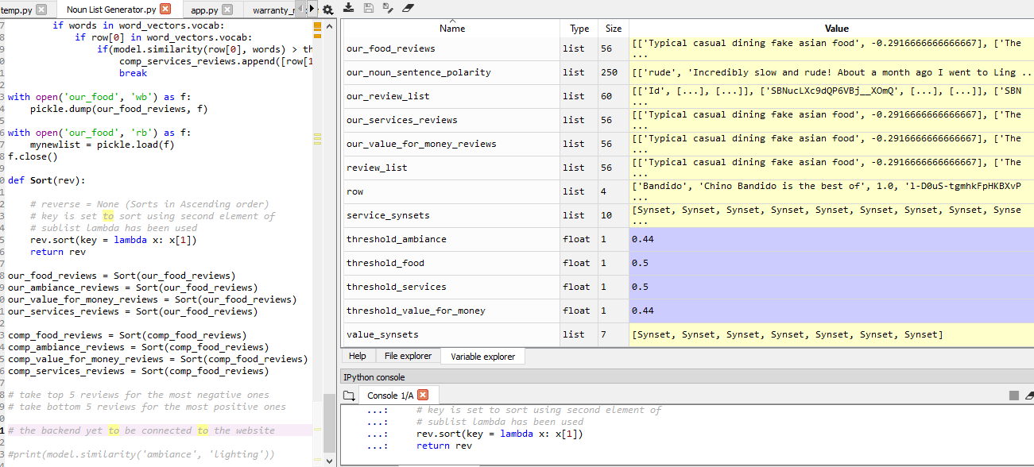

Slide 8
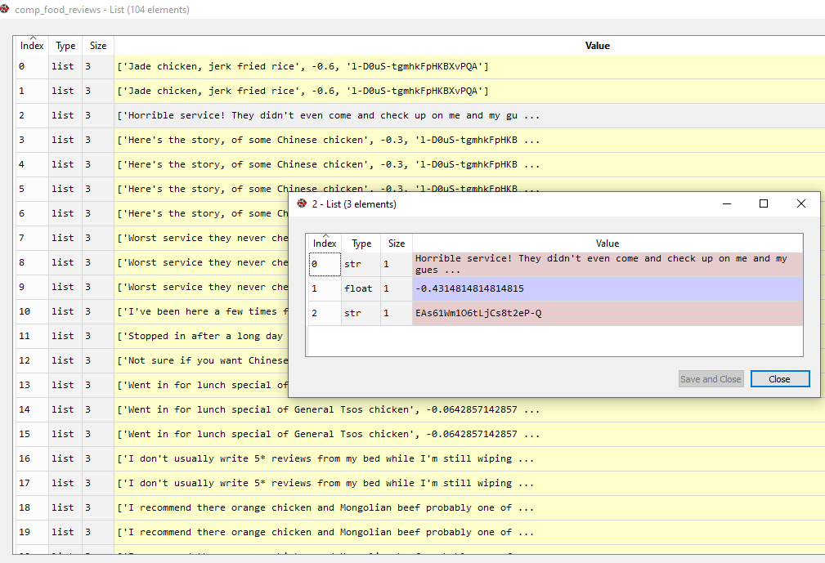

Slide 9
User Interface

Slide 10
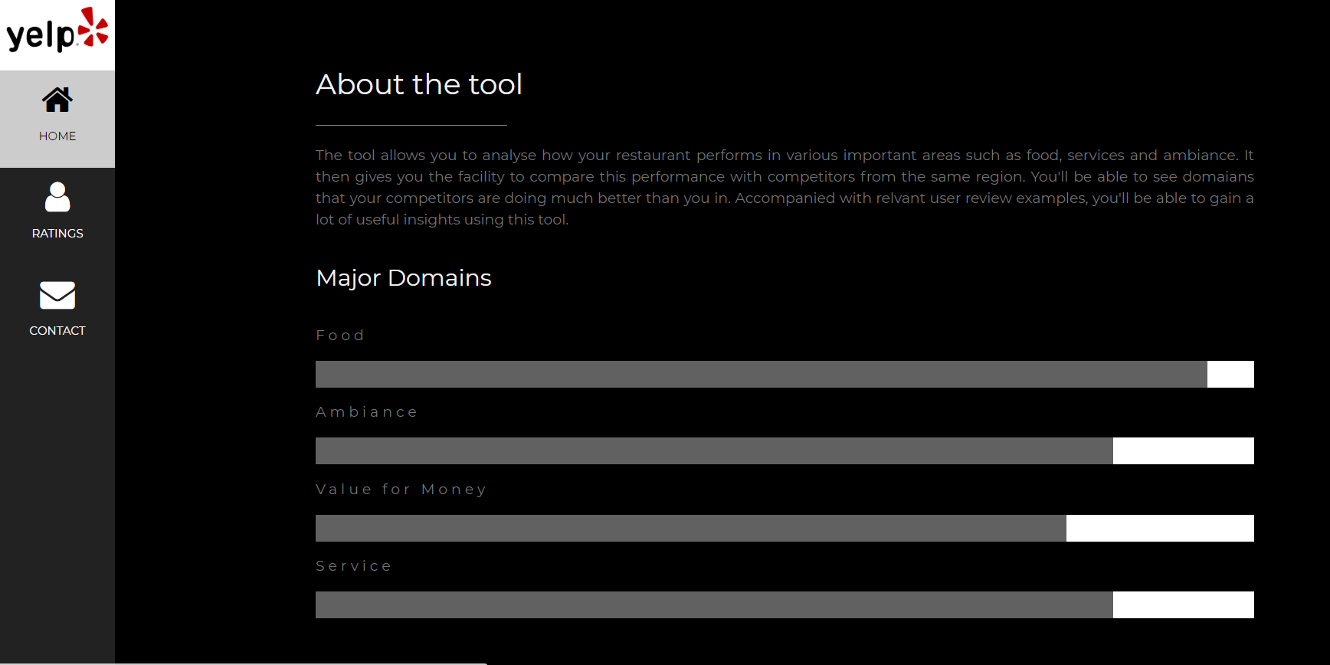

Slide 11
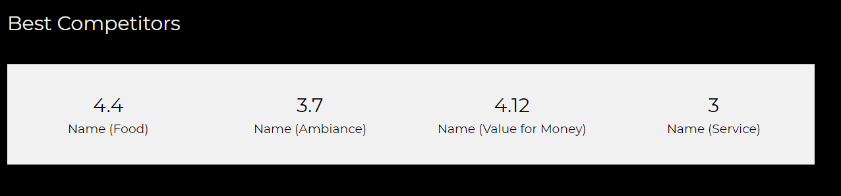
Easy to view and understand competitor scores

Slide 12
Future Scope

Slide 13
Scope for Improvement
Exception cases:
More than one domains with multiple sentiments in one sentence.
Domain noun mentioned in one sentence and sentiment mentioned in the next.
Removal of irrelevant sentences from consideration: We may use the subjectivity score for the same (assuming more subjectivity means more relevance)
The program can be scaled up (using more of the available data) and used for comparative analysis in smaller regions (than states)

Slide 14
Thank You!

