Slide 1
Traffic Violations in USA
Author: Meghna Vaishnavi Aryasri
Professor: Dr. Chaoji(Jay) Wang
Semester: Fall-2024, UMBC

Slide 2
Introduction and Background
Objective: Utilize machine learning to predict outcomes of traffic violations to enhance road safety and enforcement efficacy.
Data Source: Kaggle
Dataset Size: 7.1 MB
Number of Rows: 132,728
Number of Columns: 7columns

Slide 3
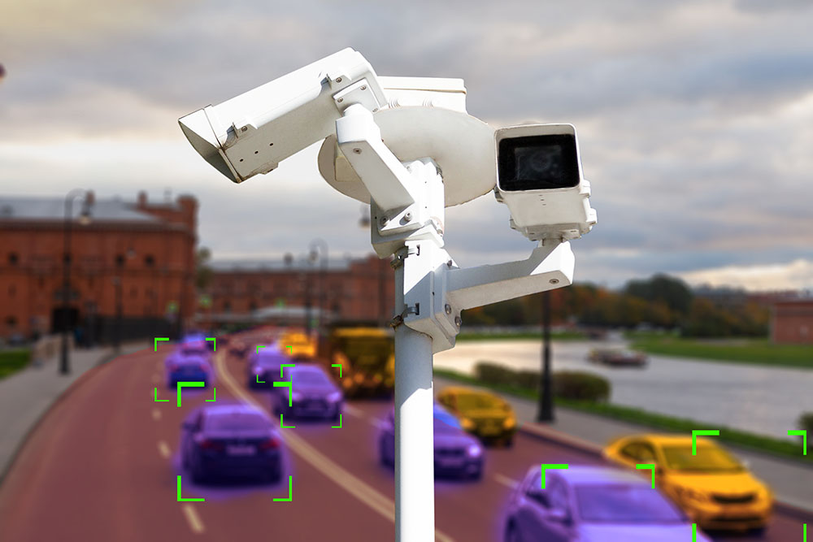
Research Questions
Trends Analysis: Identify peak times/seasons for violations.
Influential Factors: Determine key factors affecting violation outcomes.
Intervention Strategies: Develop targeted interventions based on predictive Insights.
Target Variable : Violation Type

Slide 4
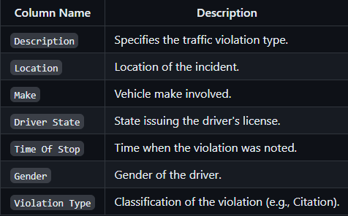
Dataset Overview
A Small Brief description about the dataset.

Slide 5
Data Preprocessing
Data Cleaning
Remove Missing Values: Deleted rows and columns with all missing data.
Duplicate Handling: Removed duplicate rows to ensure data uniqueness.
Data Type Conversion
Converted 'Time Of Stop' to datetime.
Changed 'Description', 'Make', 'Location’ etc to category types.
Feature Engineering
Introduced 'Time of Day' feature (Day or Night).
Label Encoding
Applied advanced Label Encoder for unknown labels.

Slide 6
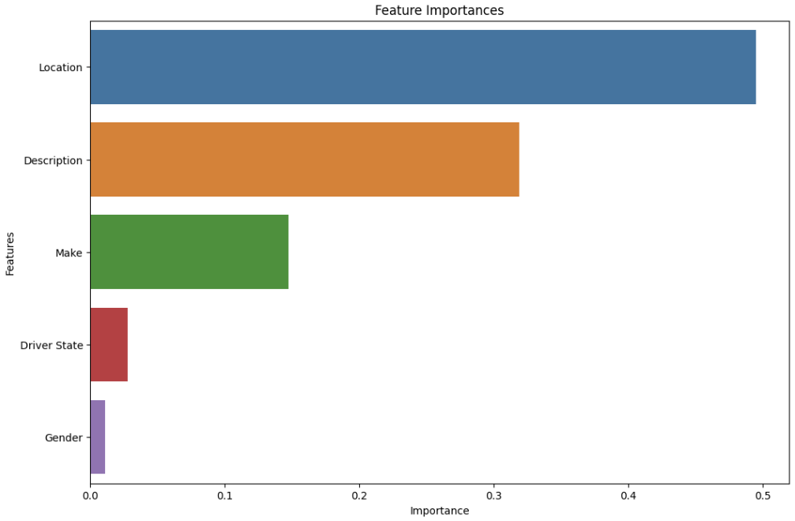
Feature Selection and Importance
Feature Selection & Importance: Optimized model performance by selecting key features and visualizing their predictive impact through importance rankings.

Slide 7
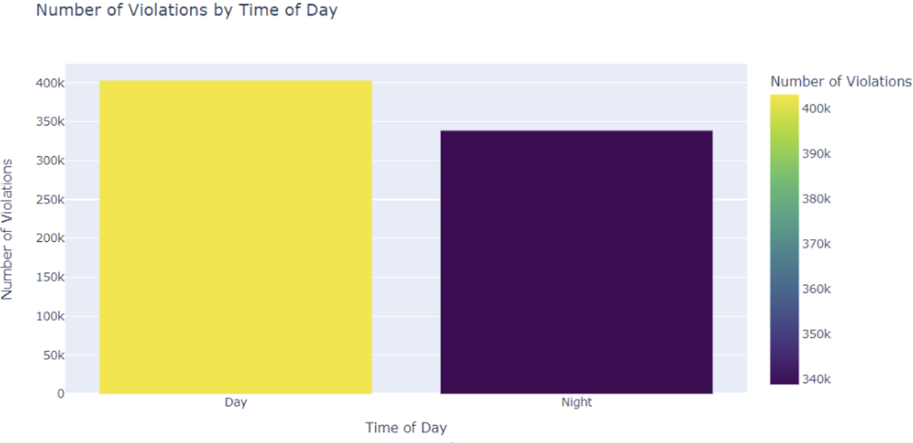
EDA
Violations by Time of Day: The bar chart shows traffic violations by time of day, indicating peak periods for enforcement.

Slide 8
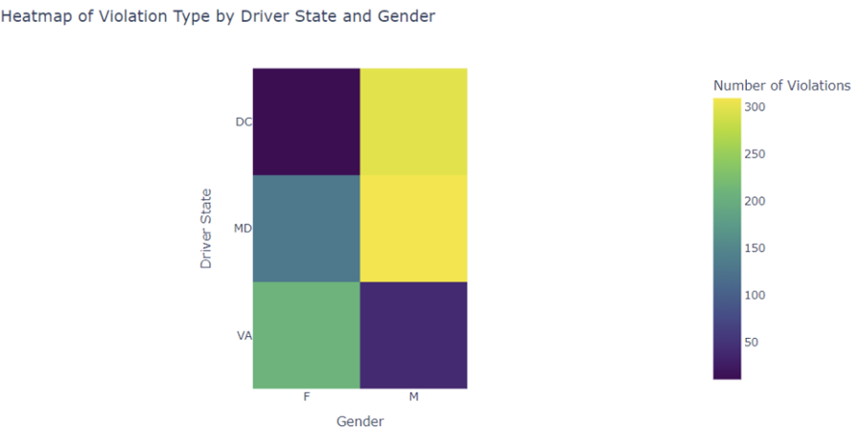
Heatmap of Violation Type by Driver State and Gender: The heatmap displays violation patterns by state and gender, aiding targeted interventions.

Slide 9
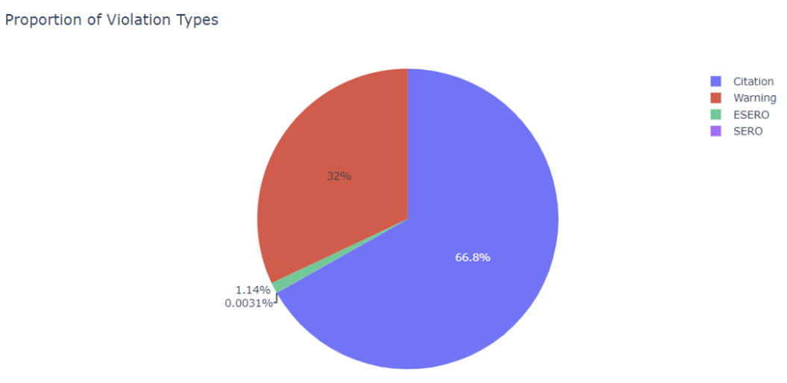
Proportion of Violation Types : The pie chart illustrates the proportion of different traffic violation types, aiding in resource allocation.

Slide 10
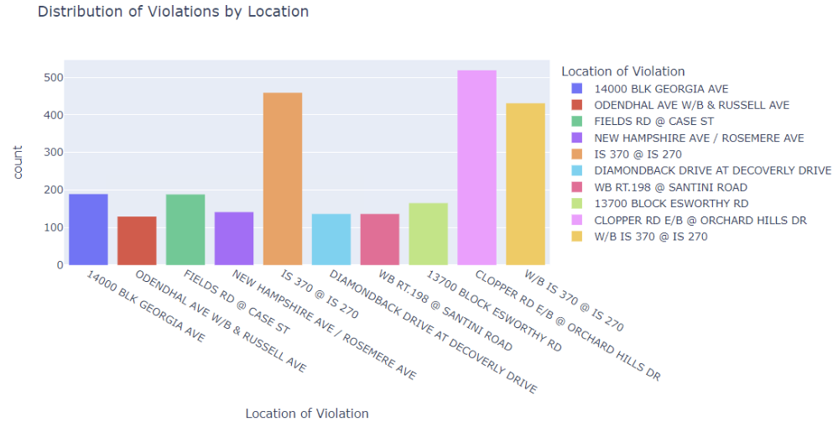
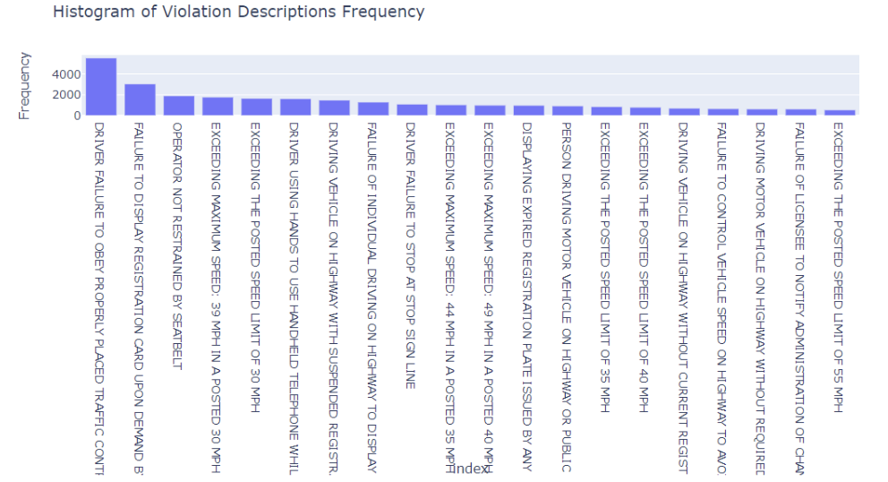
Both visualizations help identify patterns to optimize enforcement and preventive strategies.
Distribution of Violations by Location
Histogram of Descriptions Frequency

Slide 11
Model Training and Evaluation
Dataset Split: 80% training, 20% testing to ensure sufficient learning and unbiased evaluation.
Model Selection: Models used are
Random Forest,
Gradient Boosting,
Logistic Regression,
KNeighbors,
Decision Tree,
Naïve Bayes.

Slide 12
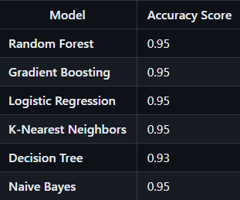
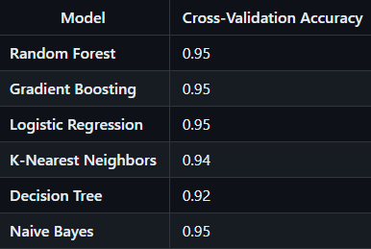
Model Evaluation
Performance Scores :
Enhanced Model Performance Scores
Cross-Validation Scores

Slide 13
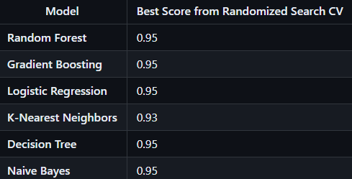

Randomized Search CV Best Scores
Ensemble Methods
Voting Classifier Performance

Slide 14

Re-Training Models
Overview: High initial accuracy scores suggested class imbalance in the dataset, risking model overfitting to the majority class.
Balancing the Dataset
Used SMOTE to correct dataset imbalance.
Generated synthetic samples for minority classes.

Slide 15
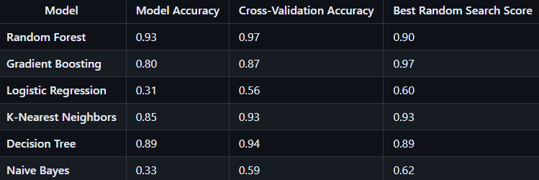
Re-Evaluation of Models
Retrained Models: Enhanced learning verified post-SMOTE.
Re-Evaluation: Assessed performance improvements after balancing.
Optimization: Fine-tuned models with Randomized Search CV.
Voting Classifier: Combined best parameters for superior accuracy.

Slide 16
Best Model Selection Post Re-Training
Model Optimization: Models were retrained and optimized on a balanced dataset.
Best Model Identification: Identified the highest performing model using Randomized Search CV results.
Top Performer: Gradient Boosting excelled with a score of 0.97, proving its effectiveness on the balanced dataset.
Model Selection: Chosen as the project's most robust predictive tool due to its high accuracy and reliability.

Slide 17
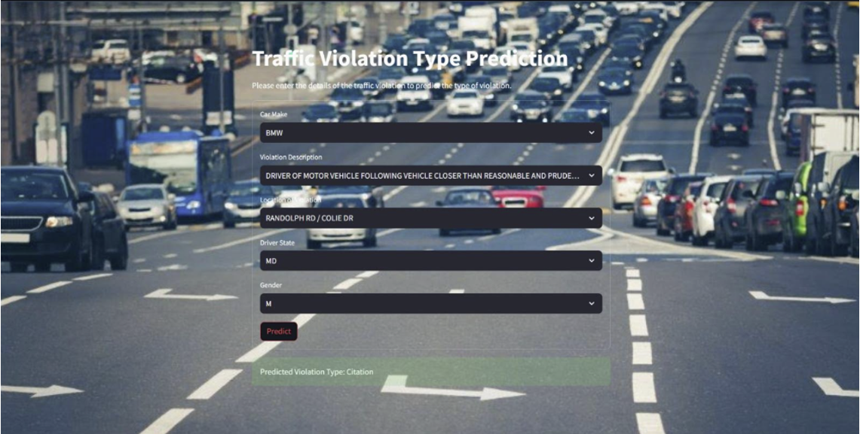
Web Application Using Streamlit

Slide 18
Web Application Overview: Streamlit app predicts traffic violations using a trained Voting Classifier.
Interactive Features: Dropdown menus allow data input for car make, violation description, location, driver state, and gender.
Real-Time Predictions: Loads and uses the Voting Classifier for immediate violation predictions upon data submission.
User-Friendly Design: Custom background and intuitive interface ensure easy user navigation.
Application Impact: Demonstrates practical use of machine learning in real-world traffic violation predictions.

Slide 19
Conclusion
Data Insights: Visualizations and analyses provided a clear understanding of when and where violations are most likely.
High Accuracy: Models like Gradient Boosting performed exceptionally well, indicating strong predictive capabilities.
Balanced Data Approach: Using SMOTE to balance the data ensured fair and accurate predictions across all violation types.
Practical Application: The Streamlit web application allows users to easily predict violations, making the model accessible to non-experts.
Broader Impact: The project demonstrates the potential of machine learning to improve public safety by informing better traffic law enforcement strategies.

Slide 20
Lessons Learned
Effective cleaning and SMOTE significantly boost model performance.
Visualizations clarify data patterns and enhance stakeholder communication.
Voting Classifier improves accuracy by leveraging strengths of multiple models.
Streamlit's intuitive design makes complex models accessible to all users.

Slide 21
References
IEEE Xplore
Detection of Traffic Rule Violations Using Machine Learning: An Analytical Review
ResearchGate
Detection of Traffic Rule Violations Using Machine Learning: An Analytical Review
Machine Learning Based Approach for Traffic Rule Violation Detection
MDPI
Machine Learning Based Approach for Traffic Rule Violation Detection
Academia.edu
Detection of Traffic Rule Violations Using Machine Learning: An Analytical Review

