Slide 1
ABC Call Volume Trend Analysis FINAL PROJECT - IV
By Meghneel Gogoi
Data Analyst Trainee
Trainity

Slide 2
Project Description
A Customer Experience (CX) team plays a crucial role in a company. They analyze customer feedback and data, derive insights from it, and share these insights with the rest of the organization. This team is responsible for a wide range of tasks, including managing customer experience programs, handling internal communications, mapping customer journeys, and managing customer data, among others.
In the current era, several AI-powered tools are being used to enhance customer experience. These include Interactive Voice Response (IVR), Robotic Process Automation (RPA), Predictive Analytics, and Intelligent Routing.
One of the key roles in a CX team is that of the customer service representative, also known as a call center agent. These agents handle various types of support, including email, inbound, outbound, and social media support.
Inbound customer support, which is the focus of this project, involves handling incoming calls from existing or prospective customers. The goal is to attract, engage, and delight customers, turning them into loyal advocates for the business.

Slide 3
Approach
Downloading the dataset
Understanding the data and the business of the company
Cleaning and handling missing data
Finding insights from the altered clean data
Data visualization through graphs and charts

Slide 4
Tech-Stack Used
Microsoft Excel 365 : Excel is used extensively for data cleaning, initial data exploration, and basic statistical analysis. Its user-friendly interface allows for quick visualization of patterns, trends, and anomalies in data.
Microsoft PowerPoint: PowerPoint is used for creating presentations to communicate insights derived from data analysis. Visualizations, charts, and summaries of findings are crafted into slides for meetings, project updates, and stakeholder briefings

Slide 5
EXCEL LINK: https://docs.google.com/spreadsheets/d/14G5nyfHpnLdfrOSUcGcXU_zbzr9MJNY_/edit?usp=sharing&ouid=117119704857987901939&rtpof=true&sd=true

Slide 6
Understanding the data
The dataset provided contained:
Columns | Rows
13 | 117988

Slide 7
Data Cleaning
If Agent_name and Agent_ID column had #N/A value in the row, it meant the call by the customer was abandoned.
Blank rows of Wrapped_By column imputed with #N/A if calls were abandoned. If calls were picked up and wrapped_by column was blank, Agent was imputed through mode imputation.
The column ringing was deleted since it only contained one value `YES`.
Row Labels | Count of Agent_Name
Agent | 60396
AutoWrapped | 9715
#N/A | 34403
(blank) | 13474
Grand Total | 117988
#N/A are the abandoned calls and blanks are imputed with agent with mode imputation

Slide 8
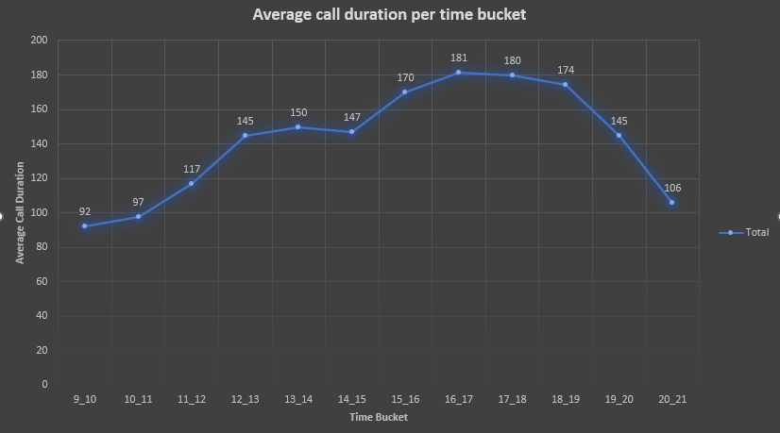
INSIGHTS
Data Analytics Tasks
TASK 1: Determine the average duration of all incoming calls received by agents. This should be calculated for each time bucket.
From the graph we can conclude longer duration calls are made mostly around 3 PM – 7 PM
Least duration calls are made during early hours of 9 AM - 11 AM

Slide 9
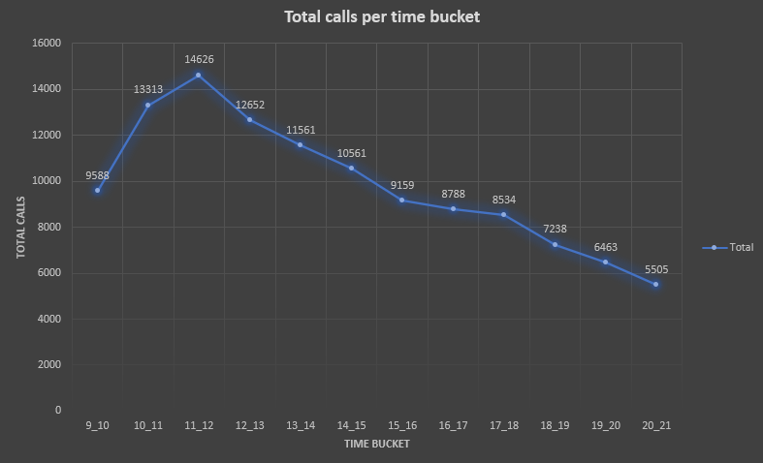
TASK 2: Visualize the total number of calls received. This should be represented as a graph or chart showing the number of calls against time. Time should be represented in buckets (e.g., 1-2, 2-3, etc.).
Most number of calls are made during time duration 10 AM – 2 PM
More number of agents should be allotted in this time slot to reduce the workload and chances of missing calls

Slide 10
TASK 3: What is the minimum number of agents required in each time bucket to reduce the abandon rate to 10%?
We’ve been provided with the agent working hour information and it concludes the following:
An agent's total working hours are 9 hours, out of which 1.5 hours are spent on lunch and snacks in the office. On average, an agent spends 60% of their total actual working hours (i.e., 60% of 7.5 hours) on calls with customers/users.
So, total hours agent can work is 4.5 hours and average duration of calls is around 140 seconds. So total calls an agent can pickup is `3600/140` which is approximately 26 calls.

Slide 11
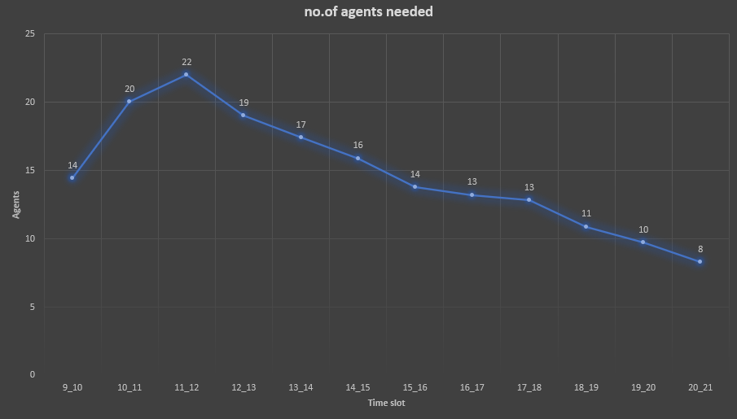
From calculations, number of agents needed throughout the day is increased to decrease the abandon rate to 10%
From 9 AM – 9 PM the agents needed are shown in the graph with proper manpower planning.
More number of agents are needed during rush hours where number of calls are high and abandoning chances increased.

Slide 12
Night Shift Manpower Planning: Customers also call ABC Insurance Company at night but don't get an answer because there are no agents available. This creates a poor customer experience. Assume that for every 100 calls that customers make between 9 am and 9 pm, they also make 30 calls at night between 9 pm and 9 am. The distribution of these 30 calls is as follows:
We know that the average total calls are 5130. 30% calls are made at night after 9 pm to 9 am.
So, average calls made at night is `5130 * 0.3` which is 1539.
Now we divide 1539 calls according to the percentage distribution given in the table accordingly.
Number of calls an agent can pick up is 26/hour so we divide 26 from the total calls we get by calculating.

Slide 13
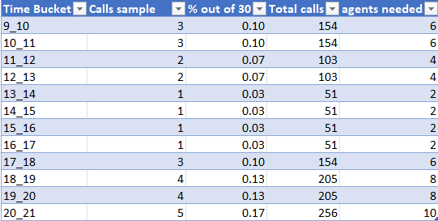
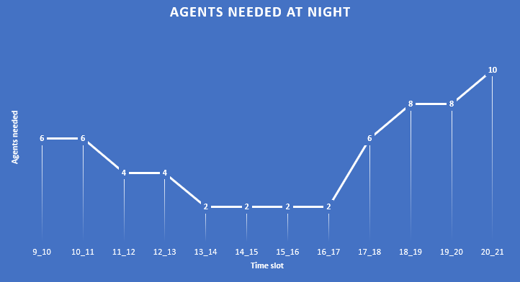
Graph shows agent needed in each time slot accordingly.
Most active hours for night shift agents is early morning.
Total number of calls increases after 6 am and agent needed also increases to pickup these calls

Slide 14
RESULT
From this project, I learned how critical customer experience is to the success of a business, especially within inbound customer support. Analyzing the dataset spanning 23 days provided valuable insights into agent performance, customer wait times, and call outcomes. Through this analysis, I was able to understand the different factors that influence customer satisfaction, such as queue times, call durations, and whether calls were abandoned, answered, or transferred.
This project helped me refresh my statistics and mathematics needed as a data analyst. Completing this project also helped me understand more about CX and how its important for any business and what goes on behind the scenes allotting each agent to maximize the efficiency.

