Slide 1
IMDB Movie Analysis
Final Project - I
~Meghneel Gogoi
Data analytics trainee
trainity

Slide 2
Project Description
The dataset provided is related to IMDB Movies. A potential problem to investigate could be: "What factors influence the success of a movie on IMDB?" Here, success can be defined by high IMDB ratings. The impact of this problem is significant for movie producers, directors, and investors who want to understand what makes a movie successful to make informed decisions in their future projects.
Project was done by me and all the tasks required were carried out with the best of my knowledge gained from the course provided by Trainity.
EXCEL FILE HYPERLINK:
https://docs.google.com/spreadsheets/d/1PGTVHaulm2yosRaziEFOgnLVTyyLoUIz/edit?usp=sharing&ouid=117119704857987901939&rtpof=true&sd=true
VIDEO LINK:
https://youtu.be/fmIKiCLK4u4

Slide 3

Approach
Downloading dataset and importing it to excel.
Carrying out tasks with the best of my knowledge gained from the course of excel.
Data cleaning: Handling missing values, removing duplicates and converting data types if necessary.
Five Why’s approach: Technique used to help dig deeper into the problem.

Slide 4
Tech-Stack Used
Microsoft Excel 365
PowerPoint Presentation (For displaying project)

Slide 5


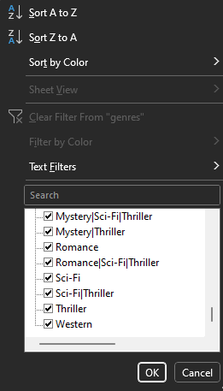
Insights
Data Cleaning:
Data was cleaned from the table. All the duplicates from the given dataset were removed and any rows with blank values were removed to perform excel functions and data analysis without any issues.
No blanks are left as you can see from the image given, same with all columns and no duplicates left hence, the data is cleaned successfully to proceed to do analysis.
Extra columns which had no need were removed and only relevant data columns needed were shown.
director_name, duration, gross, genres, movie_title, language, country, budget, title_year, imdb_score were the relevant column

Slide 6
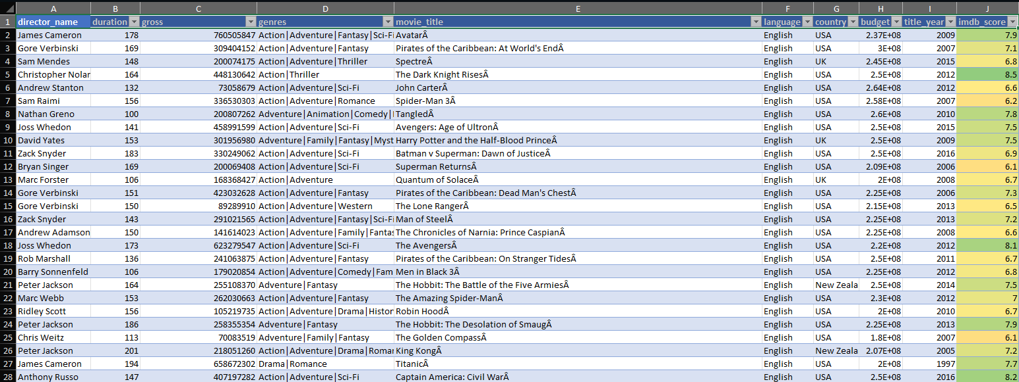
The cleaned data table looks like this now.

Slide 7
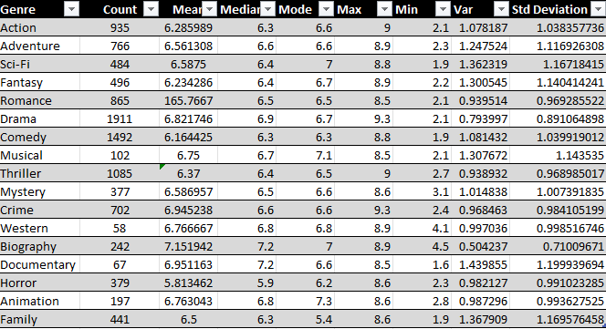
A. Movie Genre Analysis :
All the main genres with their
Count, mean, median, mode, max, min and standard deviation Drama genre has the most movie count and with an impressive average IMDB score. Biography genre has the most average IMDB score of 7.15.
People don’t seem to be liking horror genre much with it being the lowest average IMDB mean score being 5.81
Count and mean IMDB score wise, drama and crime seems to be liked by people. Crime and drama also have movies with the highest IMDB score of 9.3 .
Documentary genre seems to be the most inconsistent with std deviation being 1.19. The minimum IMDB score of documentary genre is 1.6 and highest being 8.5.

Slide 8
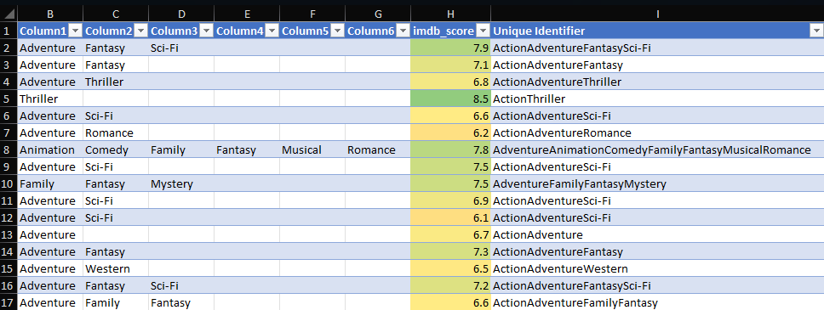
How movie genre analysis was done:
Movie genres were converted to text to column with delimeter as ` | ` so we can separated each genre for search and find functions by excel.
FUNCTIONS USED:
COUNT : =COUNTIF(A:G, M6)
MEAN : =AVERAGEIF($A$2:$G$3787, M6, $H$2:$H$3787)
MEDIAN: =MEDIAN(IF($A$2:$G$3787 = M6, $H$2:$H$3787))
MODE: =MODE(IF($A$2:$G$3787 = M6, $H$2:$H$3787))
MAX: =MAX(IF($A$2:$G$3787 = M6, $H$2:$H$3787))
MIN: =MIN(IF($A$2:$G$3787 = M6, $H$2:$H$3787))
VAR: =VAR(IF($A$2:$G$3787 = M6, $H$2:$H$3787))
STD DEV: =STDEV(IF($A$2:$G$3787 = M6, $H$2:$H$3787))

Slide 9
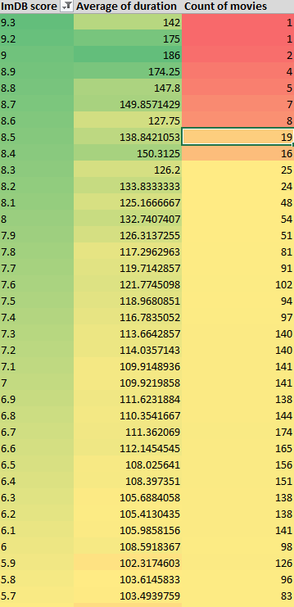
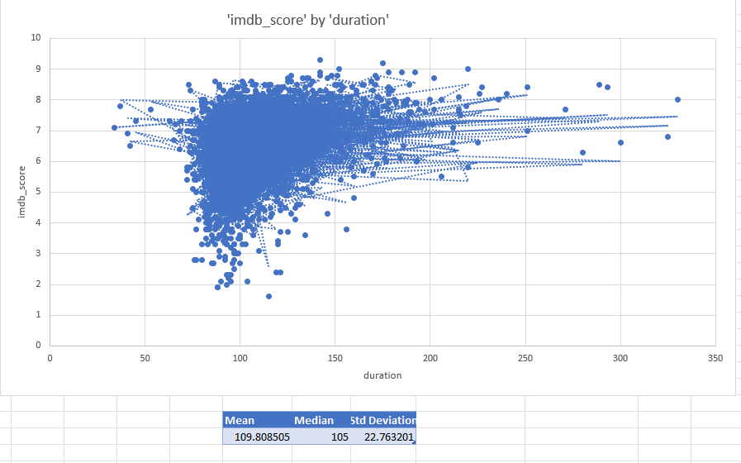
B . Movie duration Analysis:
Most movies with highest IMDB score seems to have 120+ duration.
From the table we can clearly see IMDB movie scores drop along with average of duration.
Considering 7 as an average good IMDB score, for an average movie to do good the duration should be atleast 95+ seeing the trend from the table.
As movies with higher budget have the ability to make high duration movies they seem to be loved by the audience. Lower IMDB scores have an average duration less than 100 showing their was not much effort given in making it neither did the audience loved it.

Slide 10
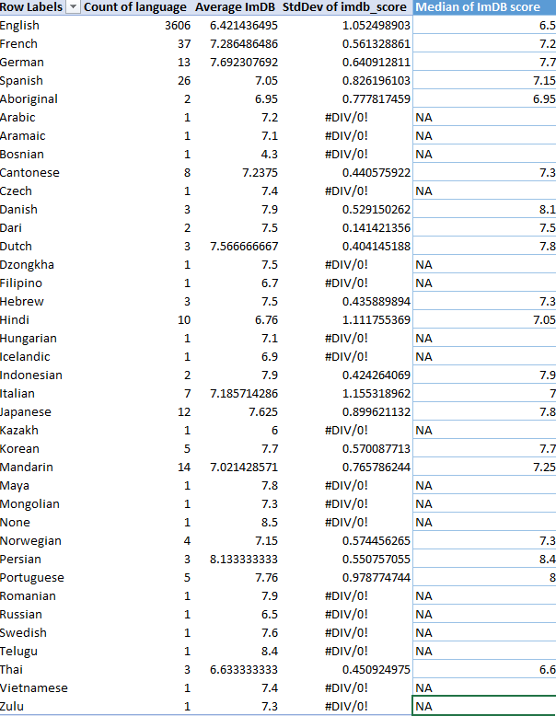
C . Language Analysis:
English language has the most movies followed by French and Spanish.
Since English has the more movies with a significant amount it has an average IMDB score of 6.4 and median score of 6.5. Most of the highest IMDB scores are from English movies.
French movies seems to be doing better than Spanish since they have more count of movies and higher average IMDB with a less standard deviation.
Languages with only one movies have no median hence showing error and no standard deviation.
Japanese and german movies seem to be doing equally good and they have mostly equal count.
But, Japanese movies have higher standard deviation meaning their IMDB scores are inconsistent, some movies either hitting the top IMDB score marks or really less imdb scores.
From the main dataset Japanese movies have scores ranging very high as 8.7 to very low as 3.9.

Slide 11
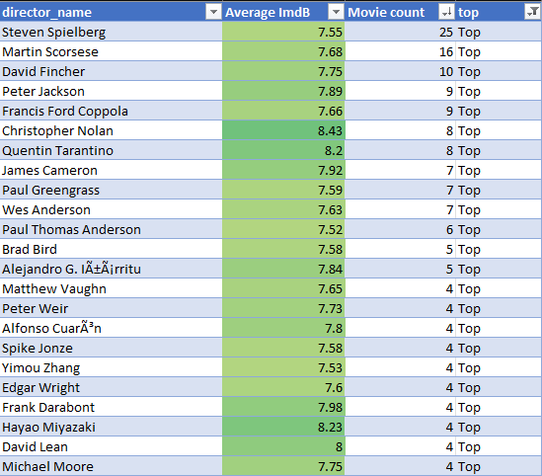
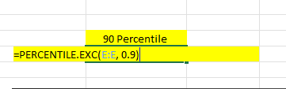
D . Director Analysis:
All the top directors with their average IMDB scores and movie count are shown.
For directors with only one movie were not counted in top director list since there were many directors with only one movies irrespective of whether they scored good IMDB.
Pivot table was used to show the data in a organised manner and a filter TOP was used which was labelled to directors with average IMDB scores higher than 90 percentile of all the director’s IMDB scores.
` =PERCENTILE.EXC(E:E, 0.9) ` function returned the value 7.5. Meaning top 90 percentile directors have average IMDB scores more than 7.5 hence labelling them as top.

Slide 12
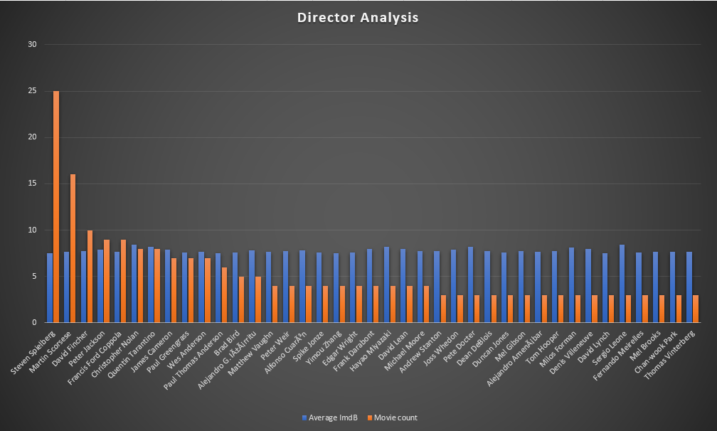
From the table we can see Steven Spielberg seems to be doing very good with an impressive movie count of 25, 9 more than the 2nd highest director of movie counts. Even with high movie count Steven has managed to maintain an impressive 7.55 IMDB score.
Cristopher Nolan is the top director with 8 movies and a staggering 8.43 average IMDB score. All his movies seem to be a blockbuster. Following him is Quentin Tarantino with same movie count and 8.2 average IMDB score.
Highest average IMDB score is with Sergio Leone with 8.44 average IMDB and 3 movie count.

Slide 13
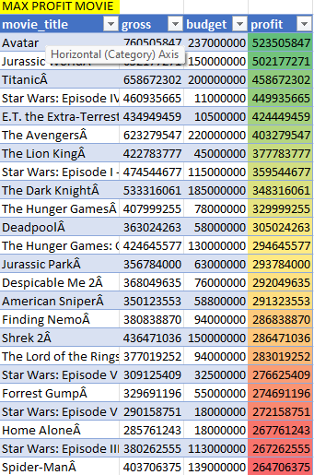
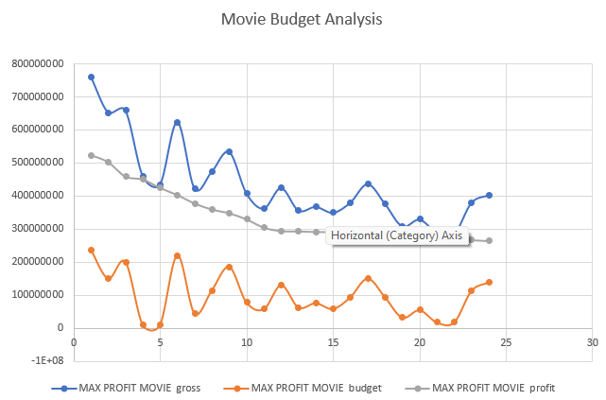
E . Budget Analysis:
Movie with most profit is Avatar with an impressive 523 million profit.
From the graph we can see there’s a high discrepancy of budget, Movies with high budget
Seems to have high gross and movies with slightly low budget can also have high gross respective of their budget having profits same as movies with higher budgets.
Movies like avatar with really high budget of 237M hit the highest grossing 760M making the profit 523M
Movies with lower budget compared to avatar such as Star War: Episode IV had only 11M budget but hit grossing of 460M, making a 449M profit.
So, we can conclude that movies with lower budget can have higher percentage gross compared to their budget making a very big profit competing the top grossing movies.

Slide 14

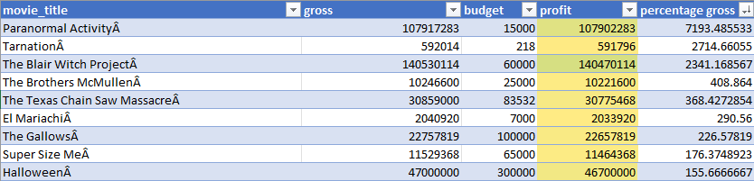
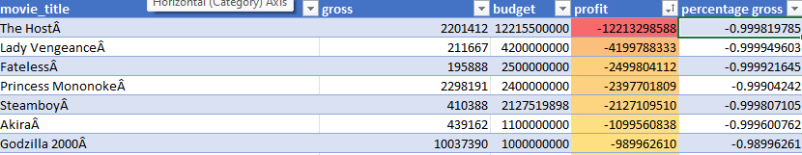
Movie budget and gross correlation was found out to be 0.096 which doesn’t mean a lot.
FORMULA: =CORREL(Table6[gross],Table6[budget])
Percentage gross column has formula =(B2-C2)/C2 which takes budget into consideration showing movies with really low budget having the most highest percentage of profit shown in the table.
Paranormal Activity with only budget of 15000 pulled off a gross of 107M that’s a percentage profit of 7193% which is mind boggling. Same goes with Tarnation with only a budget of 218 and profit of 592014.
There’s also movies with no profit. The host movie with a budget of 12 billion didn’t make any money but made a loss of 12B with a profit of
2 million.
So, to conclude movies and budget don’t have much correlation, movies with high budget can flop and movies with really low budget can make it on top, there’s no telling. The movie has to be loved by the audience and made good according to the budget.

Slide 15
Result
This project helped me learn advanced excel and how to use tables and functions in industry level. Data cleaning, data manipulation and insights concepts were put to test in excel and I delivered accordingly to my skills and knowledge gained in the course in this project.

Slide 16
Thank You

