Slide 1

Analyzing the Impact of Car Features on Price and Profitability
By Meghneel Gogoi Data Analyst Trainee Trainity

Slide 2
Project Description
The automotive industry has been rapidly evolving over the past few decades, with a growing focus on fuel efficiency, environmental sustainability, and technological innovation. With increasing competition among manufacturers and a changing consumer landscape, it has become more important than ever to understand the factors that drive consumer demand for cars.
In recent years, there has been a growing trend towards electric and hybrid vehicles and increased interest in alternative fuel sources such as hydrogen and natural gas. At the same time, traditional gasoline-powered cars remain dominant in the market, with varying fuel types and grades available to consumers.
For the given dataset, as a Data Analyst, the client has asked How can a car manufacturer optimize pricing and product development decisions to maximize profitability while meeting consumer demand?
This problem could be approached by analyzing the relationship between a car's features, market category, and pricing, and identifying which features and categories are most popular among consumers and most profitable for the manufacturer. By using data analysis techniques such as regression analysis and market segmentation, the manufacturer could develop a pricing strategy that balances consumer demand with profitability and identify which product features to focus on in future product development efforts. This could help the manufacturer improve its competitiveness in the market and increase its profitability over time.

Slide 3
Approach
Downloading the dataset
Understanding the data
Cleaning and handling missing data
Using descriptive statistics, linear regression and other analysis to find insights
Data visualization

Slide 4
Tech-Stack Used
Microsoft Excel 365 : Excel is used extensively for data cleaning, initial data exploration, and basic statistical analysis. Its user-friendly interface allows for quick visualization of patterns, trends, and anomalies in data.
Microsoft PowerPoint: PowerPoint is used for creating presentations to communicate insights derived from data analysis. Visualizations, charts, and summaries of findings are crafted into slides for meetings, project updates, and stakeholder briefings.

Slide 5
EXCEL LINK: https://docs.google.com/spreadsheets/d/1J_QRTC87hBftSccEB1wEztqsdc9oFbqU/edit?usp=sharing&ouid=117119704857987901939&rtpof=true&sd=true

Slide 6
Understanding Data
One dataset was provided in excel sheet format. DATASET . XLSX
Total columns were 16
Total rows were 11915
Duplicates removed were 715
Total Columns | Total Rows | Duplicates
16 | 11915 | 715

Slide 7
Data Cleaning
Engine fuel types were changed to make data more concise and visibly appealing
3 rows of BLANKS from engine fuel type deleted.
Blank rows of engine HP. If electric, impute 0.
engine cylinder 0 for electric
highway mpg 354 deleted, outlier detected and no such technological advancement in 2017.
Some of the missing engine fuel type were imputed using median.
Engine Fuel Type | changed
premium unleaded (required) | premium unleaded
premium unleaded (recommended) | premium unleaded
flex-fuel (unleaded/E85) | flex-fuel(E85)
flex-fuel (premium unleaded recommended/E85) | flex-fuel(E85)
flex-fuel (premium unleaded required/E85) | flex-fuel(E85)
flex-fuel (unleaded/natural gas) | flex-fuel(NG)

Slide 8
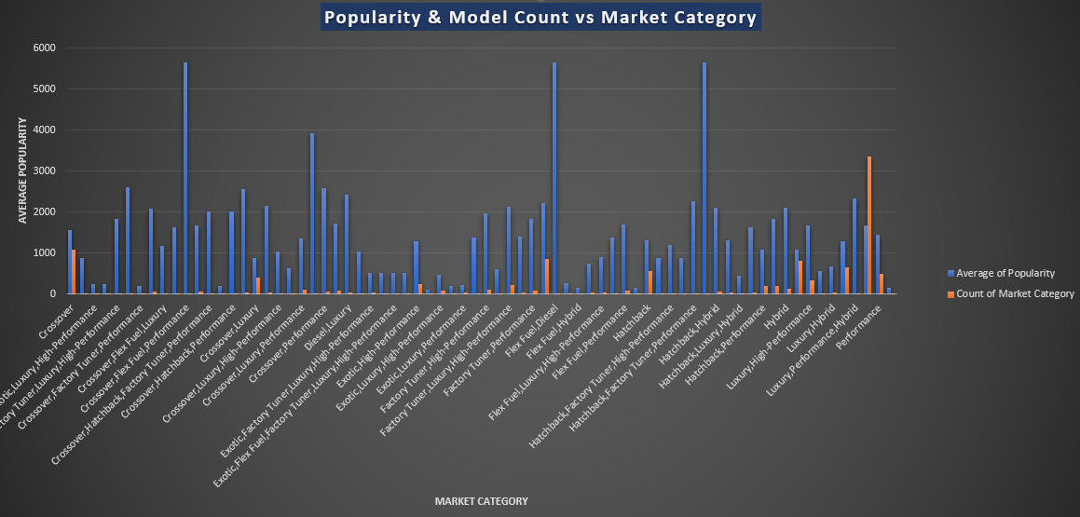
Insights
Task 1: How does the popularity of a car model vary across different market categories?
Market category with the most average popularity: Crossover, Flex Fuel, Performance | Flex Fuel, Diesel

Slide 9
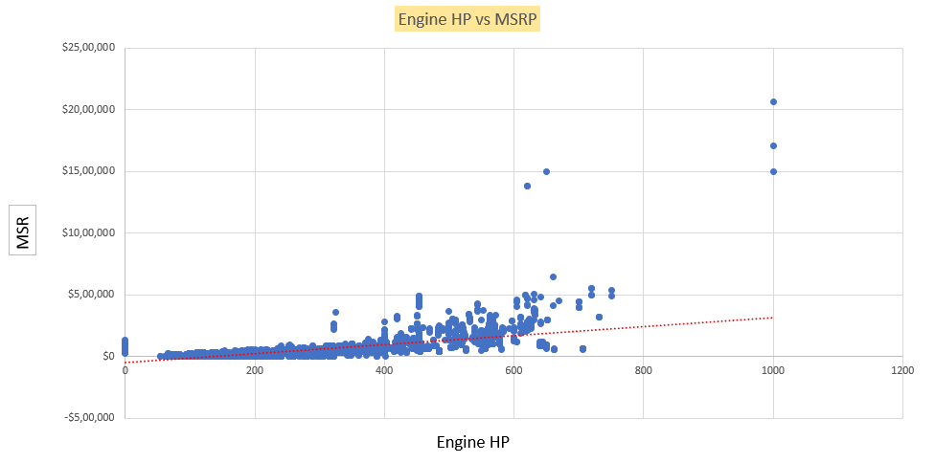
Task 2: What is the relationship between a car's engine power and its price?
Coefficient: 360.5
Positive correlation between engine HP and MSRP.

Slide 10
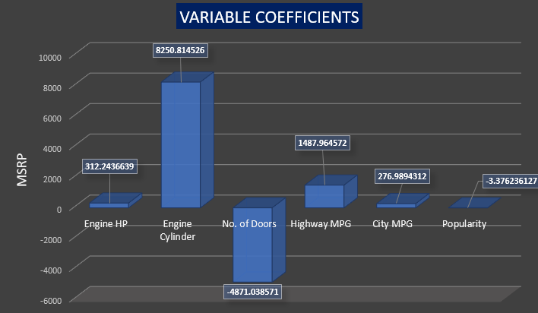
Task 3: Which car features are most important in determining a car's price?
Engine Cylinder has 8250 coefficient and number of doors has least with -4871 coefficient.

Slide 11
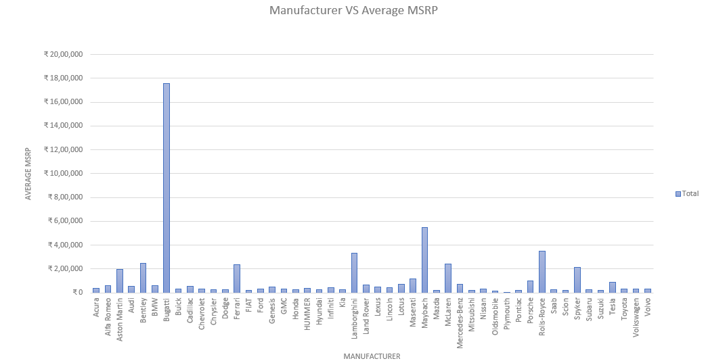
Task 4: How does the average price of a car vary across different manufacturers?
Bugatti has the highest average MSRP of $ 1,757,224.
Plymouth with only $ 3,700

Slide 12
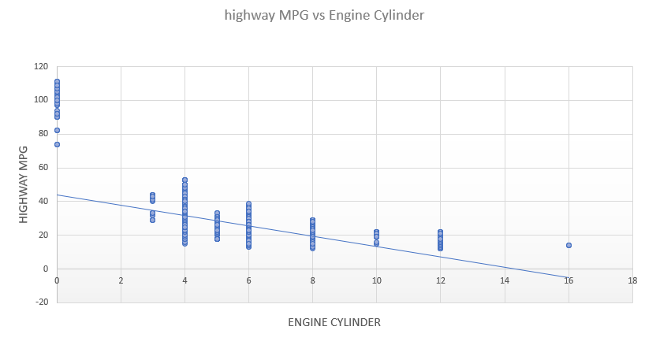
Task 5: What is the relationship between fuel efficiency and the number of cylinders in a car's engine?
Correlation coefficient: -0.6557

Slide 13
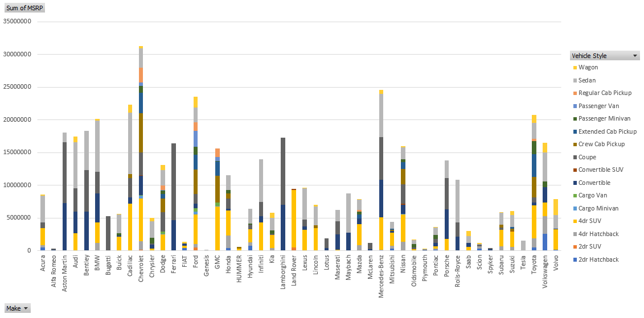
Dashboard Analysis Tasks
Task 1: How does the distribution of car prices vary by brand and body style?
Top total MSRP earned is by Chevrolet $ 31,252,763
Genesis with least MSRP earned with $1,39,850.
Slicers are provided in excel for interactive charts.

Slide 14
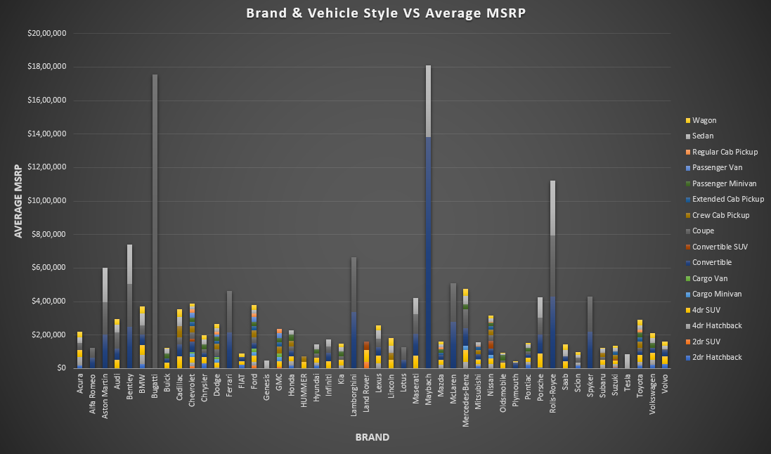
Task 2: Which car brands have the highest and lowest average MSRPs, and how does this vary by body style?
Top average MSRP is of Bugatti of $ 1.7M
Least average MSRP is of Plymouth

Slide 15
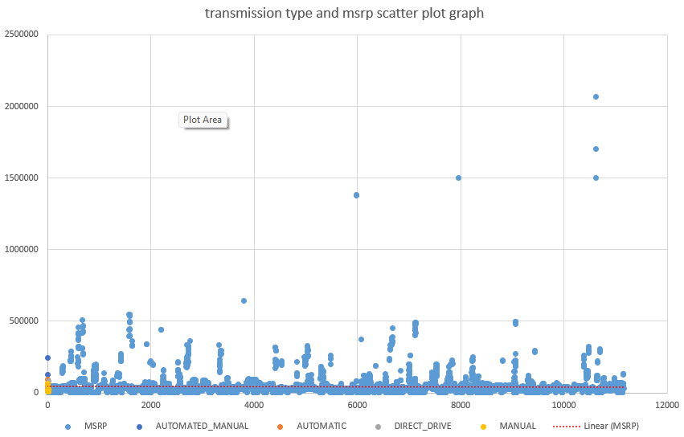
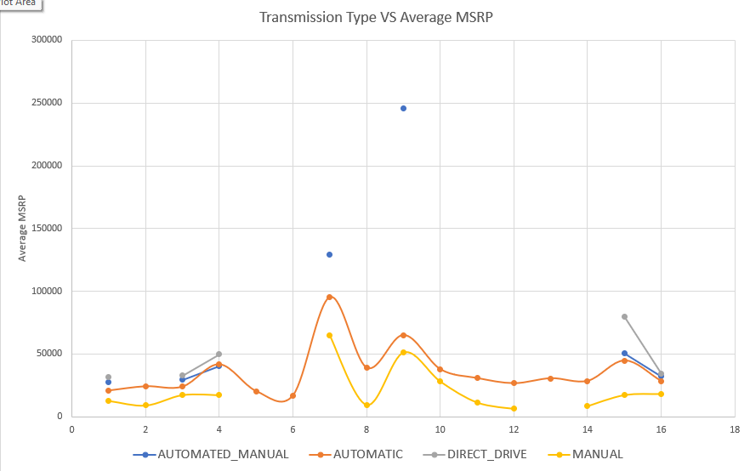
Task 3: How do the different feature such as transmission type affect the MSRP, and how does this vary by body style?
Automated_manual transmission type has the most average MSRP outliers.
Manual has the least average MSRP out of all.

Slide 16
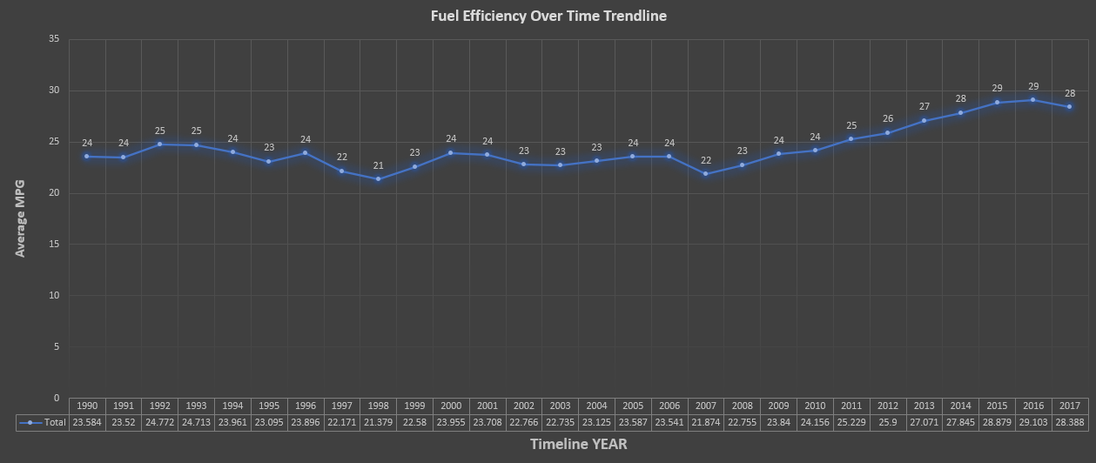
Task 4: How does the fuel efficiency of cars vary across different body styles and model years?
Fuel efficiency increase linearly after 2006.
Fuel efficiency advancement from 21 average MPG in 1998 to 29 average MPG in 2016.

Slide 17
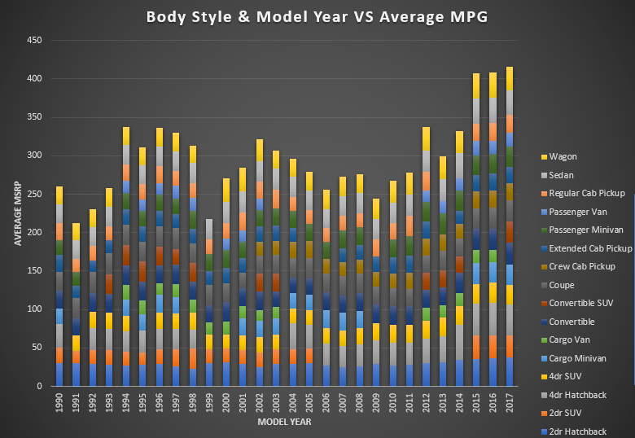
2017 highest average MPG
1991 lowest average MPG

Slide 18
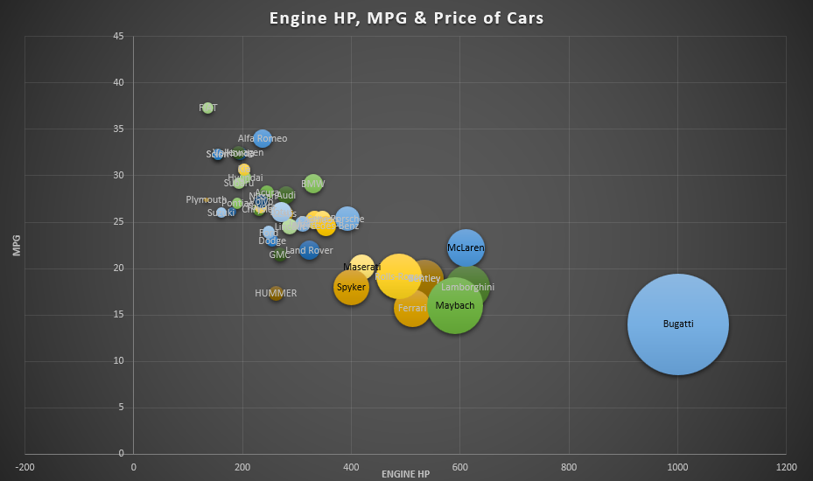
Task 5: How does the car's horsepower, MPG, and price vary across different Brands?
Bugatti has the highest horsepower of 1001 and the highest average MSRP of $ 1.7M. But its average MPG of 14 is below average.
Plymouth has the least average horsepower of 134 and the lowest average MSRP of $ 3.2K.

Slide 19
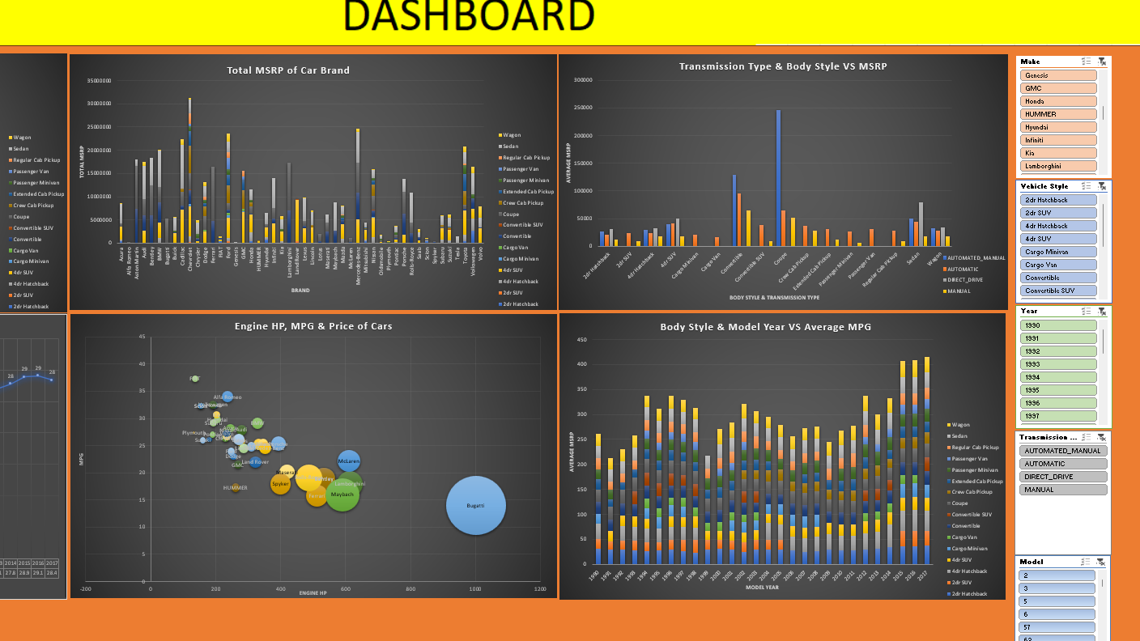
DASHBOARD provided in excel file

Slide 20
Key Insights for business / REPORT
Market category cars of Flex Fuel seems to be the most popular amongst customers. Flex fuel and crossover cars should be the safest bet for a new car manufacturer.
More the engine HP and engine cylinders, more the powerful the car is and costlier is the manufacturing process and MSRP. Bugatti has the highest average MSRP of $1.7 M as it produces only powerful cars with more engine HP and engine cylinders.
Average MPG and number of engine cylinders have negative correlation suggesting if customers want a car which has high MPG, car manufacturer should fit low number of engine cylinders in their cars.
Car body styles such as 4dr SUV, convertible, coupe and sedan are more in number and are more costly in terms of MSRP. For mass production these car body styles are most suitable.
Most popular transmission type for car is automatic. Mass production of these type is best.
Car brands like Ford mass-produce cars, resulting in a high total MSRP, while brands like Bugatti produce fewer cars with a greater focus on quality. Car manufacturer should decide which company ideas like these should he follow for an example.
Car manufacturer could also look for manufacturing electric cars as their average popularity is on par with other top cars and their growing demand for their environmental sustainability in today’s world.

Slide 21
RESULT
This project provided me with a comprehensive understanding of the automotive industry by analyzing trends in car features, fuel efficiency, pricing, and popularity across a wide range of models. I gained valuable insights into how consumer preferences and technological advancements shape the market, helping manufacturers make informed decisions about product development and pricing strategies. The project also improved my ability to predict car prices based on specific features.

