Slide 1
CHAT GPT: THE DEVELOPER'S NEW BEST FRIEND OR A REPLACEMENT FOR HUMAN INTERACTION?
UNVEILING THE BENEFITS AND
RISKS OF AI CHATBOTS

Slide 2
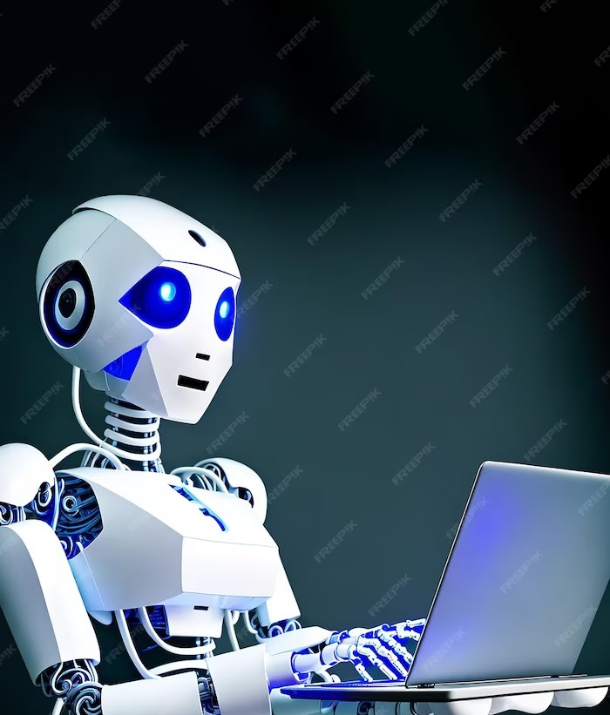
INTRODUCTION
Chat GPT (Generative Pre-trained Transformer) is a breakthrough in AI technology that has revolutionized the way developers interact with machines. However, with the rise of AI chatbots, we must ask ourselves: is this a replacement for human interaction? In this presentation, we will unveil the beneﬁts and risks of AI chatbots.

Slide 3
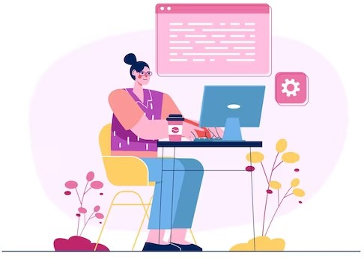
What is Chat GPT?
Chat GPT is an AI language model that is pre-trained on vast amounts of text data. It can generate human-like responses to text prompts, making it an ideal tool for developers to create chatbots and other natural language processing applications.

Slide 4
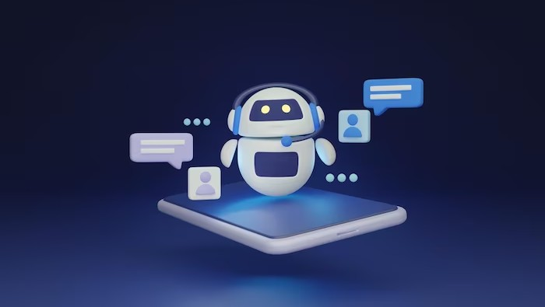
The Beneﬁts of Chat GPT
Chat GPT has many beneﬁts, including faster development times, cost savings, and improved customer experiences. With chatbots powered by Chat GPT, customers can receive instant responses to their queries, leading to higher satisfaction rates.

Slide 5
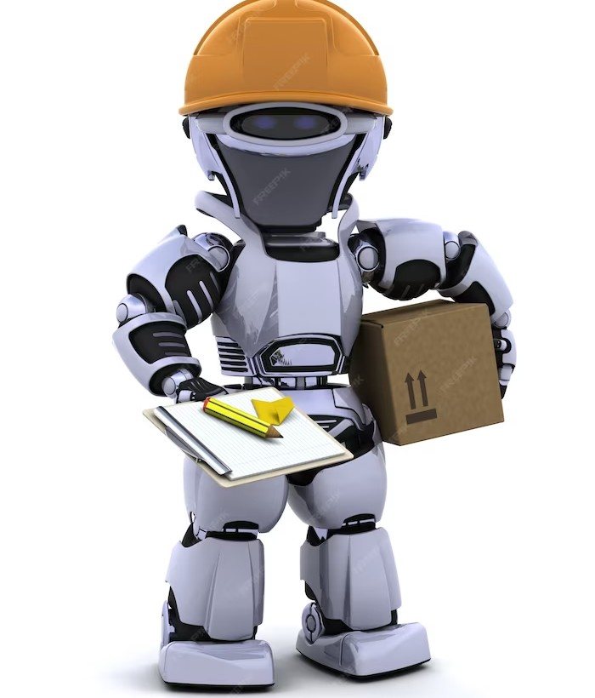
THE RISKS OF CHAT GPT
While Chat GPT has many beneﬁts, there are also risks to consider. These include lack of empathy, inability to handle complex situations, and potential biases in the data used to train the model. It is important for developers to be aware of these risks and take steps to mitigate them.

Slide 6
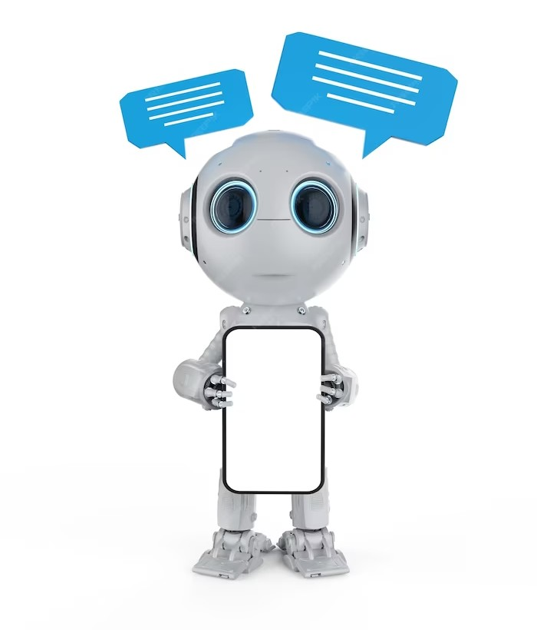
AI CHATBOTS AND HUMAN INTERACTION
AI chatbots have the potential to replace human interaction in many areas, such as customer service and support. While this can lead to cost savings and increased efﬁciency, it can also lead to loss of jobs and decreased customer satisfaction. It is important to ﬁnd a balance between AI chatbots and human interaction.

Slide 7
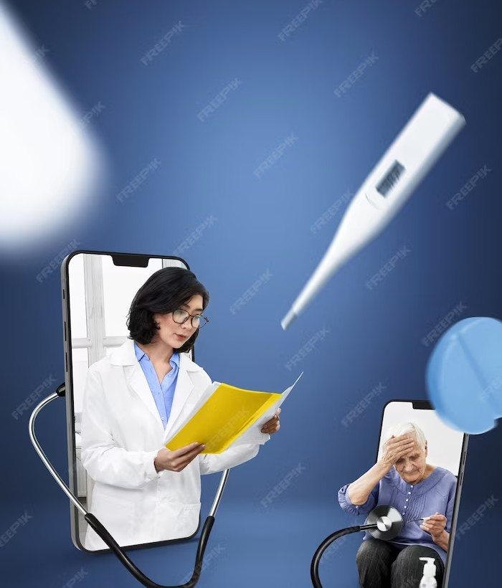
THE FUTURE OF CHAT GPT
The future of Chat GPT is exciting, with many potential applications in healthcare, education, and entertainment. As the technology continues to evolve, it is important to consider the ethical implications of AI chatbots and ensure that they are used in a responsible and beneﬁcial way.

Slide 8

CHAT GPT IN HEALTHCARE
Chat GPT has the potential to revolutionize healthcare by improving patient outcomes and reducing costs. Chatbots powered by Chat GPT can provide patients with instant access to medical information and help them manage chronic conditions. However, it is important to ensure that these chatbots are HIPAA compliant and protect patient privacy.

Slide 9
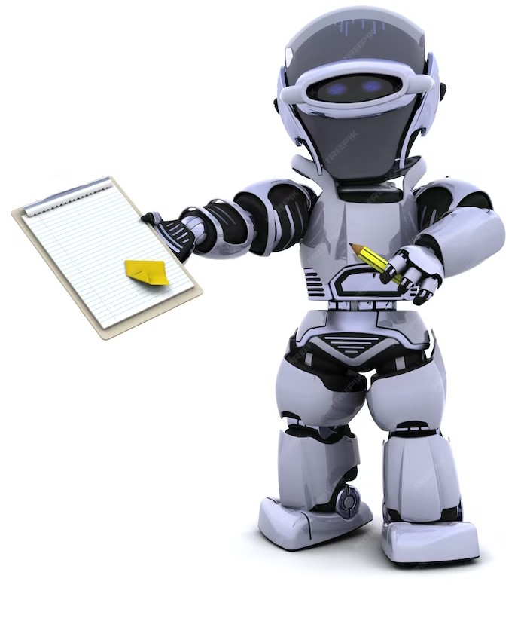
CHAT GPT IN EDUCATION
Chat GPT can also be used in education to improve student outcomes and personalize learning. Chatbots powered by Chat GPT can provide students with instant feedback on their work and help them identify areas for improvement.
However, it is important to ensure that
these chatbots are accessible and do not further widen the digital divide.

Slide 10
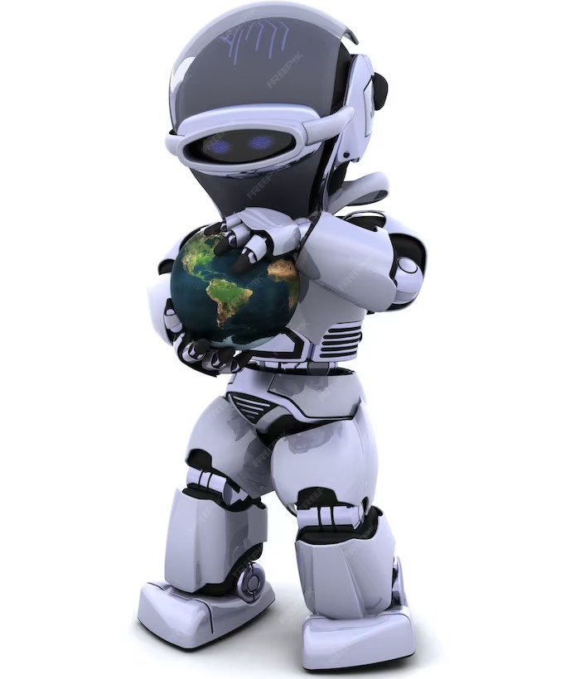
CHAT GPT IN ENTERTAINMENT
Chat GPT can also be used in entertainment to create engaging experiences for users. Chatbots powered by Chat GPT can provide users with personalized recommendations for movies, TV shows, and books. However, it is important to ensure that these chatbots do not promote harmful content or further reinforce biases.

Slide 11
CONCLUSION
Chat GPT is a powerful tool for developers that has the potential to revolutionize many industries.
However, it is important to consider the risks and ethical implications of AI chatbots and ensure that they are used in a responsible and beneﬁcial way. As the technology continues to evolve, it is up to us to shape its future.

Slide 12

Thanks!
Do you have any questions? youremail@freepik.com
+91 620 421 838
yourcompany.com

