Slide 1


Slide 2
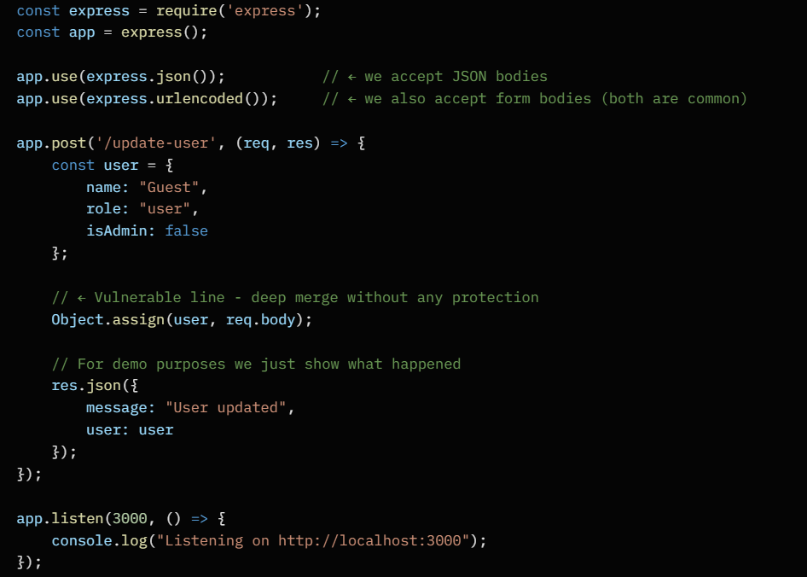
Code Example:
To define Express for use,
Convert the incoming data to JSON,
If it is in HTML format,
Decode it and then use it.
To create a POST route in Express called /update-user,
and inside it define a default user object
that contains basic user information
(name, role, and admin status)
which will be used during the request handling.
To merging the incoming data
With the object “user”
Send a response to the web page
With message and the user data
Define the listening port
For example : 3000

Slide 3
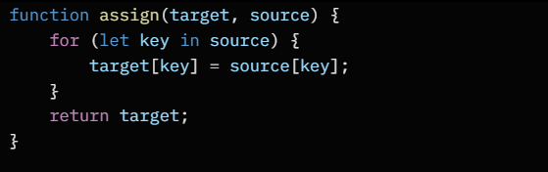
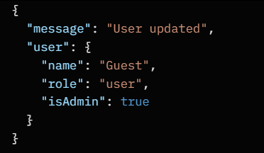
Assign function example:
Assign function to merging
The incoming user data with
The main object of user data
Like “user” object in the previous page
Data format after PP:
Example of data format
After successful PP injection
And modifying the
Administrator's role

Slide 4
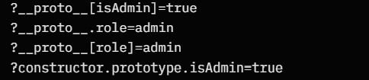
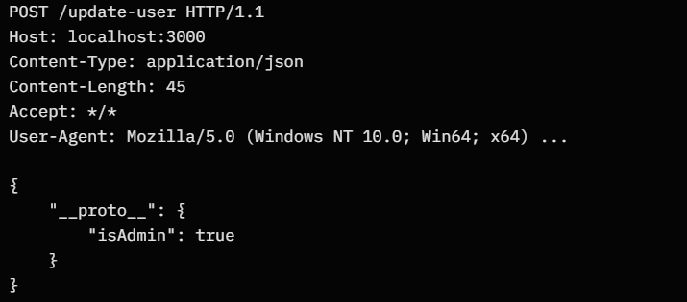
Client-Side injection Example:
Server-Side injection Example:
?__proto__.isAdmin=true
{ “__proto__”: { “isAdmin” : true } }

