Slide 1


Slide 2
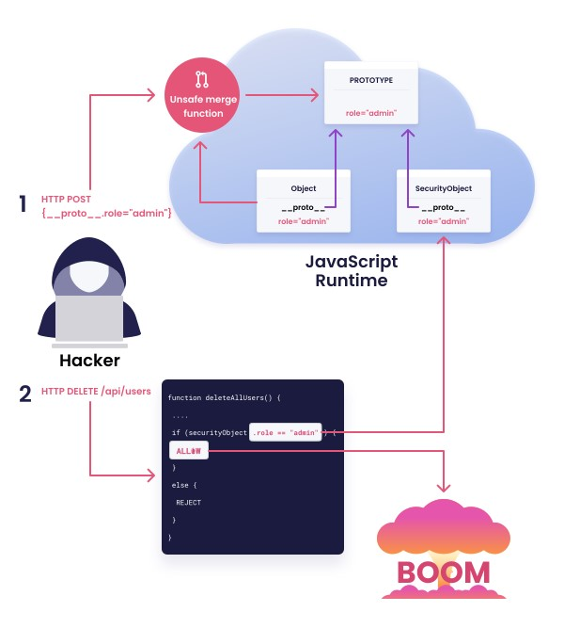

Slide 3

How to find The PP in the Web APP

Slide 4


Slide 5
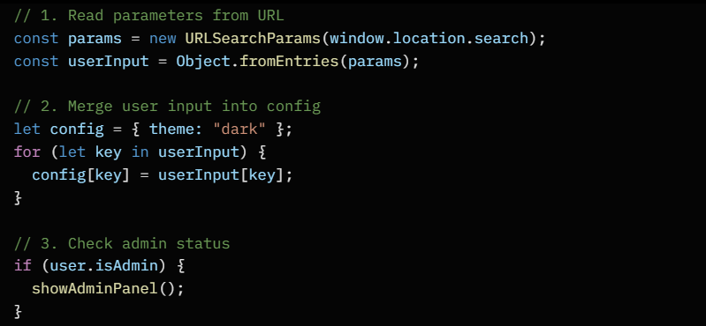
Code Example:
Take the values from URL
Then saving it as a Object’s data
In the “userInput”.
Start with a basic settings object called config
That has one default value: { theme: "dark" }.
Then take every key-value pair that came from the URL
(stored in userInput) and copy / overwrite them
Into the config object.
So if the URL contains for example:
?theme=light&language=arabic&fontSize=18
If the value of the key “isAdmin” = True
That in the Object “user” will display
The admin panel.
config.theme=light, etc…
Payload Example:
config.__proto__.isAdmin=true

