Slide 1
Hotel
hotelId: Int name: String address: String
+ getAvailability() + getServices()
1
*
Room
roomId: Int roomNumber: Int type: String rate: Double
+ checkAvailability() + reserveRoom()
Customer
customerId: Int name: String phone: String email: String
+ makeReservation () + checkIn() + checkOut()
Bill
billId: Int totalAmount: Double totalPoints: Int
+ addCharge () + generateInvoice ()
1
*
1
1
*
*
*
*
Reservation
reservationId: Int startDate: Date endDate: Date status: String
+ calculateCost () + extendStay ()
Service
serviceId: Int name: String price: Double points: Int
+ addService () + calculateCost ()
RewardsAccount
accountId: Int points: Int expiryDate: Date
+ earnPoints () + redeemPoints ()
1
1
1

Slide 2
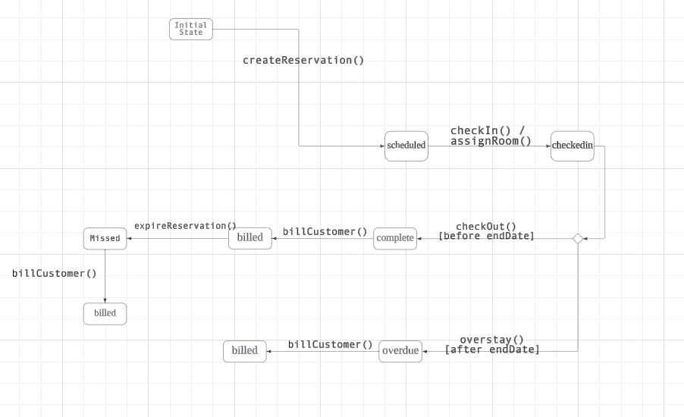

Slide 3
