Slide 1




Development of a Simulation Model for Analysis and Evaluation of Human-Machine Collaboration in Assembly Cells
Search.…
Author: João Pedro Caldas Ferreira @ FEUP Supervisor: António Almeida @ INESC-TEC

Slide 2
Table of Contents
Search.…
1
Introduction
2
State of the Art
3
Development
Overview of the research context and objectives.
Quick review of key technologies analyzed for the dissertation project.
Explanation of key settings of the development of the simulation framework, along with its limitations.
4
Case Study
5
Results
6
Conclusions
Presentation of the Bosch assembly line that was studied to evaluate the simulation framework.
Discussion of results from the case study and comparison across different scenarios.
Critical analysis of findings, and suggestions for future research.

Slide 3
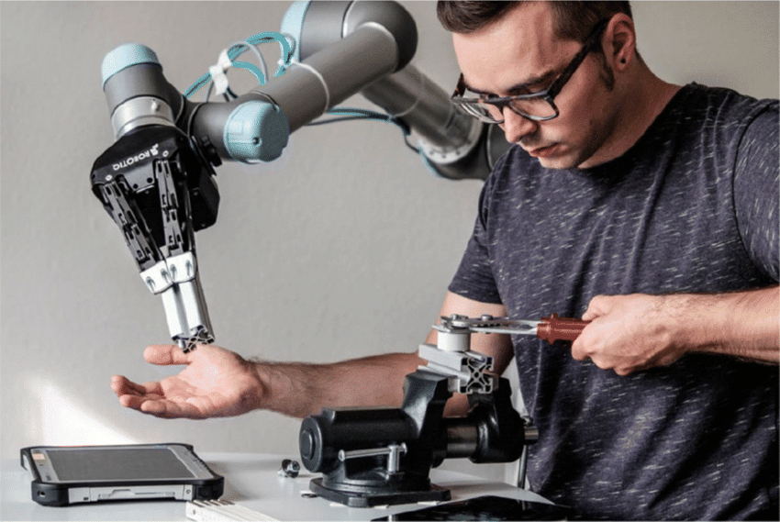

1 – Introduction
Search.…
Context and Motivation
Motivacional Background
Industrial assembly lines are increasingly relying on the distribution of tasks between robots and human operators. The challenge is to create a framework that supports setup decision-making and enhances efficiency and flexibility by enabling digital integration testing of collaborative robots in assembly lines.
Development Environment
The dissertation project was developed within Bosch Security Systems, located in Ovar, which is composed of multiple assembly lines, with different degrees of automation.

Slide 4
1 – Introduction
Search.…
Objetives
1. Mapping
2. Framework
3. Model
Study processes, sequences, patterns of operations, and task distribution.
Development of the simulation framework based on the previous study.
Create a digital model of a specific assembly line.
4. Validation
5. Simulation
6. Analysis
Validate the model by comparing it’s outputs to real-world data
Simulate differente improvement scenarios.
Make a cost-benefit analysis of selected configuration

Slide 5
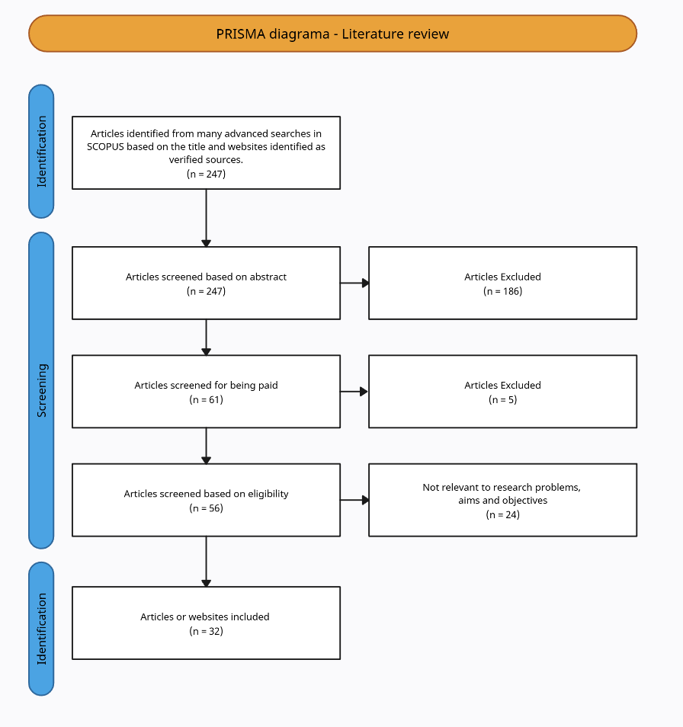



1 – Introduction
Search.…
Research Methodology
A comprehensive database is used to identify and collect relevant scientific literature.
Reference manager to organize, annotate, and cite the selected articles efficiently.
AI-powered tool for summarizing, extracting insights, and querying uploaded articles.

Slide 6
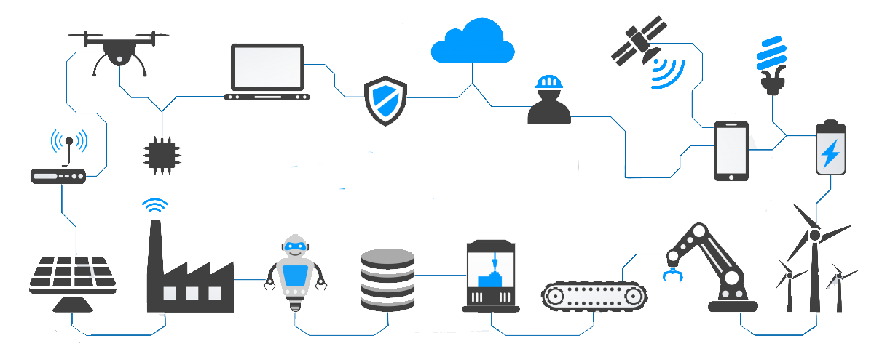
2 – State of the Art
Search.…
J. Lettori et al. DOI: 10.3233/ATDE220671 Wojciech Lewicki et al. DOI: 10.3390/app14166957
Industry 4.0
Interoperability
Virtualization
Framework integration
Virtual scenario testing
Modularity
Flexible task allocation
Decentralization
Local decision-making
Real-Time Capability
Real-time process tracking

Slide 7


2 – State of the Art
Search.…
Human-Robot Collaboration
Why does it matter?
Combines human flexibility + robot precision
Improves efficiency and system adaptability
Reduces heavy and repetitive payloads for operators
Collaboration Types
Independent: Separate tasks
Sequential: Same product, different tasks
Simultaneous: Same product, same time
Supportive: Human + robot assist

Slide 8
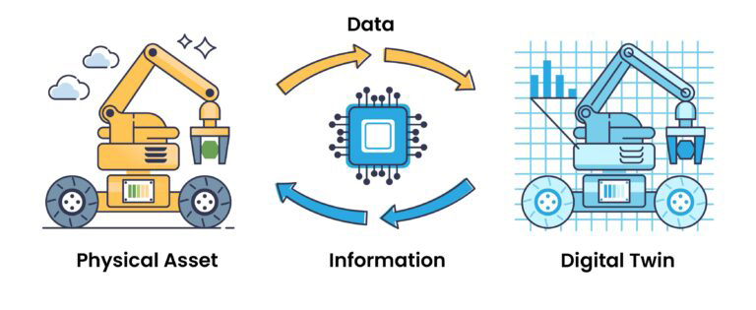
2 – State of the Art
Search.…
Digital Twins

Slide 9



2 – State of the Art
Search.…
Process Modeling
I can: Stay, Jump or Swim
Continuous
Discrete
Agent-Based

Slide 10




2 – State of the Art
Search.…
Simulation Tools
Tool | License | Flexibility | Ease of Use | Visualization | Real-Time | Documentation
 | Open | High | Moderate | Moderate | Moderate | Extensive
 | Open | High | High | Limited | Limited | Extensive
 | Paid | Moderate | High | Advanced | High | Comprehensive
 | Paid | Moderate | High | Advanced | High | Comprehensive

Slide 11




2 – State of the Art
Search.…
Driven Decision Support
Definition
Hybrid Production
Combines data, models, and user interaction to enhance decision-making.
Supports human-robot collaboration, resource allocation, and bottleneck identification.
Purpose
Benefits
Enables “what-if” analyses of production scenarios without affecting real operations
Enhances scenario evaluation and supports iterative learning to strengthen operational planning.

Slide 12

3 – Development
Search.…
Design Principles and Tool Justification
What are the goals?
Logic
The primary objective of the proposed framework is to provide a flexible, configurable, and realistic simulation environment to support scenario analysis and decision-making.
Why SimPy and Qt ?
SimPy was chosen because it is an open-source Python library that offers a flexible and precise engine for modeling processes.
Qt complements this by providing tools for creating an intuitive graphical interface, which makes the framework interactive and accessible.
Interface

Slide 13
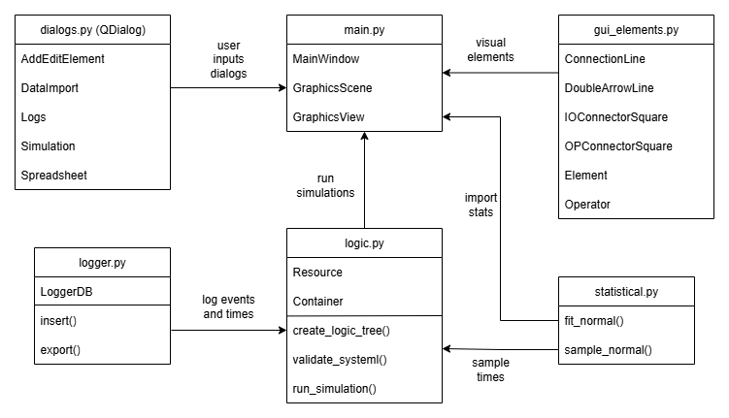
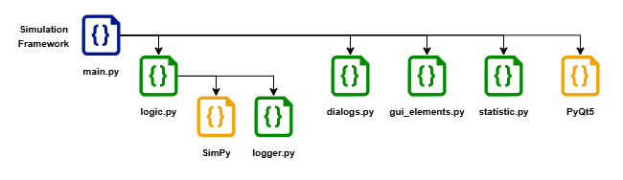
Search.…
3 – Development
Architecture

Slide 14
3 – Development
Search.…
Logic with SimPy – Process-Based Modeling
To be done

Slide 15
3 – Development
Search.…
Logic with SimPy – Simulation Entities
Operator
(simpy.Resource)
Source
(simpy.Resource)
Process
(simpy.Resource)
Converyor
(simpy.Container)
Buffer
(simpy.Container)
Target
(simpy.Resource)

Slide 16
3 – Development
Search.…
Logic with SimPy – Simulation Flow
node.request()
if needed: operator.request()
env.timeout(process)
node.release()
if not needed: operator.release()
env.timeout(transport)
node = next_node()

Slide 17




3 – Development
Search.…
Logic with SimPy – Errors and Failures Simulation
Failures & Maintenance
Piece Conformity Errors
Each process has a configurable defect rate
Detected defective parts are immediately rejected
MTBF – avg. time between failures
MTTR – avg. repair time
MTBM – avg. time between maintenance
TSLM – time since last maintenance
MTM – avg. maintenance duration
Simulation Behavior
Non-conformities occur probabilistically
Failures and maintenance trigger at the respective threshold.
Preventive Maintenance
Event Logging
Every event from piece movement and operator interaction is logged

Slide 18
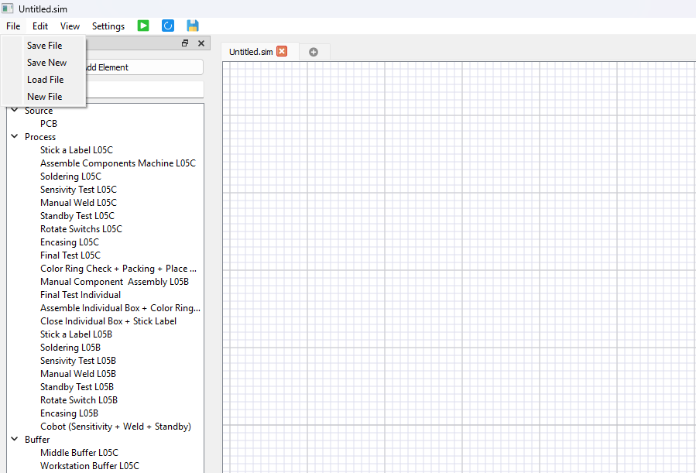
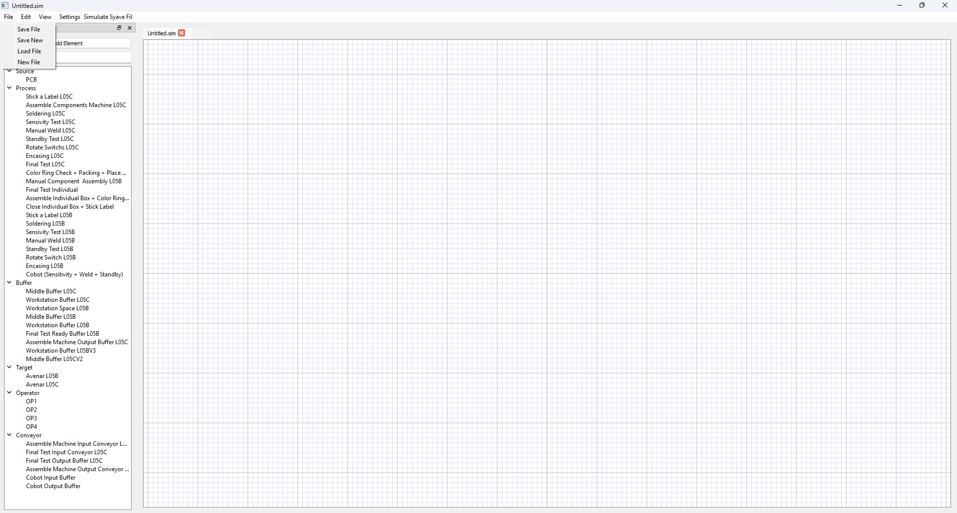
3 – Development
Search.…
GUI with Qt – Main Window
Simulation Framework Main Window

Slide 19
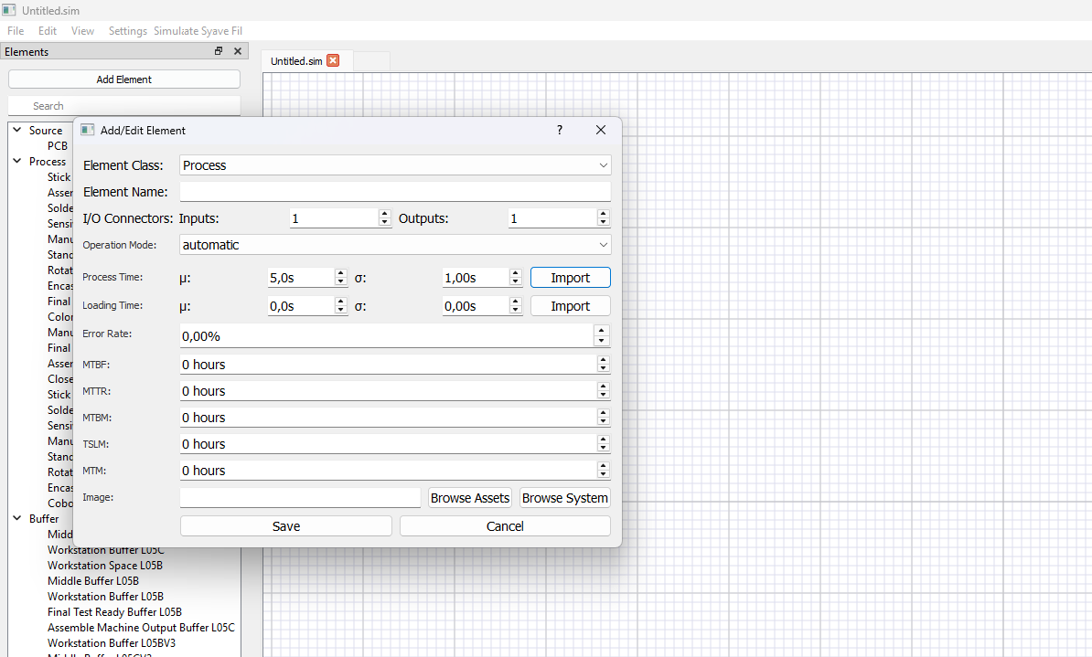
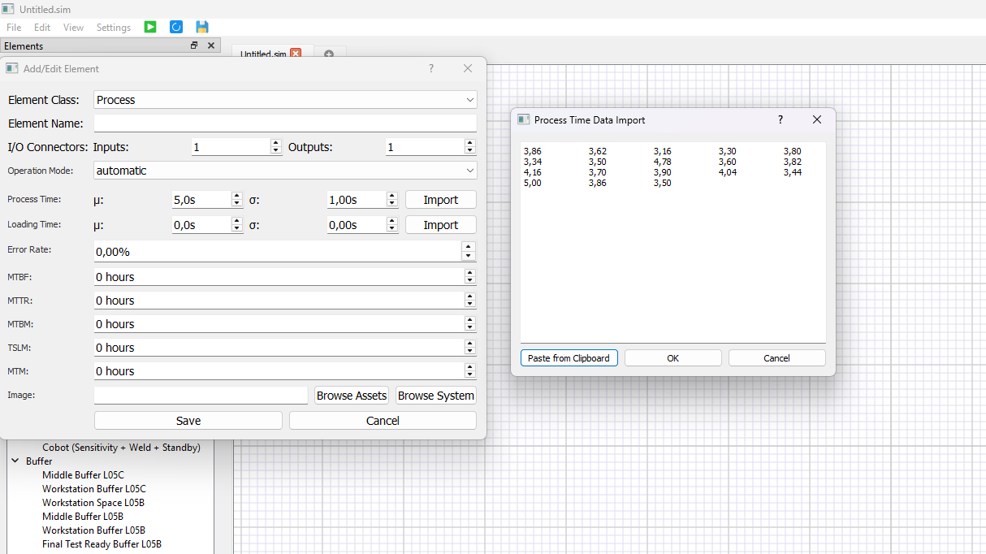
3 – Development
Search.…
GUI with Qt – Adding Elements
Add/Edit Element with Import Data Window

Slide 20
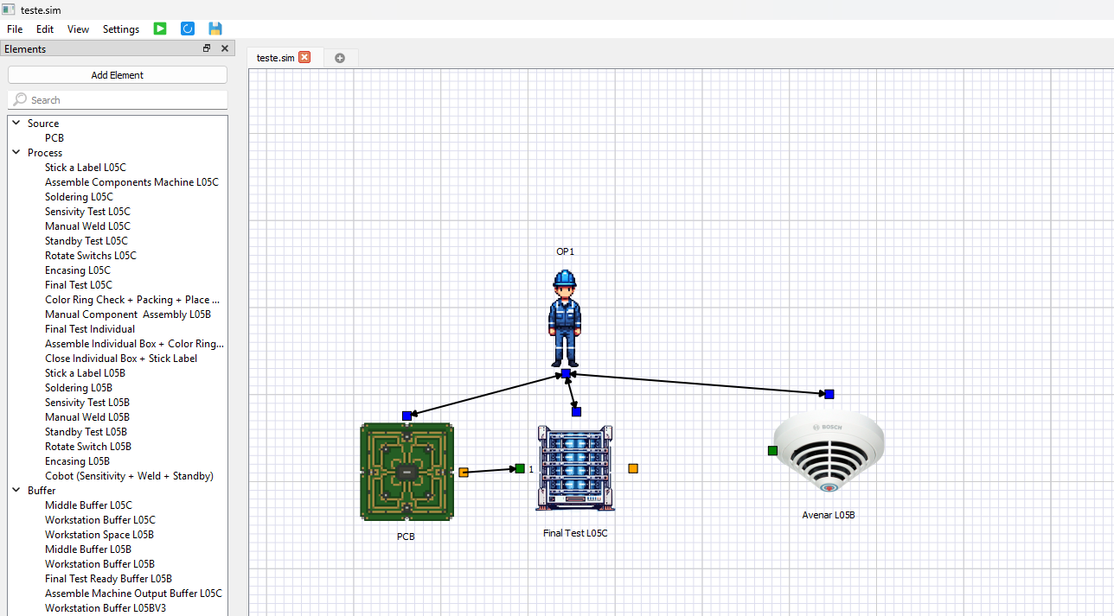
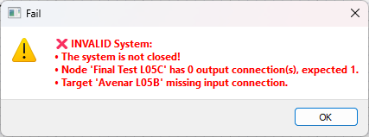
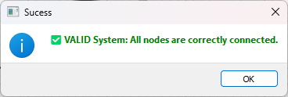
3 – Development
Search.…
GUI with Qt – Model Validation
Error Detected
Valid System
Validation Return Options

Slide 21
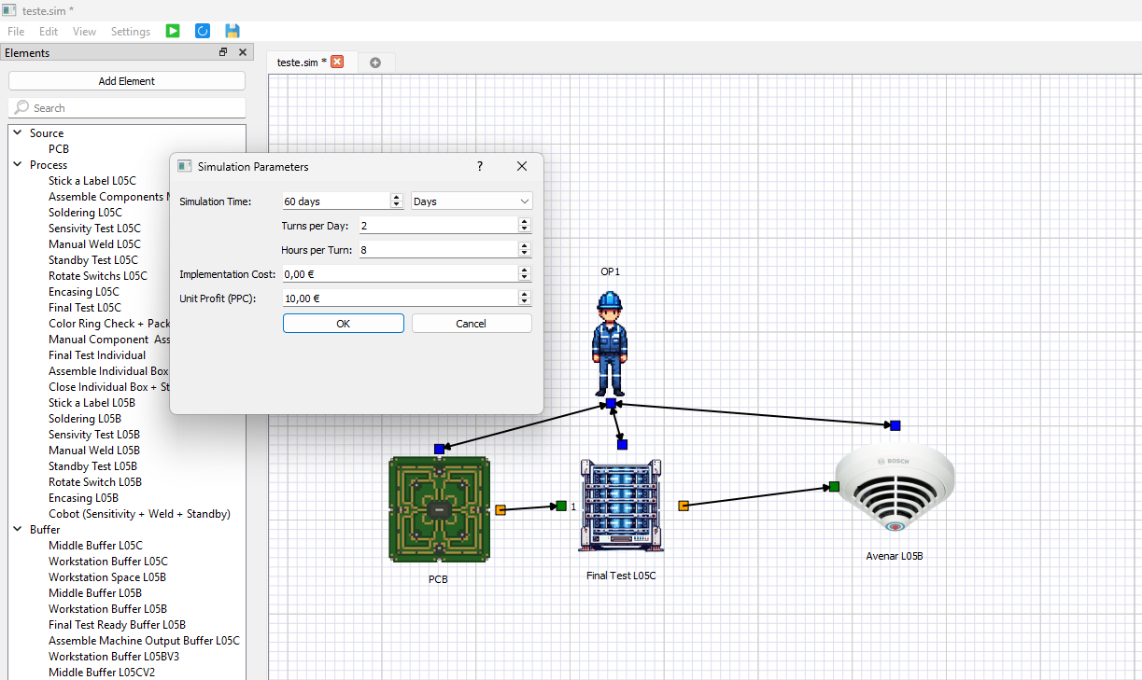
3 – Development
Search.…
GUI with Qt – Simulation Parameters
Simulation Parameters

Slide 22
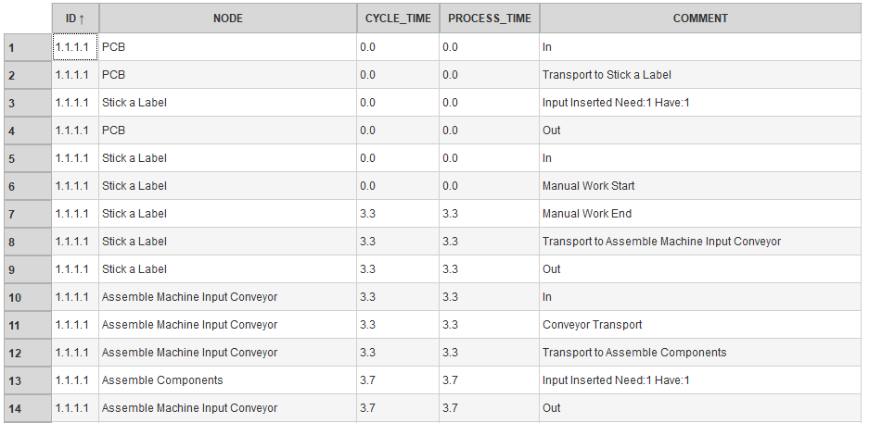
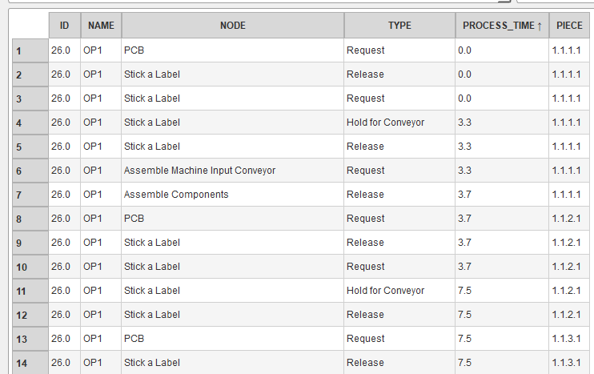
3 – Development
Search.…
Output Metrics - Flows
Simulation Piece Flow Spreadsheet
Operator Workflow Spreadsheet

Slide 23
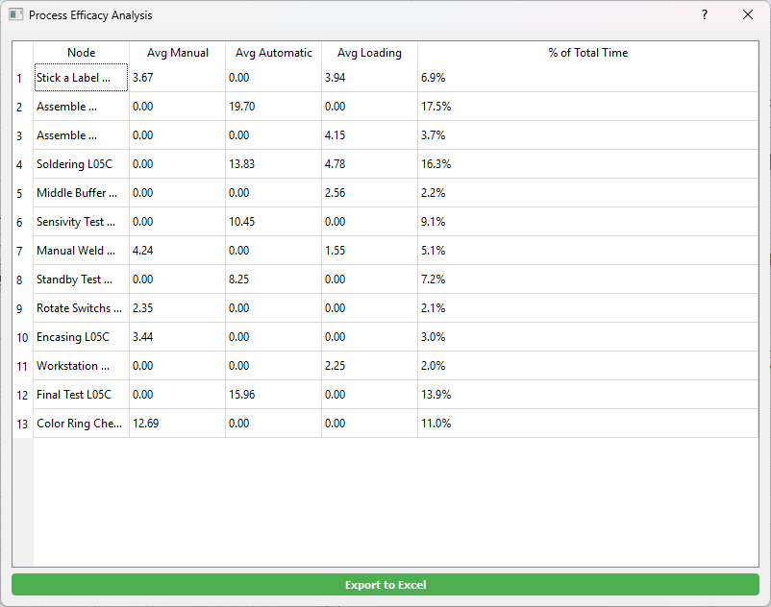
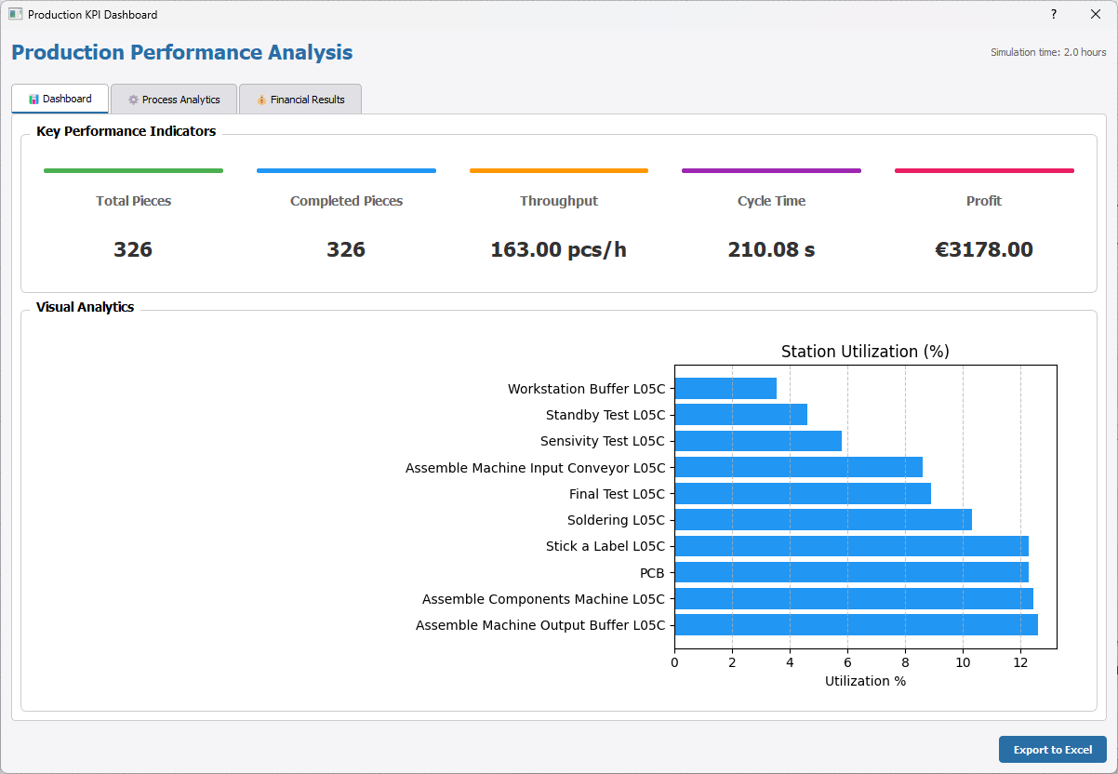
3 – Development
Search.…
Output Metrics – KPIs and Efficacy
Production KPIs Dashboard
Process Efficacy Spreadsheet

Slide 24




3 – Development
Search.…
Framework Limitations
Operator Behavior
Simulation of CoBots
Real operators level of experience and skill level are not modeled.
Operator simulation is linear and deterministic.
Cobot behavior was modeled based on field observations and internal assumptions.
Physical World Modeling
Digital Twins and AI
The framework lacks physical aspects such as safety procedures or ergonomic factors.
The framework does not include automatic balancing, intelligent routing, or optimization features.

Slide 25
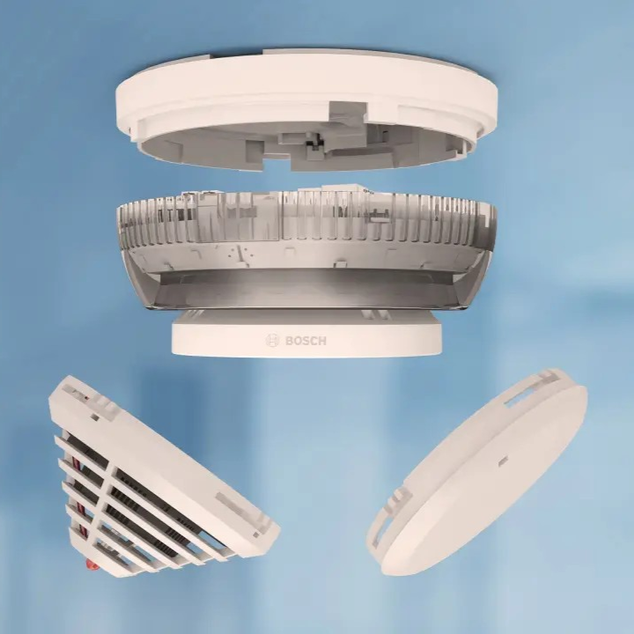
4 – Case Study
Search.…
Context
Industrial Context
Bosch Security Systems, S.A., located in Ovar, operates a significant manufacturing facility that produces security and fire detection systems. The shop floor features multiple assembly lines dedicated to assembling complex products.
Lines under Study
L05B – Produces the Avenar fire detector in a three-operator regime, which relies almost entirely on human work.
L05C – Is a more automated version of L05B
Why these two lines?
Avenar Fire Detector
Same product, two different profiles → clear comparison study for manual vs automated HRC lines.

Slide 26
4 – Case Study
Search.…
Modeling Methods
i) Conceptual Models
ii) Digital Models
Operator Modeling
Modular discrete-event blocks per station
Normal distributions for time simulation
Blocks connect following the real flow
Operator as a resource with availability and cost
Task embedded in process blocks
Each operator task is a linked process
Process flow diagrams
Built from on-site observations and engineer feedback
Excel timing mapped to tasks

Slide 27
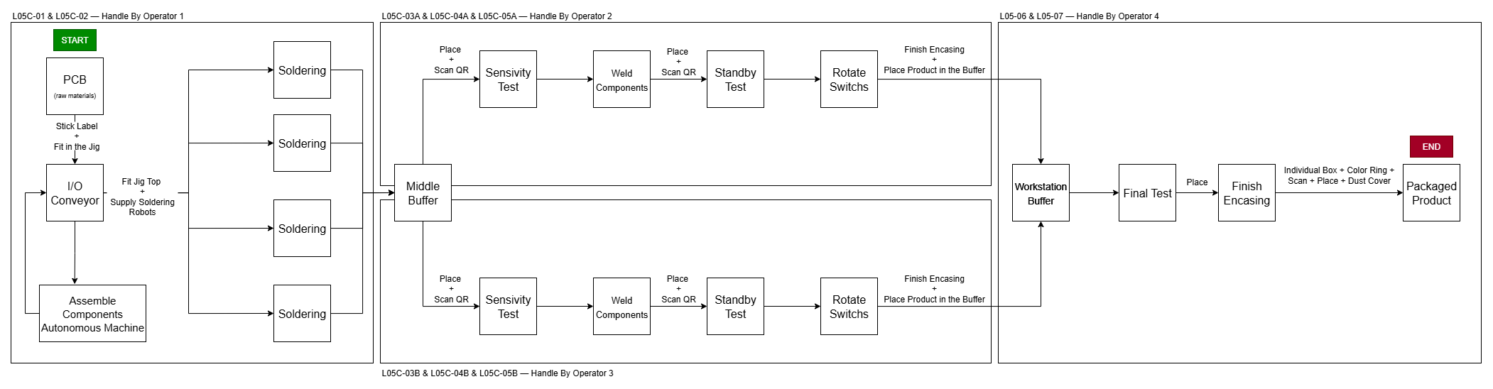
4 – Case Study
Search.…
Assembly Line L05C - Diagram
Block Diagram of L05C

Slide 28
4 – Case Study
Search.…
Assembly Line L05C – Processing Times
# | Process | Average Time (s)
1 | Stick the label | 3.73
2 | Fit the PCB in the jig | 4.04
3 | Assemble Components | 19.70
4 | Fit Jig Top + Supply Welding Robot | 4.23
5 | WeldComponents | 13.875
6 | RemoveJig + Place in the Buffer | 4.81
7 | Place in the Sensitivity Test + Scan Barcode | 2.64
8 | Sensitivity Test | 10.54
9 | Place in the Welder + Weld Components | 4.305
10 | Place in the Standby Test + Scan Barcode | 1.57
11 | Execute Standby Test | 8.335
12 | Rotate Switches | 2.19
13 | Finish Encasing + Place in Buffer | 3.505
14 | Stick Color Ring + Place in the Final Test | 2.27
15 | Execute Final Test | 16
16 | Individual Box + Color Ring + Scan + Dust Cover + Place in Collective | 11.97
Texto de suporte
L05C Bosch Provided Data

Slide 29
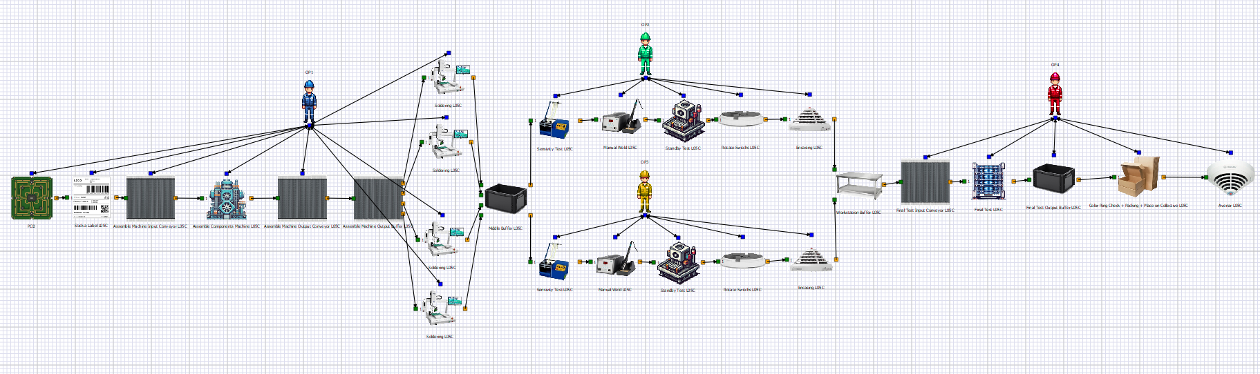
4 – Case Study
Search.…
* Wrong image in the dissertation document
Assembly Line L05C – Simulation Model
Simulation Model of L05C

Slide 30
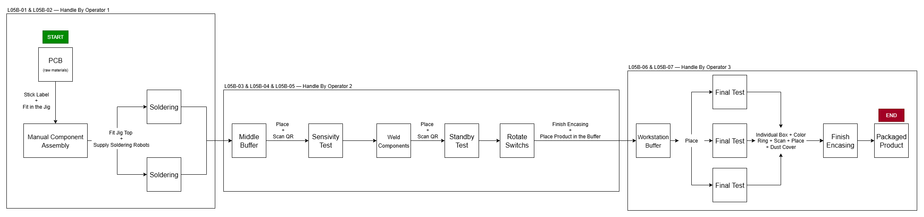
4 – Case Study
Search.…
Assembly Line L05B - Diagram
Block Diagram of L05B

Slide 31
4 – Case Study
Search.…
Assembly Line L05B – Processing Times
# | Process | Average Time (s)
1 | Stick the label | 3.73
2 | Fit the PCB in the jig | 4.36
3 | Manual Component Assembly | 24.70
4 | Fit Jig Top + Supply Welding Robot | 4.23
5 | WeldComponents | 13.88
6 | RemoveJig + Place in the Buffer | 5.54
7 | Place in the Sensitivity Test + Scan Barcode | 2.45
8 | Sensitivity Test | 10.54
9 | Place in the Welder + Weld Components | 4.56
10 | Place in the Standby Test + Scan Barcode | 1.72
11 | Execute Standby Test | 8.42
12 | Rotate Switches | 2.14
13 | Finish Encasing + Place in Buffer | 3.505
14 | Place product in Final Test | 2.56
15 | Execute Final Test | 24
16 | Assemble Individual Box + Color Ring Check + Scan + Place | 11.97
17 | Close Individual Box + Stick Label + Place | 5.96
Texto de suporte
L05B Bosch Provided Data

Slide 32
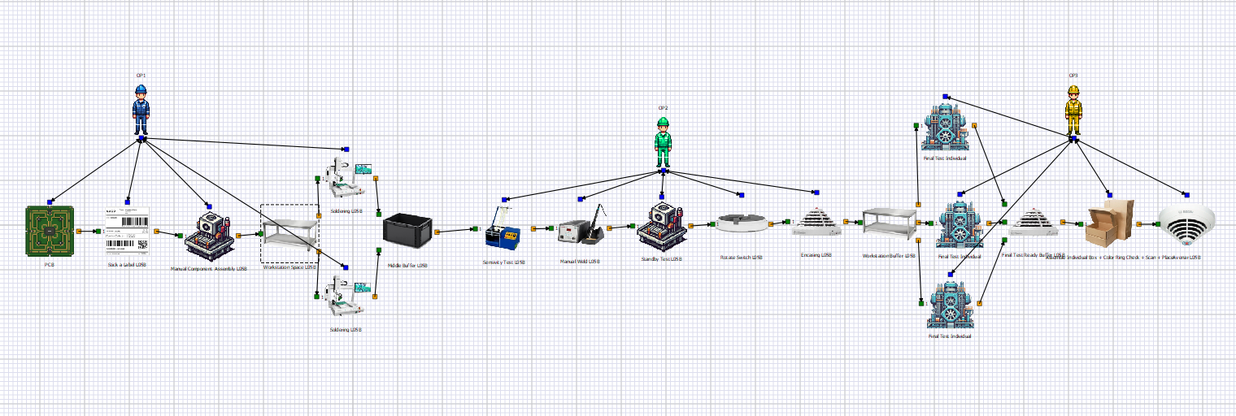
4 – Case Study
Search.…
Assembly Line L05B – Simulation Model
Simulation Model of L05B

Slide 33
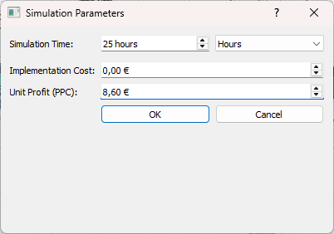
4 – Case Study
Search.…
Simulation Setup
Each scenario was executed for 25 simulated hours to match Bosch’s minimum baseline window for KPI extraction.
The economics were parameterized using PPC (Bosch’s unit profit per assembled unit) to translate throughput into revenue and estimate ROI and payback across scenarios.
This setup ensures that technical KPIs are directly comparable with other scenarios.
Simulation Setup Window

Slide 34
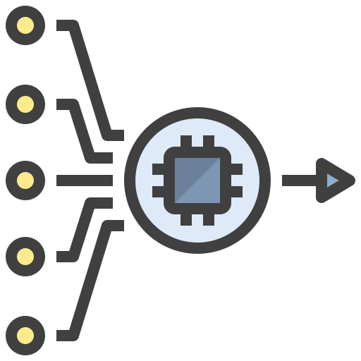




5 – Results
Search.…
Evaluation Metrics
Throughput
Overall Cycle Time (${CT}_{med}$)
Total number of average finished products per hour in a given simulation.
Represents the average time interval between the completion of two consecutive pieces.
Processing Time
Value-Added Time
Total time each piece spends being processed, in each process.
The execution of added value operations in each given node.

Slide 35
5 – Results
Search.…
Station | Time (s) | % Utilization
PCB | 22.73 | 7.75%
Stick a Label L05C | 22.72 | 7.75%
Assemble Components Machine L05C | 22.67 | 7.73%
Assemble Machine Input Conveyor L05C | 18.56 | 6.33%
Assemble Machine Output Buffer L05C | 109.77 | 37.43%
Assemble Machine Output Conveyor L05C | 21.24 | 7.24%
Soldering L05C | 18.64 | 6.36%
Middle Buffer L05C | 2.57 | 0.87%
Sensitivity Test L05C | 10.52 | 3.59%
Manual Weld L05C | 5.80 | 1.98%
Standby Test L05C | 8.34 | 2.84%
Rotate Switches L05C | 2.35 | 0.80%
Encasing L05C | 3.44 | 1.17%
Workstation Buffer L05C | 6.44 | 2.19%
Final Test L05C | 16.11 | 5.49%
Final Test Input Conveyor L05C | 1.37 | 0.47%
L05C Case Study Results – Utilization per Station
Texto de suporte
Utilization per Station L05C

Slide 36
Search.…
* Wrong figure in this section of the dissertation document
5 – Results
L05C Case Study Results – Added Time Value
Station | Manual (s) | Automatic (s) | Loading (s) | % of Total Time
Stick a Label L05C | 3.65 | 0.00 | 3.96 | 6.7%
Assemble Components Machine L05C | 0.00 | 19.70 | 0.00 | 17.3%
Assemble Machine Output Buffer L05C | 0.00 | 0.00 | 4.16 | 3.7%
Soldering L05C | 0.00 | 13.84 | 4.76 | 16.3%
Middle Buffer L05C | 0.00 | 0.00 | 2.54 | 2.2%
Sensitivity Test L05C | 0.00 | 10.44 | 0.00 | 9.2%
Manual Weld L05C | 4.24 | 0.00 | 1.55 | 5.1%
Standby Test L05C | 0.00 | 8.25 | 0.00 | 7.2%
Rotate Switchs L05C | 2.34 | 0.00 | 0.00 | 2.1%
Encasing L05C | 3.45 | 0.00 | 0.00 | 3.0%
Workstation Buffer L05C | 0.00 | 0.00 | 2.24 | 2.0%
Final Test L05C | 0.00 | 15.95 | 0.00 | 14.0%
Color Ring Check + Packing + Place on Collective L05C | 12.66 | 0.00 | 0.00 | 11.1%
Added Time Value per Station on L05C

Slide 37
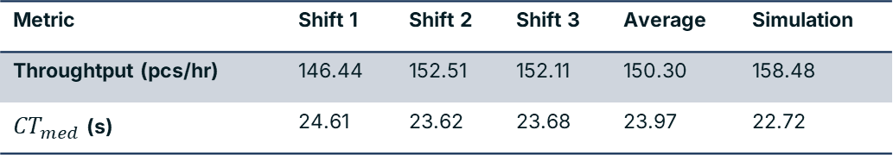
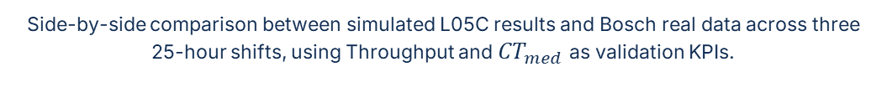
Search.…
5 – Results
L05C Case Study Results – Comparison with Real Data
Side-by-side comparison between simulated L05C results and Bosch real data across three 25-hour shifts, using Throughput and ${CT}_{med}$as validation KPIs.
Metric | Shift 1 | Shift 2 | Shift 3 | Average | Simulation
Throughtput (pcs/hr) | 146.44 | 152.51 | 152.11 | 150.30 | 158.48
${CT}_{med}$ (s) | 24.61 | 23.62 | 23.68 | 23.97 | 22.72
Simulation aligns closely with reality, with a deviation of ~5.4%. The gap is expected since human behavior isn’t modeled, yet the model captures L05C’s dynamics and is valid for scenario testing and optimization

Slide 38
5 – Results
Search.…
L05B Case Study Results – Utilization per Station
Station | Avg Time (s) | % Utilization
PCB | 34.79 | 1.16%
Stick a Label L05B | 13.12 | 0.44%
Manual Component Assembly L05B | 30.70 | 1.02%
Workstation Space L05B | 68.04 | 1.02%
Soldering L05B | 31.56 | 1.05%
Middle Buffer L05B | 1970.46 | 65.70%
Sensivity Test L05B | 27.15 | 0.91%
Manual Weld L05B | 31.71 | 1.06%
StandbyTest L05B | 29.21 | 0.97%
Rotate Switch L05B | 31.46 | 1.05%
Encasing L05B | 31.90 | 1.06%
Workstation Buffer L05B | 678.34 | 22.62%
Final Test Individual L05B | 20.95 | 0.70%
Texto de suporte
Utilization per Station L05B

Slide 39
5 – Results
Search.…
L05B Case Study Results – Added Time Value
Station | Manual (s) | Automatic (s) | Loading (s) | % of Total Time
Stick a Label L05B | 0.00 | 3.76 | 3.95 | 6.60%
Manual Component Assembly L05B | 21.59 | 0.00 | 0.00 | 18.30%
Workstation Space L05B | 0.00 | 0.00 | 3.15 | 2.70%
Soldering L05B | 0.00 | 13.80 | 5.45 | 16.30%
Middle Buffer L05B | 0.00 | 0.00 | 2.44 | 2.00%
Sensivity Test L05B | 0.00 | 10.46 | 0.00 | 8.50%
Manual Weld L05B | 3.76 | 0.00 | 1.55 | 4.30%
Standby Test L05B | 0.00 | 8.25 | 0.00 | 6.70%
Rotate Switch L05B | 2.14 | 0.00 | 0.00 | 1.70%
Encasing L05B | 0.00 | 3.95 | 0.00 | 3.20%
Workstation Buffer L05B | 0.00 | 0.00 | 2.74 | 2.20%
Final Test Individual | 0.00 | 20.95 | 0.00 | 16.90%
Assemble Individual Box + Color Ring Check + Scan + Place | 7.05 | 0.00 | 5.85 | 10.40%
Added Time Value per Station on L05B

Slide 40
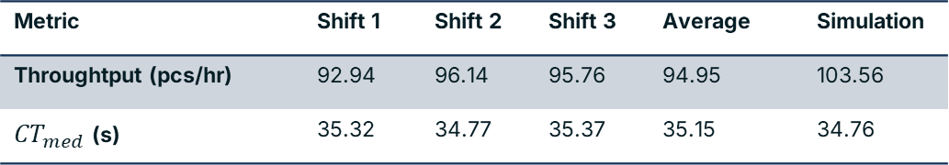
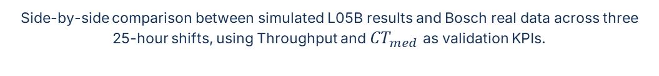
5 – Results
Search.…
L05B Case Study Results – Comparison with Real Data
Side-by-side comparison between simulated L05B results and Bosch real data across three 25-hour shifts, using Throughput and ${CT}_{med}$as validation KPIs.
Metric | Shift 1 | Shift 2 | Shift 3 | Average | Simulation
Throughtput (pcs/hr) | 92.94 | 96.14 | 95.76 | 94.95 | 103.56
${CT}_{med}$ (s) | 35.32 | 34.77 | 35.37 | 35.15 | 34.76
The simulation aligns closely with reality, with a deviation of only 9%. Because individual human behaviors are not modeled, and the flow assumes uninterrupted operation, slight output overestimation is expected.

Slide 41
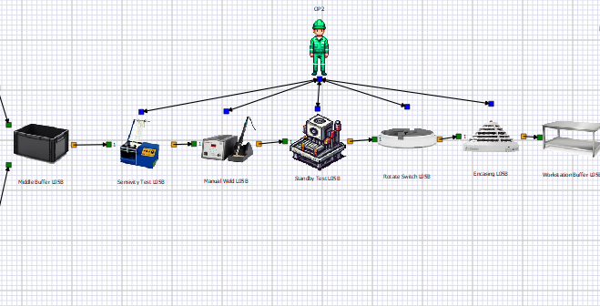
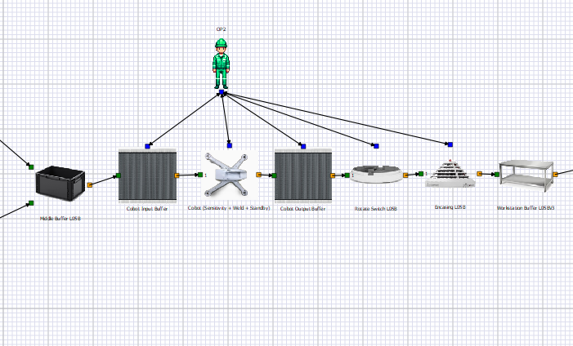
5 – Results
Search.…
Solution for L05B – Integration Description
Consolidates Sensitivity Test + Resistor Welding + Stanby Test into one coordinated loop.
A cobot manages the testing, loads components into an autonomous welder, transfers them to the standby test, and outputs to a slide buffer.
Operates within an isolated acrylic or glass enclosure, with the operator feeding into an input buffer and receiving from the slide buffer.
Loading time of N(2.43 s, 0.41 s).
Processing time of N(17.42 s, 0.80 s).
L05B Bosch Model
L05B Solution Model

Slide 42
5 – Results
Search.…
* Rough Estimates Based on Feedback from Bosch Industrial Engineers
Solution for L05B – Implementation Cost
Cost Component | Estimated Cost (€)
Cobot arm (including controller base software) | 30,000 – 50,000
Custom gripper / end effector | 5,000 – 10,000
Safety enclosuyre and physical isolation | 5,000 – 15,000
Integration, programming, and validation | 15,000 – 30,000
Layout adaptation and auxiliary rquipment | 5,000 – 10,000
Operator training and knowledge transfer | 3,000 – 7,000
Total Estimated Cost | 63,000 – 122,000
Estimating that the integration would require 5 working days, and assuming an effective daily workload of 7.70 hours.
Given an average production of 94.95 pieces an hour and a PPC of 8.6€, the temporary suspension would cost about 31,438€.
The final implementation would cost at a minimum of: 94,438 €

Slide 43
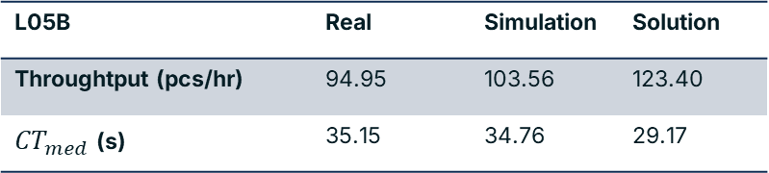
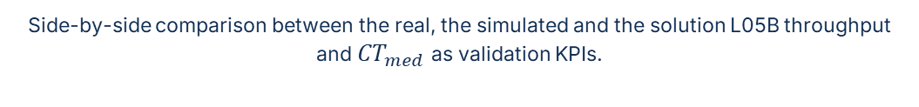
5 – Results
Search.…
* % improvement value wrong in the disseration document
Solution for L05B – Implementation Results
Side-by-side comparison between the real, the simulated and the solution L05B throughput and ${CT}_{med}$as validation KPIs.
L05B | Real | Simulation | Solution
Throughtput (pcs/hr) | 94.95 | 103.56 | 123.40
${CT}_{med}$ (s) | 35.15 | 34.76 | 29.17
The solution represents a 19% improvement in production throughput.

Slide 44
5 – Results
Search.…
Solution for L05B – Process Time
Station | Avg Time (s) | Utilization
PCB | 29.25 | 1.16%
Stick a Label L05B | 21.59 | 0.38%
Manual Component Assembly L05B | 21.59 | 1.08%
Workstation Space L05B | 3.30 | 0.16%
Soldering L05B | 15.82 | 0.79%
Middle Buffer L05B | 810.31 | 40.42%
Cobot Input Buffer L05BV2 | 29.19 | 1.46%
Cobot (Sensitibity + Weld + Standby) L05BV2 | 96.31 | 4.80%
Cobot Output Buffer L05BV2 | 268.51 | 13.40%
Rotate Switch L05B | 29.09 | 1.45%
Encasing L05B | 29.80 | 1.49%
Workstation Buffer L05B | 642.70 | 32.06%
Final Test Individual L05B | 20.95 | 1.05%
Texto de suporte
Utilization per Station on L05B Solution

Slide 45
5 – Results
Search.…
Solution for L05B – Added Time Value
Station | Manual (s) | Automatic (s) | Loading (s) | % of Total Time
Stick a Label L05B | 0.00 | 3.74 | 3.97 | 8.30%
Manual Component Assembly L05B | 21.59 | 0.00 | 0.00 | 23.10%
Workstation Space L05B | 0.00 | 0.00 | 3.15 | 3.40%
Soldering L05B | 0.00 | 13.80 | 1.95 | 16.80%
Middle Buffer L05B | 0.00 | 0.00 | 0.5 | 0.5%
Cobot (Sensitivity + Weld + Standby) | 0.00 | 12.33 | 0.00 | 11.30%
Rotate Switch L05B | 2.11 | 0.00 | 0.00 | 1.90%
Encasing L05B | 0.00 | 3.92 | 0.00 | 3.50%
Workstation Buffer L05B | 0.00 | 0.00 | 2.76 | 2.40%
Final Test Individual | 0.00 | 20.95 | 0.00 | 17.90%
Assemble Individual Box + Color Ring Check + Scan + Place | 7.07 | 0.00 | 5.83 | 11.00%
Added Time Value per Station on L05B Solution

Slide 46
5 – Results
Search.…
Metric | Value
Baseline Daily Output | 797.41 pcs
Improved Daily Output | 950.18 pcs
Baseline Days to Produce 2589 pcs | 3.25 days
Improved Days to Produce 2589 pcs | 2.72 days
Time Saved | 0.52 days
Extra Pieces in Equal Time | 484 pcs
Extra Profit Generated | 4,163.53 €
Implementation Cost | 94,438 €
Estimated Payback Time | 73.26 days
Cost-Benefit Considerations
Texto de suporte

Slide 47




6 – Conclusions
Search.…
Critical Assessment
Configurational Agility
Computational Efficiency
Core abstractions let us reconfigure assembly lines fast, like adding a cobot and reassigning OP2 needed minimal changes.
The DES kernel (Simpy) handles queuing, resource contention, and task preemption, however, high-load simulations have not been thoroughly tested.
Fidelity vs Practicality
Human Factors Exclusion
The more accurate and realistic the data, the higher the fidelity of the simulation output will be.
Ergonomics and fatigue are not considered leading to potential operator-centric design gaps.

Slide 48
6 – Conclusions
Search.…
Alignment with Dissertation Objectives
Map the main processes and operational routing in the Bosch Ovar assembly cells that could be automated using robotic systems.
Develop a simulation model using an appropriate platform (e.g., Arena, AnyLogic, FlexSim).
Simulate various operational scenarios and task-distribution strategies between operators and robots, taking into account production times and cadence, operating costs, and assembly cell flexibility.
Perform scenario analyses of operator–robot task allocation, including a sensitivity analysis based on different levels of operator experience and training.
Conduct a cost–benefit analysis of the proposed solution.
Propose improvements, optimizations, and best practices for the current production processes in Bosch assembly cells, based on the simulation results.

Slide 49




6 – Conclusions
Search.…
Future Work
Broadened Resource Modeling
Results Automation
The framework can be expanded to support a wider range of industrial elements by incorporating machines, dynamic buffers, and more reliable cobots.
Future development should also prioritize the automation of result presentation dynamics to enhance the extraction of KPIs.
Pathway to Digital Twin
Use-Case Expansion
Continuous development for real-time data integration and real-time visualization.
Strengthening the framework’s credibility requires broader deployment and testing.

Slide 50
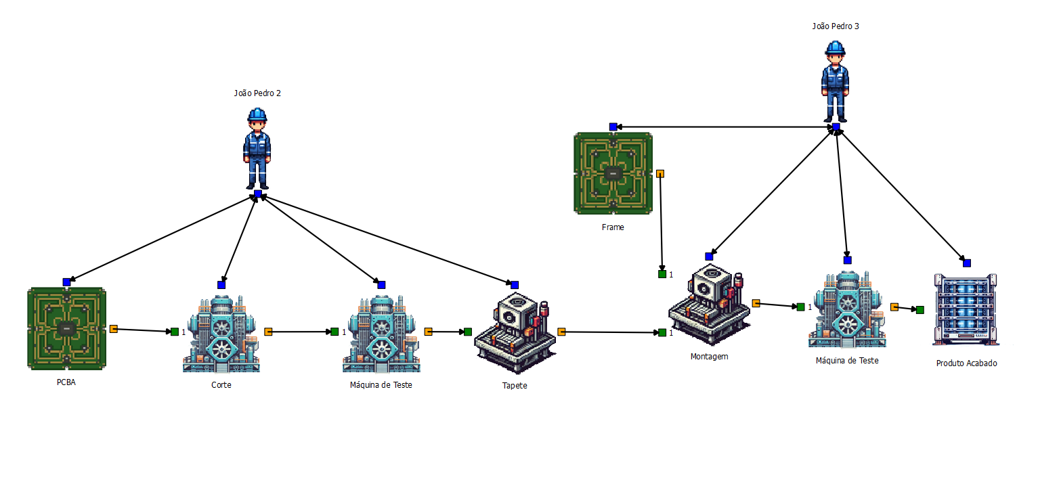
Development of a Simulation Model for Analysis and Evaluation of Human-Machine Collaboration in Assembly Cells
Search.…
Thanks for the Attention
Author: João Pedro Caldas Ferreira @ FEUP – joao.p.caldas@inesctec.pt

