Slide 1
Sharing Platform
Group no. - 09
Ahnaf Faiaz
ID: 20-42213-1
Rafid Redwan Khan
ID: 20-42239-1
Mehadi Hasan Shojib
ID: 20-42713-1

Slide 2
Outline
Introduction
Use Case Diagram
User Interface
User Story Card
Activity Diagram
JIRA
Git
Class Diagram
Timeline Chart
Budget Estimation
Conclusion

Slide 3
Introduction
In our day to day life, we often sell or buy something and even we need to find someone to donate our valuable products.
We face many obstacles in everyday life for these kinds of work. This project can help us to solve the problem and save our valuable time. By this software user can post about (rent, sell, donation) and other user can search for their desirable products.

Slide 4
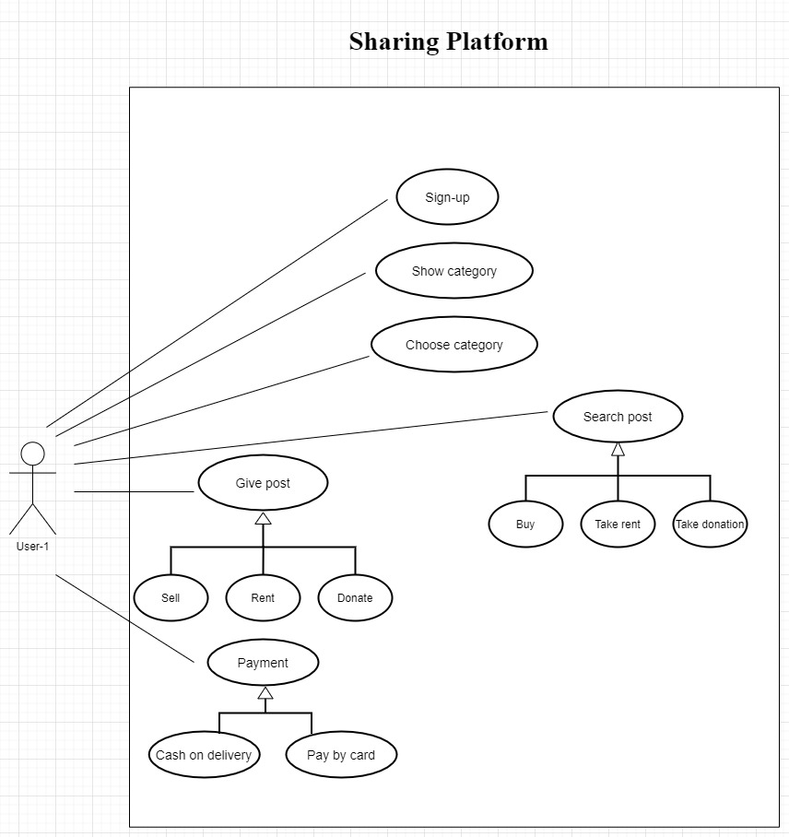
Use Case Diagram

Slide 5
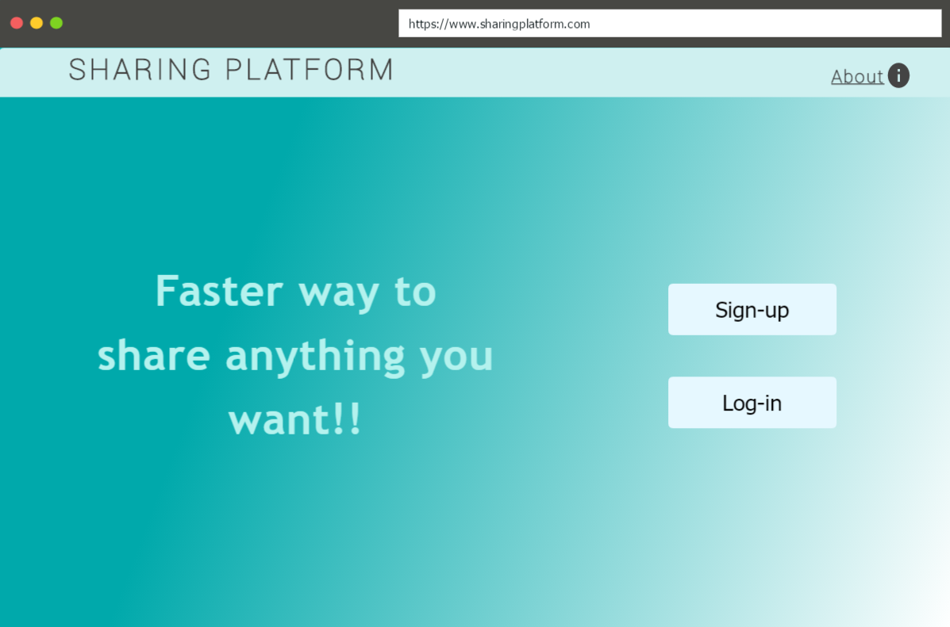
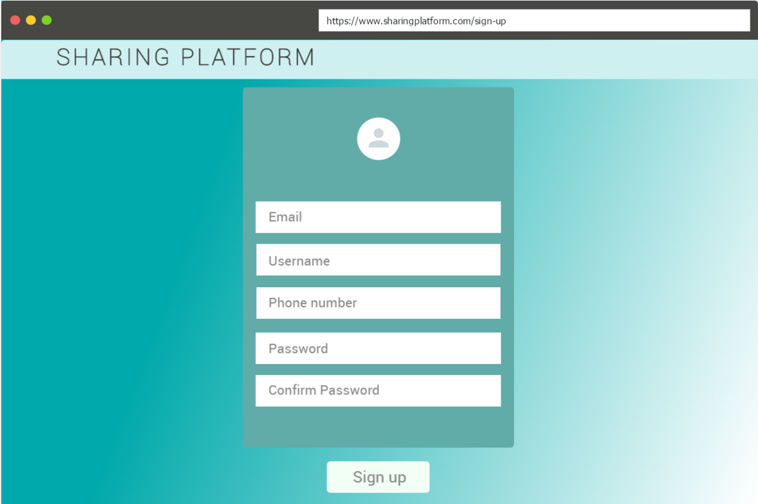
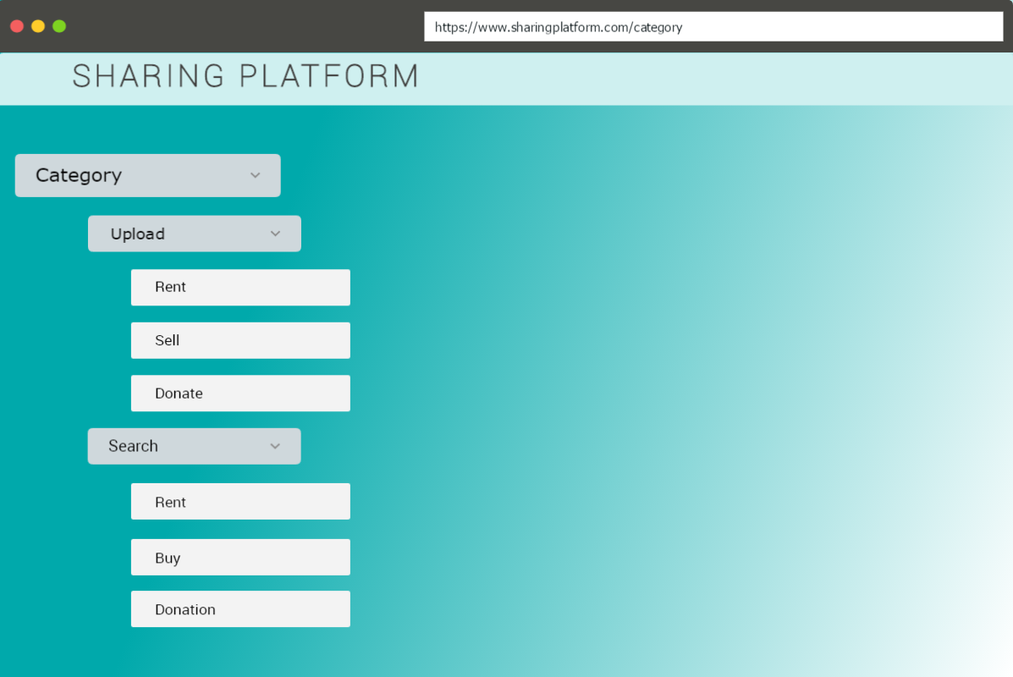
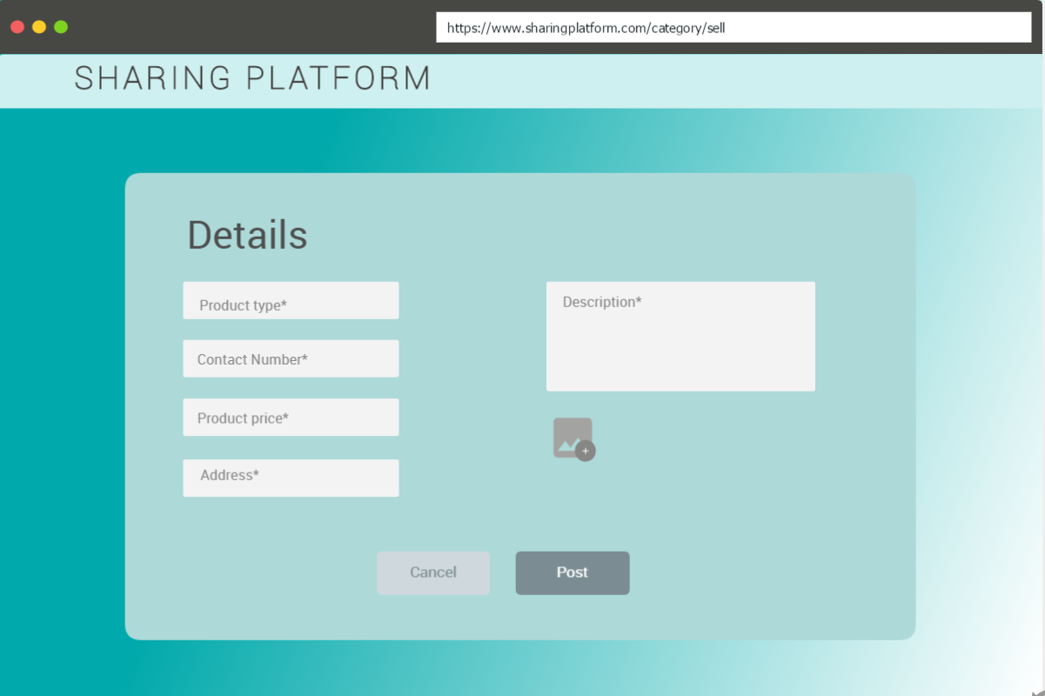
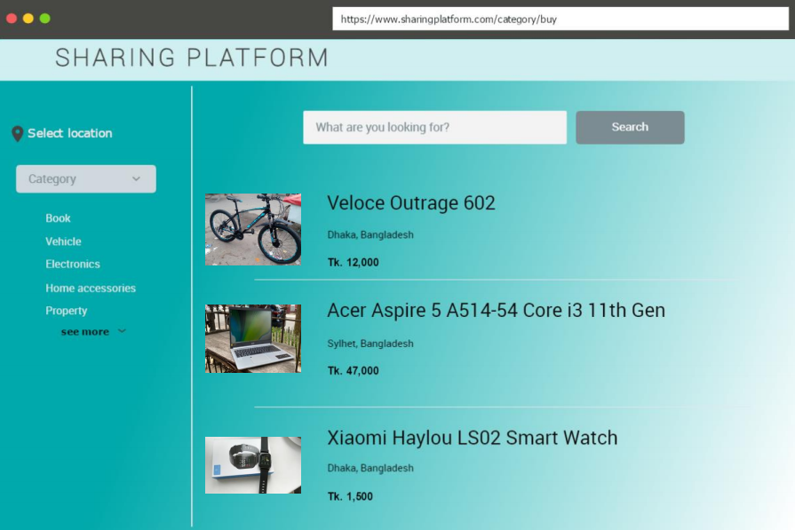
User Interface

Slide 6
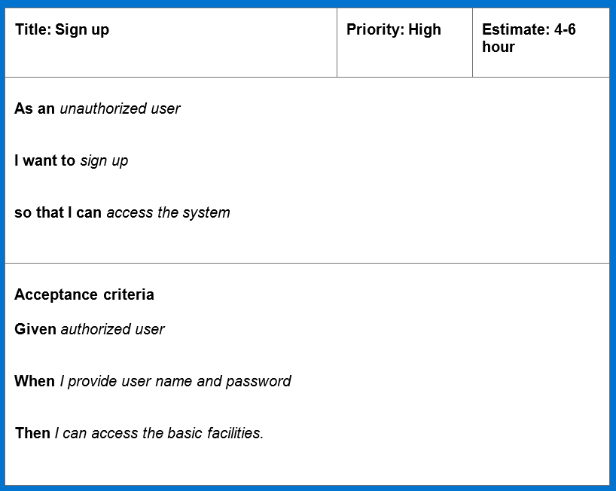
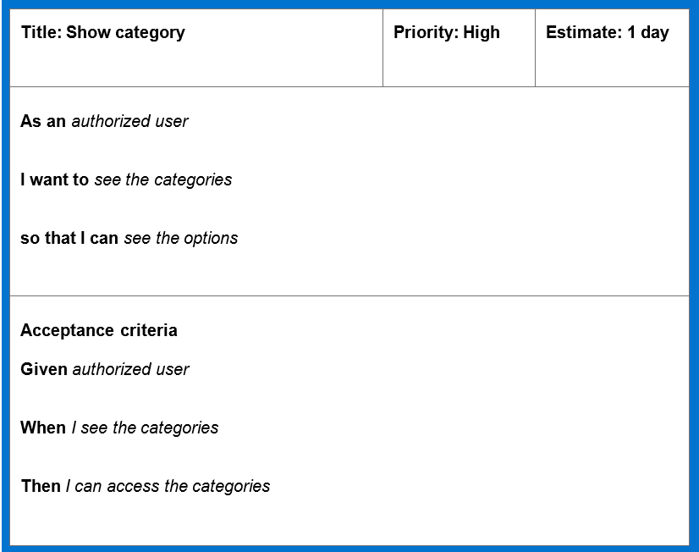
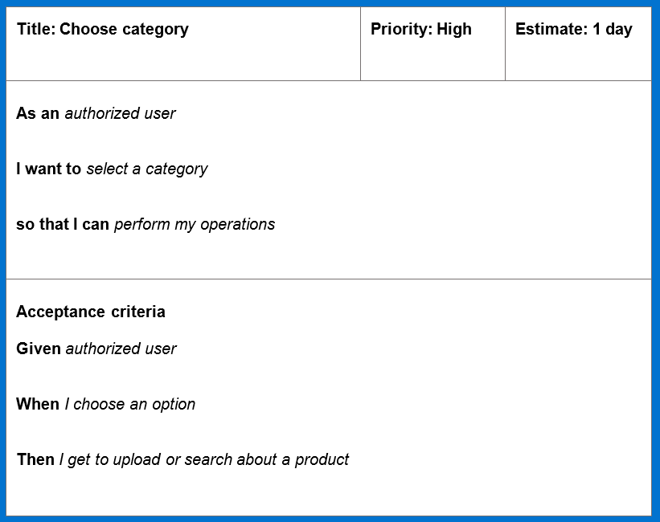
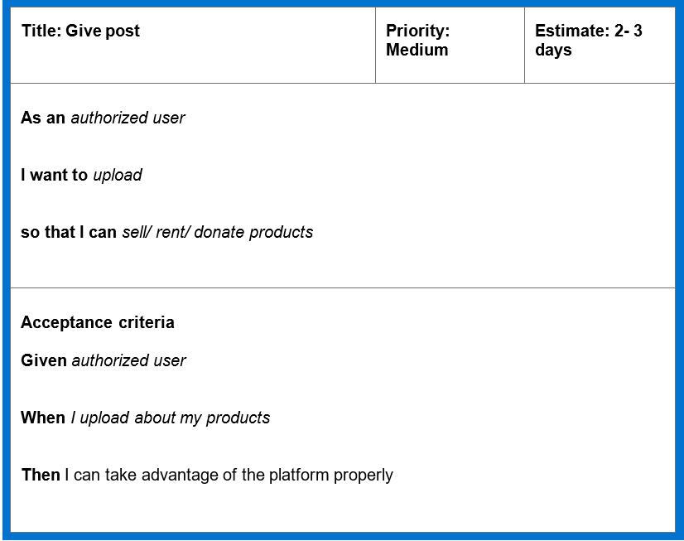
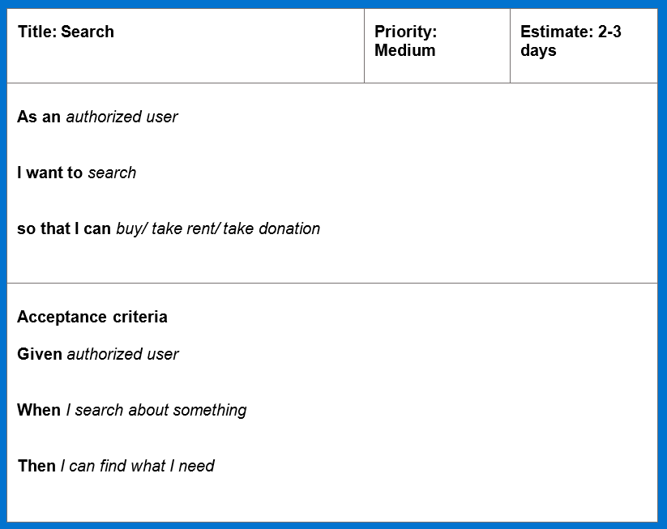
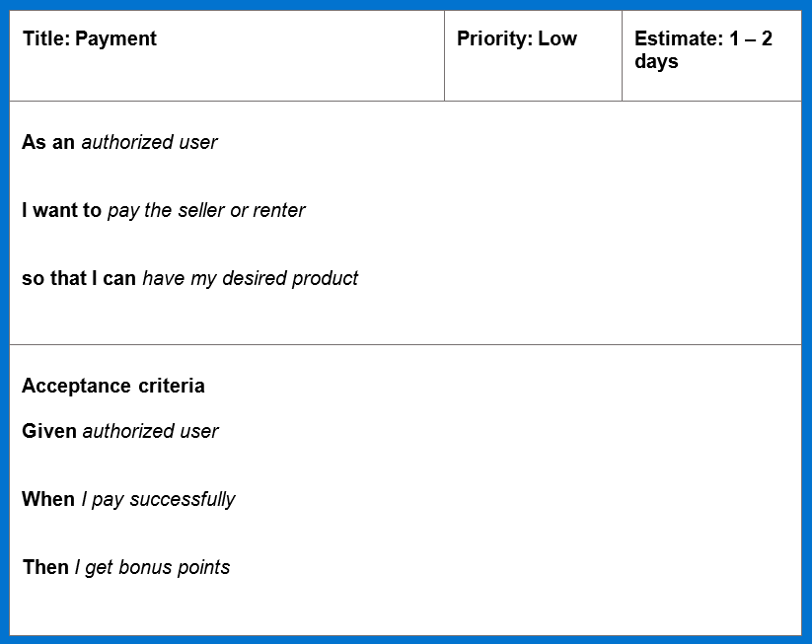
User Story Card

Slide 7
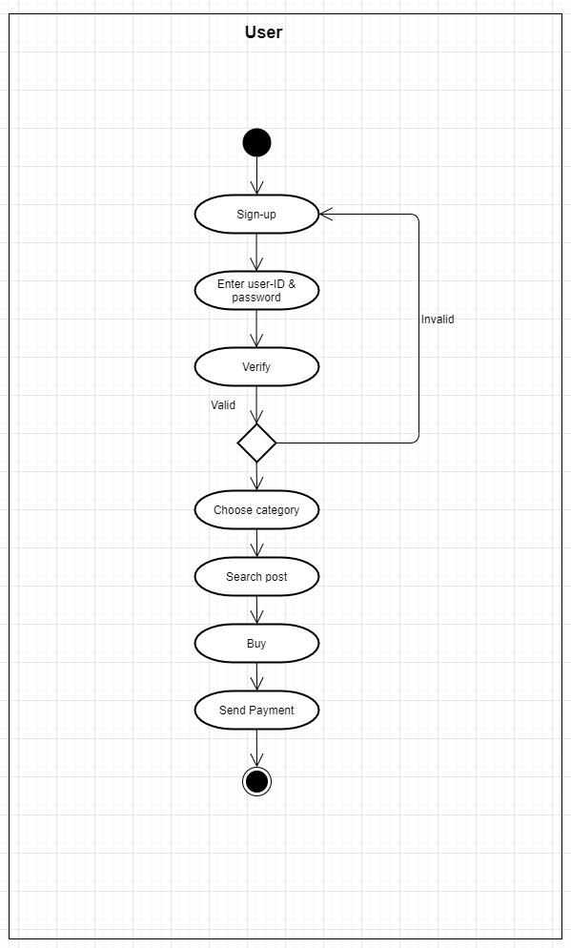
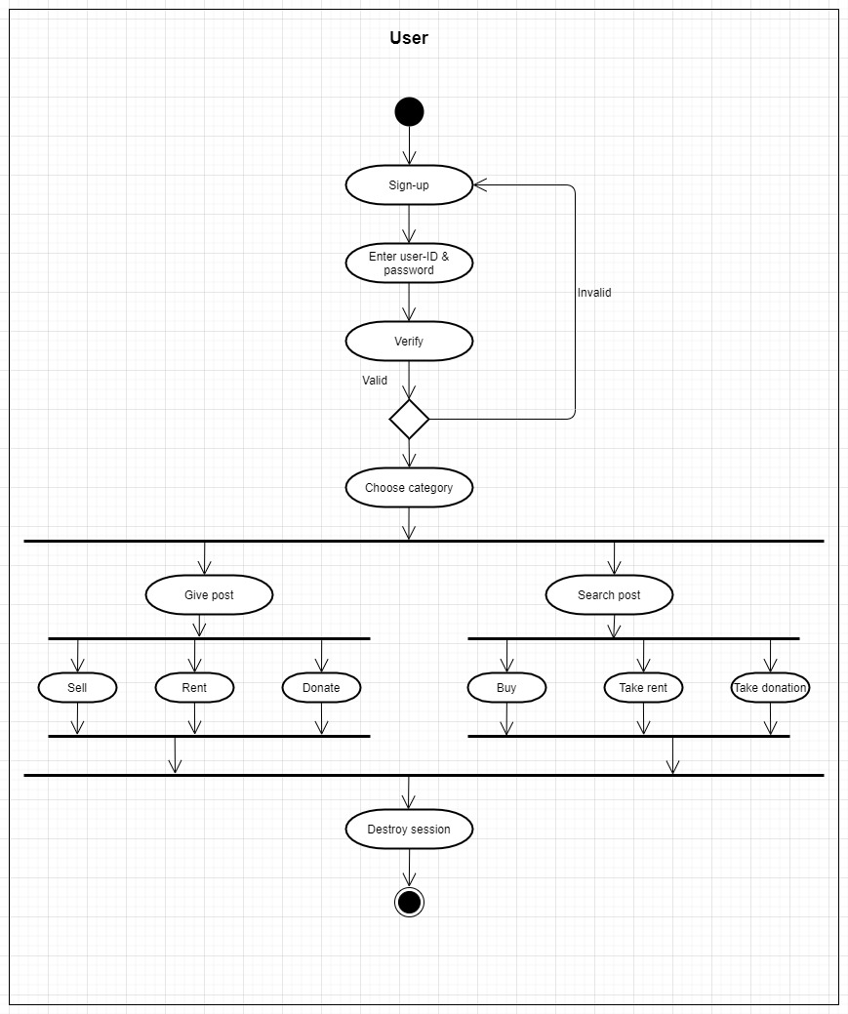
Activity Diagram

Slide 8
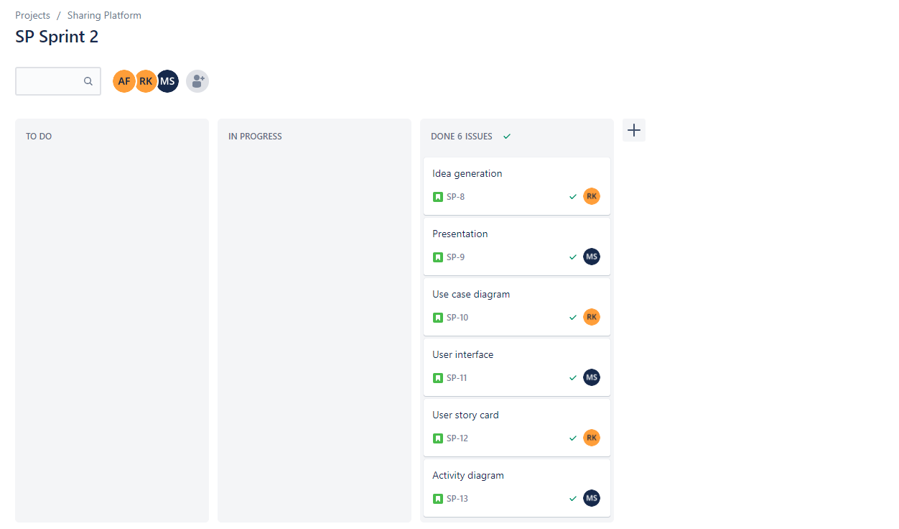
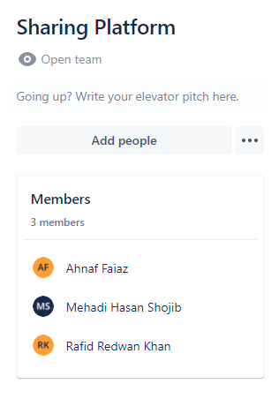
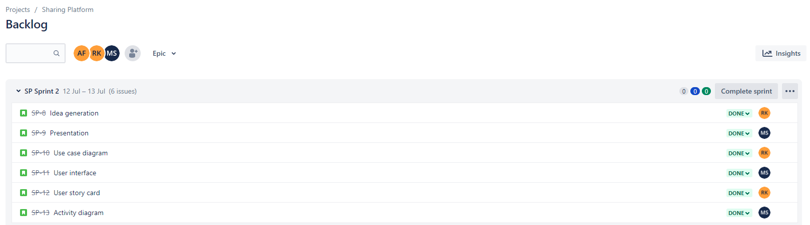
Jira

Slide 9
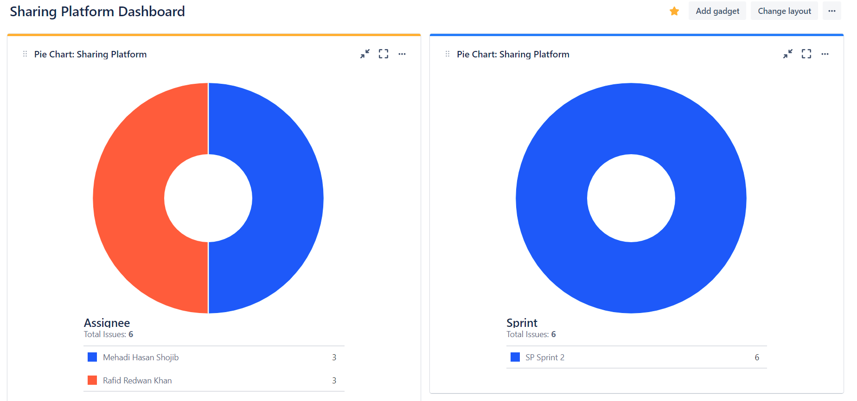

Slide 10
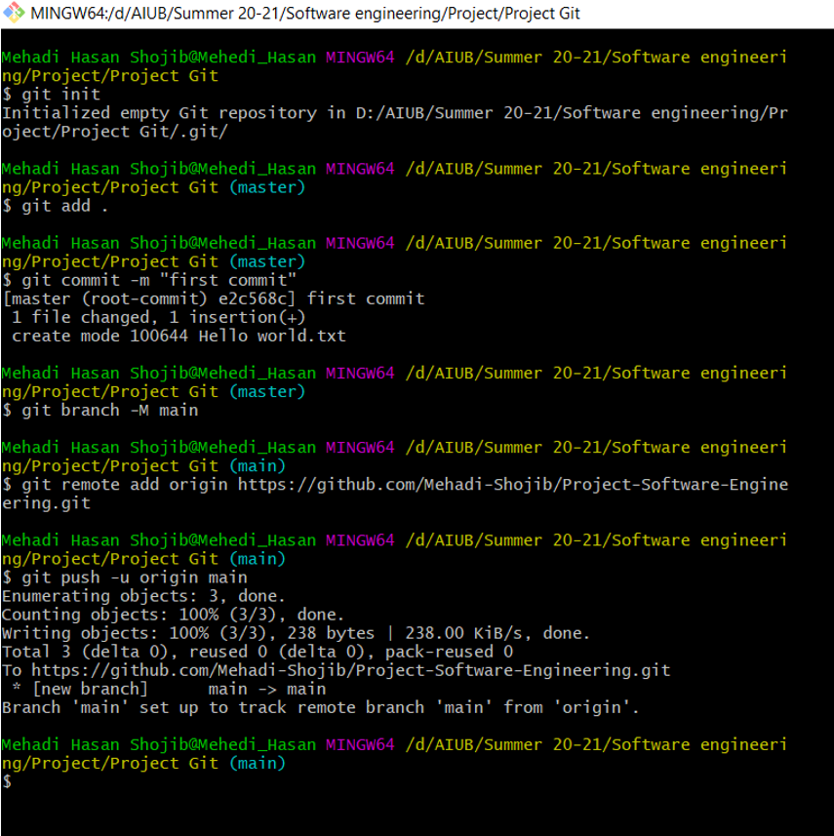
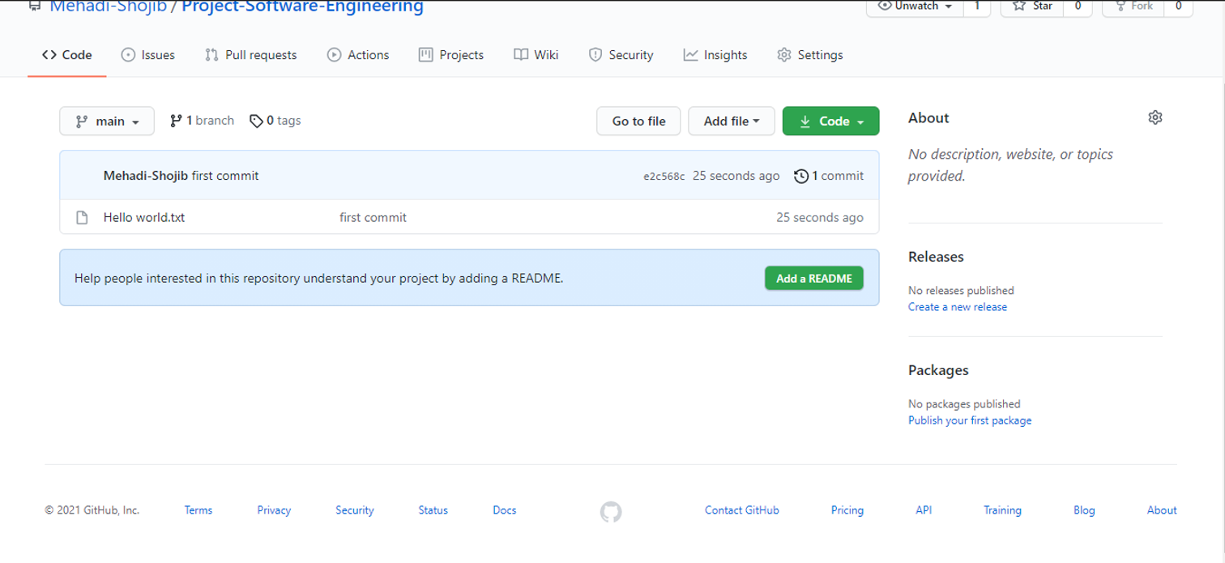
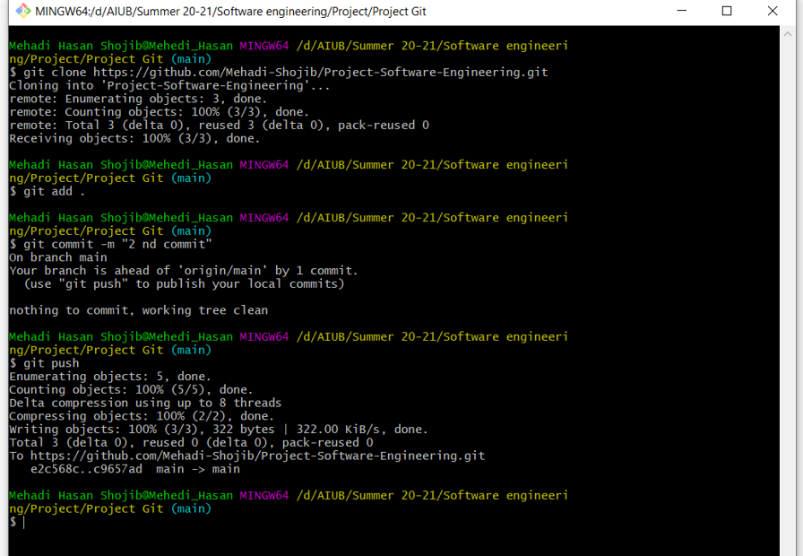
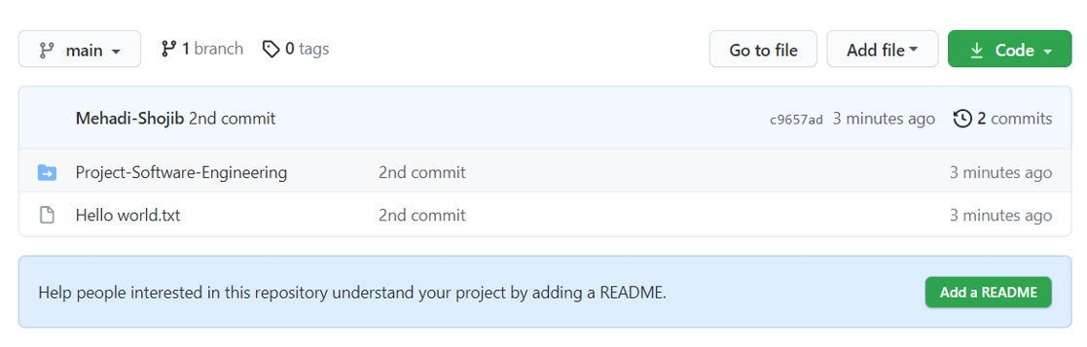
Git

Slide 11
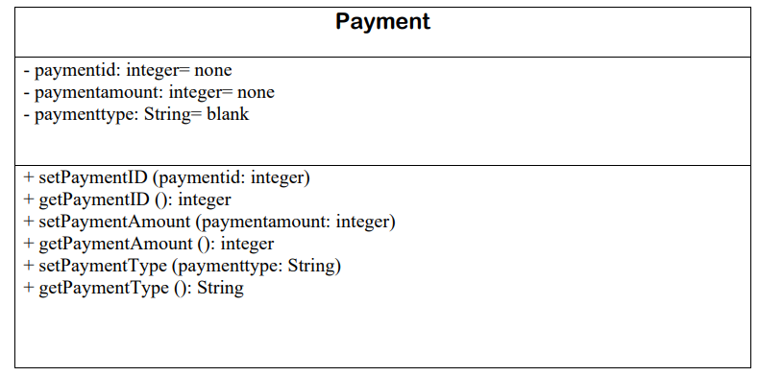
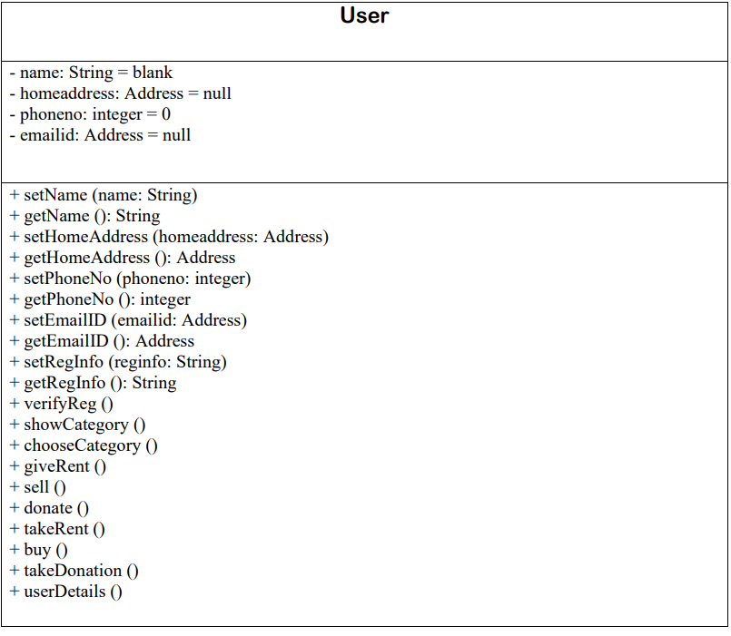
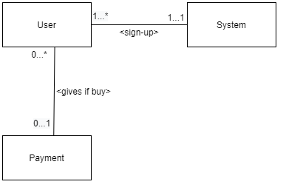
Class Diagram

Slide 12
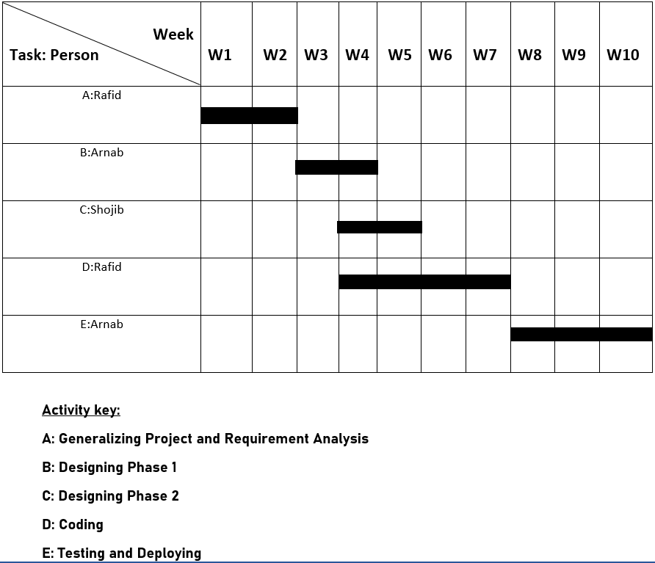
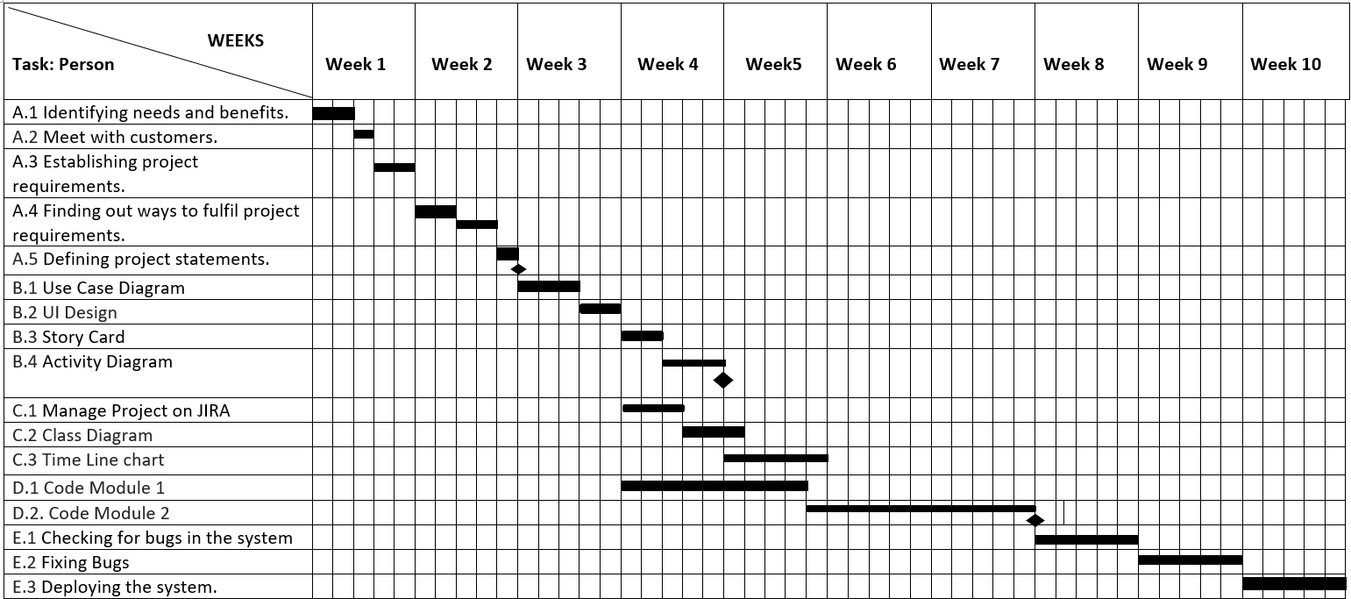
Timeline Chart

Slide 13
Budget Estimation
Budgeting:
Developer Salary in 9 months:
Per Developer salary Per working Hour = 800 Taka
Total Developer Salary = 800*1584 =1,267,200 TK
Requirement Analysis:
Time Needed:1 months (22 Working Days=176 Working Hour)
Req Analysis Person’s Hourly wage = 500 Taka
Total Req Analysis Expense = 500*176 = 88,000 Taka
Transportation Cost Estimation = 12,000 Tk
Training & Hardware Expense Estimation= 100,000 Tk
Rent Expense:
Room Per Month = 20,000 Tk
Total in 9 months =180,000 Tk
Total Utilities in 9 months= 25,000 TK
Constructive Cost Model:
Project Type : Organic
Coefficient _{<Effort Factor>}: 2.4 [P=1.05; T=0.38]
SLOC =10,000 Lines
Person Months (PM) = (2.4*10^{1.05}) = 26.92 = 27
Dev Time (DM) = (2.5*26.92^{0.38})
=8.74
= 9 Months
= 1584 working Hour
Required People (ST) =PM/DM
=3 People
Maintenance (Till 6 Months after Delivery):
Expense Per Hour = 1000 Tk
Total Estimated Time needed for Maintenance = 60 Hours
Total Estimated Maintenance Expense = 60*1000= 60,000Tk
Total Estimated Expense
=1,267,200+88,000+12,000+100,000+180,000+25,000+60,000
=1,732,200 Tk
Profit:
15% profit = 259,830 Tk
Project Budget: 1,732,200+259,830 = 1,992,030 Tk

Slide 14
Conclusion
Sharing platform is a versatile project and has a clear target market. It makes easier to get or find any thing through online. Specially students can use this software for their benefits. This project’s functionality is easily understood and it is very simple to use.
Thank You!

