Slide 1
MASK IT
INTELLIGENT AIR QUALITY DETECTION
MEHAK BERI | LUCIA BOTIQUIN

Slide 2
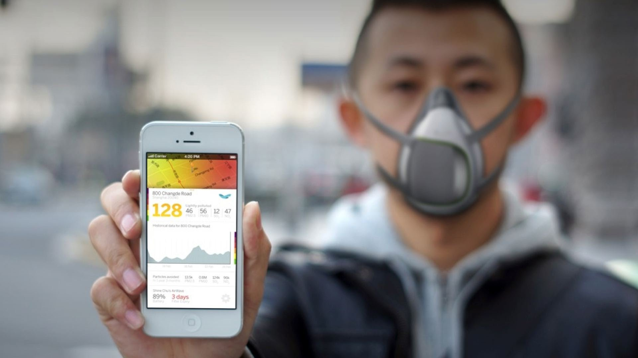
WHY Mask IT?
Notes:
Instead of using expensive sensors; use machine learning powered model which takes as input different gas levels, temperature, humidity, luminosity to give a calculated decision on whether a user should wear a pollution mask or not

Slide 3
Technology
Assume the pollution level is decided by independent pollution level values (eg A>130; B>100 => polluted)
But in real life, values are not independent, the pollution level cannot be determined from a single variable alone. Ex- more traffic during morning and evening.
Machine Learning model calculates weights using perceptrons:
Equation: A.w1 + B.w2 + C.w3 + D.w4 + E.w5
New data is test data (real time) and gets classified based on weights calculated using machine learning model

Slide 4
Sensors Needed
Temperature Sensor
Humidity Sensor
Luminosity Sensor
LCD Display
Gas Sensors (NOX, No2, O3)

Slide 5
Architecture

Slide 6
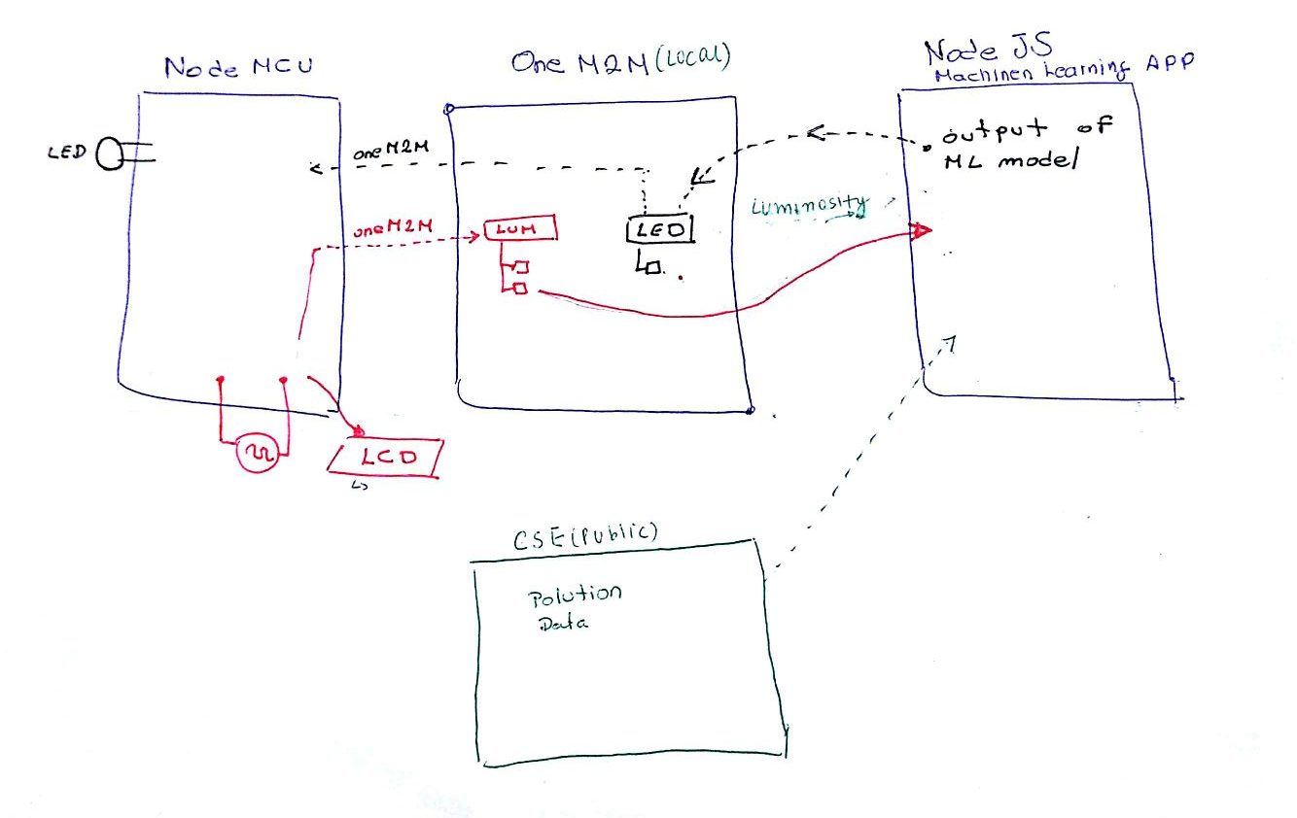

ML Model

Slide 7
WEBSITE

Slide 8
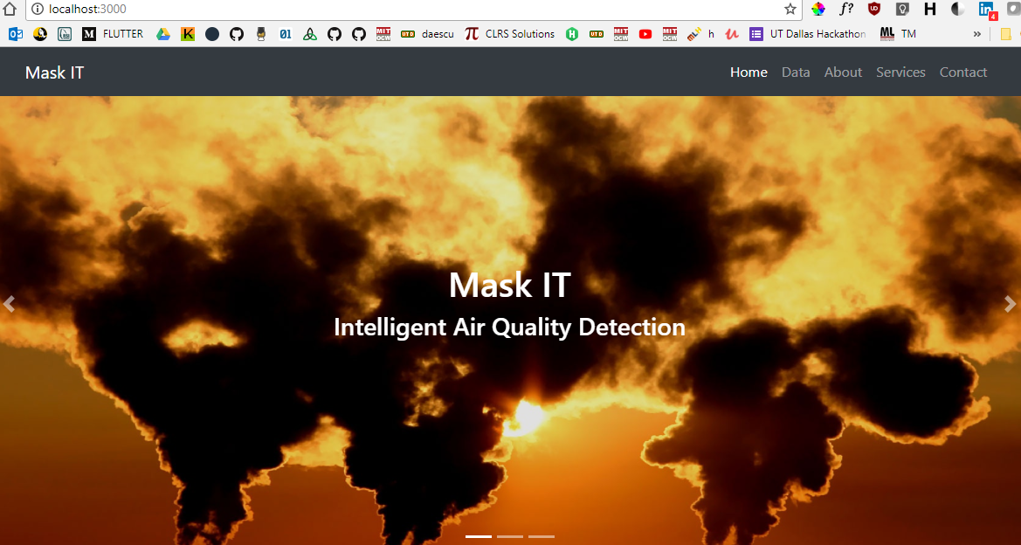

Slide 9
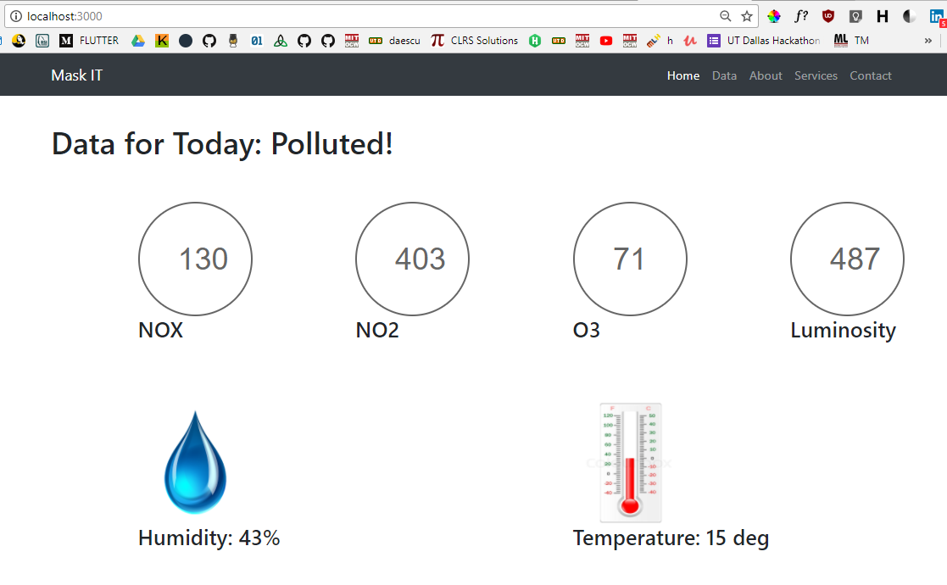
WEBSITE

Slide 10
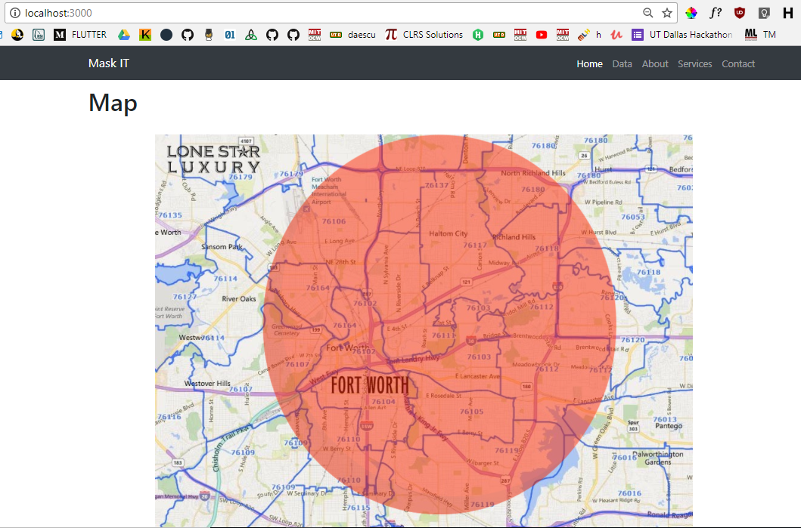

Slide 11
Self Improving technology
Can use the costly device and calculate validation values for one week of real time data to improve models
This data when added to the machine learning model, updates weights and gives more accurate classification for further values
This script can be run as and when needed

Slide 12
Real Time Data: OneM2M
Real time data from the sensors displayed on website using OneM2M protocol
We get data from 5 different sensors onto the server using the OneM2M protocol
This data will be used by our model to compute the pollution status: Polluted/ Non polluted – from weight multiplication with real time values
Pollution state is sent to the server and M2M protocol will send that back to the LCD.

Slide 13
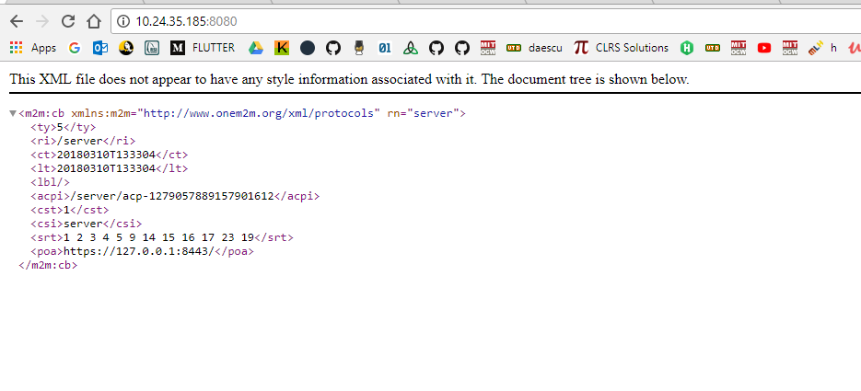

Slide 14
Area wise air quality detection
Implemented color coded area display on website using Google Map API
Can divide the city into quadrants and detect average pollution ratings for each quadrant
Create a weighted vector using area value as well and show in map that area which has maximum pollution.

Slide 15
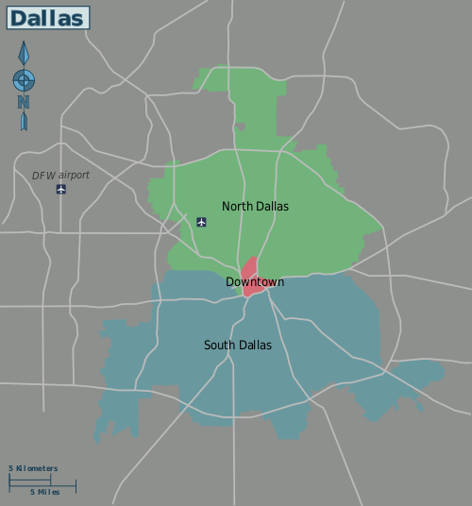
Notes:
Credits: http://alg.umbc.edu/usaq/archives/2011_06.html

Slide 16
DEMO

