Slide 1
Flight Delay Predictor
Kush Aggarwal
Anoushka Kumar
Mehak Gopal
Nalin Arora

Slide 2
Motivation
Flight delays have a profound effect on both passengers and the aviation sector.
They bring about inconveniences for travellers, including missed connections and disrupted itineraries.
Delays lead to operational inefficiencies, elevated expenses, and reduced airline customer satisfaction.
In this project we intend to predict the delay in a flight to enhance user experience and cut down on inefficiency costs.

Slide 3
Literature Review
Airline Flight Delay Prediction Using Machine Learning Models,Yuemin Tang,2021, ACM, New York, NY, USA :
Performs binary classification using five models and compares their performance
Uses a dataset containing flight details from JFK airport over a span of 1 year
The results point towards Decision Trees as having the most accurate predictions.
This paper uses the same dataset that we have used in our project. It follows the same trajectory as our project till binary classification, following which we will perform linear regression to calculate the amount of delay.

Slide 4
Literature Review
Prediction of Flight Time Deviation for Lithuanian Airports Using Supervised Machine Learning Model, P. Stefanovič, R. Štrimaitis, and O. Kurasova, Computational Intelligence and Neuroscience, vol. 2020
Analyzes the flight time deviation of Lithuanian Airports
Uses 7 different models to compare and contrast results, and SMOTE analysis to address class imbalance
Uses grid search to compare result parameters and maximise the accuracy

Slide 5
Literature Review
A machine learning approach for prediction of on-time performance of flights, Balasubramanian Thiagarajan,Lakshminarasimhan Srinivasan, Aditya Vikram Sharma, Dinesh Shrikanthan,Vineeth Vijayaraghavan, IEEE
2-stage prediction model to predict the expected delay
Carries out both regression and classification tasks with four models for each
Built a real-time Decision Support Tool to inform passengers and airlines about expected delays using available factors

Slide 6
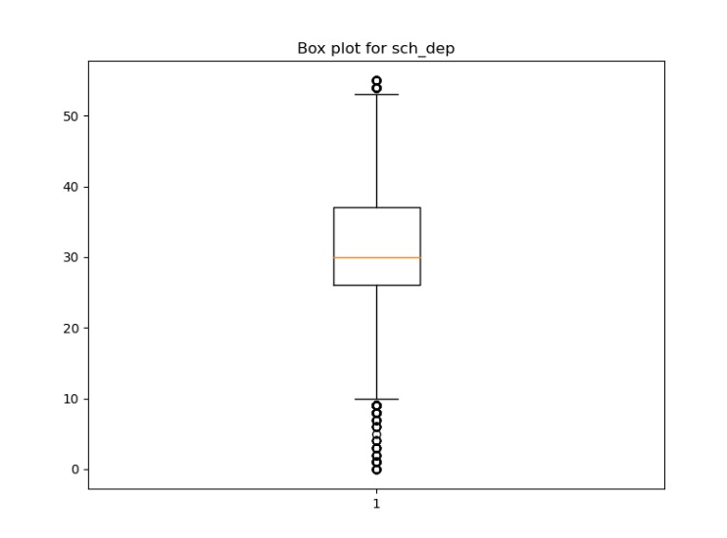
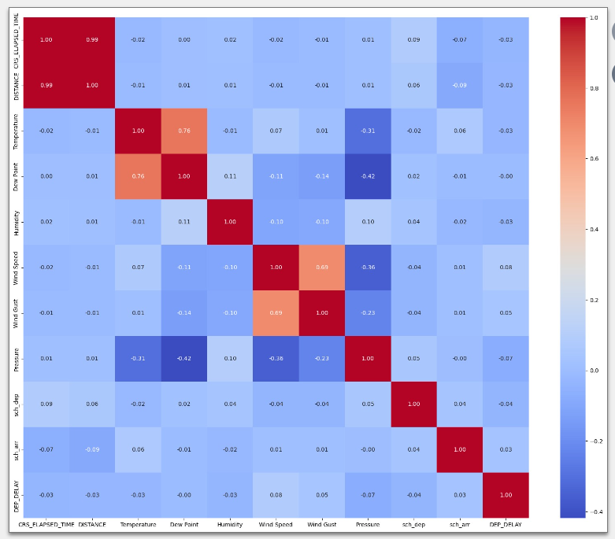
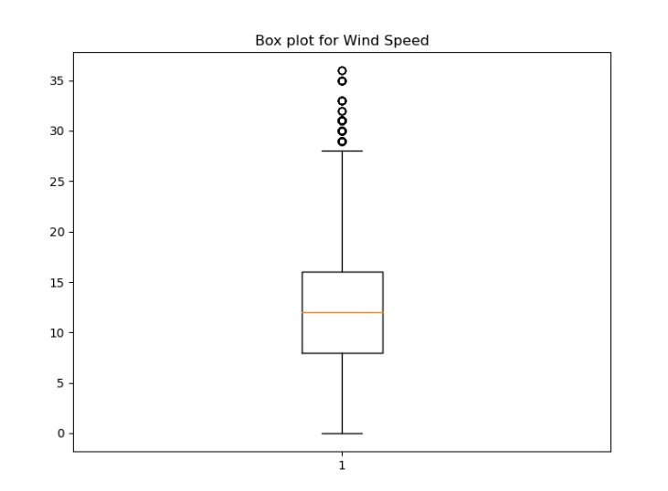
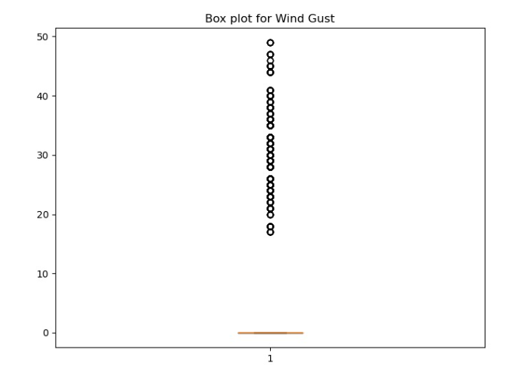
Exploratory Data Analysis
We made boxplots and a correlation heatmap for the dataset. The boxplots led to the conclusion that normalisation of the features was required.

Slide 7
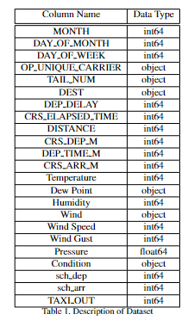
Dataset Preprocessing
We had 23 features in our dataset total and its description is shown.
We deleted the NaN entries(2 samples).
Six columns ('OP_UNIQUE_CARRIER', 'TAIL_NUM', 'CRS_DEP_M', 'DEP_TIME_M', 'CRS_ARR_M' and 'TAXI_OUT’) were dropped which we considered unnecessary to our model predictions
The ‘DEW_POINT’ column was changed to int type and the ‘DEP_DELAY’ column was changed to 0/1 format for binary classification and moved to the end of the dataset. For regression, ‘DEP_DELAY’ was kept as is and the ground truth for classification (0/1 format) was added in a separate column called ‘delayed’.
We label encoded categorical columns (‘DEST’, ‘Wind’ and ‘Condition’) and Z-normalised the columns.

Slide 8
Methodology
The objective was to correctly classify delay in flights and predict the amount of delay.
Classification: This was attempted through multiple classification models using K-fold cross validation.
We set K = 10 and used the following classification methods:
Decision Trees
Random Forest
K-Nearest Neighbours
Naive Bayes
Logistic Regression
SVM
Gradient Boosting
ADA Boosting

Slide 9
Methodology
Class Imbalance: This was addressed using SMOTE analysis.
Regression: This was done by fitting several regression models and using K fold cross validation (K=10) and comparing the obtained results.
We used the following regression methods:
K-Nearest Neighbours
Decision Tree Regressor
Random Forest Regressor
Ridge and Lasso
XGBoost
Linear Regression
SVR
Gradient Boost Regressor
ADA Boost regressor

Slide 10
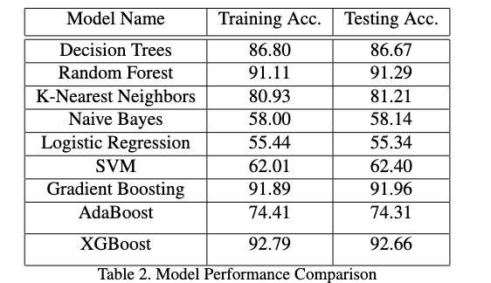
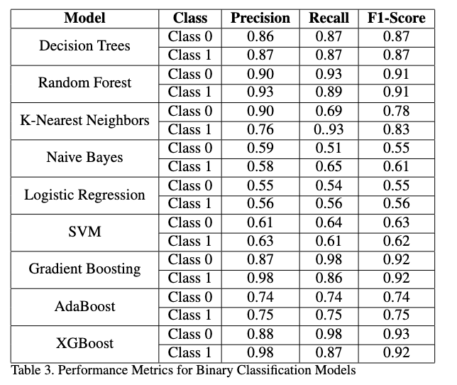
Results & Analysis
Among the models, XGBoost consistently exhibits the highest metrics, with impressive precision and recall for both classes.
Decision Trees and Random Forest follow closely, showcasing balanced metrics.
Naive Bayes lags behind, displaying lower scores across precision, recall, and F1-Score, making it the least performing model in this binary classification evaluation.

Slide 11
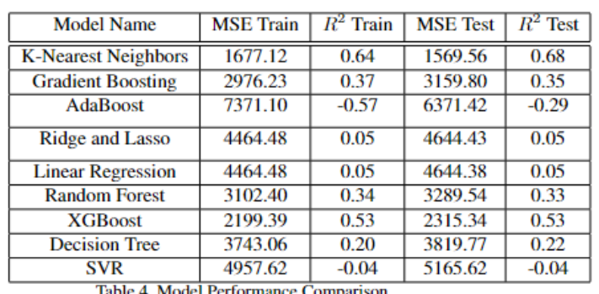
Results & Analysis
K-Nearest Neighbours has the lowest Mean Squared Error (MSE) on both the training and test datasets, and high R-square values (0.64-train, 0.68-test) , and thus gives the best results
XGBoost has a reasonably high R-square value (0.53) and thus would give reasonably accurate predictions
AdaBoost and SVR give the lowest R-square values and are thus the weakest models

Slide 12
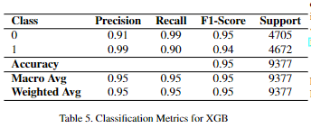
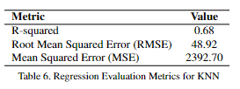
Pipeline
The best classifier and regressor were tested on unseen data and their evaluation metrics were calculated and are as follows:
Best classifier: XGB
Best Regressor: K-Nearest Neighbours

Slide 13
Timeline
Pre- Midsem: We preprocessed data, conducted EDA and tested various classification models.
Post - Midsem: We addressed class imbalance and tested various regression models.
All in all, we were able to follow the timeline that we proposed in the project proposal.

Slide 14
Individual Contributions
Kush Aggarwal: Literature Review, EDA and preprocessing of dataset, Model Implementation, Analysis and Inference of results
Anoushka Kumar: Literature Review, EDA and preprocessing of dataset, Model Implementation, Analysis and Inference of results
Mehak Gopal: Literature Review, EDA and preprocessing of dataset, Model Implementation, Analysis and Inference of results
Nalin Arora: Literature Review, EDA and preprocessing of dataset, Model Implementation, Analysis and Inference of results

