Slide 1
LL1
By
Attia Agha

Slide 2
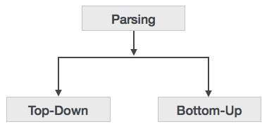
Syntax analzers
Syntax analyzers follow production rules defined by means of context-free grammar. The way the production rules are implemented (derivation) divides parsing into two types : top-down parsing and bottom-up parsing.

Slide 3
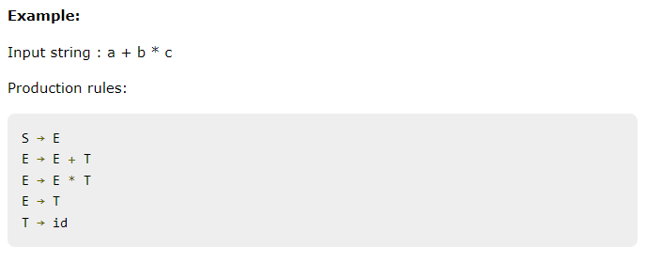
Bottom-up Parsing
bottom-up parsing starts with the input symbols and tries to construct the parse tree up to the start symbol

Slide 4
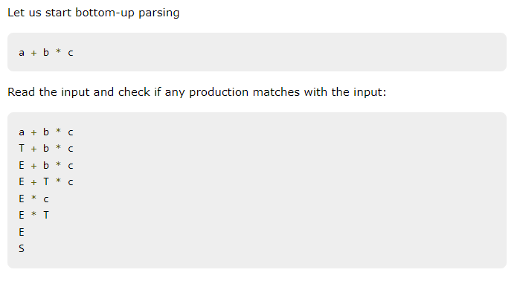
Cont.

Slide 5
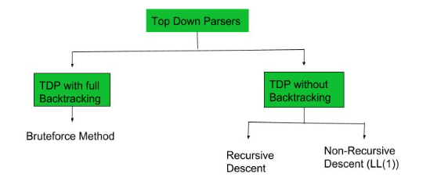
Top down
A top-down parser builds the parse tree from the top down, starting with the start non-terminal. There are two types of Top-Down Parsers:
Top-Down Parser with Backtracking
Top-Down Parsers without Backtracking
Top-Down Parsers without backtracking can further be divided into two parts:

Slide 6
Top-down Parsing
When the parser starts constructing the parse tree from the start symbol and then tries to transform the start symbol to the input, it is called top-down parsing.
Recursive descent parsing : It is a common form of top-down parsing. It is called recursive as it uses recursive procedures to process the input. Recursive descent parsing suffers from backtracking.
Backtracking : It means, if one derivation of a production fails, the syntax analyzer restarts the process using different rules of same production. This technique may process the input string more than once to determine the right production.

Slide 7
LL1 parsing
LL(1) Parsing: Here the 1st L represents that the scanning of the Input will be done from the Left to Right manner and the second L shows that in this parsing technique, we are going to use the Left most Derivation Tree. And finally, the 1 represents the number of look-ahead, which means how many symbols are you going to see when you want to make a decision.
Essential conditions to check first are as follows:
The grammar is free from left recursion.
The grammar should not be ambiguous.
The grammar has to be left factored in so that the grammar is deterministic grammar.

Slide 8
Algorithm to construct LL(1) Parsing Table:
Step 1: First check all the essential conditions mentioned above and go to step 2.
Step 2: Calculate First() and Follow() for all non-terminals.
First(): If there is a variable, and from that variable, if we try to drive all the strings then the beginning Terminal Symbol is called the First.
Follow(): What is the Terminal Symbol which follows a variable in the process of derivation.
Step 3: For each production A –> α. (A tends to alpha)
Find First(α) and for each terminal in First(α), make entry A –> α in the table.
If First(α) contains ε (epsilon) as terminal, then find the Follow(A) and for each terminal in Follow(A), make entry A –> ε in the table.
If the First(α) contains ε and Follow(A) contains $ as terminal, then make entry A –> ε in the table for the $.

Slide 9
Cont.
An LL(1) parser is a type of top-down parser for context-free grammars that parses the input from Left to right, and produces a Leftmost derivation of the sentence using 1 lookahead token. It works by predicting which rule to apply by looking at the next token in the input.
Components of an LL(1) Parser:
Input buffer: Holds the string to be parsed.
Stack: Holds the sequence of grammar symbols that need to be processed.
Parsing table: Guides the parser in deciding which grammar rule to apply.
Lookahead symbol: The current input symbol (one symbol ahead).
Output: The production rules applied.

Slide 10

Simple example
Let’s use a simple grammar to explain the concept:
Here, the non-terminal S expands to A B, A expands to a, and B expands to b.

Slide 11
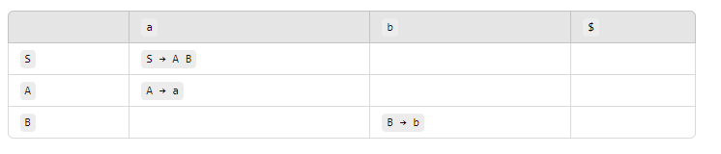
Steps to Parse with an LL(1) Parser:
Let's parse the input string "ab".
1. Initialize:
Stack: Start with $ (end of stack marker) and the start symbol (S): S$
Input: "ab$"
Lookahead: a
2. Parsing Table:
To construct an LL(1) parsing table, we use two functions:
First: What terminal symbols can appear at the beginning of a string derived from a non-terminal.
Follow: What terminal symbols can appear immediately after a non-terminal.

Slide 13
Cont.
3. Parsing Process:
Step 1:Stack: S$Input: ab$Lookahead: aSince the top of the stack is S, and the lookahead is a, from the parsing table, we apply the production S → A B.Stack: A B$Step
2:Stack: A B$Input: ab$Lookahead: aThe top of the stack is A, and the lookahead is a. According to the table, we apply A → a.Stack: a B$Step
3:Stack: a B$Input: ab$Lookahead: aThe top of the stack is a terminal a, and the lookahead is also a, so we match them and move forward.Stack: B$Input: b$Lookahead: bStep
4:Stack: B$Input: b$Lookahead: bThe top of the stack is B, and the lookahead is b. From the table, we apply B → b.Stack: b$

Slide 14
Step 5:Stack: b$Input: b$Lookahead: bThe top of the stack is b, and the lookahead is also b, so we match them.Stack: $Input: $Step
6:Both the stack and input are $, so the parsing is successful!
The LL(1) parser successfully parsed the input "ab" by following the grammar rules and using one symbol of lookahead at each step. It uses a stack and parsing table to decide which production to apply based on the current input.

Slide 15
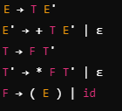
Another example
E is the expression.
E' is for handling + expressions.
T is a term.
T' is for handling * expressions.
F is a factor, which can either be an id (identifier) or an expression inside parentheses

Slide 16
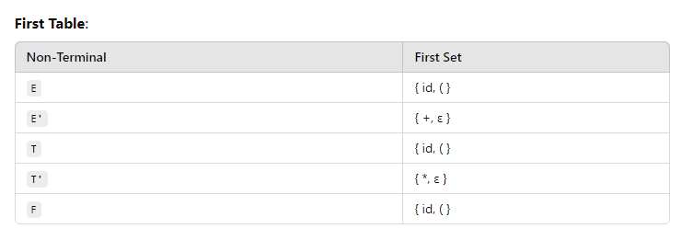
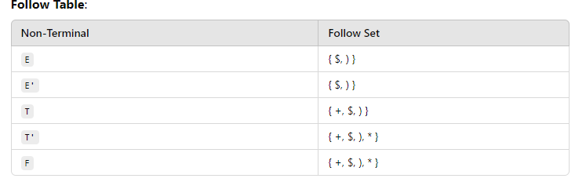

Slide 17
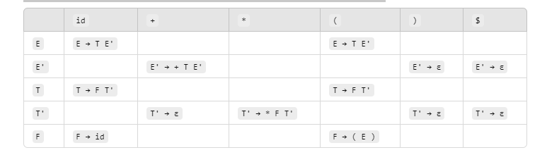
Parsing table
We'll generate the LL(1) parsing table based on the First and Follow sets.
Input String:Let’s parse the input string id + id * id

Slide 18
Parsing Steps:
Initialize:
Stack: E$
Input: id + id * id$
Lookahead: id
Step 1:
Stack: E$
Input: id + id * id$
Lookahead: id
According to the parsing table for E and id, we apply E → T E'.
Stack: T E'$
Input: id + id * id$
Step 2:
Stack: T E'$
Input: id + id * id$
Lookahead: id
The top of the stack is T, and the lookahead is id. We apply T → F T'.
Stack: F T' E'$
Input: id + id * id$

Slide 19
Cont.
Step 3:
Stack: F T' E'$
Input: id + id * id$
Lookahead: id
The top of the stack is F, and the lookahead is id. We apply F → id.
Stack: id T' E'$
Input: id + id * id$
Step 4:
Stack: id T' E'$
Input: id + id * id$
Lookahead: id
The top of the stack is id, which matches the lookahead. So, we match and move forward.
Stack: T' E'$
Input: + id * id$
Lookahead: +

Slide 20
Cont.
Step 5:
Stack: T' E'$
Input: + id * id$
Lookahead: +
The top of the stack is T', and the lookahead is +. From the parsing table for T' and +, we apply T' → ε (which means we pop T').
Stack: E'$
Input: + id * id$
Step 6:
Stack: E'$
Input: + id * id$
Lookahead: +
The top of the stack is E', and the lookahead is +. From the parsing table for E' and +, we apply E' → + T E'.
Stack: + T E'$
Input: + id * id$

Slide 21
Cont.
Step 7:
Stack: + T E'$
Input: + id * id$
Lookahead: +
The top of the stack is +, which matches the lookahead. So, we match and move forward.
Stack: T E'$
Input: id * id$
Lookahead: id
Step 8:
Stack: T E'$
Input: id * id$
Lookahead: id
The top of the stack is T, and the lookahead is id. From the parsing table, we apply T → F T'.
Stack: F T' E'$
Input: id * id$

Slide 22
Cont.
Step 9:
Stack: F T' E'$
Input: id * id$
Lookahead: id
The top of the stack is F, and the lookahead is id. From the parsing table, we apply F → id.
Stack: id T' E'$
Input: id * id$
Step 10:
Stack: id T' E'$
Input: id * id$
Lookahead: id
The top of the stack is id, which matches the lookahead. So, we match and move forward.
Stack: T' E'$
Input: * id$
Lookahead: *

Slide 23
Cont.
Step 11:
Stack: T' E'$
Input: * id$
Lookahead: *
The top of the stack is T', and the lookahead is *. From the parsing table, we apply T' → * F T'.
Stack: * F T' E'$
Input: * id$
Step 12:
Stack: * F T' E'$
Input: * id$
Lookahead: *
The top of the stack is *, which matches the lookahead. So, we match and move forward.
Stack: F T' E'$
Input: id$
Lookahead: id

Slide 24
Cont.
Step 13:
Stack: F T' E'$
Input: id$
Lookahead: id
The top of the stack is F, and the lookahead is id. From the parsing table, we apply F → id.
Stack: id T' E'$
Input: id$
Step 14:
Stack: id T' E'$
Input: id$
Lookahead: id
The top of the stack is id, which matches the lookahead. So, we match and move forward.
Stack: T' E'$
Input: $
Lookahead: $
Step 15:
Stack: T' E'$
Input: $
Lookahead: $
The top of the stack is T', and the lookahead is $. From the parsing table, we apply T' → ε.
Stack: E'$

Slide 25
Cont.
Step 16:
Stack: E'$
Input: $
Lookahead: $
The top of the stack is E', and the lookahead is $. From the parsing table, we apply E' → ε.
Stack: $
Step 17:
Stack: $
Input: $
Both the stack and input are $, so the parsing is successful!
Summary:
The LL(1) parser successfully parsed the input id + id * id by following the grammar rules.

