Slide 1
SDT
Syntax directed translation

Slide 2
SDT
Syntax Directed Translation has augmented rules to the grammar that facilitate semantic analysis. SDT involves passing information bottom-up and/or top-down to the parse tree in form of attributes attached to the nodes. Syntax-directed translation rules use 1) lexical values of nodes, 2) constants & 3) attributes associated with the non-terminals in their definitions.
The general approach to Syntax-Directed Translation is to construct a parse tree or syntax tree and compute the values of attributes at the nodes of the tree by visiting them in some order. In many cases, translation can be done during parsing without building an explicit tree.

Slide 3
SDT example
To generate the syntax-directed translation for the given grammar and input aadbc in a top-down manner, we'll follow these steps:
Start from the start symbol SSS.
Apply production rules and print according to the semantic actions provided.
Match the input symbols in a left-to-right manner.

Slide 4
Example top down
S --> AS { printf(1)} 1
S --> AB { printf (2)} 2
A --> a { printf (3)} 3
B --> bC { printf (4)} 4
B --> dB { printf (5)} 5
C --> C { printf (6)} 6
Input: aadbc
We'll go through the input step by step and apply the grammar rules.

Slide 5
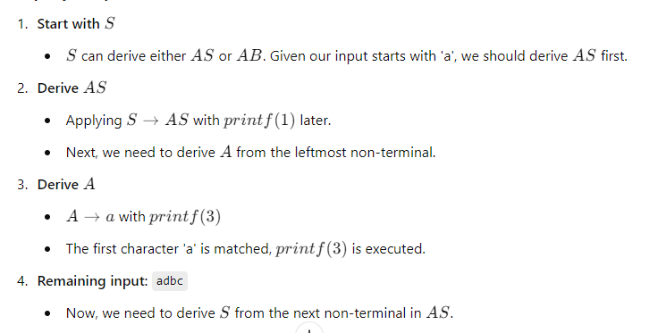
Step-by-Step Derivation

Slide 6
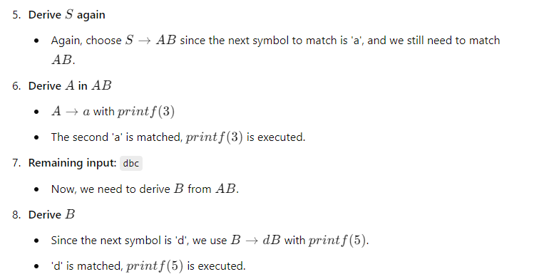

Slide 7
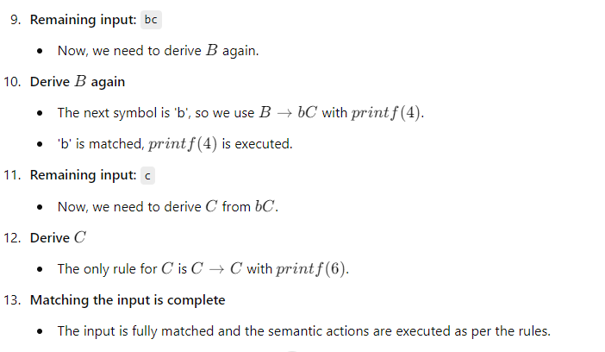

Slide 8
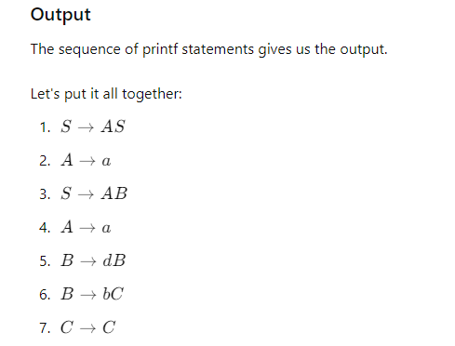
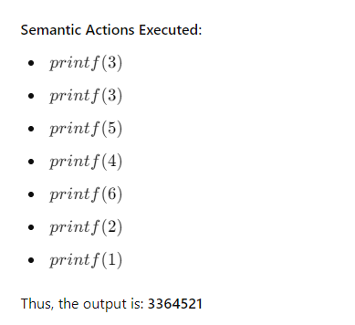

Slide 9
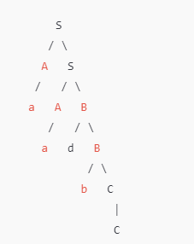
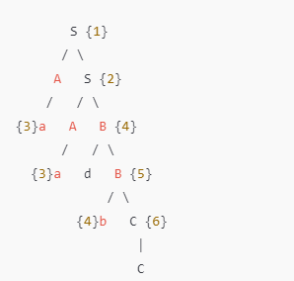
Parse tree and Parse Tree with Annotations (Semantic Actions):

Slide 10
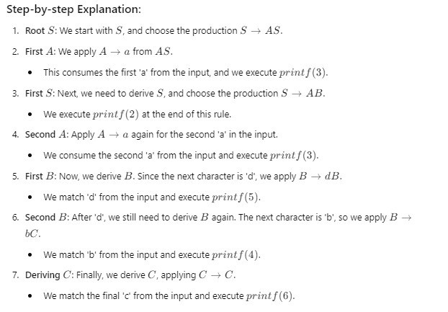
Steps of tree

Slide 11
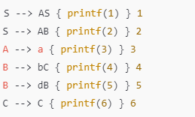
Bottom up with same example

Slide 12
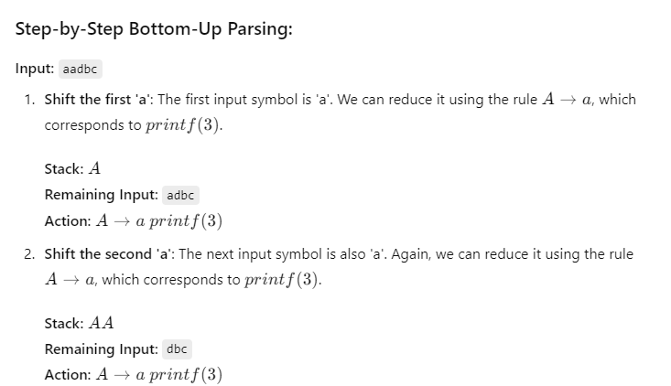

Slide 13
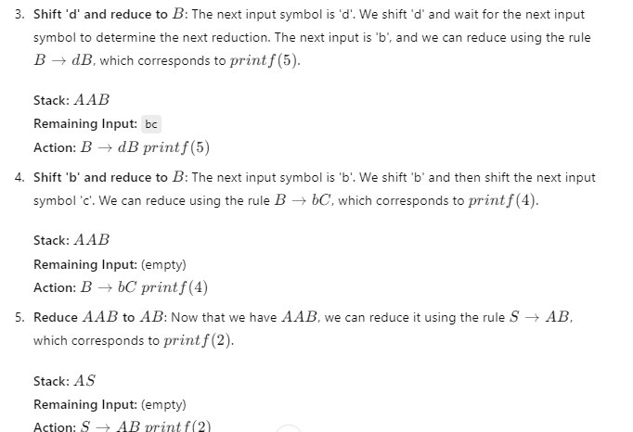

Slide 14
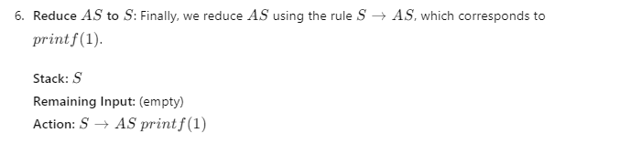

Slide 15
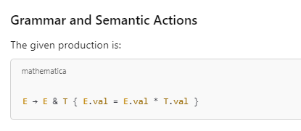
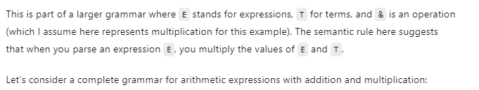
In a syntax-directed translation (SDT) scheme for arithmetic expressions, semantic actions are typically used to compute values while parsing the expression

Slide 16
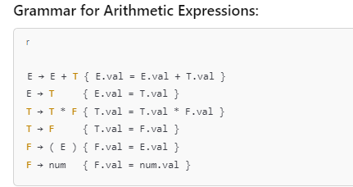
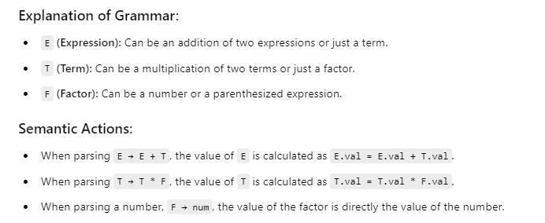

Slide 17
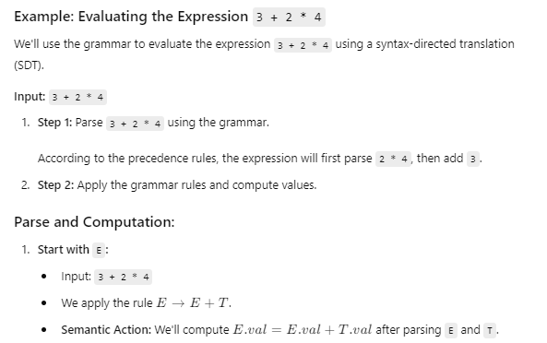

Slide 18
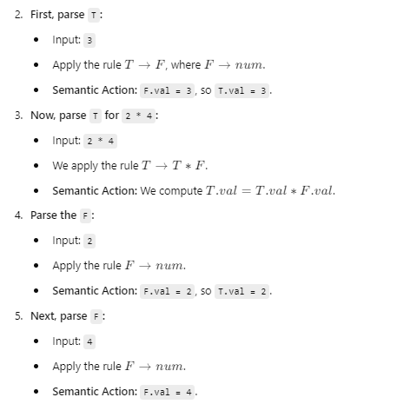

Slide 19
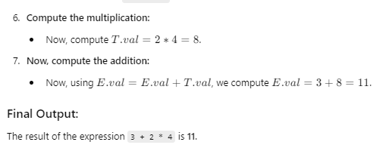

Slide 20
