Slide 1
CHAPTER 1:
Usability of Interactive Systems
Designing the User Interface:
Strategies for Effective Human-Computer Interaction
Fifth Edition
Ben Shneiderman & Catherine Plaisant
in collaboration with
Maxine S. Cohen and Steven M. Jacobs

Slide 2
Introduction
The Interdisciplinary Design Science of Human-Computer Interaction (HCI) combines knowledge and methods associated with professionals including:
  Psychologists (incl. Experimental, Educational, Social and Industrial Psychologists)
  Computer Scientists
  Instructional and Graphic Designers
  Technical Writers
  Human Factors and Ergonomics Experts
  Anthropologists and Sociologists
1-<number>

Slide 3
Introduction (continued)
What are the Ramifications?
  Success Stories: Microsoft, Linux, Amazon.com, Google
  Competition: Firefox vs. Internet Explorer
  Copyright Infringement Suits - Apple vs. Microsoft (Windows) and Napster vs. The music industry
  Mergers: AOL and Time Warner
  Corporate Takeovers: IBM's seizure of Lotus
  Privacy and Security issues: identification theft, medical information, viruses, spam, pornography, national security
1-<number>

Slide 4
Introduction (continued)
Individual User Level
  Routine processes: tax return preparation
  Decision support: a doctor’s diagnosis and treatment
  Education and training: encyclopedias, drill-and-practice exercises, simulations
  Leisure: music and sports information
  User generated content: social networking web sites, photo and video share sites, user communities
  Internet-enabled devices and communication
1-<number>

Slide 5
Introduction (continued)
Communities
  Business use: financial planning, publishing applications
  Industries and professions: web resources for journals, and career opportunities
  Family use: entertainment, games and communication
  Globalization: language and culture
1-<number>

Slide 6
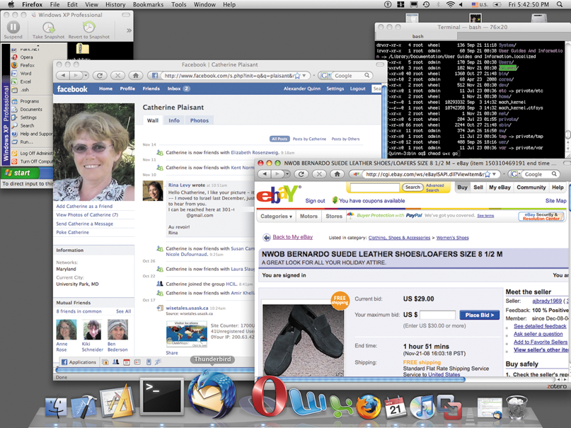
Introduction (continued)
The new “look and feel” of computers (Mac)
1-<number>

Slide 7
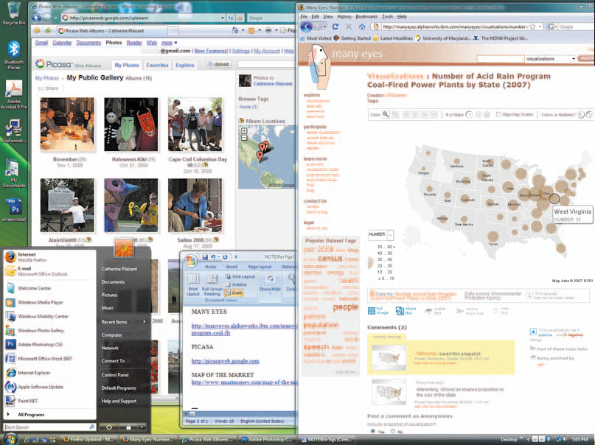
Introduction (continued)
The new “look and feel” of computers (Vista)
1-<number>

Slide 8
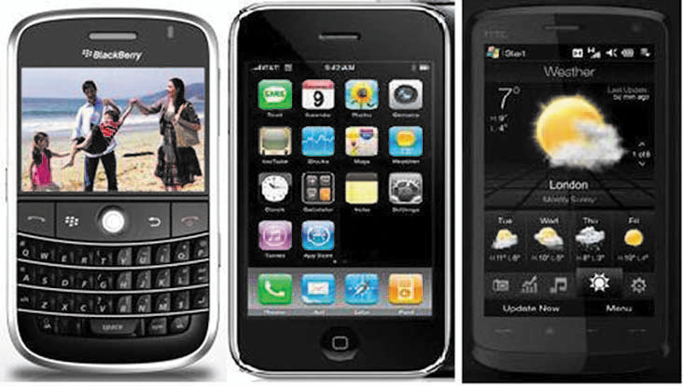
Introduction (concluded)
And smaller devices doing more…
1-<number>

Slide 9
Book overview
Chapter 1:
  A broad overview of human-computer interaction from practitioner and research perspectives
Chapter 2:
  Guidelines, principles, and theories
Chapters 3-4:
  Managing design processes and evaluating designs
Chapters 5-9:
  Interaction styles
Chapters 10-14:
  Critical design decisions
Afterword:
  Societal and individual impacts of user interfaces
1-<number>

Slide 10
Usability requirements
Synonyms for “user-friendly” in Microsoft Word 2002 are easy to use; accessible; comprehensible; intelligible; idiot proof; available; and ready
But a “friend” also seeks to help and be valuable. A friend is not only understandable, but understands. A friend is reliable and doesn’t hurt. A friend is pleasant to be with.
These measures are still subjective and vague, so a systematic process is necessary to develop usable systems for specific users in a specific context
1-<number>

Slide 11
Usability requirements (cont.)
The U.S. Human Engineering Design Criteria for Military Systems (1999) states these purposes:
  Achieve required performance by operator, control, and maintenance personnel
  Minimize skill and personnel requirements and training time
  Achieve required reliability of personnel-equipment/software combinations
  Foster design standardization within and among systems
Should improving the user’s quality of life and the community also be objectives?
Usability requires project management and careful attention to requirements analysis and testing for clearly defined objectives
1-<number>

Slide 12
Goals for requirements analysis
Ascertain the user’s needs
  Determine what tasks and subtasks must be carried out
  Include tasks which are only performed occasionally. Common tasks are easy to identify.
  Functionality must match need or else users will reject or underutilize the product
1-<number>

Slide 13
Goals for requirements analysis
Ensure reliability
  Actions must function as specified
  Database data displayed must reflect the actual database
  Appease the user's sense of mistrust
  The system should be available as often as possible
  The system must not introduce errors
  Ensure the user's privacy and data security by protecting against unwarranted access, destruction of data, and malicious tampering
1-<number>

Slide 14
Goals for requirements analysis
Promote standardization, integration, consistency, and portability
  Standardization: use pre-existing industry standards where they exist to aid learning and avoid errors (e.g. the W3C and ISO standards)
  Integration: the product should be able to run across different software tools and packages (e.g. Unix)
  Consistency:
    compatibility across different product versions
    compatibility with related paper and other non-computer based systems
    use common action sequences, terms, units, colors, etc. within the program
  Portability: allow for the user to convert data across multiple software and hardware environments
1-<number>

Slide 15

Goals for requirements analysis
Complete projects on time and within budget
Late or over budget products can create serious pressure within a company and potentially mean dissatisfied customers and loss of business to competitors
1-<number>

Slide 16
Usability measures
Define the target user community and class of tasks associated with the interface
Communities evolve and change (e.g. the interface to information services for the U.S. Library of Congress)
5 human factors central to community evaluation:
  Time to learn
  How long does it take for typical members of the community to learn relevant task?
  Speed of performance
  How long does it take to perform relevant benchmarks?
  Rate of errors by users
  How many and what kinds of errors are made during benchmark tasks?
  Retention over time
  Frequency of use and ease of learning help make for better user retention
  Subjective satisfaction
  Allow for user feedback via interviews, free-form comments and satisfaction scales
1-<number>

Slide 17
Usability measures (cont.)
Trade-offs in design options frequently occur.
  Changes to the interface in a new version may create consistency problems with the previous version, but the changes may improve the interface in other ways or introduce new needed functionality.
Design alternatives can be evaluated by designers and users via mockups or high-fidelity prototypes.
  The basic tradeoff is getting feedback early and perhaps less expensively in the development process versus having a more authentic interface evaluated.
1-<number>

Slide 18
Usability motivations
Many interfaces are poorly designed and this is true across domains:
Life-critical systems
  Air traffic control, nuclear reactors, power utilities, police & fire dispatch systems, medical equipment
  High costs, reliability and effectiveness are expected
  Length training periods are acceptable despite the financial cost to provide error-free performance and avoid the low frequency but high cost errors
  Subject satisfaction is less an issue due to well motivated users
1-<number>

Slide 19
Usability motivations (cont.)
Industrial and commercial uses
  Banking, insurance, order entry, inventory management, reservation, billing, and point-of-sales systems
  Ease of learning is important to reduce training costs
  Speed and error rates are relative to cost
  Speed of performance is important because of the number of transactions
  Subjective satisfaction is fairly important to limit operator burnout
1-<number>

Slide 20
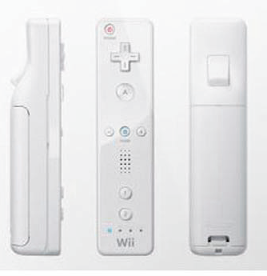
Usability motivations (cont.)
Office, home, and entertainment applications
  Word processing, electronic mail, computer conferencing, and video game systems, educational packages, search engines, mobile device, etc.
  Ease of learning, low error rates, and subjective satisfaction are paramount due to use is often discretionary and competition fierce
  Infrequent use of some applications means interfaces must be intuitive and easy to use online help is important
  Choosing functionality is difficult because the population has a wide range of both novice and expert users
  Competition cause the need for low cost
  New games and gaming devices!
    For example, Nintendo Wii
1-<number>

Slide 21
Usability motivations (cont.)
Exploratory, creative, and cooperative systems
  Web browsing, search engines, artist toolkits, architectural design, software development, music composition, and scientific modeling systems
  Collaborative work
  Benchmarks are hard to describe for exploratory tasks and device users
  With these applications, the computer should be transparent so that the user can be absorbed in their task domain
1-<number>

Slide 22
Usability motivations (cont.)
Social-technical systems
  Complex systems that involve many people over long time periods
  Voting, health support, identity verification, crime reporting
  Trust, privacy, responsibility, and security are issues
  Verifiable sources and status feedback are important
  Ease of learning for novices and feedback to build trust
  Administrators need tools to detect unusual patterns of usage
1-<number>

Slide 23
Universal Usability
Physical abilities and physical workplaces
  Basic data about human dimensions comes from research in anthropometry
  There is no average user, either compromises must be made or multiple versions of a system must be created
  Physical measurement of human dimensions are not enough, take into account dynamic measures such as reach, strength or speed
1-<number>

Slide 24
Universal Usability (cont.)
  Screen-brightness preferences vary substantially, designers customarily provide a knob to enable user control
  Account for variances of the user population's sense perception
  Vision: depth, contrast, color blindness, and motion sensitivity
  Touch: keyboard and touchscreen sensitivity
  Hearing: audio clues must be distinct
  Workplace design can both help and hinder work performance
1-<number>

Slide 25
Universal Usability (cont.)
The standard ANSI/HFES 100-2007 Human Factors Engineering of Computer Workstations (2007) lists these concerns:
  Work-surface and display-support height
  Clearance under work surface for legs
  Work-surface width and depth
  Adjustability of heights and angles for chairs and work surfaces
  Posture - seating depth and angle; back-rest height and lumbar support
  Availability of armrests, footrests, and palmrests
1-<number>

Slide 26
Universal Usability (cont.)
Cognitive and perceptual abilities
  The human ability to interpret sensory input rapidly and to initiate complex actions makes modern computer systems possible
  The journal Ergonomics Abstracts offers this classification of human cognitive processes:
    Long-term and semantic memory
    Short-term and working memory
    Problem solving and reasoning
    Decision making and risk assessment
    Language communication and comprehension
    Search, imagery, and sensory memory
    Learning, skill development, knowledge acquisition, and concept attainment
1-<number>

Slide 27
Universal Usability (cont.)
  They also suggest this set of factors affecting perceptual and motor performance:
    Arousal and vigilance
    Fatigue and sleep deprivation
    Perceptual (mental) load
    Knowledge of results and feedback
    Monotony and boredom
    Sensory deprivation
    Nutrition and diet
    Fear, anxiety, mood, and emotion
    Drugs, smoking, and alcohol
    Physiological rhythms
  But note, in any application, background experience and knowledge in the task domain and the interface domain play key roles in learning and performance
1-<number>

Slide 28
Universal Usability (cont.)
Personality differences
  There is no set taxonomy for identifying user personality types
  Designers must be aware that populations are subdivided and that these subdivisions have various responses to different stimuli
  Myers-Briggs Type Indicator (MBTI)
    extroversion versus introversion
    sensing versus intuition
    perceptive versus judging
    feeling versus thinking
1-<number>

Slide 29
Universal Usability (cont.)
Cultural and international diversity
  Characters, numerals, special characters, and diacriticals
  Left-to-right versus right-to-left versus vertical input and reading
  Date and time formats
  Numeric and currency formats
  Weights and measures
  Telephone numbers and addresses
  Names and titles (Mr., Ms., Mme.)
  Social-security, national identification, and passport numbers
  Capitalization and punctuation
  Sorting sequences
  Icons, buttons, colors
  Pluralization, grammar, spelling
  Etiquette, policies, tone, formality, metaphors
1-<number>

Slide 30
Universal Usability (cont.)
Users with physical challenges
  Designers must plan early to accommodate users with disabilities
  Early planning is more cost efficient than adding on later
  Businesses must comply with the "Americans With Disabilities" Act for some applications
Older Adult Users
  Including the elderly is fairly easy
    Designers should allow for variability within their applications via settings for sound, color, brightness, font sizes, etc. with less distracting animation
1-<number>

Slide 31
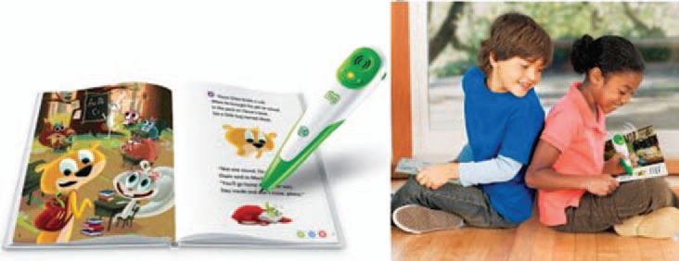

Universal Usability (concluded)
Younger users
1-<number>

Slide 32
Goals for our profession
Potential research topics
  Reducing anxiety and fear of computer usage
  Graceful evolution
  Specification and implementation of interaction
  Direct manipulation
  Social media participation
  Input devices
  Online assistance
  Information exploration
1-<number>

Slide 33
Goals for our profession (cont.)
Providing tools, techniques, and knowledge for system implementers
  Rapid prototyping is easy when using contemporary tools
  Use general or self-determined guideline documents written for specific audiences
  To refine systems, use feedback from individual or groups of users
Raising the computer consciousness of the general public
  Many novice users are fearful due to experience with poor product design
  Good designs help novices through these fears by being clear, competent, and nonthreatening
1-<number>

