Slide 1
Learnability

Slide 2
Today’s Topics
Human memory
Interaction styles
User model vs. system model
Learnability principles & design patterns
Notes:
Today’s lecture is about learnability and memorability – making interfaces easier for new users to learn, and for casual users to remember.
We’ll start with a tiny bit of cognitive science, looking at (very roughly) how the human memory system works. Then we’ll look at the evolution of graphical user interfaces from a learnability point of view, surveying three interface styles that have been (and still are) used. We’ll talk about how users learn about an interface by forming a mental model of its parts and their behaviors. Finally, we’ll talk about some design principles that you can apply if learnability is an important criterion for your interface.

Slide 3
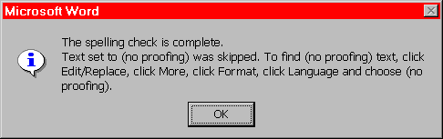
People Don't Learn Instantly
Source: Interface Hall of Shame
Notes:
When you're designing for learnability, you have to be aware of how people actually learn. You can't assume that if the interface tells the user something, that the user will immediately learn and remember it.
This dialog box is a great example of overreliance on the user’s memory. It’s a modal dialog box, so the user can’t start following its instructions until after clicking OK. But then the instructions vanish from the screen, and the user is left to struggle to remember them. Just because you've said it, doesn't mean they know it. (Incidentally, an obvious solution to this problem would be a button that simply executes the instructions directly! This message is clearly a last-minute patch for a usability problem.)

Slide 4
Memory
Working
Memory
Long-term
Memory
Working memory
Small: 7 ± 2 “chunks”
Short-lived: ~10 sec
Maintenance rehearsal fends off decay (but costs attention)
Long-term memory
Practically infinite in size and duration
Elaborative rehearsal transfers chunks to long-term memory
Notes:
Just as it helps to understand the properties of the computer system you’re programming for – its processor speed, memory size, hard disk, operating system, and the interaction between these components – it’s important for us to understand some of the properties of the human that we’re designing for. Needless to say, there’s far more to this topic than we can cover in this course (check out Course 9 if you’re interested), so we’ll just hit some highlights that are particularly worth knowing when you’re designing a user interface.
For this lecture, the relevant part of the human machine is memory. The conventional model for human memory has two components: working memory and long-term memory. These two components behave very differently from computer memory, and learning (the process of putting information and procedures into long-term memory) is not a simple storage process.
Working memory is where you do your conscious thinking. The currently favored model in cognitive science holds that working memory is not actually a separate place in the brain, but rather a pattern of activation of elements in the long-term memory. A famous result is that the capacity of working memory is roughly 7 ± 2 things (technically called “chunks”, see the next slide). That’s pretty small! Although working memory size can be increased by practice (if the user consciously applies mnemonic techniques that convert arbitrary data into more memorable chunks), it’s not a good idea to expect the user to do that. A good interface won’t put heavy demands on the user’s working memory.
Data put in working memory disappears in a short time – a few seconds or tens of seconds. Maintenance rehearsal – repeating the items to yourself – fends off this decay, but maintenance rehearsal requires attention. So distractions can easily destroy working memory.
Long-term memory is probably the least understood part of human cognition. It contains the mass of our memories. Its capacity is huge, and it exhibits little decay. Long-term memories are apparently not intentionally erased; they just become inaccessible.
Maintenance rehearsal (repetition) appears to be useless for moving information into long-term memory. Instead, the mechanism seems to be elaborative rehearsal, which seeks to make connections with existing chunks. Elaborative rehearsal lies behind the power of mnemonic techniques like associating things you need to remember with familiar places, like rooms in your childhood home. But these techniques take hard work and attention on the part of the user. One key to good learnability is making the connections as easy as possible to make – and consistency is a good way to do that.

Slide 5
Chunking
“Chunk” is a unit of memory or perception
Depends both on presentation and on what you already know
Hard: M W B C R A L O A B I M B F I
Easier: MWB CRA LOA BIM BFI
Easiest: BMW RCA AOL IBM FBI
Notes:
The elements of perception and memory are called chunks. In one sense, chunks are defined symbols; in another sense, a chunk represents the activation of past experience. Our ability to form chunks in working memory depends strongly on how the information is presented: a sequence of individual letters tend to be chunked as letters, but a sequence of three-letter groups tend to be chunked as groups. It also depends on what we already know. If the three letter groups are well-known TLAs (three-letter acronyms) with well-established chunks in long-term memory, we are better able to retain them in working memory.
Chunking is illustrated well by a famous study of chess players. Novices and chess masters were asked to study chess board configurations and recreate them from memory. The novices could only remember the positions of a few pieces. Masters, on the other hand, could remember entire boards, but only when the pieces were arranged in legal configurations. When the pieces were arranged randomly, masters were no better than novices. The ability of a master to remember board configurations derives from their ability to chunk the board, recognizing patterns from their past experience of playing and studying games. (De Groot, A. D., Thought and choice in chess, 1965.)

Slide 6
Recognition vs. Recall
Recognition: remembering with the help of a visible cue
aka “Knowledge in the world”
Recall: remembering with no help
aka “Knowledge in the head”
Recognition is much easier
so menus are more learnable than command languages
Notes:
It’s important to make a distinction between recognition (remembering with the help of a visible cue) and recall (remembering something with no help from the outside world). Recognition is far, far easier than uncued recall.
Psychology experiments have shown that the human memory system is almost unbelievably good at recognition. In one study, people looked at 540 words for a brief time each, then took a test in which they had to determine which of a pair of words they had seen on that 540-word list. The result? 88% accuracy on average! Similarly, in a study with 612 short sentences, people achieved 89% correct recognition on average.
Note that since these recognition studies involve so many items, they are clearly going beyond working memory, despite the absence of elaborative rehearsal. Other studies have demonstrated that by extending the interval between the viewing and the testing. In one study, people looked briefly at 2,560 pictures, and then were tested a year later – and they were still 63% accurate in judging which of two pictures they had seen before, significantly better than chance. One more: people were asked to study an artificial language for 15 min, then tested on it two years later – and their performance in the test was better than chance.

Slide 7

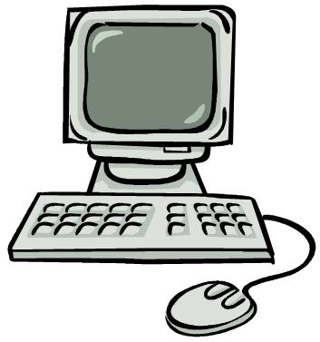
Gulfs of Execution and Evaluation
Evaluation
User Goals
Intention
GULF OF EVALUATION
GULF OF EXECUTION
Interpretation
Planning
System
Perception
Execution
Notes:
We can think about learnability (and visibility and efficiency) in terms of a generalized cognitive model for how people use a computer system (first articulated by Don Norman in The Design of Everyday Things, a strongly-recommended book).
The user has some goal in mind – let’s say, using Photoshop to brighten a photo. Doing it requires constructing a plan of action and executing it. For a new user, the plan might start out with searching for a command in the Photoshop menus called something like “brightness.” The user starts executing actions, and the system responds with some output. The user must then perceive, interpret, and evaluate (compare) the output against the original goal (“does this menu have a Brightness command? when I invoke it, does it do what I want?”) and then either replan (“let’s try the Tools menu”) or change the goal (“oh well, I guess I can’t brighten the image after all, I’ll just add a kitten to it instead”).
A more learnable interface would have smaller gulfs of execution and evaluation, so that the user’s goals are closer to the system representation in a certain sense – easier to execute, and easier to compare.
Learnability is not the only usability property that can be understood with this model. Visibility and feedback is about the gulf of evaluation. Efficiency is an measure of the whole cycle – the speed of execution and perception.

Slide 8
Interaction Styles
Command language
Menus & forms
Direct manipulation
Notes:
Better learnability has been one of the major goals in the evolution of graphical user interfaces over the last few decades.
Let’s look at three major kinds of user interface styles for desktop computing (i.e., a computer with a screen, keyboard, and mouse) that have been used. We’ll tackle them in roughly chronological order as they were developed. In general, the progression of these styles has been towards greater and greater learnability, and we’ll see how.

Slide 9
Command Language
User types in commands in an artificial language
ls -l *.java
Unix shell
+6.831 site:mit.edu
search engine query
http://www.mit.edu/admissions/
URL
Notes:
The earliest computer interfaces were command languages: job control languages for early computers, which later evolved into the Unix command line.
Although a command language is rarely the first choice of a user interface designer nowadays, they still have their place – often as an advanced feature embedded inside another interaction style. For example, Google’s query operators form a command language. Even the URL in a web browser is a command language, with particular syntax and semantics.

Slide 10
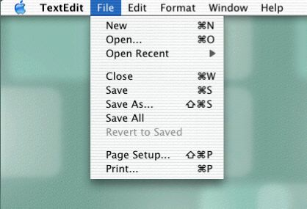
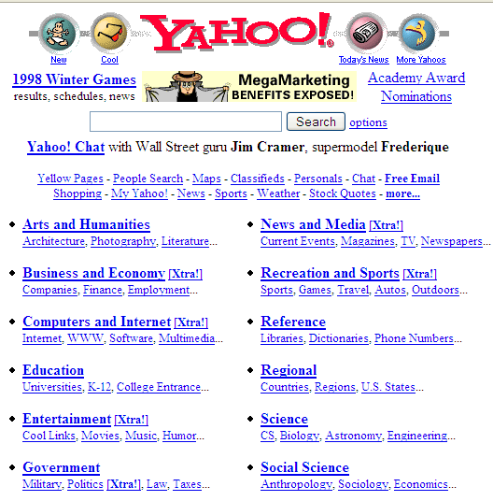
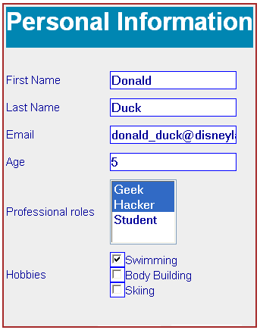
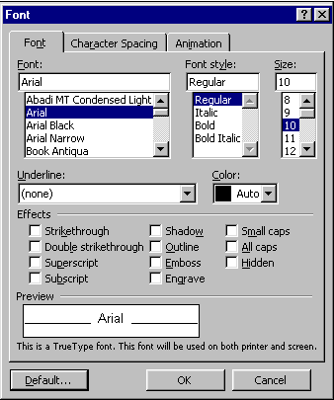
Menus and Forms
User is prompted to choose from menus and fill in forms
Notes:
A menu/form interface presents a series of menus or forms to the user. Traditional (Web 1.0) web sites behave this way. Most graphical user interfaces have some kind of menu/forms interaction, such as a menubar (which is essentially a tree of menus) and dialog boxes (which are essentially forms).

Slide 11
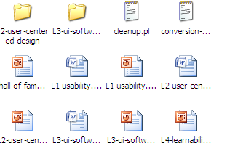
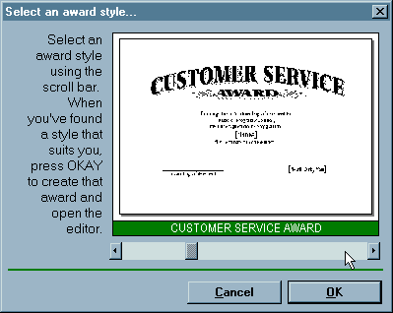
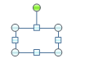
Direct Manipulation
User interacts with visual representation of data objects
Continuous visual representation
Physical actions or labeled button presses
Rapid, incremental, reversible, immediately visible effects
Scrollbar
Files & folders on desktop
Selection handles
Notes:
Finally, we have direct manipulation: the preeminent interface style for graphical user interfaces. Direct manipulation is defined by three principles [Shneiderman, Designing the User Interface, 2004]:
1. A continuous visual representation of the system’s data objects. Examples of this visual representation include: icons representing files and folders on your desktop; graphical objects in a drawing editor; text in a word processor; email messages in your inbox. The representation may be verbal (words) or iconic (pictures), but it’s continuously displayed, not displayed on demand. Contrast that with the behavior of ed, a command-language-style text editor: ed only displayed the text file you were editing when you gave it an explicit command to do so.
2. The user interacts with the visual representation using physical actions or labeled button presses. Physical actions might include clicking on an object to select it, dragging it to move it, or dragging a selection handle to resize it. Physical actions are the most direct kind of actions in direct manipulation – you’re interacting with the virtual objects in a way that feels like you’re pushing them around directly. But not every interface function can be easily mapped to a physical action (e.g., converting text to boldface), so we also allow for “command” actions triggered by pressing a button – but the button should be visually rendered in the interface, so that pressing it is analogous to pressing a physical button.
3. The effects of actions should be rapid (visible as quickly as possible), incremental (you can drag the scrollbar thumb a little or a lot, and you see each incremental change), reversible (you can undo your operation – with physical actions this is usually as easy as moving your hand back to the original place, but with labeled buttons you typically need an Undo command), and immediately visible (the user doesn’t have to do anything to see the effects; by contrast, a command like “cp a.txt b.txt” has no immediately visible effect).
Why is direct manipulation so powerful? It exploits perceptual and motor skills of the human machine – and depends less on linguistic skills than command or menu/form interfaces. So it’s more “natural” in a sense, because we learned how to manipulate the physical world long before we learned how to talk, read, and write.

Slide 12
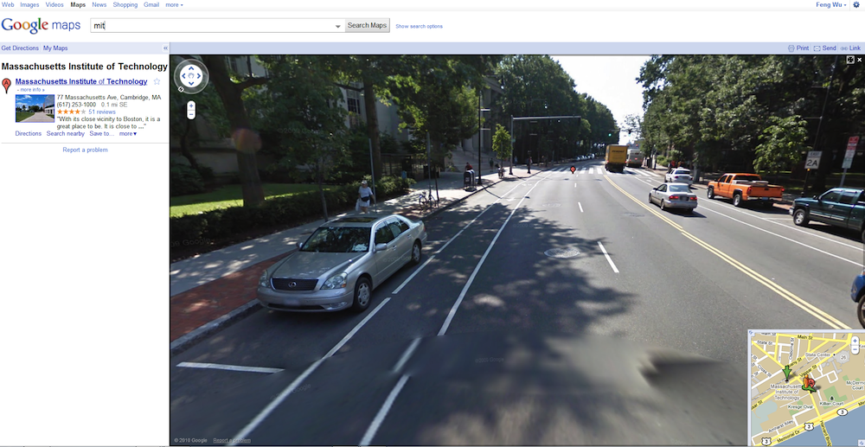
Notes:
The Street View feature of Google Maps is a great example of direct manipulation in an interface. The interface allows the user to either click or click-drag to change their perspective and location in Google Maps. The interactive map gives the user a continuous visual representation of geographical data that responds rapidly, visually, and incrementally to physical mouse movements. (suggested by Feng Wu)

Slide 13
Comparison of Interaction Styles
Knowledge in the head vs. world
Error messages
Efficiency
User experience
Synchrony
Programming difficulty
Accessibility
Notes:
Let’s compare and contrast the three styles: command language (CL), menus and forms (MF), and direct manipulation (DM).
Learnability: knowledge in the head vs. knowledge in the world. CL requires significant learning. Users must put a lot of knowledge into their heads in order to use the language, by reading, training, practice, etc. (Or else compensate by having manuals, reference cards, or online help close at hand while using the system.) The MF style puts much more information into the world, i.e. into the interface itself. Well-designed DM also has information in the world, delivered by the affordances, feedback, and constraints of the visual metaphor. Since recognition is so much easier than recall, this means that MF and DM is much more learnable and memorable than CL.
Error messages: CL and MF often have error messages (e.g. “you didn’t enter a phone number”), but DM rarely needs error messages. There’s no error message when you drag a scrollbar too far, for example; the scrollbar thumb simply stops, and the visual constraints of the scrollbar make it obvious why it stopped.
Efficiency: Experts can be very efficient with CL, since they don’t need to wait for and visually scan system prompts, and many CL systems have command histories and scripting facilities that allow commands to be reused rather than constantly retyped. Efficient performance with MF interfaces demands good shortcuts (e.g. keyboard shortcuts, tabbing between form fields, typeahead). Efficient performance with DMs is possible when the DM is appropriate to the task; but using DM for a task it isn’t well-suited for may feel like manual labor with a mouse.
User type: CL is generally better for expert users, who keep their knowledge active and who are willing to invest in training and learning in exchange for greater efficiency. MF and DM are generally better for novices and infrequent users.
Synchrony: Command languages are synchronous (first the user types a complete command, then the system does it). So are menu systems and forms; e.g., you fill out a web form, and then you submit it. DM, on the other hand, is asynchronous: the user can point the mouse anywhere and do anything at any time. DM interfaces are necessarily event-driven.
Programming difficulty: CL interfaces are relatively easy to implement: just parsing text with rigid syntax requirements. MF interfaces have substantial toolkit support; e.g., it’s easy to create an MF web site using plain vanilla HTML, or an MF Java program using nothing but Java Swing widgets like textboxes, buttons, and checkboxes. DM is hardest to program: you have to draw, you have to handle low-level keyboard and mouse input, and you have to display feedback. Relatiavely few off-the-shelf components are available to help. You won’t find a “selection handles” widget or a “rubber-band selection rectangle” included with Swing, for example; you have to build them yourself.
Accessibility: CL and MF interfaces are more textual, so they are easier for vision-impaired users to read with screen readers. DM interfaces are much harder for these users.

Slide 14
Models
Model of a system = how it works
its constituent parts and how they work together to do what the system does
Implementation models
Pixel editing vs. structured graphics
Text file as single string vs. list of lines
Interface models
RealCD’s online help as liner notes
Notes:
Regardless of interaction style, learning a new system requires the user to build a mental model of how the system works. Learnability can be strongly affected by difficulties in building that model.
A model of a system is a way of describing how the system works. A model specifies what the parts of the system are, and how those parts interact to make the system do what it’s supposed to do.
Consider image editing software. Programs like Photoshop and Gimp use a pixel editing model, in which an image is represented by an array of pixels (plus a stack of layers). Programs like Visio and Illustrator, on the other hand, use a structured graphics model, in which an image is represented by a collection of graphical objects, like lines, rectangles, circles, and text. In this case, the choice of model strongly constrains the kinds of operations available to a user. You can easily tweak individual pixels in Photoshop, but you can’t easily move an object once you’ve drawn it into the picture.
Similarly, most modern text editors model a text file as a single string, in which line endings are just like other characters. But it doesn’t have to be this way. Some editors represent a text file as a list of lines instead. When this implementation model is exposed in the user interface, as in old Unix text editors like ed, line endings can’t be deleted in the same way as other characters. ed has a special join command for deleting line endings.

Slide 15
Models in UI Design
Three models are relevant to UI design:
Interface model
User model
System model
Notes:
The preceding discussion hinted that there are actually several models you have to worry about in UI design:
The system model (sometimes called implementation model) is how the system actually works.
The interface model (or manifest model) is the model that the system presents to the user through its user interface.
The user model (or conceptual model) is how the user thinks the system works.
Note that we’re using model in a more general and abstract sense here than when we talk about the model-view-controller pattern. In MVC, the model is a software component (like a class or group of classes) that stores application data and implements the application behavior behind an interface. Here, a model is an abstracted description of how a system works. The system model on this slide might describe the way an MVC model class behaves (for example, storing text as a list of lines). The interface model might describe the way an MVC view class presents that system model (e.g., allowing end-of-lines to be “deleted” just as if they were characters). Finally, the user model isn’t software at all; it’s all in the user’s mind.

Slide 16
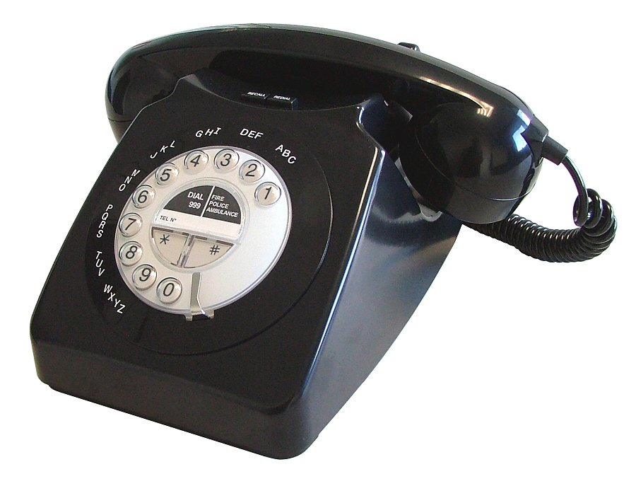
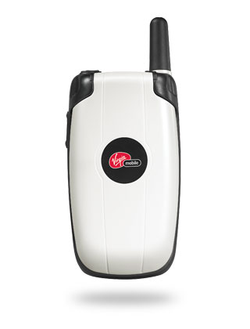
Interface Model Hides System Model
Interface model should be:
Simple
Appropriate: reflect user’s model of the task
Well-communicated
Notes:
The interface model might be quite different from the system model. A text editor whose system model is a list of lines doesn’t have to present it that way through its interface. The interface could allow deleting line endings as if they were characters, even though the actual effect on the system model is quite different.
Similarly, a cell phone presents the same simple interface model as a conventional wired phone, even though its system model is quite a bit more complex. A cell phone conversation may be handed off from one cell tower to another as the user moves around. This detail of the system model is hidden from the user.
As a software engineer, you should be quite familiar with this notion. A module interface offers a certain model of operation to clients of the module, but its implementation may be significantly different. In software engineering, this divergence between interface and implementation is valued as a way to manage complexity and plan for change. In user interface design, we value it primarily for other reasons: the interface model should be simpler and more closely reflect the user’s model of the actual task.

Slide 17
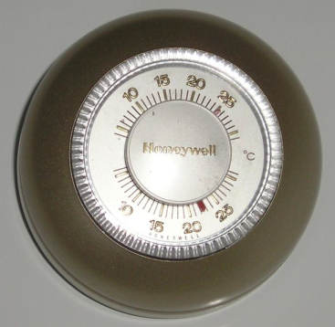
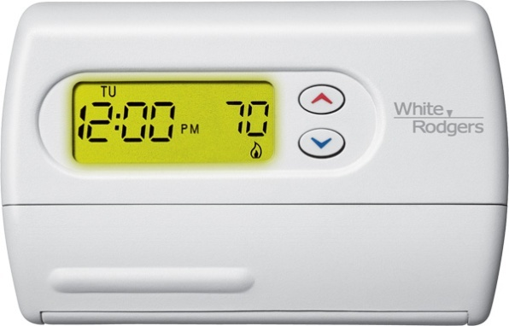
User Model May Be Wrong
Sometimes harmless
Electricity as water
Sometimes misleading
Thermostat as a valve
Notes:
The user’s model may be totally wrong without affecting the user’s ability to use the system. A popular misconception about electricity holds that plugging in a power cable is like plugging in a water hose, with electrons traveling from the power company through the cable into the appliance. The actual system model of household AC current is of course completely different: the current changes direction many times a second, and the actual electrons don’t move far, and there’s really a circuit in that cable, not just a one-way tube. But the user model is simple, and the interface model supports it: plug in this tube, and power flows to the appliance.
But a wrong user model can lead to problems, as well. Consider a household thermostat, which controls the temperature of a room. If the room is too cold, what’s the fastest way to bring it up to the desired temperature? Some people would say the room will heat faster if the thermostat is turned all the way up to maximum temperature. This response is triggered by an incorrect mental model about how a thermostat works: either the timer model, in which the thermostat controls the duty cycle of the furnace, i.e. what fraction of time the furnace is running and what fraction it is off; or the valve model, in which the thermostat affects the amount of heat coming from the furnace. In fact, a thermostat is just an on-off switch at the set temperature. When the room is colder than the set temperature, the furnace runs full blast until the room warms up. A higher thermostat setting will not make the room warm up any faster. (Norman, Design of Everyday Things, 1988)
These incorrect models shouldn’t simply be dismissed as “ignorant users.” (Remember, the user is always right! If there’s a consistent problem in the interface, it’s probably the interface’s fault.) These user models for heating are perfectly correct for other systems: a car heater and a stove burner both use the valve model. And users have no problem understanding the model of a dimmer switch, which performs the analogous function for light that a thermostat does for heat. When a room needs to be brighter, the user model says to set the dimmer switch right at the desired brightness.
The problem here is that the thermostat isn’t effectively communicating its model to the user. In particular, there isn’t enough feedback about what the furnace is doing for the user to form the right model.

Slide 18
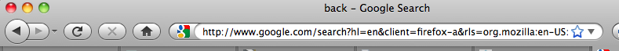

Example: the Back Button
Notes:
Here’s an example drawn directly from graphical user interfaces: the Back button in a web browser. What is the model for the behavior of Back? Specifically: how does the user think it behaves (the mental model), and how does it actually behave (the system model)?
The system model is that Back goes back to the last page the user was viewing, in a temporal history sequence. But on a web site that has pages in some kind of linear sequence of their own -- such as the result pages of a search engine (shown here) or multiple pages of a news article – then the user’s mental model might easily confuse these two sequences, thinking that Back will go to the previous page in the web site’s sequence. In other words, that Back is the same as Previous! (The fact that the “back” and “previous” are close synonyms, and that the arrow icons are almost identical, strongly encourages this belief.)
Most of the time, this erroneous mental model of Back will behave just the same as the true system model. But it will deviate if the user mixes the Previous link with the Back button – after pressing Previous, the Back button will behave like Next!
A nice article with other examples of tricky mental model/system model mismatch problems is “Mental and conceptual models, and the problem of contingency” by Charles Hannon, interactions, November 2008. http://portal.acm.org/citation.cfm?doid=1390085.1390099

Slide 19
Learnability Principles
Cues that communicate the system model
Affordances
Natural mapping
Visibility
Feedback
Consistency
Internal, external, metaphorical
Speak the user’s language
Metaphors
Platform standards
Notes:
Now we turn to some practical design advice for increasing learnability.
The first set of principles come from Don Norman’s book The Design of Everyday Things. He identified a number of cues that we use in our interaction with physical objects, like doors and scissors, to figure out a mental model of how they work. Since a direct manipulation interface is intended to be a visual metaphor for physical interaction, we’ll look at some of these cues and how they apply to computer interfaces.
The second set of principles fall under the general umbrella of consistency: interfaces are easier to learn if they’re already familiar, and if they have fewer special cases, exceptions, or internal contradictions.

Slide 20
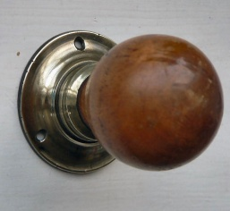
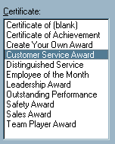
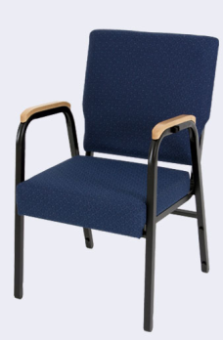
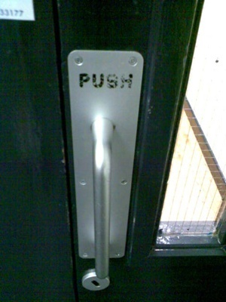

Affordances
Perceived and actual properties of a thing that determine how the thing could be used
Perceived vs. actual
Notes:
According to Norman, affordance refers to “the perceived and actual properties of a thing”, primarily the properties that determine how the thing could be operated. Chairs have properties that make them suitable for sitting; doorknobs are the right size and shape for a hand to grasp and turn. A button’s properties say “push me with your finger.” Scrollbars say that they continuously scroll or pan something that you can’t entirely see. Affordances are how an interface communicates nonverbally, telling you how to operate it.
Affordances are rarely innate – they are learned from experience. We recognize properties suitable for sitting on the basis of our long experience with chairs. We recognize that listboxes allow you to make a selection because we’ve seen and used many listboxes, and that’s what they do.
Note that perceived affordance is not the same as actual affordance. A facsimile of a chair made of papier-mache has a perceived affordance for sitting, but it doesn’t actually afford sitting: it collapses under your weight. Conversely, a fire hydrant has no perceived affordance for sitting, since it lacks a flat, human-width horizontal surface, but it actually does afford sitting, albeit uncomfortably.
Recall the textbox from our first lecture, whose perceived affordance (type a time here) disagrees with what it can actually do (you can’t type, you have to push the Set Time button to change it). Or the door handle on the right, whose nonverbal message (perceived affordance) clearly says “pull me” but whose label says “push” (which is presumably what it actually affords). The parts of a user interface should agree in perceived and actual affordances.
The original definition of affordance (from psychology) referred only to actual properties, but when it was imported into human computer interaction, perceived properties became important too. Actual ability without any perceivable ability is an undesirable situation. We wouldn't call that an affordance. Suppose you're in a room with completely blank walls. No sign of any exit -- it's missing all the usual cues for a door, like an upright rectangle at floor level, with a knob, and cracks around it, and hinges where it can pivot. Completely blank walls. But there is actually an exit, cleverly hidden so that it's seamless with the wall, and if you press at just the right spot it will pivot open. Does the room have an "affordance" for exiting? To a user interface designer, no, it doesn't, because we care about how the room communicates what should be done with it. To a psychologist (and perhaps an architect and a structural engineer), yes, it does, because the actual properties of the room allow you to exit, if you know how.
What if the room has a fake door that looks like a door, but doesn't actually open? Does the room have an "affordance" for exiting? Both the UI designer and the psychologist would say no; the UI designer because its perceivable properties are lying to the user and you can't actually get out, and the psychologist because its actual properties don't allow you to exit.

Slide 21
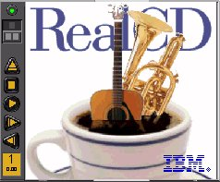
Natural Mapping
Physical arrangement of controls should match arrangement of function
Best mapping is direct, but natural mappings don’t have to be direct
Light switches
Stove burners
Turn signals
Audio mixer
Notes:
Another important principle of interface communication is natural mapping of functions to controls.
Consider the spatial arrangement of a light switch panel. How does each switch correspond to the light it controls? If the switches are arranged in the same fashion as the lights themselves, it is much easier to learn which switch controls which light.
Direct mappings are not always easy to achieve, since a control may be oriented differently from the function it controls. Light switches are mounted vertically, on a wall; the lights themselves are mounted horizontally, on a ceiling. So the switch arrangement may not correspond directly to a light arrangement.
Other good examples of mapping include:
Stove burners. Many stoves have four burners arranged in a square, and four control knobs arranged in a row. Which knobs control which burners? Most stoves don’t make any attempt to provide a natural mapping.
Car turn signals. The turn signal switch in most cars is a stalk that moves up and down, but the function it controls is a signal for left or right turn. So the mapping is not direct, but it is nevertheless natural. Why?
An audio mixer for DJs (proposed by Max Van Kleek for the Hall of Fame) has two sets of identical controls, one for each turntable being mixed. The mixer is designed to sit in between the turntables, so that the left controls affect the turntable to the left of the mixer, and the right controls affect the turntable to the right. The mapping here is direct.
The controls on the RealCD interface don’t have a natural mapping. Why not?
Here’s a quick exercise. Consider the lights in this classroom, and design a panel of light switches to control the room's lights, for installation next to one of the entrance doors. Devise a natural mapping between your switch panel and the lights it controls, so that a user can easily learn and remember how to use it. Don't stop with just one design, but sketch out a few.
A few things to think about: (1) It may not make sense to control every light individually. How should the lights be grouped? (2) Think about consistency. Will your panel be recognizable as light switches from across the room? On the other hand, are there better choices than the standard North American flip switches (3) If you use flip switches, how should they be oriented?

Slide 22
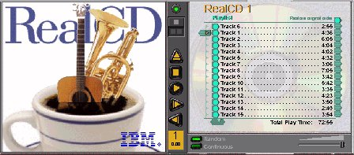

Visibility
Relevant parts of system should be visible
Not usually a problem in the real world
But takes extra effort in computer interfaces
Availability of drag & drop is often invisible
mouse over
Notes:
Visibility is an essential principle – probably the most important – in communicating a model to the user.
If the user can’t see an important control, they would have to (1) guess that it exists, and (2) guess where it is. Recall that this was exactly the problem with RealCD’s online help facility. There was no visible clue that the help system existed in the first place, and no perceivable affordance for getting into it.
Visibility is not usually a problem with physical objects, because you can usually tell its parts just by looking at it. Look at a bicycle, or a pair of scissors, and you can readily identify the pieces that make it work. Although parts of physical objects can be made hidden or invisible – for example, a door with no obvious latch or handle – in most cases it takes more design work to hide the parts than just to leave them visible.
The opposite is true in computer interfaces. A window can interpret mouse clicks anywhere in its boundaries in arbitrary ways. The input need not be related at all to what is being displayed. In fact, it takes more effort to make the parts of a computer interface visible than to leave them invisible. So you have to guard carefully against invisibility of parts in computer interfaces.
Interestingly, lack of visibility is responsible for a common learnability flaw in direct manipulation interfaces that use drag & drop. Drag & drop is an incredibly powerful direct manipulation technique, but it has so little visibility that many users simply don’t realize when drag & drop is possible, and when it isn’t. As a result, this wonderful direct-manipulation technique is often secondary, a shortcut used only by expert users who know about it, while some less usable (often menu & form style) interface is used by the bulk of novice and casual users. A quick poll for Firefox users:
Who knew that you can drag the website’s icon out of the address bar to make a bookmark?
Who knew that you can rearrange tabs by dragging them around?
Who knew that you can rearrange bookmarks on the Bookmarks menu?
There’s an interesting experiment from cognitive psychology (mainly concerned with biases in problem solving, not with learnability). Two ropes are hanging from ceiling, more than an armspan apart, and the goal is to tie their ends together. People were more likely to solve the problem if the experimenter gently swung one rope a bit while explaining the goal. (Maier, "Reasoning in humans," J Comp Psych v12, 181-194, 1931.) In other words, a visual hint helped a lot. Perhaps draggable things might make themselves visible by wiggling a bit when you come near them, or when you’re dragging them toward a likely target.
We’ll have much more to say about visibility in a future lecture.

Slide 23
Feedback
Actions should have immediate, visible effects
Push buttons
Scrollbars
Drag & drop
Kinds of feedback
Visual
Audio
Haptic
Notes:
The final principle of interface communication is feedback: what the system does when you perform an action. When the user successfully makes a part work, it should appear to respond. Push buttons depress and release. Scrollbar thumbs move. Dragged objects follow the cursor.
Feedback doesn’t always have to be visual. Audio feedback – like the clicks that a keyboard makes – is another form. So is haptic feedback, conveyed by the sense of touch. The mouse button gives you haptic feedback in your finger when you feel the vibration of the click. That’s much better feedback then you get from a touchscreen, which doesn’t give you any physical sense when you’ve pressed it hard enough to register.

Slide 24
Consistency
Also called the “principle of least surprise”
Similar things should look and act similar
Different things should look different
Kinds of consistency
Internal
External
Metaphorical
Notes:
Affordances and natural mapping are examples of a general principle of learnability: consistency. This rule is often given the hifalutin’ name the Principle of Least Surprise, which basically means that you shouldn’t surprise the user with the way a command or interface object works. Similar things should look, and act, in similar ways. Conversely, different things should be visibly different.
There are three kinds of consistency you need to worry about: internal consistency within your application; external consistency with other applications on the same platform; and metaphorical consistency with your interface metaphor or similar real-world objects.
The RealCD interface has problems with both metaphorical consistency (CD jewel cases don’t play; you don’t open them by pressing a button on the spine; and they don’t open as shown), and with external consistency (the player controls aren’t arranged horizontally as they’re usually seen; and the track list doesn’t use the same scrollbar that other applications do).

Slide 25
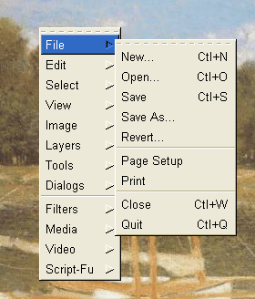
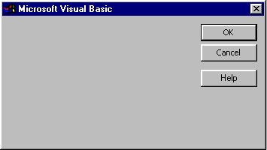
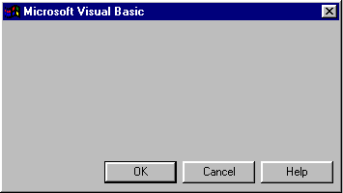
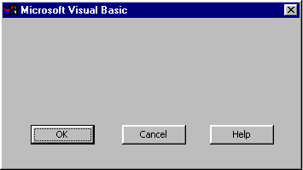
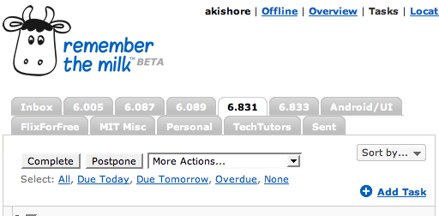
Consistency of Layout
Notes:
One important area of consistency is in layout – where controls and information are displayed on the screen. This is the reason that menubars appear at the top of the screen (or window). The GIMP definitely reduced its learnability by putting all its menus in a right-click menu, because this design is externally inconsistent.
The dialog boxes on the right are three different layouts used in Visual Basic’s dialog boxes, showing a lack of internal consistency.
Preserving consistency of layout over time is also important. The multi-row tab widget on the bottom left sacrifices consistency of layout in favor of consistency with the tabbed-notebook metaphor, and it’s not a good tradeoff. RememberTheMilk makes the decision in favor of layout consistency instead, keeping tabs fixed in place even it breaks the metaphor.

Slide 26

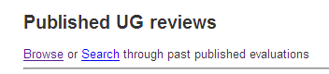
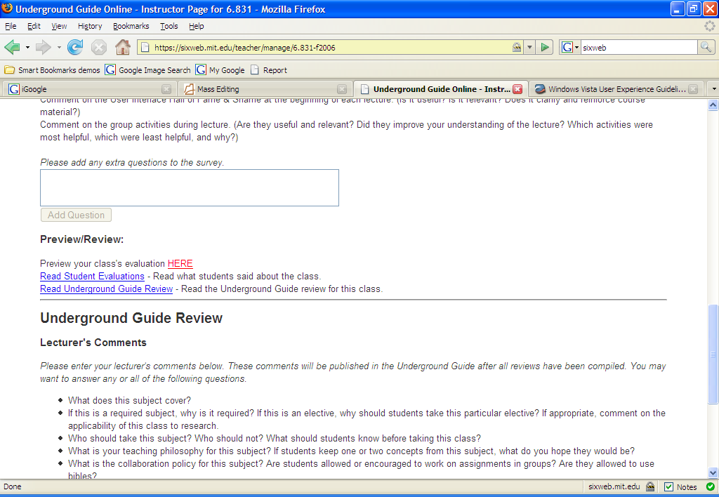
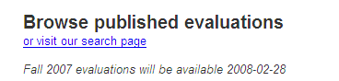
Consistency in Wording
Notes:
Another important kind of consistency, often overlooked, is in wording. Use the same terms throughout your user interface. If your interface says “share price” in one place, “stock price” in another, and “stock quote” in a third, users will wonder whether these are three different things you’re talking about. Don’t get creative when you’re writing text for a user interface; keep it simple and uniform, just like all technical writing.
Here are some examples from the Course VI Underground Guide web site – confusion about what’s a “review” and what’s an “evaluation”.

Slide 27
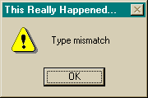
Speak the User’s Language
Use common words, not techie jargon
But use domain-specific terms where appropriate
Allow aliases/synonyms in command languages
Source: Interface Hall of Shame
Notes:
External consistency in wording is important too – in other words, speak the user’s language as much as possible, rather than forcing them to learn a new one. If the user speaks English, then the interface should also speak English, not Geekish. Technical jargon should be avoided. Use of jargon reflects aspects of the system model creeping up into the interface model, unnecessarily. How might a user interpret the dialog box shown here? One poor user actually read type as a verb, and dutifully typed M-I-S-M-A-T-C-H every time this dialog appeared. The user’s reaction makes perfect sense when you remember that most computer users do just that, type, all day. But most programmers wouldn’t even think of reading the message that way. Yet another example showing that you are not the user.
Technical jargon should only be used when it is specific to the application domain and the expected users are domain experts. An interface designed for doctors shouldn’t dumb down medical terms.
When designing an interface that requires the user to type in commands or search keywords, support as many aliases or synonyms as you can. Different users rarely agree on the same name for an object or command. One study found that the probability that two users would mention the same name was only 7-18%. (Furnas et al, “The vocabulary problem in human-system communication,” CACM v30 n11, Nov. 1987).
Incidentally, there seems to be a contradiction between these guidelines. Speaking the User’s Language argues for synonyms and aliases, so a command language should include not only delete but erase and remove too. But Consistency in Wording argued for only one command name, lest the user wonder whether these are three different commands that do different things. One way around the impasse is to look at the context in which you’re applying the heuristic. When the user is talking, the interface should make a maximum effort to understand the user, allowing synonyms and aliases. When the interface is speaking, it should be consistent, always using the same name to describe the same command or object. What if the interface is smart enough to adapt to the user – should it then favor matching its output to the user’s vocabulary (and possibly the user’s inconsistency) rather than enforcing its own consistency? Perhaps, but adaptive interfaces are still an active area of research, and not much is known.

Slide 28
Follow Platform Standards
Follow platform standards
Apple Human Interface Guidelines
Windows Vista User Experience Guidelines
GNOME Human Interface Guidelines
KDE User Interface Guidelines
Java Look & Feel Design Guidelines
Or imitate what the popular programs do
Notes:
External consistency also comes from following platform standards, which many platforms have codified into a rulebook. (All the guidelines listed here are online; find them with your favorite search engine.)
The guidelines in these books tend to be very specific, e.g. the Windows rulebook says you should have a File menu, and there should be a command called Exit on it (not Quit, not Leave, not Go Away). Some of these guidelines even get down to very specific graphic design conventions, such as the pixel distances between OK and Cancel buttons on a dialog.
Following platform guidelines ensures consistency among different applications running on the same platform, which is valuable for novice and frequent users alike. However, platform guidelines are relatively limited in scope, offering solutions for only a few of the design decisions in a typical UI.
In the absence of a well-defined standard, you can achieve external consistency by looking at the popular programs on your platform, and imitating them where reasonable.

Slide 29
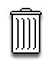

Metaphors
Advantages
Highly learnable when appropriate
Hooks into user’s existing mental models very easily
Dangers
Often hard for designers to find
May be deceptive
May be constraining
Metaphor is usually broken somewhere
Use of a metaphor doesn’t excuse other bad design decisions
Desktop metaphor
Trashcan metaphor
Notes:
Metaphors are one way you can bring the real world into your interface. We started out by talking about RealCD, an example of an interface that uses a strong metaphor in its interface. A well-chosen, well-executed metaphor can be quite effective and appealing, but be aware that metaphors can also mislead. A computer interface must deviate from the metaphor at some point -- otherwise, why aren’t you just using the physical object instead? At those deviation points, the metaphor may do more harm than good. For example, it’s easy to say “a word processor is like a typewriter,” but you shouldn’t really use it like a typewriter. Pressing Enter every time the cursor gets close to the right margin, as a typewriter demands, would wreak havoc with the word processor’s automatic word-wrapping.
The advantage of metaphor is that you’re borrowing a conceptual model that the user already has experience with. A metaphor can convey a lot of knowledge about the interface model all at once. It’s a notebook. It’s a CD case. It’s a desktop. It’s a trashcan. Each of these metaphors carries along with it a lot of knowledge about the parts, their purposes, and their interactions, which the user can draw on to make guesses about how the interface will work.
Some interface metaphors are famous and largely successful. The desktop metaphor – documents, folders, and overlapping paper-like windows on a desk-like surface – is widely used and copied. The trashcan, a place for discarding things but also for digging around and bringing them back, is another effective metaphor – so much so that Apple defended its trashcan with a lawsuit, and imitators are forced to use a different look. (Recycle Bin, anyone?)
The basic rule for metaphors is: use it if you have one, but don’t stretch for one if you don’t. Appropriate metaphors can be very hard to find, particularly with real-world objects. The designers of RealCD stretched hard to use their CD-case metaphor (since in the real world, CD cases don’t even play CDs), and it didn’t work well.
Metaphors can also be deceptive, leading users to infer behavior that your interface doesn’t provide. Sure, it looks like a book, but can I write in the margin? Can I rip out a page?
Metaphors can also be constraining. Strict adherence to the desktop metaphor wouldn’t scale, because documents would always be full-size like they are in the real world, and folders wouldn’t be able to have arbitrarily deep nesting.
The biggest problem with metaphorical design is that your interface is presumably more capable than the real-world object, so at some point you have to break the metaphor. Nobody would use a word processor if really behaved like a typewriter. Features like automatic word-wrapping break the typewriter metaphor, by creating a distinction between hard carriage returns and soft returns.
Most of all, using a metaphor doesn’t save an interface that does a bad job communicating itself to the user. Although RealCD’s model was metaphorical – it opened like a CD case, and it had a liner notes booklet inside the cover – these features had such poor visibility and perceived affordances that they were ineffective.

Slide 30
Case Against Consistency (Grudin)
Inconsistency is appropriate when context and task demand it
Arrow keys
But if all else is (almost) equal, consistency wins
QWERTY vs. Dvorak
OK/Cancel button order
Notes:
Jonathan Grudin (in “The Case Against User Interface Consistency, CACM v32 n10, Oct 1989) finesses the issue of consistency still further. His argument is that consistency should not be treated as a sacred cow, but rather remain subservient to the needs of context and task. For example, although the inverted-T arrow-key arrangement on modern keyboards is both internally and metaphorically inconsistent in the placement of the down arrow, it’s the right choice for efficiency of use. If two design alternatives are otherwise equivalent, however, consistency should carry the day.
Designs that are seriously inconsistent but provide only a tiny improvement in performance will probably fail. The Dvorak keyboard, for example, is slightly faster than the standard QWERTY keyboard, but not enough to overcome the power of an entrenched standard.

Slide 31
Summary
Learnable interfaces should clearly communicate the correct mental model to the user
Use affordances, natural mapping, visibility
Consider metaphors
Be consistent internally, externally, metaphorically
Prefer knowledge in the world over knowledge in the head

Slide 32
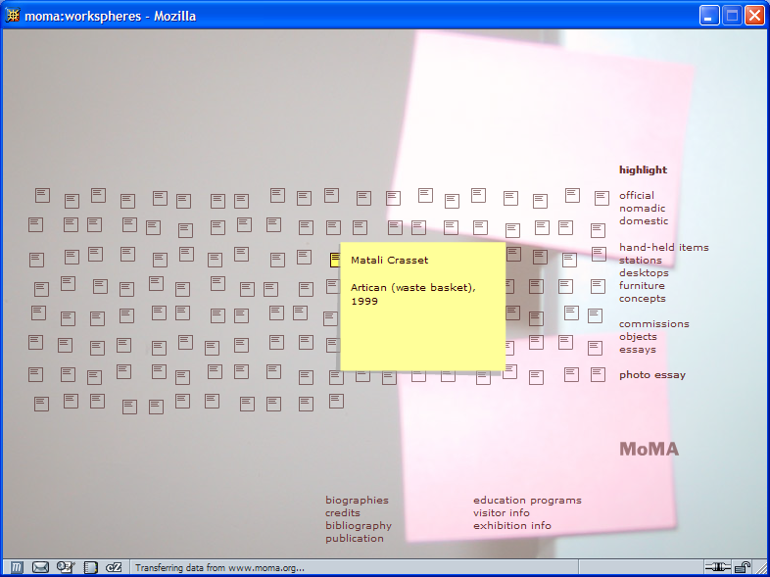
Next Time: UI Hall of Fame or Shame?
Suggested by Vishy Venugopalan
Notes:
This Flash-driven web site is the Museum of Modern Art’s Workspheres exhibition (http://www.moma.org/exhibitions/2001/workspheres/), a collection of objects related to the modern workplace. This is its main menu: an array of identical icons. Mousing over any icon makes its label appear (the yellow note shown), and clicking brings up a picture of the object.
Think about this site with respect to:
- metaphor
- simplicity
- visibility

