Slide 1
ERP
Enterprise Resource Planning

Slide 2
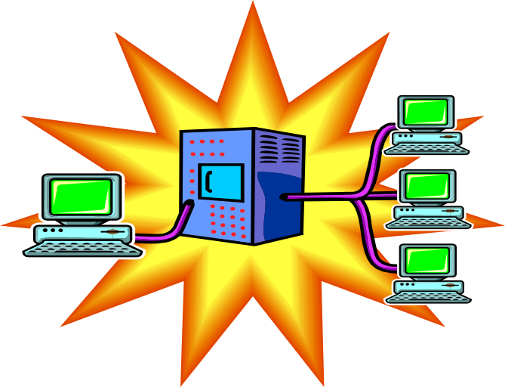
ERP
Enterprise resource planning (ERP): An expanded effort to integrate marketing, financial, manufacturing and human resources in a single information system. Standardized record-keeping permits information sharing throughout the organization.

Slide 3

ERP Systems Include:
Single integrated software program
Single database
Information shared and communicated
Automates customer orders, order fulfillment, billing, shipping, etc.
Tracking

Slide 4

How SAP’s R/3 Works
An order triggers a chain reaction of events throughout the enterprise.
1: Ordering A sales rep from International Sneaker Co. takes an order for 1,000 pairs of shoes from a Brazilian retailer. From her portable PC the rep taps into the R/3 sales module back at headquarters which checks the price, including any discounts the retailer is eligible for, and looks up the retailer’s credit history.

Slide 5

2. Availability Simultaneously, R/3’s inventory software checks the stock situation and notifies the sales rep that half the order can be filled immediately from a Brazilian warehouse. The other sneakers will be delivered in five days directly from ISC’s factory in Taiwan.

Slide 6

3. Production R/3’s manufacturing software schedules the production of the sneakers at the Taiwan factory, meanwhile alerting ISC’s warehouse manager in Brazil to ship the 500 purple tennis shoes to the retailer. An invoice gets printed in Portuguese.

Slide 7

4. Manpower That’s when R/3’s human resources model identifies a shortage of workers to handle the order and alerts the personnel manager of the need for temporary workers.

Slide 8

5. Purchasing R/3’s materials planning module notifies the purchasing manager that it’s time to reorder purple dye, rubber, and shoelaces.

Slide 9

6. Order Tracking The customer logs on to the sneaker company’s R/3 system through the Internet and sees that 250 of the 500 pairs of shoes coming from Taiwan have been made and dyed. The customer also sees that there are 500 pairs of orange tennis shoes in stock and places a follow-up order on the Net.

Slide 10
7. Planning Based on data from R/3’s forecasting and financial modules, the CEO sees that colored sneakers are not only in hot demand but are also highly profitable. He decides to add a line of fluorescent footwear!

Slide 11
The Manufacturing Planning and Execution Process: From Forecast to Settlement
Forecast |  | SOP |  | Demand Management |  | MPS |  | MRP |  | Execution |  | Order Settlement
Key
  SOP: Sales and Operations Planning
  MPS: Master Production Scheduling
  MRP: Material Requirements Planning

Slide 12

The Manufacturing Planning and Execution Process: Forecasting
Forecasting utilizes data from the sales information system as well as profitability analysis. The output of the forecasting activity becomes the input for sales and operation planning.
In profitability analysis monetary turnover goals are set and budgets are determined so that these goals can be reached.

Slide 13

The Manufacturing Planning and Execution Process: Sales and Operations Planning
In sales and operations planning medium to long-term sales quantities are determined and the measures that have to be made to realize these quantities are roughly planned (rough estimate of feasibility of these plans).

Slide 14

The Manufacturing Planning and Execution Process: Demand Management
In demand management the planning and production strategy is selected and the requirement quantities and delivery dates are also determined.

Slide 15

The Manufacturing Planning and Execution Process: Master Production Schedule
In master production scheduling the parts or products that greatly influence company profits or that take up critical resources are planned with extra attention.

Slide 16
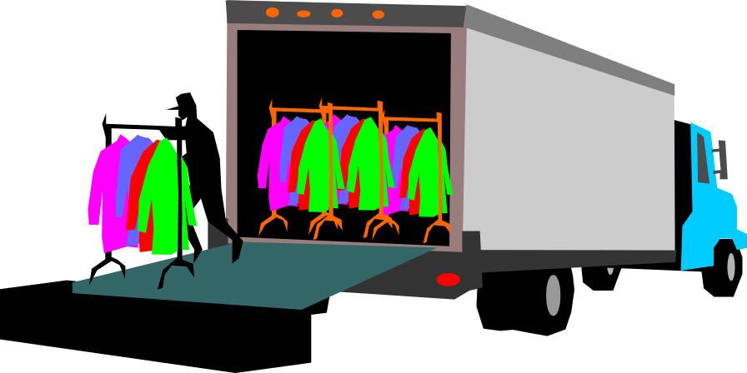
The Manufacturing Planning and Execution Process: Material Requirements Planning
Material requirements planning ensures that the required materials are procured in the correct quantities at the right time.

Slide 17

The Manufacturing Planning and Execution Process: Execution
In execution production orders are created and released. Further, materials are issued, jobs are tracked, and goods receipts to stock are posted when the last production operation is completed.

Slide 18

The Manufacturing Planning and Execution Process: Order Settlement
In order settlement the difference between actual costs incurred from the production order and the credits the order received from goods receipts is cleared.

