Slide 1

Chapter
1
Information Systems in Global Business Today

Slide 2
Management Information Systems
Chapter 1 Information Systems in Global Business Today
LEARNING OBJECTIVES
Explain why information systems are so essential in business today.
Define an information system from both a technical and a business perspective.
Identify and describe the three dimensions of information systems.

Slide 3
Management Information Systems
Chapter 1 Information Systems in Global Business Today
LEARNING OBJECTIVES (Continued)
Assess the complementary assets required for information technology to provide value to a business.
Identify and describe contemporary approaches to the study of information systems and distinguish between computer literacy and information systems literacy.

Slide 4
Management Information Systems
Chapter 1 Information Systems in Global Business Today
Smart Systems and Smart Ways of Working Help Toyota Become Number One
Problem: Tough competition and demanding customers.
Solutions: Redesigned order and production processes reduce costs, increase revenue, and improve customer service.
Oracle E-Business Suite makes it possible to build cars to order and forecast demand and production requirements more accurately.
Demonstrates IT’s role in analyzing market trends and monitoring quality, efficiency, and costs.
Illustrates the emerging digital firm landscape where businesses can use tools to analyze critical data.

Slide 5
Management Information Systems
Chapter 1 Information Systems in Global Business Today
The Role of Information Systems in Business Today
How information systems are transforming business
Globalization opportunities
The emerging digital firm
Strategic business objectives of information systems
  Operational excellence
  New products, services, and business models
  Customer and supplier intimacy
  Improved decision making
  Competitive advantage
  Survival

Slide 6
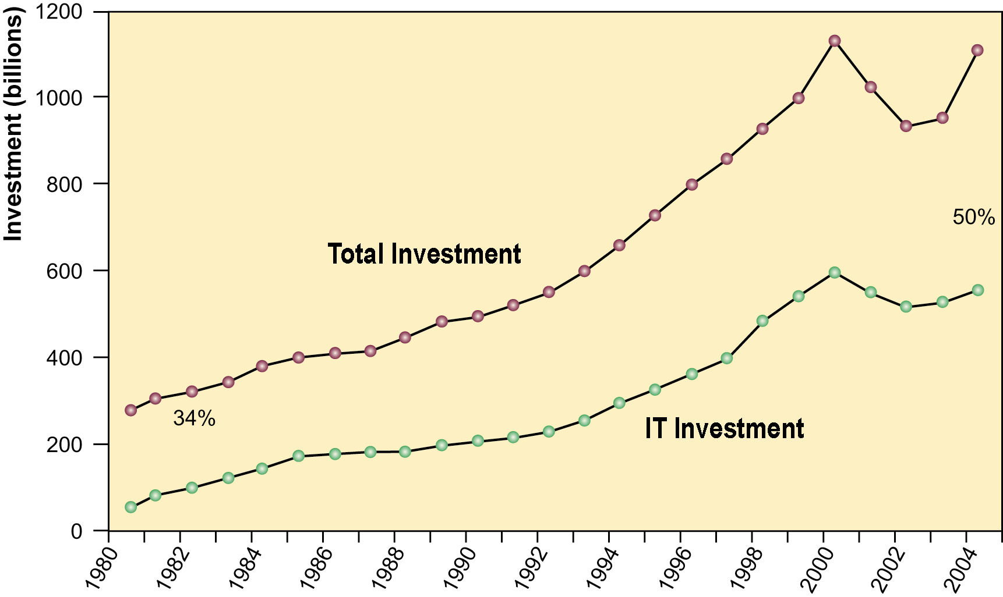
Management Information Systems
Chapter 1 Information Systems in Global Business Today
The Role of Information Systems in Business Today
Information Technology Capital Investment
Information technology investment, defined as hardware, software, and communications equipment, grew from 34% to 50% between 1980 and 2004.
Source: Based on data in U.S. Department of Commerce, Bureau of Economic Analysis, National Income and Product Accounts, 2006.
Figure 1-1

Slide 7
Management Information Systems
Chapter 1 Information Systems in Global Business Today
The Role of Information Systems in Business Today
Virtual Management at Accenture
Read the Interactive Session: Organizations, and then discuss the following questions:
  What are the advantages of working in a virtual environment like the one created by Accenture? What are the disadvantages?
  Would you like to work at a company like Accenture? Why or why not? Explain your answer.
  What kinds of companies could benefit from being run virtually like Accenture? Could all companies be run virtually like Accenture?

Slide 8
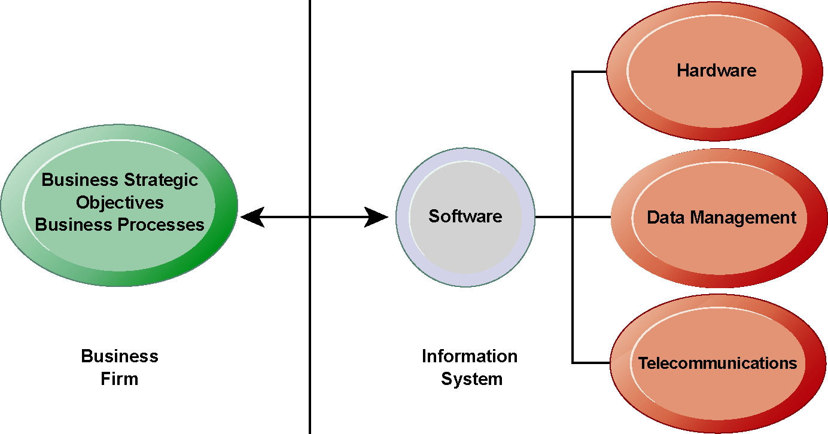
Management Information Systems
Chapter 1 Information Systems in Global Business Today
The Role of Information Systems in Business Today
The Interdependence Between Organizations and Information Technology
There is a growing interdependence between a firm’s information systems and its business capabilities. Changes in strategy, rules, and business processes increasingly require changes in hardware, software, databases, and telecommunications. Often, what the organization would like to do depends on what its systems will permit it to do.
Figure 1-2

Slide 9
Management Information Systems
Chapter 1 Information Systems in Global Business Today
Perspectives on Information Systems
What is an information system?
Dimensions of information systems
  Organizations
  Management
  Technology
It isn’t just a technology: A Business perspective on information systems
Complementary assets: Organizational capital and the right business model

Slide 10
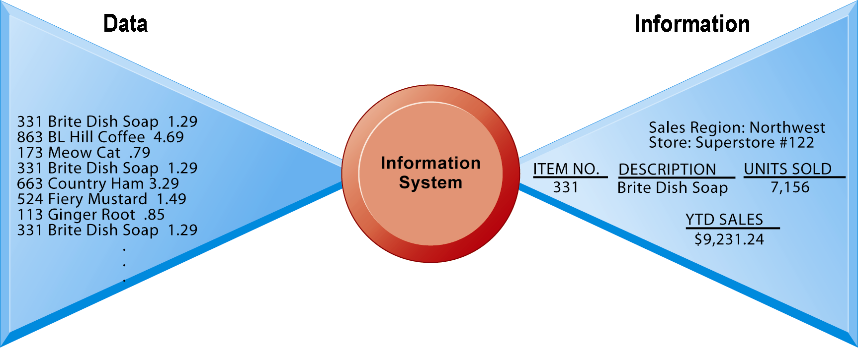
Management Information Systems
Chapter 1 Information Systems in Global Business Today
Perspectives on Information Systems
Data and Information
Raw data from a supermarket checkout counter can be processed and organized to produce meaningful information, such as the total unit sales of dish detergent or the total sales revenue from dish detergent for a specific store or sales territory.
Figure 1-3

Slide 11
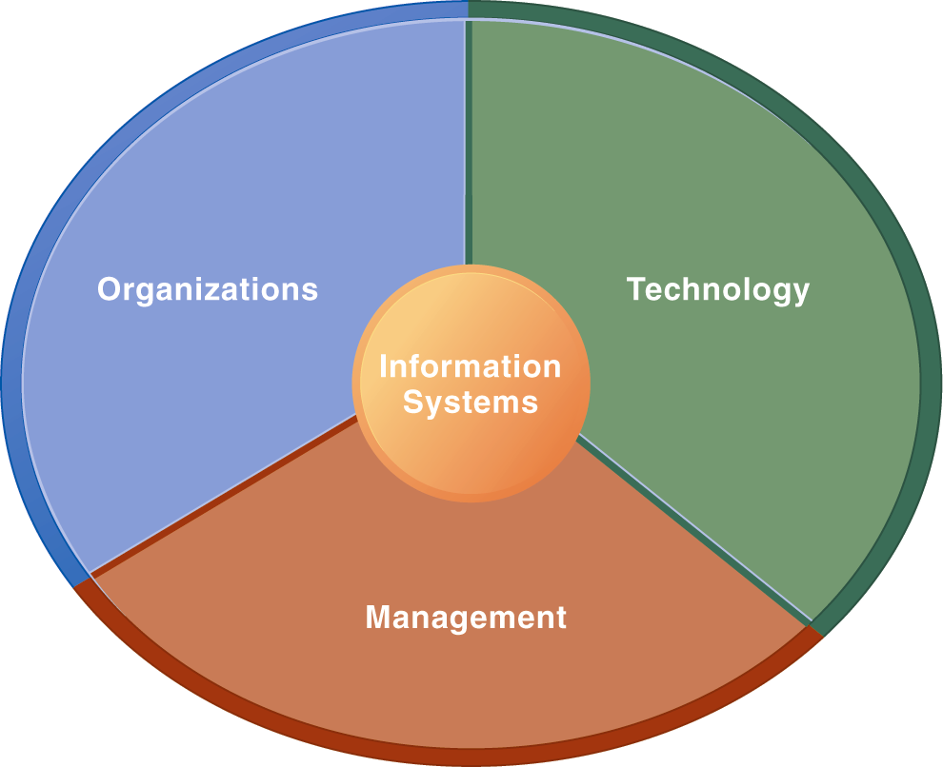
Management Information Systems
Chapter 1 Information Systems in Global Business Today
Perspectives on Information Systems
Information Systems Are More Than Computers
Using information systems effectively requires an understanding of the organization, management, and information technology shaping the systems. An information system creates value for the firm as an organizational and management solution to challenges posed by the environment.
Figure 1-5

Slide 12
Management Information Systems
Chapter 1 Information Systems in Global Business Today
Perspectives on Information Systems
UPS Competes Globally with Information Technology
Read the Interactive Session: Technology, and then discuss the following questions:
  What are the inputs, processing, and outputs of UPS’s package tracking system?
  What technologies are used by UPS? How are these technologies related to UPS’s business strategy?
  What problems do UPS’s information systems solve? What would happen if these systems were not available?

Slide 13
Management Information Systems
Chapter 1 Information Systems in Global Business Today
Contemporary Approaches to Information Systems
Technical approach
Behavioral approach
Approach of this text: Sociotechnical systems

